Slide 1
Corporate Social Responsibility
LECTURE 9
Corporate Social Responsibility
MGT 610

Slide 2
Corporate Social Responsibility
Chapter 3
Stakeholder Theory

Slide 3
Corporate Social Responsibility
LEARNING OBJECTIVES
Understand the definition of stakeholder
Understand why the stakeholder theory is important
Learn the taxonomy of stakeholders
Analyze stakeholder
Relationship understand holistic
Growth through tangible and intangible manifestations in a corporate business

Slide 4
Corporate Social Responsibility
Taxonomy of stakeholders
Group who can affect or is affected by the organizations purpose
Benefits from or harmed by and whose rights are violated or respected by corporate actions
People with the power to respond, negotiate and change the strategic future of the organizations

Slide 5
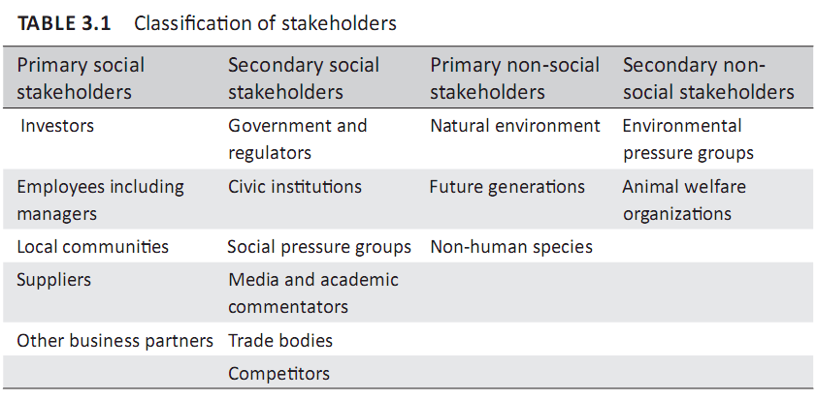
Corporate Social Responsibility
TAXONOMY OF STAKEHOLDERS
In simple terms, stakeholders can be defined as individuals or groups who either get advantage or are disadvantaged by corporate decision or action.

Slide 6
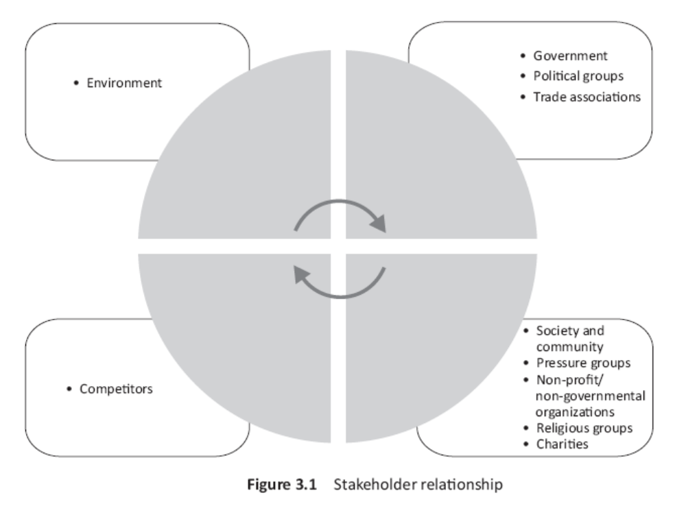
Corporate Social Responsibility

Slide 7
Corporate Social Responsibility
Stockholders
  Financial stake
  Demand returns
  Organizations have to honor the demand
  Stake will be different based n the type of owner
Employees
  Hired based on skills, expertise
  In return for work demand compensation
  Levels of management and their work
  Employee loyalty in return for need compensation
  Problem of pseudo commitment
  Ethical education should correspond to their level of action
Suppliers
  Provide raw materials and gets rewarded by getting contract
  Long term relations hip and partnership based approach
    Based on trust and collaboration
  Problem when parties underplay social responsibility and only focus on profits

Slide 8
Corporate Social Responsibility
Customers
  Defined as king of business
  Older tradition – made right decisions to get the best gains
  New concept – companies success depends upon how closely the customer relationship is monitored
    More satisfied the customer = more profits
  The relationship does not get honored because of the following producers rights:
    The rights to make decisions about product offered for sale i.e. design and sale
    The right to set price including warranties
    The right to determine how product will be made available to the customer
    The right to promote
  The consumer has the veto option
  Customer can switch from one product to another but that depends upon the availability of similar goods
  Relationship defined – BUYER BEWARE
  Consumer rights and consumer awareness

Slide 9
Corporate Social Responsibility
Competition
  concept of free markets
  Fix price and share information with consumers
  Enter markets by cheating, lying and poaching
  Competition affects and gets affected by mutual behavior that can or help the organization responsiveness
Government
  Large number of actors and institutions that can make and issue laws
    Local to international level
  Since society gives sanctions to business, laws codify what the society thinks as right or wrong
  The government relationship
    Government as a representative of society trying to regulate businesses and facilitating businesses
    Government dependant upon the economic prosperity and the economy is run by businesses
    Government is a competition of business

Slide 10
Corporate Social Responsibility
Society and community
  Include Non for profit, non government, charities, religious groups, pressure groups
  Represents the voice and needs of individual stakeholders

Slide 11
Corporate Social Responsibility
Impact and dilemmas of business
Up till now the process of development pursued capital formation and raising GNP in the belief that the mysterious hand would ensure the fair distribution of gains
Affluence cannot be the goal for society
Corporations have to recognize the philosophy of empty plenty
Businesses have to work for the physical and emotional need of the people
Corporation is the best option
  Issues of trust and values
  Have open directed systems Vs closed entropic systems
To be meaningful the organizations an honest assessment of internal and external environment
  Threats and opportunities
  Listening to diverse ideas
  Encourage change
    Avoid extremes
      Total conformity Vs total disregard
  Diversity in ideas is important for CSR to work internally and externally

Slide 12
Corporate Social Responsibility
The above mentioned system needs to be driven by professionals
  Associated with values and ideals. Intertwined with social well being
As professionals cannot have stereotype meanings of entities
  Use knowledge to diagnose, infer, analyze and then offer solutions
The danger
  Misuse of specialized knowledge
The society trust professionals
Individual values that make the organizations values

Slide 13
Corporate Social Responsibility
IMPACTS AND DILEMMAS OF BUSINESS
To be meaningful, organizations have to make life reverent and just. this requires an honest assessment of the internal and external environment, so that the realities are matched.
Importance of professionals- professionalism is associated with certain values and ideals. It is intricately intertwined with a concept of social well-being as that is the prerequisite for any kind of survival— individual or group.

Slide 14
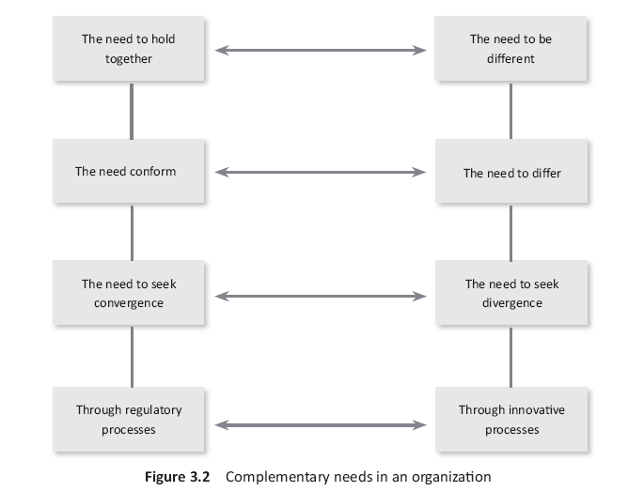
Corporate Social Responsibility

