Slide 1
Corporate Social Responsibility
LECTURE 8:
Corporate Social Responsibility
MGT 610

Slide 2
Corporate Social Responsibility
Chapter 3
Stakeholder Theory

Slide 3
Corporate Social Responsibility
LEARNING OBJECTIVES
Understand the definition of stakeholder
Understand why the stakeholder theory is important
Learn the taxonomy of stakeholders
Analyze stakeholder
Relationship understand holistic
Growth through tangible and intangible manifestations in a corporate business

Slide 4
Corporate Social Responsibility
INTRODUCTION
At ground level, resources include land, labour, and capital and their productive utilization needs the consideration of economic, social, and environmental costs. at the higher end, the resources include information, knowledge, and wisdom, which again require judicious application. effective and efficient utilization of these resources is the focus of every business.

Slide 5
Corporate Social Responsibility
Effective and efficient utilization is the focus of all organizations
Find best method for value added utilization of resources
Interaction with number of entities i.e. stakeholders
Relationship has been analyzed from
  Economic level
  Moral level
  Value level
Obstacles to ethical conduct
  Individuals
  Groups
  Society
Need is for coexistence of two parties that is mutually beneficial

Slide 6
Corporate Social Responsibility
Economics rooted in local communities
  High sense or morality
The frontier cultures of America (home to modern management)
  Glorified harmonious existence
Industrial revolution
  Need for rules and regulations
Social scientist like Weber, Taylor endorsed rule driven hierarchies, scalar chain and quantification of results
  Resulted in high standards of efficiency but demise of human spirit
The free human spirit was now in search for security
  People submitted to the dominance of entrepreneurs
Superficial justice and equality was offered by creating stockholders relationships
The relationship between the employee and the organizations
  Loyalty in return for employment
The lack of human sensitivity resulted in Maslow need hierarchy and two factor theory and empowerment, autonomy etc

Slide 7
Corporate Social Responsibility
Post war development and political movements gave importance to individuals
The individualism lead to the concept of free markets
  Economic activity should not be judged on moral ground
  This culture led to burn out and resource exploitation
Market lost its stability

Slide 8
Corporate Social Responsibility
Taxonomy of stakeholders
Group who can affect or is affected by the organizations purpose
Benefits from or harmed by and whose rights are violated or respected by corporate actions
People with the power to respond, negotiate and change the strategic future of the organizations

Slide 9
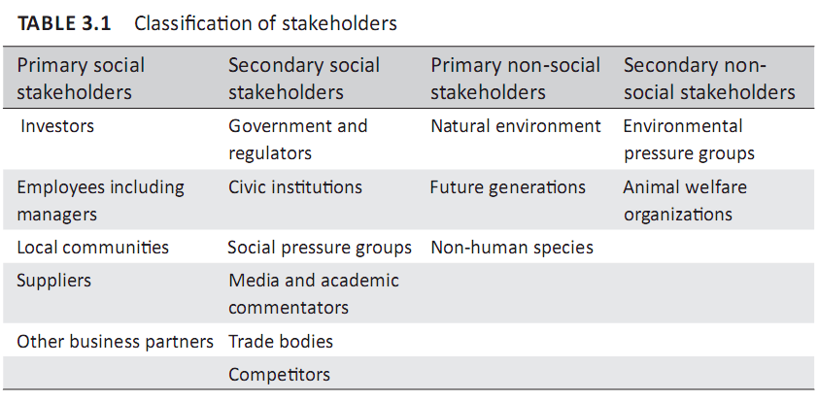
Corporate Social Responsibility
TAXONOMY OF STAKEHOLDERS
In simple terms, stakeholders can be defined as individuals or groups who either get advantage or are disadvantaged by corporate decision or action.

