Slide 1
Corporate Social Responsibility
LECTURE 7:
Corporate Social Responsibility
MGT 610

Slide 2
Corporate Social Responsibility
Chapter 2
Evolution of Company and CSR

Slide 3
Corporate Social Responsibility
After Studying this chapter, you will be able to:
Understand the concept of corporation
Trace a brief history of corporations
Understand how modern corporations come in to existence
Provide a brief outline of corporate governance
Analyze the importance of CSR in governance

Slide 4
Corporate Social Responsibility
Importance of CSR in corporate governance
Stakeholders theory is integral to corporate governance in addition to shareholders value
General acceptance that government cannot mange all needs of society and companies have to involve themselves for the welfare of stakeholders
Corporations have the following responsibility
  Economic
  Legal
  Ethical
    Honor trust
    Be culture sensitive to provide the right services
    Discretionary
      Undertake voluntary activities and expenses, keeping the greater good of society in mind

Slide 5
Corporate Social Responsibility
Many countries have created laws
  The companies act of 2006 of UK formally includes CSR as responsibility to be undertaken by the companies
CG is a powerful tool which can ensure CSR permeates throughout the company
Operate in internal, intermediate and outer circle
Every company has to find and frame its own frame work of CSR

Slide 6
Corporate Social Responsibility
Leadership Crisis
The obligations of a corporations can be discharged if leaders believe in them
Human aspect ensure success or failure as they are the process creator, process owners and process deliverers
Organizations need a team that can identify with the mission statement
  If the organization is defined by economic terms …. The management fails to realize the deeper values that the organization offers to employees in term of security, personal growth, purpose in life
Organization cannot have a two set of moral
  Organizations have to realize that making money is essential but it is certainly not its purpose
Businesses do not operate outside society therefore it has a responsibility towards society
This can be fulfilled by the value orientation of the people within the business

Slide 7
Corporate Social Responsibility
Relations between Values and Skills
Are leaders value oriented?
Society gives them a high pedestal and this respect demands that leaders fulfill their responsibility towards the society
Increased specializations has resulted in more interdependencies
  Rules cannot be made for every relationship as they are guidelines and not end-all of every relationship
Usually organizations have visions and values to guide decision makers and rely on collaborations.
  This can work if leaders are committed to work and work becomes the motivation and not pay or perks
Usually rules results in complacency, but code signifies minimum necessary
The concept of compassion and common good should be guiding factors while reviewing work and its results

Slide 8
Corporate Social Responsibility
According to business week annual executive compensation survey
  Between 1990-2003
    The CE pay rose 313% compared with profits rising 128% and average worker pay increasing only 49%
Professionals have to unite to create a leadership cadre that can fight such unethical conduct that is sustained in the name of expertise
Leaders have to take a proactive stand and exert authority to shape policies conducive to human good
Leader should develop unique qualities in every stakeholders as everybody knows something that other don’t and using this skills will result in successful corporation

Slide 9
Corporate Social Responsibility
The Social Impact
Law and order situation is also dependent on economics of a country
Anger is directed towards big businesses
If business needs customer with buying power then it has to ensure that common man position improves
Unless the business community contributes to the basic development needs, its own survival will be threatened
Managers behave as if we are alone and that they don’t have choices – it is this lack of choices which is the killer of humanity
Problem with the concept of survival of fittest
The spirit of cut throat competition has resulted in accumulation of wealth without thinking of ethics
  Result – social havoc
Consensus management is the need of the day
  Create a family within the corporation
    Basic human values, trust, integrity, honesty, selfless
  Hence back to the principal of being ethical

Slide 10
Corporate Social Responsibility
Corporate social performance encompasses an organizations commitment to behave in an economically and environmentally sustainable manner, while honoring the interest of the direct stakeholders and benefitting the greater community at large
The success of this performance depends upon
  What people think about the business
  How people behave in an organization

Slide 11
Corporate Social Responsibility
The value of CSR is actually a transcendent value. When such inspirational ideology is combined with formal structure the result is the following 4 types of organizations:
  Anarchy
    Hypothetical state, results in turmoil, chaos, conflict and extinction
  Robot
    Represents the mechanistic view
    Organization acts as a machine and the humans act in a predefined pattern
  Social
    Humans are the only structure that exists
    Interconnection between common values and direction
    Difficult to find state other than certain small organizations
  Incorporated
    Ideal state where values and structures are strong
    Integrated structures are because of collective consciousness of all the members of the organization

Slide 12
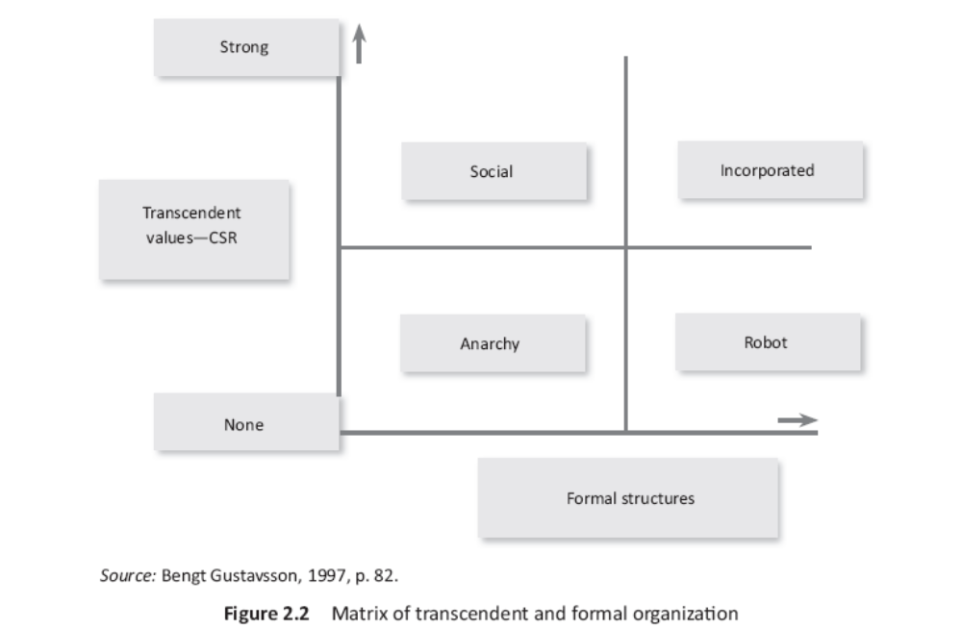
Corporate Social Responsibility

Slide 13
Corporate Social Responsibility
The value of CSR is actually a transcendent value. When such inspirational ideology is combined with formal structure the result is the following 4 types of organizations:
  Anarchy
    Hypothetical state, results in turmoil, chaos, conflict and extinction
  Robot
    Represents the mechanistic view
    Organization acts as a machine and the humans act in a predefined pattern
  Social
    Humans are the only structure that exists
    Interconnection between common values and direction
    Difficult to find state other than certain small organizations
  Incorporated
    Ideal state where values and structures are strong
    Integrated structures are because of collective consciousness of all the members of the organization

Slide 14
Corporate Social Responsibility

