Slide 1
Corporate Social Responsibility
LECTURE 21:
Corporate Social Responsibility
MGT 610

Slide 2
Corporate Social Responsibility
Chapter 5
Creating CSR Framework

Slide 3
Corporate Social Responsibility
LEARNING OBJECTIVES
Understand the importance of historical evidence in exploring the concept of CSR
Examine the processes of integrating CSR into the strategic framework of organizations
Provide simple suggestions on implementation processes of CSR for organizations understand that CSR
Perception and delivery have to take into account both global and local practices

Slide 4
Corporate Social Responsibility
From the previous lecture
  CSR requires understanding of history and culture
  Committed integration in to the strategy of an organization
    Risk analysis
    Building trust
    Subliminal impact of history
    Corporate ideology and history
    Appreciating culture
    Governance and culture
    Apprehensions of the societies
    True nationalism

Slide 5
Corporate Social Responsibility
Creating a framework for CSR
  Creation of a corporate culture
    The institutional environment must reflect the beliefs, values and norms of the members of the institutions
    Industry culture is the organizational manifestation of institutional beliefs and values
    While implementing CSR one has to keep in mind the concept of invented traditions
      Set of practices governed by overtly or tacitly accepted rules. These rules have symbolic nature and inculcate certain values and norms of repeated behavior which implies continuity with the past
  CSR practices should be woven in to the fabric of the organization
  CSR cannot remain as a separate voluntary activity

Slide 6
Corporate Social Responsibility
Creating a framework for CSR
  Three level implementation framework
    The implementation has to be integrated through three stages
      Inner corporate level
      Intermediate national level
      Outer universal level

Slide 7
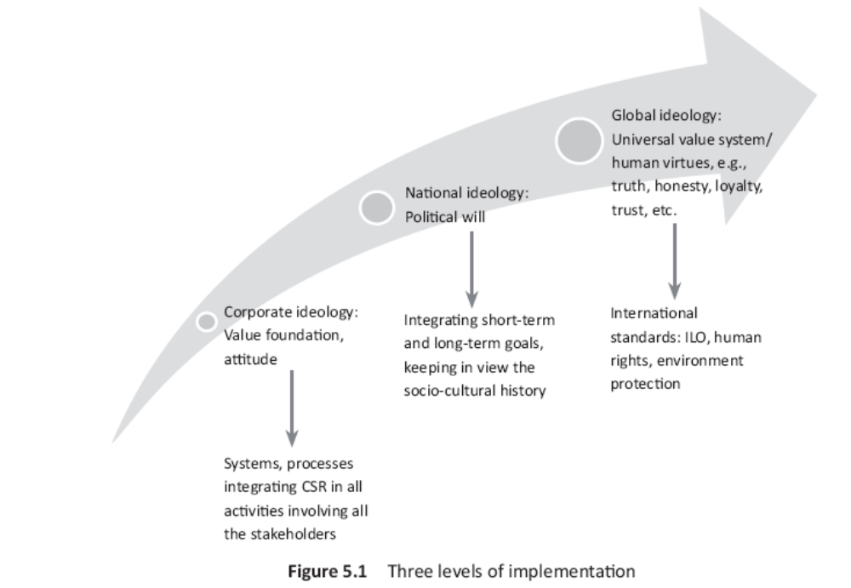
Corporate Social Responsibility

Slide 8
Corporate Social Responsibility
Creating a framework for CSR
  Three level implementation framework
    Inner corporate ideology
      Core value foundation based on integrity, accountability and transparency needs to be built
      Can give directions to decision makers to choose between two rights and one right and one wrong alternative
      A practical approach to judging value based management would be to understand
        Micro level integration
        Macro level integration
        Integration of CSR at operation and process level

Slide 9
Corporate Social Responsibility
Micro level integration by the firm
  Relates to individual activities that the firm undertakes both as suppliers and a consumer of labour and capital
  The concept of integration helps the firm examine how values can become an integral part of the various activities that they undertake to allocate resources drawn from the society to earn profits
  The individual activities that needs to be viewed in their pursuit for CSR are
    Position in the stock market
    Value creation to be judged through
      Portfolio management
      Choice between the strategic option
      Assessment of impact of business plan
      Target setting and bench marking
    Analyze resource sourcing, prioritizing and allocating resources

Slide 10
Corporate Social Responsibility
    Appraisal of performance and organizational image
    Focus on business and operational strategies that maximize value
    Learn the skills to enhance delegation as well increase accountability and responsibility
    Break down plans in to keep objective, ensure value throughout the organization
    Provide undiluted support for difficult but essential long term initiatives
    Invest in R&D
    Be transparent about risk and benefits of technology and be open to disruptive innovations
  Macro level integration by the government
    Refers to national and international level policies that impact business
    When policy makers become accountable and show responsible behavior while formulating economic policies then CSR becomes easy
    The immediate areas of implementation are:

Slide 11
Corporate Social Responsibility
    The immediate areas of implementation are:
      Draw long term unambiguous policy framework of target and regulations
      Establish mandatory minimum standards for public participation, supported by improved incentives and performance appraisal
      Incorporate public welfare in decision making and each stage of firms policy cycle
      Improve transparency of governance and operations
      Expand and protect political space for democratic decision making at the national level
      Find new and attractive ways to finance social initiatives related to sustainable growth

Slide 12
Corporate Social Responsibility
Integration of CSR at the operations and process level
  See the flow production and operations flowcharts to see if the responsibilities are being handled ethically
  This strategy would ensure
    Poor substitute of collective bargaining are not made
    Remove danger of stakeholders becoming docile and flexible at the cost of profit mongering
    Long term viability would be addresses because at every stage quality would be scrutinized
    The potential danger of pseudo NGO can be addressed

Slide 13
Corporate Social Responsibility
  Importance of flow chart
    Give an overview of all activities
    Is the building CSR ate every level
    The firm can start by doing the following
      Resources
      Production processes
      Production of goods
      Planning
      Organizing
      Control
      Operations
      Human resource

Slide 14
Corporate Social Responsibility
Intermediate national ideology
  CSR becomes difficult when companies maintain and build facilities in countries without the appreciation of the natural cultures and history
  The relation between the culture and the CSR depends upon the size of the company
  Companies have to be actively committed to a sustainable improvement in the macro environment situation and introduce measure that go beyond statutory requirements on the countries in which they operate
  Statutory regulations
      Should take in to account the socio economic situation
      The reason that high social responsibility standards may not be immediately possible in developing countries. This is because

Slide 15
Corporate Social Responsibility
Danger of stereotyping
  To create an environment at the national level
    Mistake of copying system
    Stereotyping is bracketing problems and solutions under a common frame because theoretically they look similar
    The reality is when we analyze the problem at the practical level and try to implement solution, stark differences and challenges are revealed
    Example: poverty

Slide 16
Corporate Social Responsibility
Outer global ideology
  Standards laid by UN and ILO have to be practiced
  Conflict issues are
    Collective bargaining
    Gender equality
    Human rights
    Environmental protection
    Free trade
    Financial transparency
    Corporate governance
  To overcome conflict in addition to CSR, and understanding cultural relativism, the issue of economic justice have to be taken up
  Need balance between total control and absolute laissez faire at the macro level
  International bodies have to be involved in brining social justice and economic welfare in an accountable and transparent manner

Slide 17
Corporate Social Responsibility

Slide 18
Corporate Social Responsibility
Creating an implementation framework
The strategy needs to build the CSR structure that helps analyze risks and build trusts so that profits can be earned
This can be visualized at different levels of value implementation
Inner circle is where the values are entrenched
Second circle is where the application of the values occur
Third is the layer of rules, structures, systems, processes and codes that are put in place
Leader journey

Slide 19
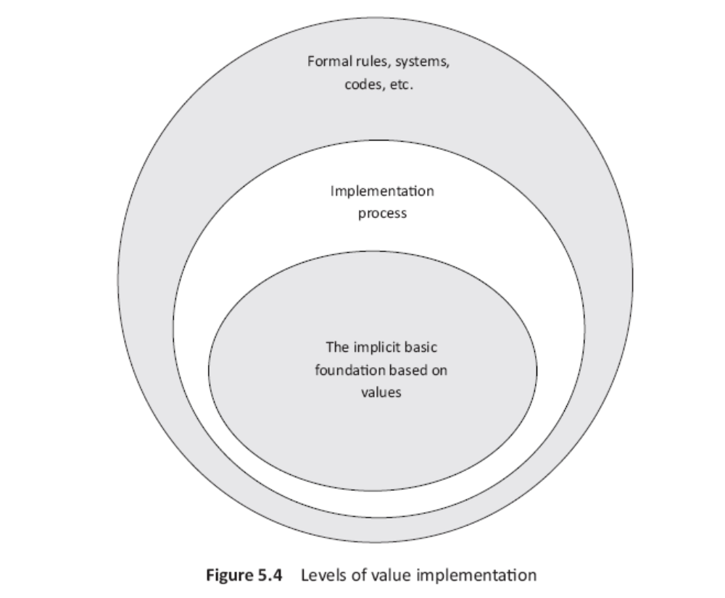
Corporate Social Responsibility

Slide 20
Corporate Social Responsibility
The training approach for value implementation should follow three simple stages (evaluation of risk and opportunities will be easy)
Information sharing
  Organization values
  Vision and mission
  Cultural briefing
  Tolerance/intolerance of ethical activities
  Zero tolerance
Checking effectiveness
  Reminder of values, vision and mission
  Problem faced and solved
  Critical decisions should be supported by values
  Training in ethics
  Learning to assimilate ethics at workplace
Integration approach
  Formation of an assessment center
  Real on the job experience
  Analysis of response
  Developing sensitivity
  Appreciating differences

Slide 21
Corporate Social Responsibility
The usual method of taking CSR decisions are result, duties and moral obligation dependent
Manager gets confused if analysis is from cultural perspective
Long term value creation should be the practical objective of all businesses
This can be understood through

Slide 22
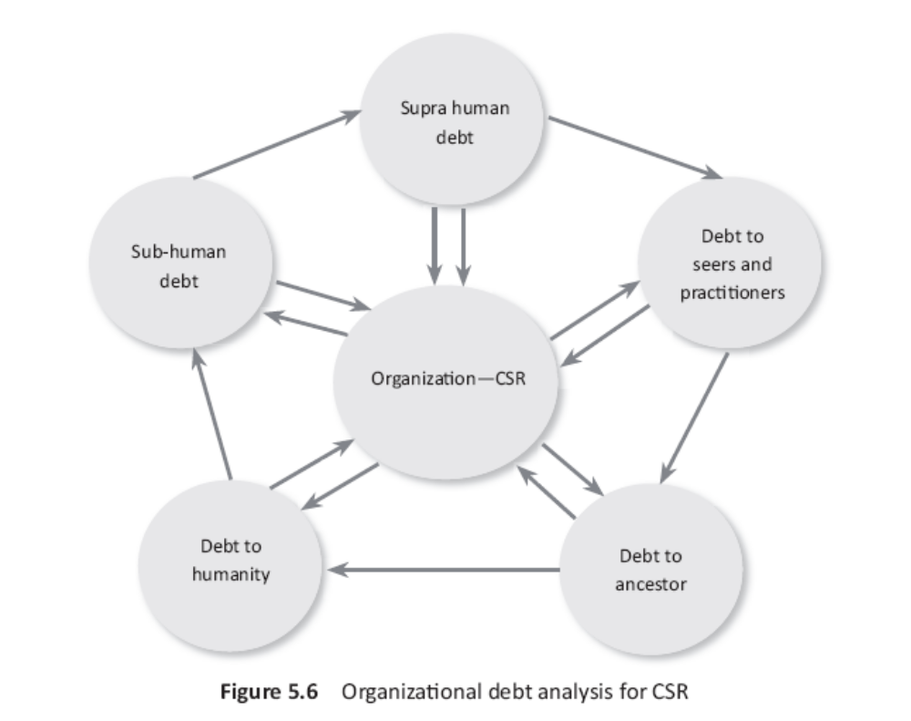
Corporate Social Responsibility

Slide 23
Corporate Social Responsibility
If an organization attitudes towards social existence is driven and inspired by this orientation, the journey will be towards duties, responsibilities and sacrifice – core essence of CSR
Another way of implementing CSR is the integrative model of development C – covering the three c’s
  Understanding concepts
  Acquiring competencies
  Building connectivity

Slide 24
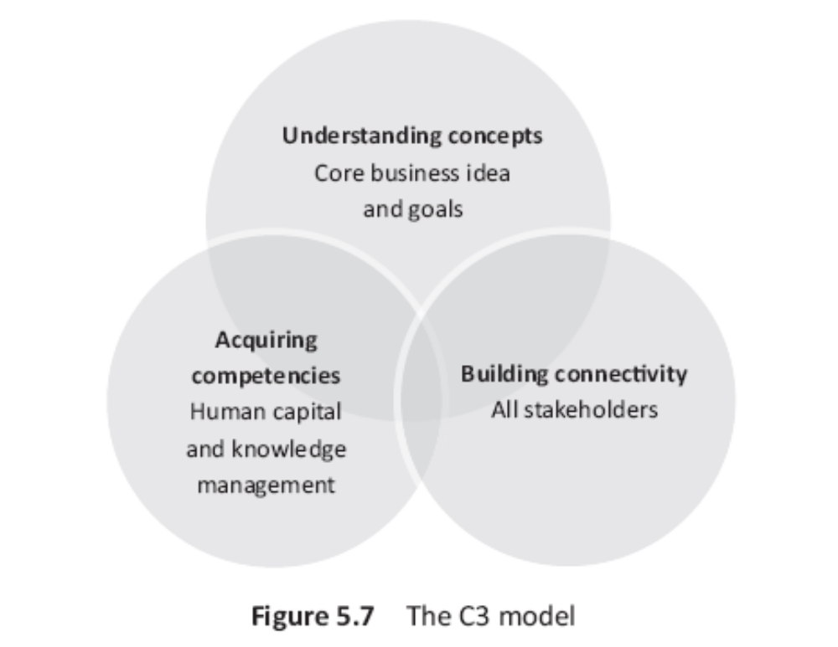
Corporate Social Responsibility

Slide 25
Corporate Social Responsibility

