Slide 1
Corporate Social Responsibility
LECTURE 20:
Corporate Social Responsibility
MGT 610

Slide 2
Corporate Social Responsibility
Chapter 5
Creating CSR Framework

Slide 3
Corporate Social Responsibility
LEARNING OBJECTIVES
Understand the importance of historical evidence in exploring the concept of CSR
Examine the processes of integrating CSR into the strategic framework of organizations
Provide simple suggestions on implementation processes of CSR for organizations
understand that CSR perception and delivery have to take into account both global and local practices

Slide 4
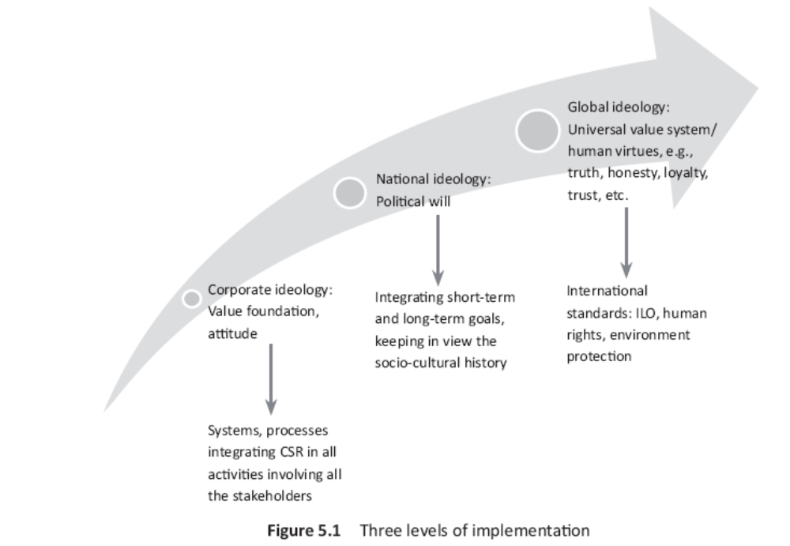
Corporate Social Responsibility

Slide 5
Corporate Social Responsibility
Intermediate national ideology
  CSR becomes difficult when companies maintain and build facilities in countries without the appreciation of the natural cultures and history
  The relation between the culture and the CSR depends upon the size of the company
  Companies have to be actively committed to a sustainable improvement in the macro environment situation and introduce measure that go beyond statutory requirements on the countries in which they operate
  With globalization and outsourcing, companies have to be alert with respect to subsidiaries, partners, suppliers and license holders
    Statutory regulations
      Should take in to account the socio economic situation
      The reason that high social responsibility standards may not be immediately possible in developing countries. This is because

Slide 6
Corporate Social Responsibility
Intermediate national ideology
    Statutory regulations
      Should take in to account the socio economic situation
      The reason that high social responsibility standards may not be immediately possible in developing countries. This is because
        The infrastructure is not available
        The implementation may reduce the competitive advantage of low cost of production
        Removal of social evil without a contingency plan may increase rate of crime
        Formal modern education results in decline in vocational skills and indigenous heritage
      The nation should have a structured policy aimed at reducing red tape, corruption and increase fair distribution instead of piecemeal solutions

Slide 7
Corporate Social Responsibility
Danger of stereotyping
  To create an environment at the national level
    Mistake of copying system
    Stereotyping is bracketing problems and solutions under a common frame because theoretically they look similar
    The reality is when we analyze the problem at the practical level and try to implement solution, stark differences and challenges are revealed

Slide 8
Corporate Social Responsibility

Slide 9
Corporate Social Responsibility
Outer global ideology
  Standards laid by UN and ILO have to be practiced
  Conflict issues are
    Collective bargaining
    Gender equality
    Human rights
    Environmental protection
    Free trade
    Financial transparency
    Corporate governance
  To overcome conflict in addition to CSR, and understanding cultural relativism, the issue of economic justice have to be taken up
  Need balance between total control and absolute laissez faire at the macro level
  International bodies have to be involved in brining social justice and economic welfare in an accountable and transparent manner

Slide 10
Corporate Social Responsibility

Slide 11
Corporate Social Responsibility
Creating an implementation framework
The strategy needs to build the CSR structure that helps analyze risks and build trusts so that profits can be earned
This can be visualized at different levels of value implementation
Inner circle is where the values are entrenched
Second circle is where the application of the values occur
Third is the layer of rules, structures, systems, processes and codes that are put in place
Leader journey

Slide 12
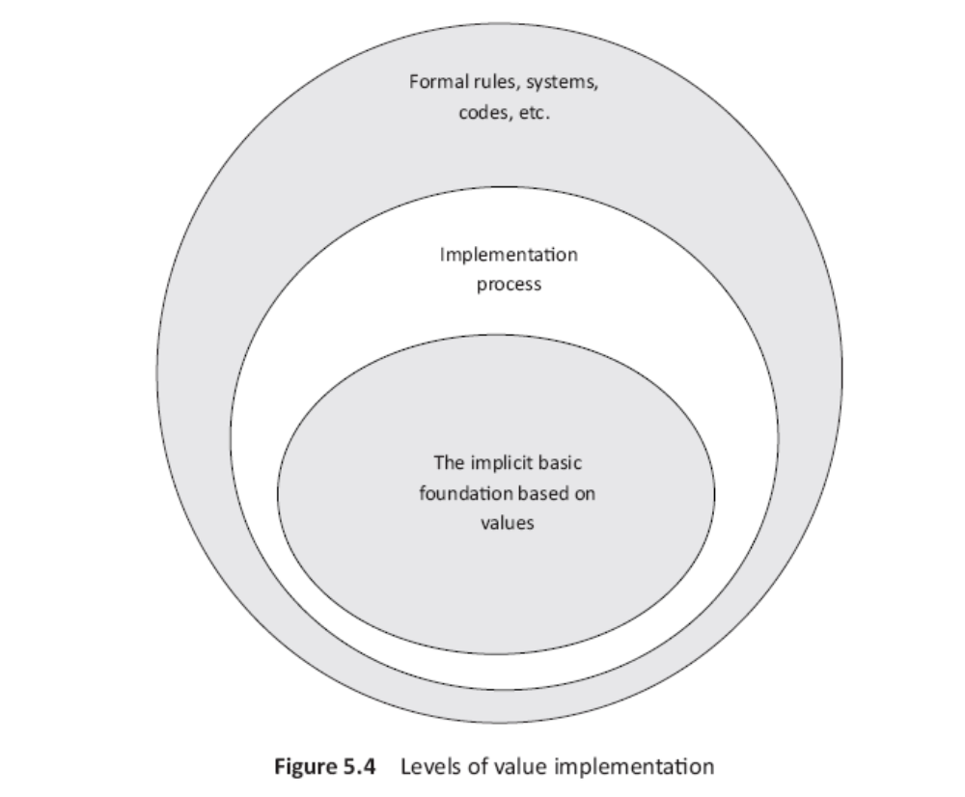
Corporate Social Responsibility

Slide 13
Corporate Social Responsibility
The training approach for value implementation should follow three simple stages (evaluation of risk and opportunities will be easy)
Information sharing
  Organization values
  Vision and mission
  Cultural briefing
  Tolerance/intolerance of ethical activities
  Zero tolerance
Checking effectiveness
  Reminder of values, vision and mission
  Problem faced and solved
  Critical decisions should be supported by values
  Training in ethics
  Learning to assimilate ethics at workplace
Integration approach
  Formation of an assessment center
  Real on the job experience
  Analysis of response
  Developing sensitivity
  Appreciating differences

Slide 14
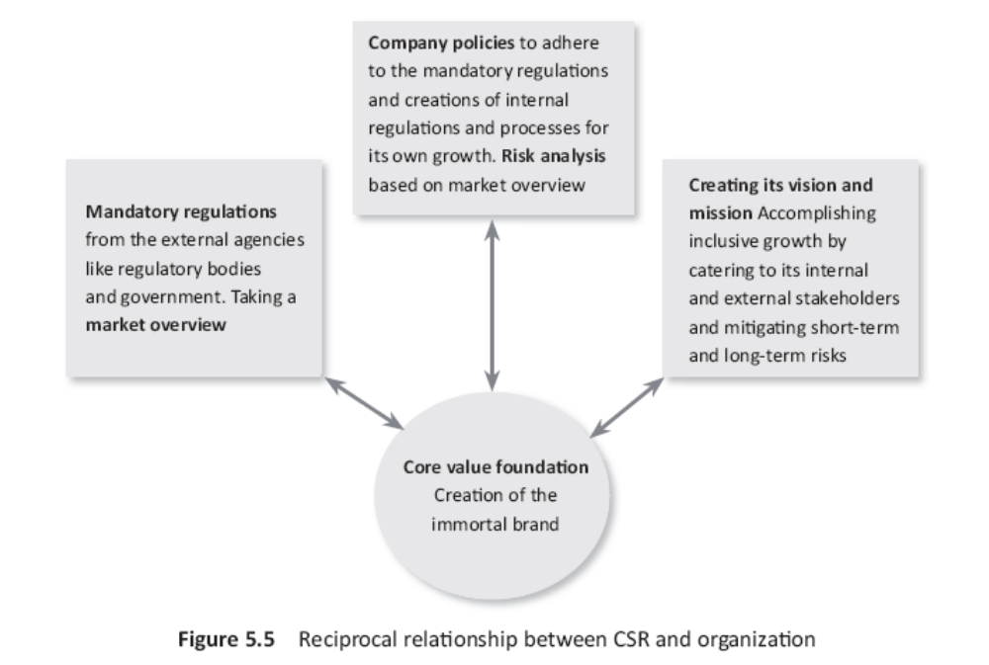
Corporate Social Responsibility

Slide 15
Corporate Social Responsibility
The usual method of taking CSR decisions are result, duties and moral obligation dependent
Manager gets confused if analysis is from cultural perspective
Long term value creation should be the practical objective of all businesses
This can be understood through

Slide 16
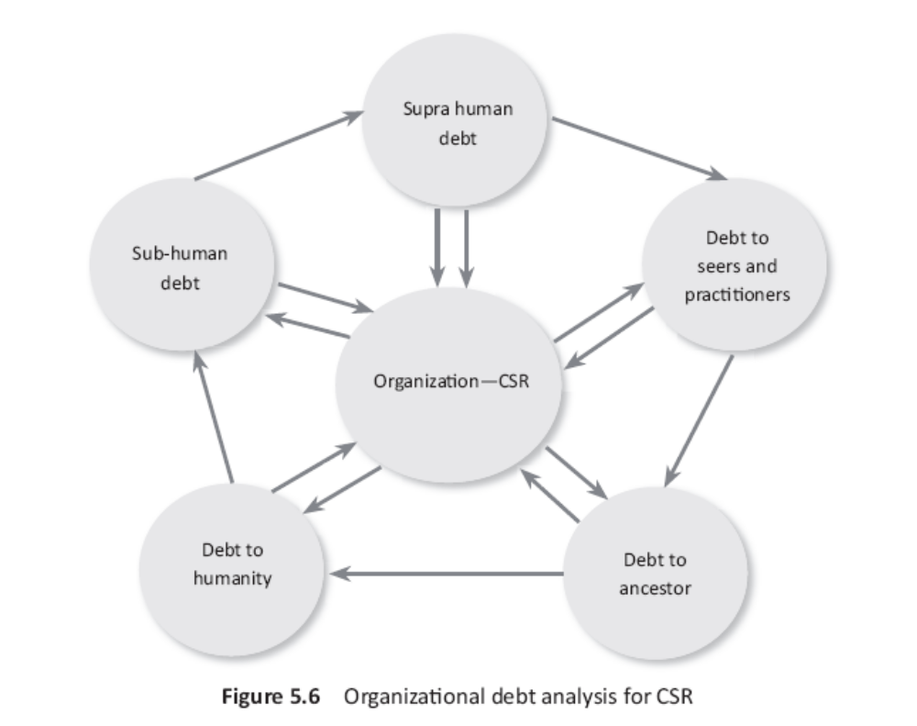
Corporate Social Responsibility

Slide 17
Corporate Social Responsibility
If an organization attitudes towards social existence is driven and inspired by this orientation, the journey will be towards duties, responsibilities and sacrifice – core essence of CSR
Another way of implementing CSR is the integrative model of development C – covering the three c’s
  Understanding concepts
  Acquiring competencies
  Building connectivity

Slide 18
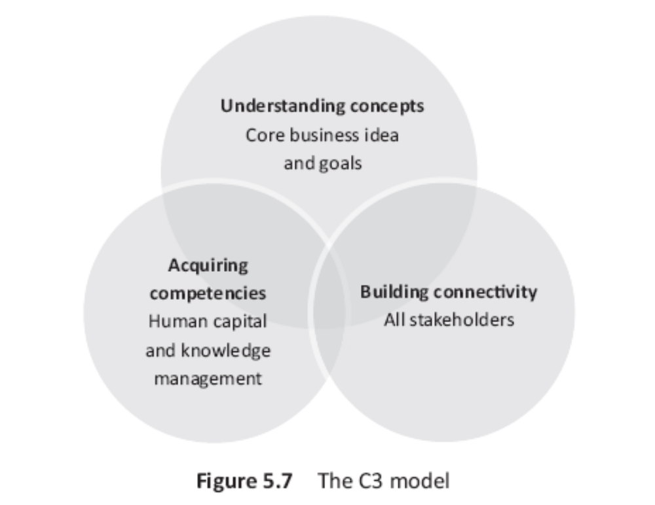
Corporate Social Responsibility

