Slide 1
Corporate Social Responsibility
LECTURE 19:
Corporate Social Responsibility
MGT 610

Slide 2
Corporate Social Responsibility
Chapter 5
Creating CSR Framework

Slide 3
Corporate Social Responsibility
LEARNING OBJECTIVES
Understand the importance of historical evidence in exploring the concept of CSR
Examine the processes of integrating CSR into the strategic framework of organizations
Provide simple suggestions on implementation processes of CSR for organizations
understand that CSR perception and delivery have to take into account both global and local practices

Slide 4
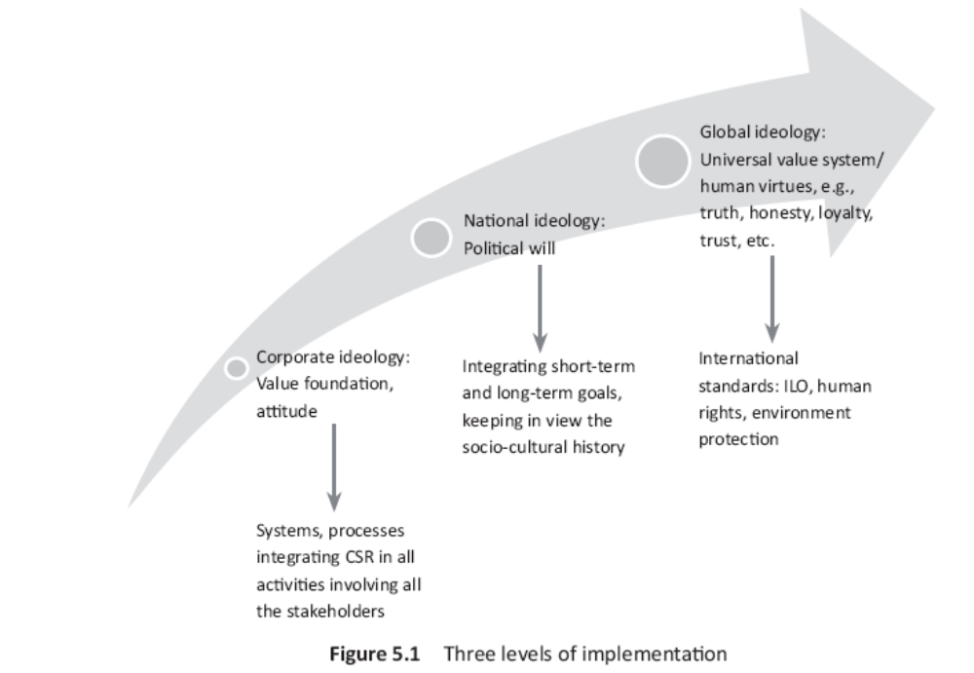
Corporate Social Responsibility

Slide 5
Corporate Social Responsibility
    Inner corporate ideology
      A practical approach to judging value based management would be to understand
        Micro level integration
        Macro level integration
        Integration of CSR at operation and process level

Slide 6
Corporate Social Responsibility
Micro level integration by the firm
  Relates to individual activities that the firm undertakes both as suppliers and a consumer of labour and capital
  The concept of integration helps the firm examine how values can become an integral part of the various activities that they undertake to allocate resources drawn from the society to earn profits
  The individual activities that needs to be viewed in their pursuit for CSR are
    Position in the stock market
    Value creation to be judged through
      Portfolio management
      Choice between the strategic option
      Assessment of impact of business plan
      Target setting and bench marking
    Analyze resource sourcing, prioritizing and allocating resources

Slide 7
Corporate Social Responsibility
    Appraisal of performance and organizational image
    Focus on business and operational strategies that maximize value
    Learn the skills to enhance delegation as well increase accountability and responsibility
    Break down plans in to keep objective, ensure value throughout the organization
    Provide undiluted support for difficult but essential long term initiatives
    Invest in R&D
    Be transparent about risk and benefits of technology and be open to disruptive innovations
  Macro level integration by the government
    Refers to national and international level policies that impact business
    When policy makers become accountable and show responsible behavior while formulating economic policies then CSR becomes easy
    The immediate areas of implementation are:

Slide 8
Corporate Social Responsibility
    The immediate areas of implementation are:
      Draw long term unambiguous policy framework of target and regulations
      Establish mandatory minimum standards for public participation, supported by improved incentives and performance appraisal
      Incorporate public welfare in decision making and each stage of firms policy cycle
      Improve transparency of governance and operations
      Expand and protect political space for democratic decision making at the national level
      Find new and attractive ways to finance social initiatives related to sustainable growth

Slide 9
Corporate Social Responsibility
Integration of CSR at the operations and process level
  See the flow production and operations flowcharts to see if the responsibilities are being handled ethically
  This strategy would ensure
    Poor substitute of collective bargaining are not made
    Remove danger of stakeholders becoming docile and flexible at the cost of profit mongering
    Long term viability would be addresses because at every stage quality would be scrutinized
    The potential danger of pseudo NGO can be addressed
  Importance of flow chart
    Give an overview of all activities
    Is the organization building CSR at every level
    The firm can start by doing the following
      Resources
        Sourced and utilized for profit as well as sustainable economic activity
        Built social concern at the beginning of the production process
      Production processes

Slide 10
Corporate Social Responsibility
  Importance of flow chart
    Give an overview of all activities
    Is the building CSR ate every level
    The firm can start by doing the following
      Resources
      Production processes
        Is the organization alert about satisfying the internal and external customer
      Production of goods
        Specifications are being met
        Selection of design
        Selection of raw material
      Planning
        While planning for men and machinery
          Product, basic need, existing solution and current problem
          Focus on these variables would help to analyze the ethical impacts

Slide 11
Corporate Social Responsibility
  Importance of flow chart
    Give an overview of all activities
    Is the building CSR ate every level
    The firm can start by doing the following
      Resources
      Production processes
      Production of goods
      Planning
      Organizing
        Processes, plant location, plant layout, routing, stores and record keeping
        Impact of these on internal and external conditions CSR would be built in the system
      Control
        Audit done of ethicality followed then CSR would be incorporated
      Operations
        Implement strategic decisions made by marketing, finance, and management
        If the vision is integrated with CSR then the entire business strategy would be consistent with CSR

Slide 12
Corporate Social Responsibility
  Importance of flow chart
    Give an overview of all activities
    Is the building CSR ate every level
    The firm can start by doing the following
      Resources
      Production processes
      Production of goods
      Planning
      Organizing
      Control
      Operations
      Human resource
        Work culture
          Empowerment, engaged, accountable
        Leadership
          Communicative, emphatic, accessible
        People
          Work/life balance, encouraged to take care of themselves and families, flexible policies

Slide 13
Corporate Social Responsibility
  Importance of flow chart
    Give an overview of all activities
    Is the building CSR ate every level
    The firm can start by doing the following
      Resources
      Production processes
      Production of goods
      Planning
      Organizing
      Control
      Operations
      Human resource
        Work culture
        Leadership
        People
        Work
        Growth and opportunity
        Compensation and benefits
        Social awareness

Slide 14
Corporate Social Responsibility

Slide 15
Corporate Social Responsibility
Intermediate national ideology
  CSR becomes difficult when companies maintain and build facilities in countries without the appreciation of the natural cultures and history
  The relation between the culture and the CSR depends upon the size of the company
  Companies have to be actively committed to a sustainable improvement in the macro environment situation and introduce measure that go beyond statutory requirements on the countries in which they operate
  With globalization and outsourcing, companies have to be alert with respect to subsidiaries, partners, suppliers and license holders
    Statutory regulations
      Should take in to account the socio economic situation
      The reason that high social responsibility standards may not be immediately possible in developing countries. This is because

Slide 16
Corporate Social Responsibility
Intermediate national ideology
    Statutory regulations
      Should take in to account the socio economic situation
      The reason that high social responsibility standards may not be immediately possible in developing countries. This is because
        The infrastructure is not available
        The implementation may reduce the competitive advantage of low cost of production
        Removal of social evil without a contingency plan may increase rate of crime
        Formal modern education results in decline in vocational skills and indigenous heritage
      The nation should have a structured policy aimed at reducing red tape, corruption and increase fair distribution instead of piecemeal solutions

