Slide 1
Corporate Social Responsibility
LECTURE 18:
Corporate Social Responsibility
MGT 610

Slide 2
Corporate Social Responsibility
Chapter 5
Creating CSR Framework

Slide 3
Corporate Social Responsibility
LEARNING OBJECTIVES
Understand the importance of historical evidence in exploring the concept of CSR
Examine the processes of integrating CSR into the strategic framework of organizations
Provide simple suggestions on implementation processes of CSR for organizations
understand that CSR perception and delivery have to take into account both global and local practices

Slide 4
Corporate Social Responsibility
From the previous lecture
  CSR requires understanding of history and culture
  Commit integration in to the strategy of an organization
    Risk analysis
    Building trust
    Subliminal impact of history
    Corporate ideology and history
    Appreciating culture
    Governance and culture
    Apprehensions of the societies
    True nationalism

Slide 5
Corporate Social Responsibility
Creating a framework for CSR
  Creation of a corporate culture
    The relationship between the organization and the environment is known
    Open system organization
      Porous boundaries
    The institutional environment must reflect the beliefs, values and norms of the members of the institutions
    Industry culture is the organizational manifestation of institutional beliefs and values
    While implementing CSR one has to keep in mind the concept of invented traditions
      Set of practices governed by overtly or tacitly accepted rules. These rules have symbolic nature and inculcate certain values and norms of repeated behavior which implies continuity with the past
      Examples are founders beliefs, national cultures and industry pressures

Slide 6
Corporate Social Responsibility
CSR practices should be woven in to the fabric of the organization
CSR cannot remain as a separate voluntary activity
Corporate scams like Enron, and Satyam have clearly exposed the need to do more
  Not park a part of profits in trust and use that for social work
  Such efforts does not protect society from fraud

Slide 7
Corporate Social Responsibility
Creating a framework for CSR
  Three level implementation framework
    The implementation has to be integrated through three stages
      Inner corporate level
      Intermediate national level
      Outer universal level

Slide 8
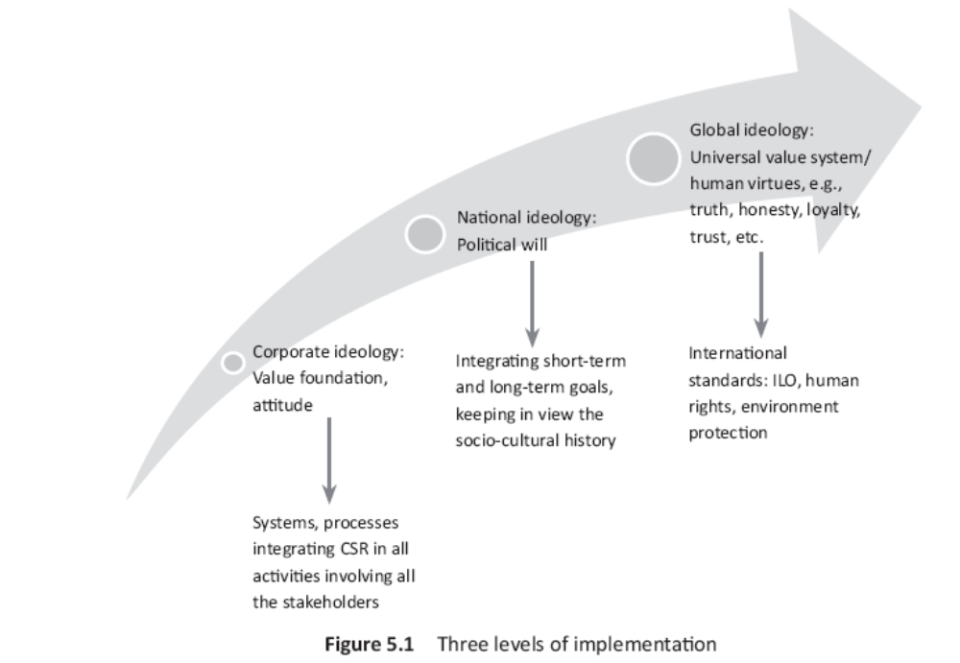
Corporate Social Responsibility

Slide 9
Corporate Social Responsibility
Creating a framework for CSR
  Three level implementation framework
    Inner corporate ideology
      Core value foundation based on integrity, accountability and transparency needs to be built
      Can give directions to decision makers to choose between two rights and one right and one wrong alternative
      choosing between two rights is difficult (right to privacy and right to freedom
      CSR becomes handy because if it is woven in to the business plan and mission it would be easier to see that which right needs priority at a particular time and location
      Law and order situation is also dependent on economic conditions

Slide 10
Corporate Social Responsibility
    Inner corporate ideology
      A practical approach to judging value based management would be to understand
        Micro level integration
        Macro level integration
        Integration of CSR at operation and process level

Slide 11
Corporate Social Responsibility
Micro level integration by the firm
  Relates to individual activities that the firm undertakes both as suppliers and a consumer of labour and capital
  The concept of integration helps the firm examine how values can become an integral part of the various activities that they undertake to allocate resources drawn from the society to earn profits
  The individual activities that needs to be viewed in their pursuit for CSR are
    Position in the stock market
    Value creation to be judged through
      Portfolio management
      Choice between the strategic option
      Assessment of impact of business plan
      Target setting and bench marking
    Analyze resource sourcing, prioritizing and allocating resources

Slide 12
Corporate Social Responsibility
    Appraisal of performance and organizational image
    Focus on business and operational strategies that maximize value
    Learn the skills to enhance delegation as well increase accountability and responsibility
    Break down plans in to keep objective, ensure value throughout the organization
    Provide undiluted support for difficult but essential long term initiatives
    Invest in R&D
    Be transparent about risk and benefits of technology and be open to disruptive innovations
  Macro level integration by the government
    Refers to national and international level policies that impact business
    When policy makers become accountable and show responsible behavior while formulating economic policies then CSR becomes easy
    The immediate areas of implementation are:

Slide 13
Corporate Social Responsibility
    The immediate areas of implementation are:
      Draw long term unambiguous policy framework of target and regulations
      Establish mandatory minimum standards for public participation, supported by improved incentives and performance appraisal
      Incorporate public welfare in decision making and each stage of firms policy cycle
      Improve transparency of governance and operations
      Expand and protect political space for democratic decision making at the national level
      Find new and attractive ways to finance social initiatives related to sustainable growth

