Slide 1
Corporate Social Responsibility
LECTURE 10:
Corporate Social Responsibility
MGT 610

Slide 2
Corporate Social Responsibility
Chapter 3
Stakeholder Theory

Slide 3
Corporate Social Responsibility
LEARNING OBJECTIVES
Understand the definition of stakeholder
Understand why the stakeholder theory is important
Learn the taxonomy of Stakeholder
Analyze stakeholder relationship
Understand holistic gowth through tangible and intangible manifestations in a corporate business

Slide 4
Corporate Social Responsibility
Impact and dilemmas of business
Up till now the process of development pursued capital formation and raising GNP in the belief that the mysterious hand would ensure the fair distribution of gains
Affluence cannot be the goal for society
Corporations have to recognize the philosophy of empty plenty
Businesses have to work for the physical and emotional need of the people
Corporation is the best option
  Issues of trust and values
  Have open directed systems Vs closed entropic systems
To be meaningful the organizations an honest assessment of internal and external environment
  Threats and opportunities
  Listening to diverse ideas
  Encourage change
    Avoid extremes
      Total conformity Vs total disregard
  Diversity in ideas is important for CSR to work internally and externally

Slide 5
Corporate Social Responsibility
Impact and dilemmas of business (contd)
The above mentioned system needs to be driven by professionals
  Associated with values and ideals. Intertwined with social well being
As professionals cannot have stereotype meanings of entities
  Use knowledge to diagnose, infer, analyze and then offer solutions
The danger
  Misuse of specialized knowledge
The society trust professionals
Individual values that make the organizations values

Slide 6
Corporate Social Responsibility
Impact and dilemmas of business (contd)
To be meaningful, organizations have to make life reverent and just. this requires an honest assessment of the internal and external environment, so that the realities are matched.
Importance of professionals- professionalism is associated with certain values and ideals. It is intricately intertwined with a concept of social well-being as that is the prerequisite for any kind of survival— individual or group.

Slide 7
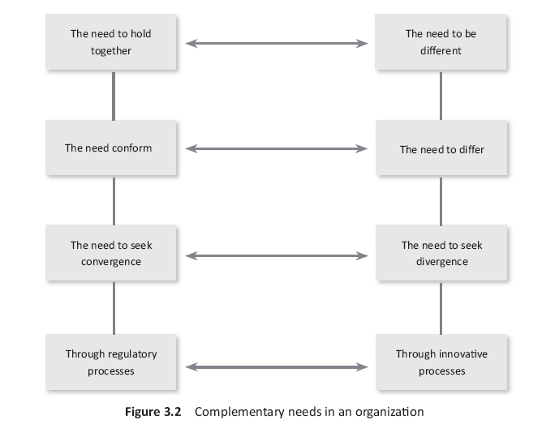
Corporate Social Responsibility

Slide 8
Corporate Social Responsibility
Impact and dilemmas of business (contd)
Intangible aspect of the stakeholders approach
Stakeholders approach is based on long term relationships with stakeholders
Relationships need nurturing and trust has to be maintained so that all stakeholders remain committed to the well being of the organization, society and the community
Values can be experienced but they cannot be measured and quantified
Values are the intangible aspect of stakeholders approach

Slide 9
Corporate Social Responsibility
Impact and dilemmas of business (contd)
Balancing Emotional Quotient and Intelligent Quotient
Search for right professional who can make the incentive oriented journey towards perfection
Realty – instead of focusing on emotions attempts are made to annihilate emotions
  Through the concept of an economic man
Asking our professionals to keep emotions at home while they do activities which have profound global influence
The emotional intelligence decides whether the subjective individual is going to deliver the correct objectives
  The intelligent brain can justify any activity hence when emotions are not managed individuals can commit the most heinous crimes

Slide 10
Corporate Social Responsibility
Impact and dilemmas of business (contd)
Unfortunately, management focuses more on skill development and less on value development
  Intellect and reasons are tool for skill development
  Skills and action need to be guided by values of human existence
Right choice that people have to make as there is no area of life that does not contain value and ethical elements

Slide 11
Corporate Social Responsibility
Impact and dilemmas of business (contd)
Importance of ethics
Healthy and wholesome growth in the corporate world cannot ignore ethics
Main concern is to make profit and ethics has to be proactive part of business if profits are to be sustained
Organizations have to pre-suppose accountability and integrity for perfect business processes
Knowledge has no value if it is not creative

Slide 12
Corporate Social Responsibility
Impact and dilemmas of business (contd)
Importance of ethics
Creativity always related to positive sustainable growth
Difference between the right and the wrong professional
Right people are supposed to make life more comfortable
The purpose of business
  To create material wealth so that life can be made enjoyable
  As a reward for this, society allows them to make profits
  Material wealth is of value if it results in human preservation
Understand the difference between need, want and greed
  Selfish individuals preservation is fueled by want and greed and hence money

Slide 13
Corporate Social Responsibility
Impact and dilemmas of business (contd)
The tussle between means and ends
Means are as important as the ends
Free from stress and fear when one is committed to means and ends
This dedication leads to a balance
  Failure becomes a stepping stone to success
  Hope to try again
There is no alternative to work, it is the motivation which decides whether the result is positive of negative
Unhappiness occurs when somebody else achieves success quicker than us by using unfair mean but the question is that how long can that success last

Slide 14
Corporate Social Responsibility
Impact and dilemmas of business (contd)
Combining tangible gains with intangible satisfaction
Can a business ignore its stakeholders
Relationships depends upon trust and not skill
If the individual is not value orientated how can the his action be value oriented
Businesses depends on a vision
Vision is achieved through smaller missions
  To achieve this organization should have
    Sight
      Day to day activity
    Insight
      Debriefing, appraisal is made of the activities and their results
    Foresight
      Setting the goals towards which the company ahs to proceed

Slide 15
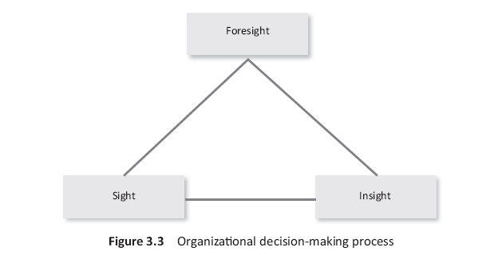
Corporate Social Responsibility

Slide 16
Corporate Social Responsibility
Impact and dilemmas of business (contd)
To complete this journey the professional has to move away and look at the work
Learn to delegate and let go to do intelligent wok
True leader will be alert and relaxed to give the right decision
The people have to stand by values and orther will follow
Basic values are universal as they stem from the depth of human existence

Slide 17
Corporate Social Responsibility
Impact and dilemmas of business (contd)
Holistic growth
Professionals cannot work within their respective areas and believe that development would happen
Can magic of the market place resolve the problems of the missions who live below the poverty line
The process of globalization should have a human face
Economic growth has to be shared

Slide 18
Corporate Social Responsibility
Stakeholders Trade-Offs
While implementing the stakeholders theory
  Tradeoffs between stakeholders as it is not possible to meet the demand of all equally
Donaldson and Preston (1995) proposed three uses of the stakeholder model:
  Descriptive
    Helps to understand how corporation are organized and managed
    Description of the organization and what people believe their roles are
  Instrumental
    How stakeholders are a practical method of earning profits
  Normative.
    It relates to the interest of stakeholders which should be promoted for the sake of the corporation

Slide 19
Corporate Social Responsibility
Stakeholders Trade-Offs (contd)
Mitchell et al. (1997) suggest that the importance or salience of the stakeholder can be judged from the parameters of power, legitimacy, and urgency
  Power is the ability to influence organizations decisions making and actions
  Legitimacy relates to how far the organization perceives the activities of stakeholders as appropriate and desirable
  Urgency as the word suggests judges the importance of stakeholders claim to immediate action
Based on which stakeholders demonstrate how many attributes, they can be classified as
  Latent
  Expectant
  Definitive
Then the organization can decide how its would engage with various stakeholders

Slide 20
Corporate Social Responsibility
Stakeholders Trade-Offs (contd)
A framework for making the trade-off is offered by Jenson (2006). He calls it the enlightened value maximization and enlightened stakeholder theory.
  Stakeholders theory directs corporate managers to serve many masters
  Experience confusion, conflict, inefficiency
We cannot maximize the long term market value of the organizations if we ignore or mistreat any important constituency
Value criteria would help the organizations to decide the trade-off more effectively
Cautioned that stakeholders theory can play in the hand of special interest groups who would legitimize using resources for their own good under the guise of stakeholders welfare
  Result in more harm than good
We must set our organizations so that it is motivated to seek value and make strategies to raise value

Slide 21
Corporate Social Responsibility

Slide 22
Corporate Social Responsibility

