Slide 2
Lecture 9
Topics for today
Assumptions of CLRM
Co variance
Standard Error or precision of estimates
Gauss-Markov Theorem
Coefficient of determination

Slide 3
Assumptions….
1- The model is Linear in parameters
2- X values are ﬁxed in repeated sampling. Values taken by the regressor X are considered ﬁxed in repeated samples. More technically, X is assumed to be nonstochastic.
What this means is that our regression analysis is conditional regression analysis, that is, conditional on the given values of the regressor(s) Xi.
3: Zero mean value of disturbance Ui.
Given the value of X, the mean, or expected, value of the random disturbance term Ui is zero. Technically, the conditional mean value of Ui is zero. Symbolically, we have

Slide 5

Assumptions…
4- Homoscedasticity or equal variance of error term.
Given the value of X, the variance of Ui is the same for all observations. That is, the conditional variances of Ui are identical. Symbolically,

Slide 7

Assumptions…
5- No autocorrelation between the disturbances. Given any two X values, Xi and Xj (i not equal to j ), the correlation between any two Ui and Uj is zero. Symbolically,
6- Zero covariance between Ui and Xi ,
E(Ui, Xi) = 0.

Slide 9
Assumptions….
7- The number of observations n must be greater than the number of parameters to be estimated.
8- The X values in a given sample must not all be the same. Technically, Var (X) must be a ﬁnite positive number.
9-The regression model is correctly speciﬁed. Alternatively, there is no speciﬁcation bias or error in the model used in empirical analysis.
10- There is no perfect Multicollinearity. That is, there are no perfect linear relationships among the explanatory variables.

Slide 11
Are these assumption realistic?
It is worth million $ and old age question in the philosophy of science.
Some argue that reality does not matter it is the prediction that is made.
Assumptions help to build theory.
It make the understanding simple.
Latter we can check what happens if these assumption are not maintained.
All theories are based on some assumption.
Researcher must aware of these assumptions.

Slide 12
Precision or standard error of OLS estimates.
LSE are the function of the sample data
Estimates change as data changes from sample to sample.
Some measure of reliability or precision is needed.
Precision of estimates is measured by Standard Error.
SE is nothing but the standard deviation of the sample distribution of the estimator.
Sampling distribution of an estimator is simply a probability distribution of the estimate.

Slide 13
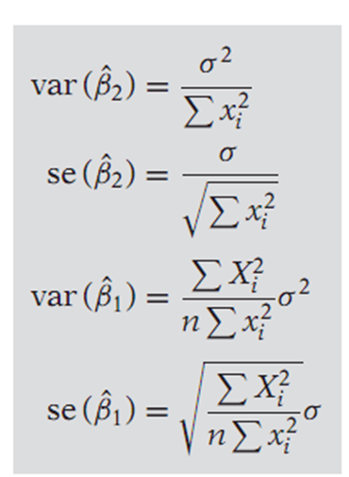

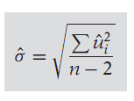


Some Formulas to Remember

Slide 14
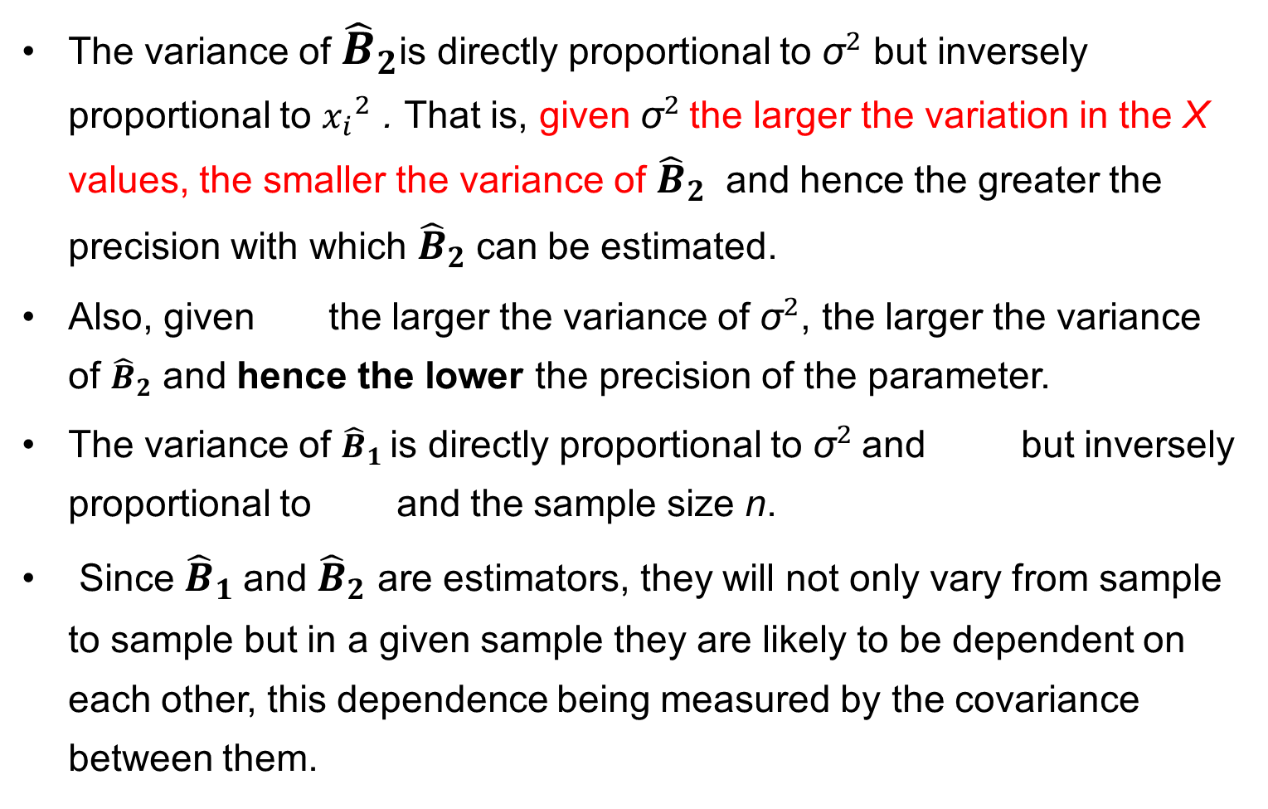
Features of the variances of ${\hat{B}}_{1}$ and ${\hat{B}}_{2}$
The variance of ${\hat{B}}_{2}$is directly proportional to ${\text{σ}}^{2}$ but inversely proportional to ${x_{i}}^{2}$ . That is, given ${\text{σ}}^{2}$the larger the variation in the X values, the smaller the variance of ${\hat{B}}_{2}$ and hence the greater the precision with which ${\hat{B}}_{2}$can be estimated.
Also, given the larger the variance of ${\text{σ}}^{2}$, the larger the variance of ${\hat{B}}_{2}$ and hence the lower the precision of the parameter.
The variance of ${\hat{B}}_{1}$is directly proportional to ${\text{σ}}^{2}$and but inversely proportional to and the sample size n.
Since ${\hat{B}}_{1}$and ${\hat{B}}_{2}$ are estimators, they will not only vary from sample to sample but in a given sample they are likely to be dependent on each other, this dependence being measured by the covariance between them.

Slide 16
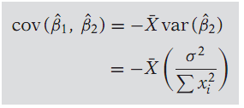
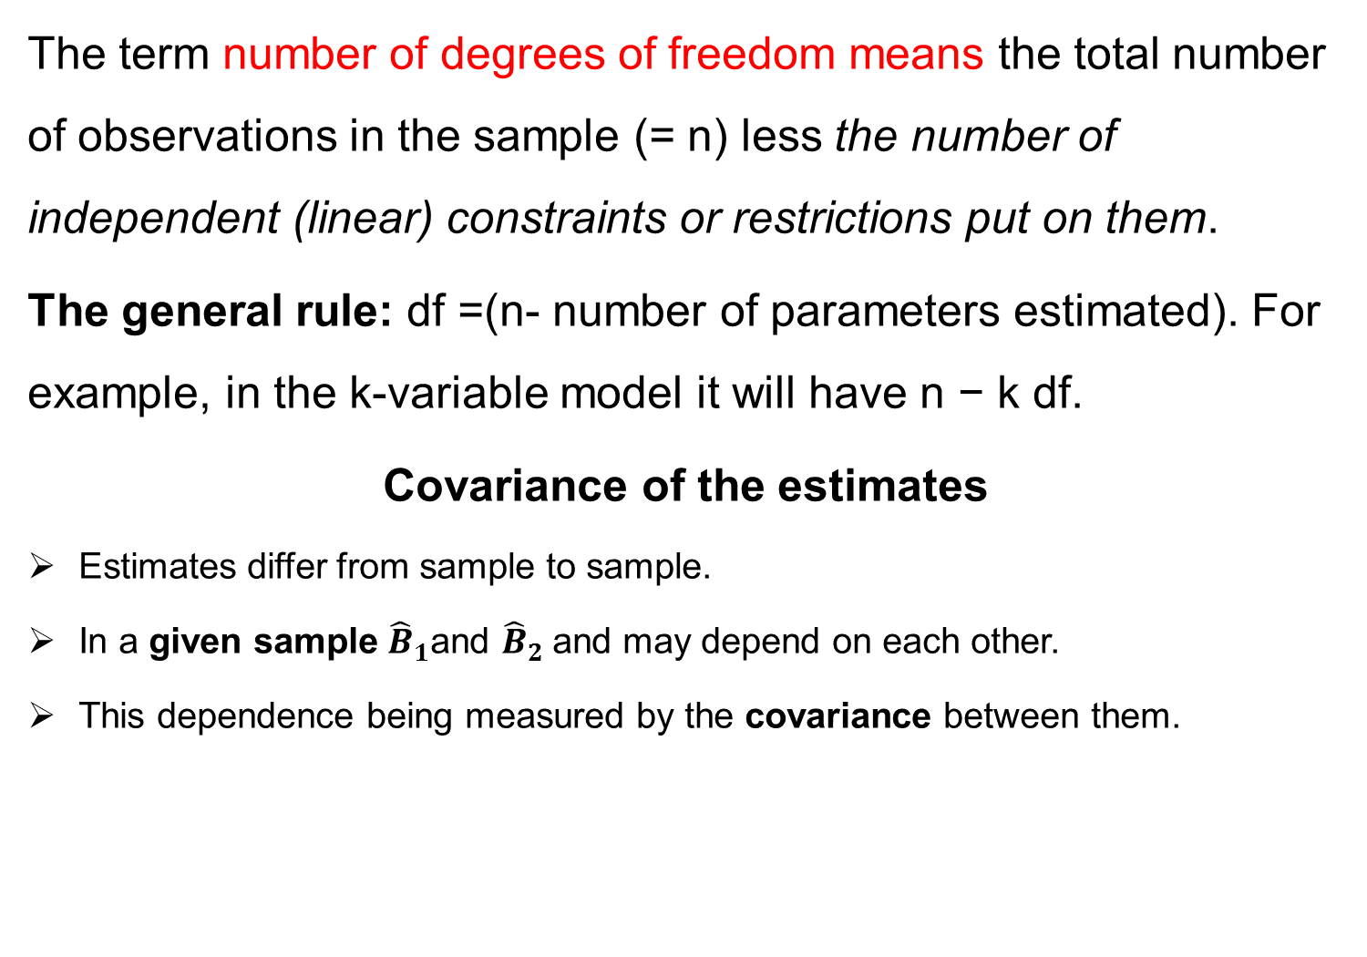
Degree of Freedom and Covariance of Estimates
The term number of degrees of freedom means the total number of observations in the sample (= n) less the number of independent (linear) constraints or restrictions put on them.
The general rule: df =(n- number of parameters estimated). For example, in the k-variable model it will have n − k df.
Covariance of the estimates
Estimates differ from sample to sample.
In a given sample ${\hat{B}}_{1}$and ${\hat{B}}_{2}$and may depend on each other.
This dependence being measured by the covariance between them.

Slide 18
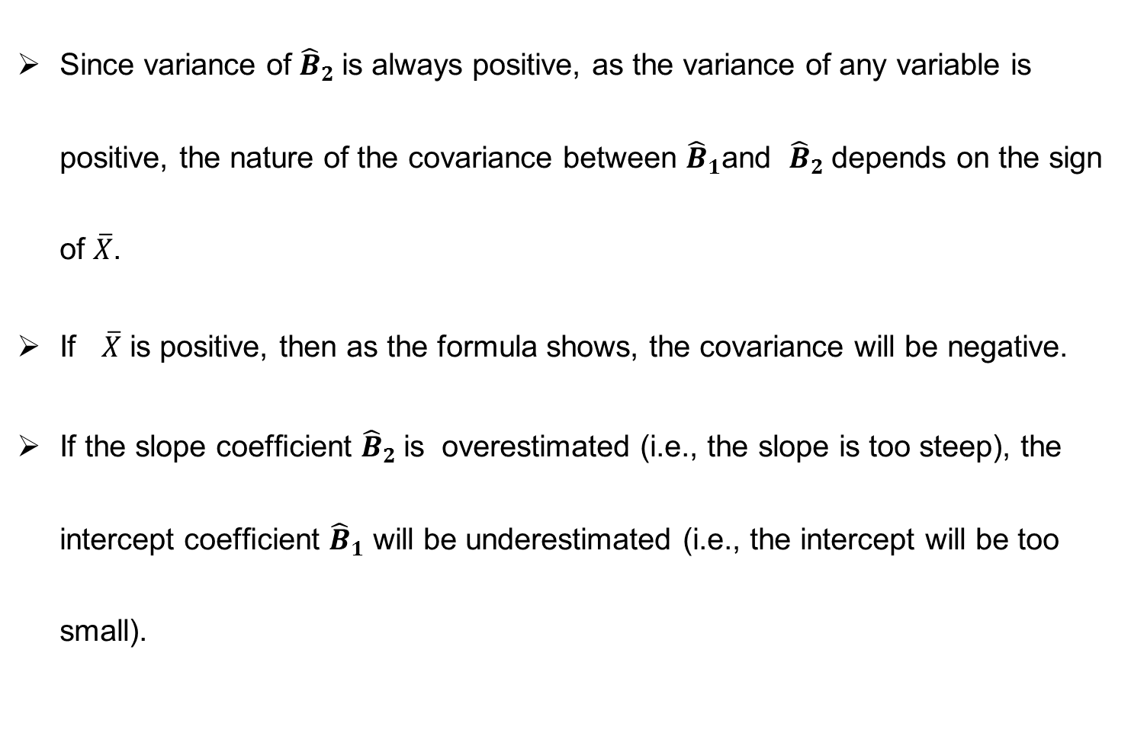
Covariance of estimates….
Since variance of${\hat{B}}_{2}$is always positive, as the variance of any variable is positive, the nature of the covariance between ${\hat{B}}_{1}$and ${\hat{B}}_{2}$depends on the sign of $\overline{X}$.
If $\overline{X}$ is positive, then as the formula shows, the covariance will be negative.
If the slope coefﬁcient ${\hat{B}}_{2}$is overestimated (i.e., the slope is too steep), the intercept coefﬁcient ${\hat{B}}_{1}$ will be underestimated (i.e., the intercept will be too small).

Slide 19
Summary
Assumptions of CLRM
Co variance
Standard Error or precision of estimates

