Slide 1
Lecture 7
Topics for today
Population Regression Function
Sample Regression Function
OLS estimators
Assumptions of CLRM and Derivation of OLS estimates

Slide 2
Population Regression Function(PRF)- the concept
E(Y/Xi)=f(Xi) …………………is called….PRF OR CEF
What form the f(Xi) assume- important question
E(Y/Xi)= B1+B2 Xi ------------------------------------------linear
B1 and B2 are unknown but fixed parameters known as regression coefficients.
B1 and B2 also known as intercept and slope coefficients.
Other names are Regression, Regression equation, Regression model used synonymously.
The purpose of the regression is to estimate the values of the parameters i.e. B1 and B2

Slide 4
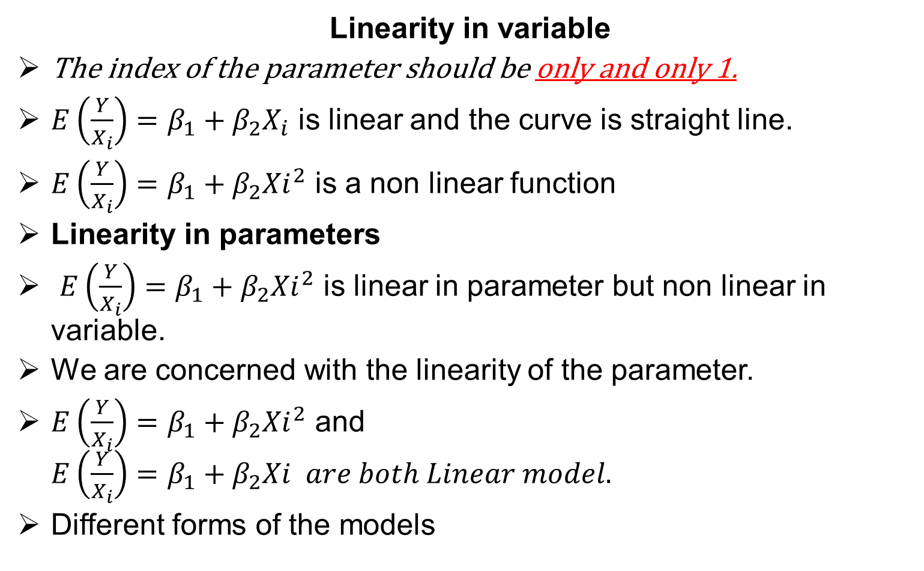
Linearity- what it is?
Linearity in variable
The index of the parameter should be only and only 1.
$E\left(\frac{Y}{X_{i}}\right)=β_{1}+β_{2}X_{i}$ is linear and the curve is straight line.
$E\left(\frac{Y}{X_{i}}\right)=β_{1}+β_{2}{Xi}_{}^{2}$ is a non linear function
Linearity in parameters
$E\left(\frac{Y}{X_{i}}\right)=β_{1}+β_{2}{Xi}_{}^{2}$ is linear in parameter but non linear in variable.
We are concerned with the linearity of the parameter.
$E\left(\frac{Y}{X_{i}}\right)=β_{1}+β_{2}{Xi}_{}^{2}$ and $E\left(\frac{Y}{X_{i}}\right)=β_{1}+β_{2}Xi are both Linear model.$
Different forms of the models

Slide 7



Stochastic Specification of PRF
Introduction of the random term into the model

Slide 8
Sample Regression Function
Task is to estimate PRF on the basis of SRF
Now only one value of Y against Xi
Can we accurately estimate the PRF from SRF.
Fluctuations in samples.
Sample regression lines are supposed to represent PRL.
N samples N regression line.
Which sample regression line is the best?
The best is that which is close to PRF: or sample parameters should be as closed to Population parameters as possible.

Slide 9
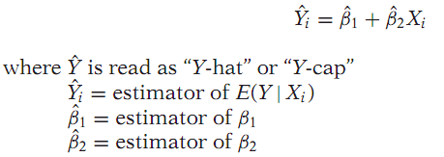

SAMPLE TERMINOLOGY
Now the PRF can be divided into two parts.
Where Ui is the residual term

Slide 10

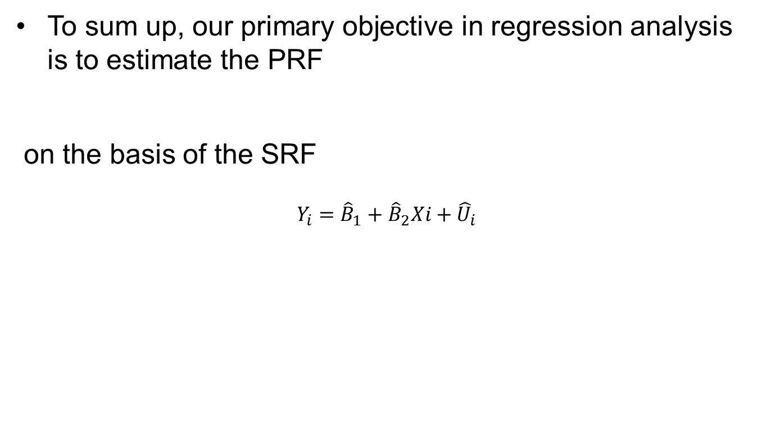
Final Forms of PRF AND SRF
To sum up, our primary objective in regression analysis is to estimate the PRF
on the basis of the SRF
$$Y_{i}={\hat{B}}_{1}+{\hat{B}}_{2}Xi+{\hat{U}}_{i}$$

Slide 11
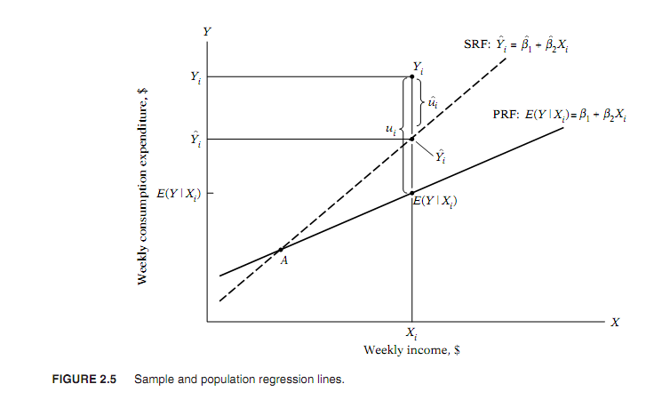

Slide 13
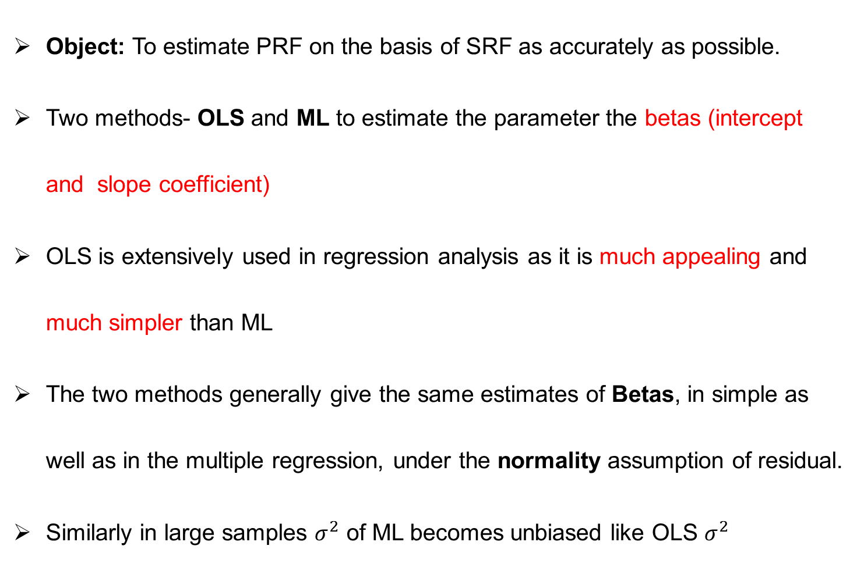
THE PROBLEM OF ESTIMATION
Object: To estimate PRF on the basis of SRF as accurately as possible.
Two methods- OLS and ML to estimate the parameter the betas (intercept and slope coefficient)
OLS is extensively used in regression analysis as it is much appealing and much simpler than ML
The two methods generally give the same estimates of Betas, in simple as well as in the multiple regression, under the normality assumption of residual.
Similarly in large samples $σ^{2}$ of ML becomes unbiased like OLS $σ^{2}$

Slide 14


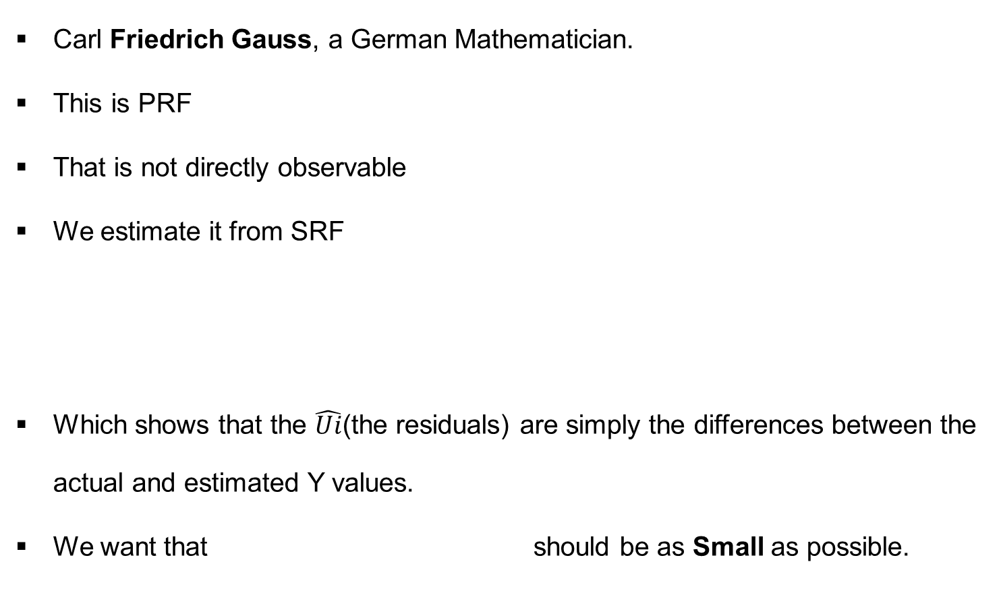
OLS
Carl Friedrich Gauss, a German Mathematician.
This is PRF
That is not directly observable
We estimate it from SRF
Which shows that the $\hat{Ui}$(the residuals) are simply the differences between the actual and estimated Y values.
We want that should be as Small as possible.

Slide 15
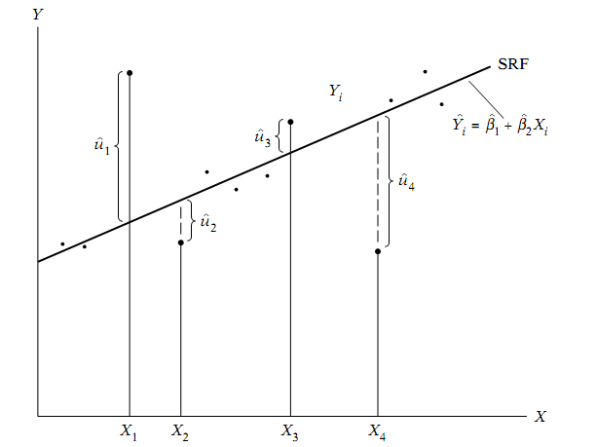
OLS…
If this criteria all the residual receive the same weightage.

