Slide 1
Lecture 6
WHAT WE ARE GOING TO COVER TODAY
Correlation
Causation
Regression

Slide 2
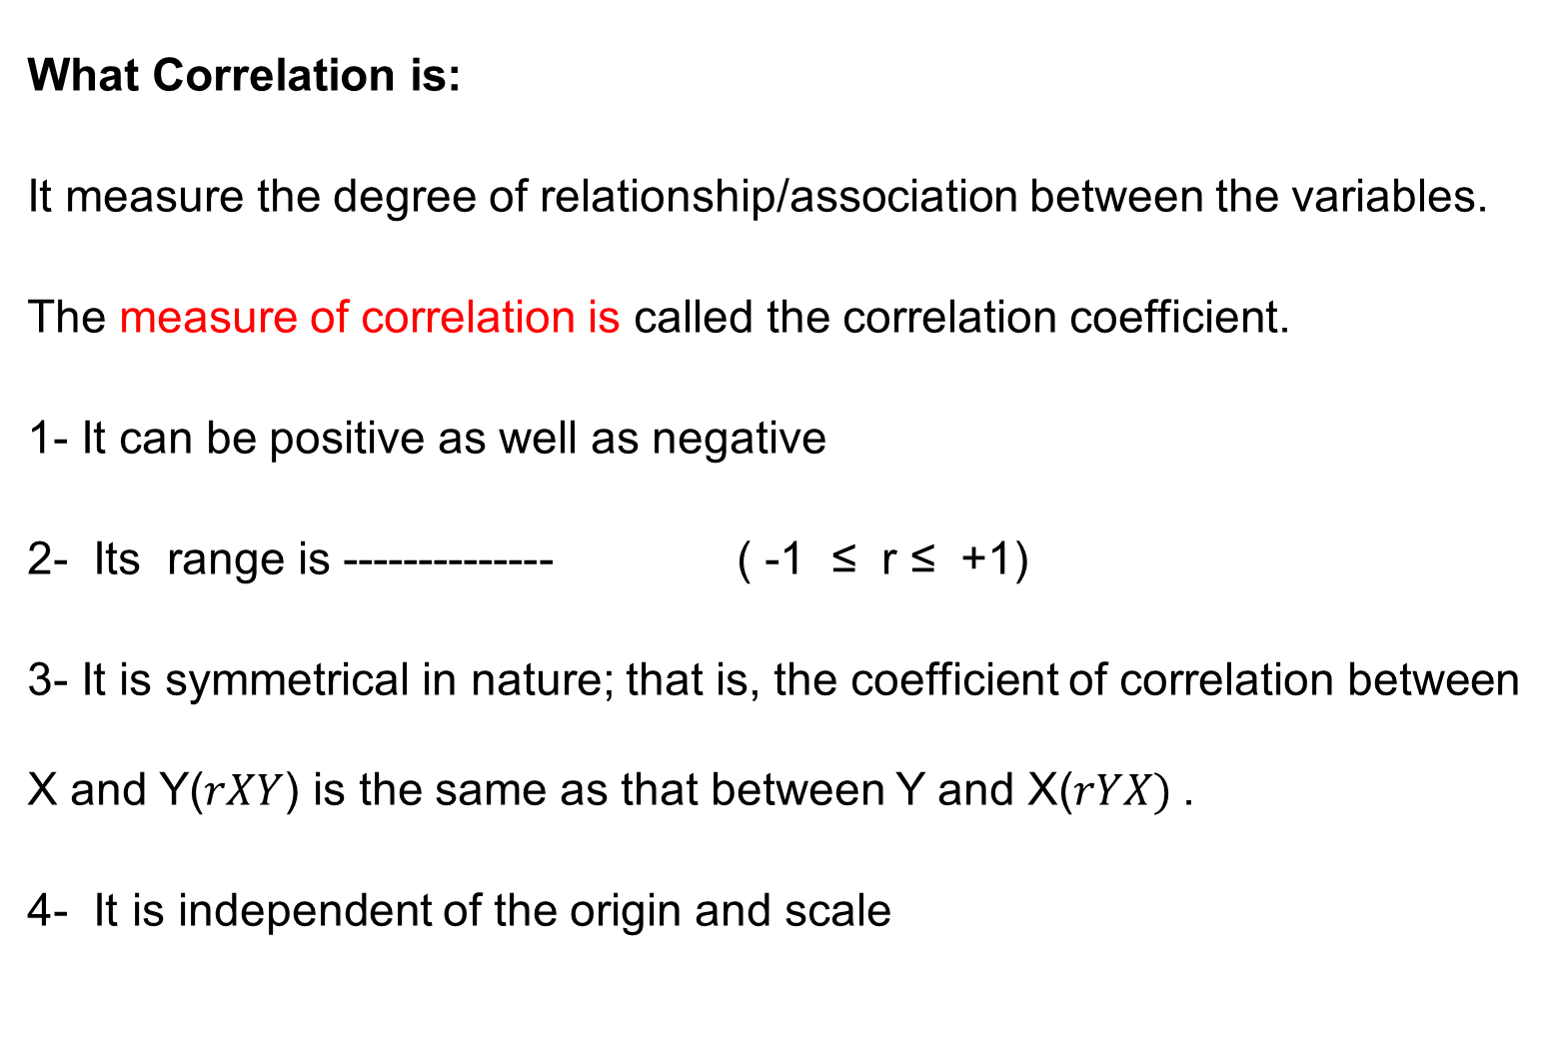
Correlation
What Correlation is:
It measure the degree of relationship/association between the variables.
The measure of correlation is called the correlation coefficient.
1- It can be positive as well as negative
2- Its range is -------------- ( -1 ≤ r ≤ +1)
3- It is symmetrical in nature; that is, the coefficient of correlation between X and Y($rXY$) is the same as that between Y and X($rYX)$.
4- It is independent of the origin and scale

Slide 5
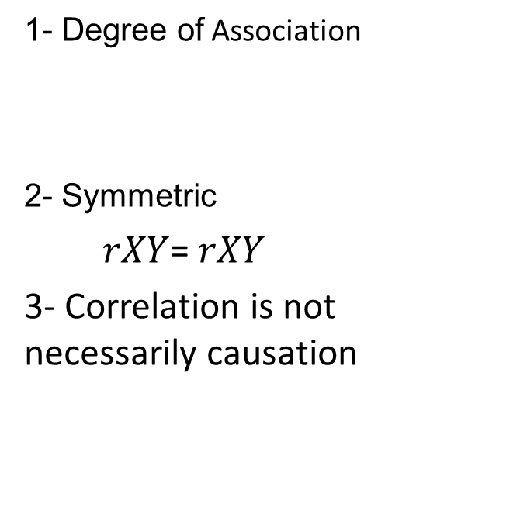
Causation versus correlating
Causation
Correlation
Cause and effect
Asymmetric
Y=f(x) is not equal to x=f(y)
3- Causation is necessarily correlation
1- Degree of Association
2- Symmetric
$rXY$= $rXY$
3- Correlation is not necessarily causation

Slide 6
Notation
Dependent variable Independent variable
Explained variable Explanatory variable
Predictand Predictor
Regressand Regressor
Response Stimulus
Endogenous Exogenous
Outcome Covariate
Controlled variable Control variable
LHS RHS

Slide 7
Regression
History- Francis Galton
Tall parents----------tall children
However average height of children less than parents
Short parents…….. Short children
However average height of children was greater than parents.
The average height of children tend to move or regress the average height of population as a whole. Galton law of universal Regression
Karl Pearson verified it by collecting data from 1000 people and called it regression to mediocrity

Slide 9
Modern concept
Regression analysis concerned with the study of dependence of one variable (dependent variable) on one or more variables (explanatory variables) with a view to estimate or predict the average/mean value of the DV in term of the given/fixed value of the known EV variable.
Example 1- sons height and fathers height
Example 2- height at different age level
Note that this line has a positive slope but the slope is less than 1, which is in conformity with Galton’s regression to mediocrity.

Slide 11
Statistical Versus Deterministic Relationship
Regression concerns with statistical relationship not functional or deterministic dependence of variables as in physics.
Example 1: Dependency of crop yield
Y= f ( temp, sunshine, rainfall, fertilizers,……….)
Measurement of error, many other variable, prediction is not 100% correct
Newton's law of gravity
F becomes random if the measurement error arises in k.

Slide 13
Statistical versus deterministic Relationship
Statistical
Functional or Deterministic
Concerned with variable dependency
Variables are random
Statistical dependency
Can not be predicted with accuracy
Example: Crop yield
Concerned with variable dependency
Variables are non random
Deterministic or functional dependency
Can be predicted accurately
Example: Newton's law

Slide 14
Regression versus causation
Although the regression analysis deal with dependency of one variable on other variables
It does not necessarily imply causation.
A statistical relationship, however strong can never establish causal connection.
There is no statistical reason to assume that rainfall does not depend on crop yield.
Our idea of causation must come from outside statistics ultimately from some theory or other information.
Key Point: a statistical relationship in itself cannot logically imply causation.

Slide 15
Simple or Bivariate Regression
Regression analysis is largely concerned with estimating and/or predicting the (population) mean value of the dependent variable on the basis of the known or ﬁxed values of the explanatory variable(s).
Example: EXPENDITURE-INCOME
Conditional Mean: E(Y/X)
Unconditional Mean: E(Y)
The population regression line is simply the locus of the conditional mean of the dependent variable for the fixed values of the explanatory variable.

Slide 17
Population Regression Function(PRF)
E(Y/Xi)=f(Xi)---------------------------------------A
The above equation is called conditional expectation function(CEF) or Population Regression Function PRF.
What form the f(Xi) assume- important question
E(Y/Xi)= B1+B2 Xi ---------------(B)
B1 and B2 are unknown but fixed parameters known as regression coefficients.
B1 and B2 also known as intercept and slope coefficients.
Other names are Regression, Regression equation, Regression model used synonymously.
The purpose of the regression is to estimate the values of the parameters i.e. unknown parameters B1 and B2

Slide 18
Summary
Correlation
Correlation and causation
Regression
Regression and causation

Slide 19
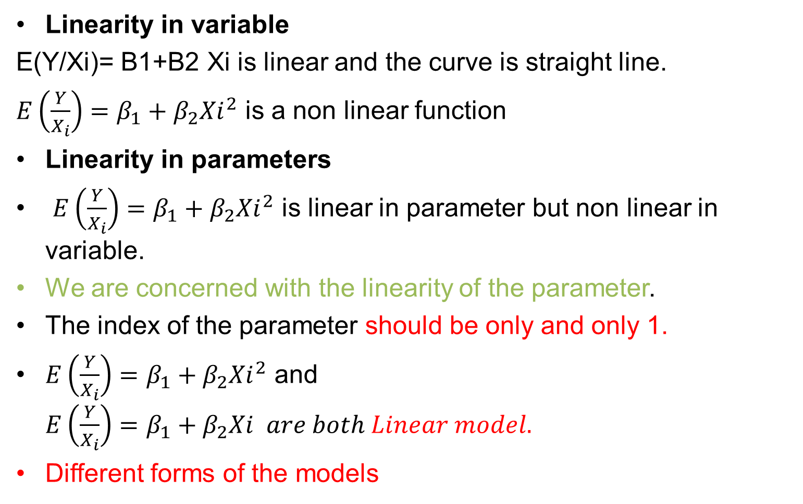
Linearity
Linearity in variable
E(Y/Xi)= B1+B2 Xi is linear and the curve is straight line.
$E\left(\frac{Y}{X_{i}}\right)=β_{1}+β_{2}{Xi}_{}^{2}$ is a non linear function
Linearity in parameters
$E\left(\frac{Y}{X_{i}}\right)=β_{1}+β_{2}{Xi}_{}^{2}$ is linear in parameter but non linear in variable.
We are concerned with the linearity of the parameter.
The index of the parameter should be only and only 1.
$E\left(\frac{Y}{X_{i}}\right)=β_{1}+β_{2}{Xi}_{}^{2}$ and $E\left(\frac{Y}{X_{i}}\right)=β_{1}+β_{2}Xi are both Linear model.$
Different forms of the models

Slide 20
