Slide 1
Lecture 5
Discussion for Today
Probability sampling
Non probability sampling
Questionnaire

Slide 2
Probability sampling-the types
1- Random Sampling or Simple Random Sampling
When each and every unit of the population has equal probability of being included in the sample example: a lottery system.
When to use Simple random sample
Have an accurate and easily accessible sampling frame that lists the entire population, preferably stored on a computer.
Not suitable for face-to-face data collection methods if the population covers a large geographical area.
Prefer this sampling whenever possible
It minimizes the biases.

Slide 4
2- Stratified Random Sampling
This is a form of random sampling in which units are divided into groups or categories (homogenous) that are mutually exclusive. These groups are called strata.
Within each stratum simple or systematic random is selected.
Grouping by age, sex
Advantages:
a- It provides more accurate impression of the population.
b- It is an improvement over random sampling when the population is more heterogeneous.
Disadvantages:
a- If not properly designed, overlapping, the accuracy of the results decreases.

Slide 6
3- Systematic sampling
A form of random sampling involving a system which means there is gap, interval or no sampling between each selected units
When to use systematic sampling
It is used when the population that we want to study is connected to an identified site, e.g.
Patients attending a clinic.
Houses that are ordered along a road
Customers who walk one by one through an entrance
Advantages:
Sufficiently random to obtain reliable estimates
Disadvantages:
It is not fully random because after the first step each unit is selected with a fixed interval.
It could be problematic if particular characteristics arise. For example every 10th house in the sector may be corner house.

Slide 8
4- Cluster/area Sampling
Clusters are formed by breaking down the area to be surveyed into smaller areas.
Then a few of smaller areas are selected randomly.
If the clusters is small all the respondents are interviewed otherwise
The units/respondents are selected randomly.
When to use:
It is used when the population is widely dispersed across the regions. For example universities, villages.
Advantages:
When no suitable sampling framework, this is the suitable method.
Time and money is saved to avoid travelling.
Do not need a complete frame of the population, need a complete list of clusters.
Disadvantages:
Cluster may contain similar units.
Stratum is homogeneous, cluster should be as heterogeneous as possible

Slide 10
Multistage cluster sampling
It is a combination of the methods of random sampling.
Population is divided into number of stages.
It guarantees the greatest representativity for the survey
It is also one of the most complex methods.
Simply speaking it is a series of samples taken at successive stages.
Normally used to overcome problems associated with a geographically dispersed population when face-to-face contact is needed.

Slide 12
Non-Probability Sampling
It is a process in which the personal judgment determines rather the statistical procedure which unit is to be selected. It is also called non. Random sampling.
1- Quota Sampling: In this techniques interviewer is asked to select a person with certain characteristics.
The purpose is to make sample more representative of the population.
Advantages:
An alternative when there is no suitable random framework
Lower cost as the survey is carried rapidly.
Disadvantages:
Identifying the unit is difficult.

Slide 13
2- Snow ball sampling:
Used when the population is hidden, for example sex workers and drug addictor.
First key informants are identified that help in reaching the respondents.
With the help of that respondents further are contacted.
The sample increases as it rolls down.
The process continues till the requirement.

Slide 15
Which techniques to use
No rule of thumb
Purpose of the researcher
Resource
Time
Nature of the study

Slide 16
SUMMARY

Slide 17
QUESTIONNAIRE
A QUESTIONNAIRE IS ONLY AS GOOD AS THE QUESTIONS IT ASKS

Slide 18
Questionnaire
What a Questionnaire is?
A series of written questions in a fixed, rational order to generate the statistical information from a specific Population needed to accomplish the research objectives.
Purposes of the Questionnaire
Ensures standardization and comparability of the data across interviews – everyone is asked the same questions
Allows the researcher to collect the relevant information necessary to address the management decision problem

Slide 19
Criteria to consider
Does it provide the necessary information?
Does it consider the respondent?
Does it meet editing, coding and data processing requirements?

Slide 20
Questionnaire Design
1- List variables
Focus Groups that include
key Informants
Theory or Conceptual Framework,
Expert opinion.
2- Borrow from other Instruments
Save development effort (reinventing the wheel)
Borrow reliability, validity
Facilitate comparison with previous studies
3. Solicit input from colleagues and friends

Slide 21
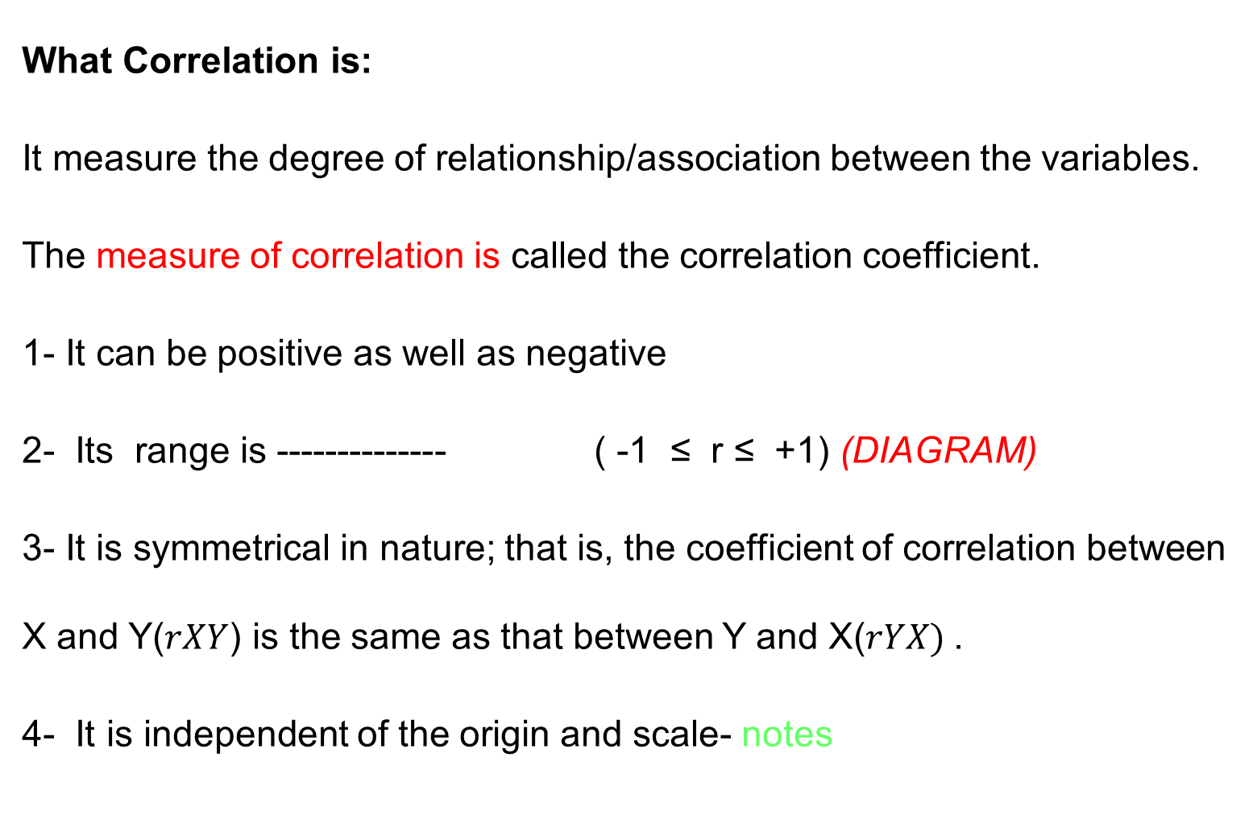
Correlation
What Correlation is:
It measure the degree of relationship/association between the variables.
The measure of correlation is called the correlation coefficient.
1- It can be positive as well as negative
2- Its range is -------------- ( -1 ≤ r ≤ +1) (DIAGRAM)
3- It is symmetrical in nature; that is, the coefficient of correlation between X and Y($rXY$) is the same as that between Y and X($rYX)$.
4- It is independent of the origin and scale- notes

Slide 22
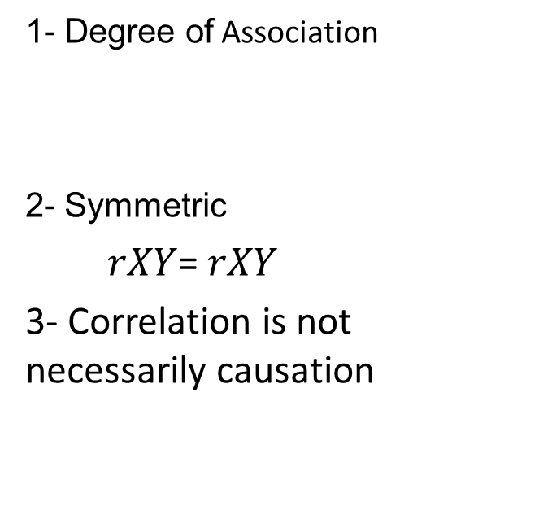
Causation versus correlating
Causation
Correlation
Cause and effect
Asymmetric
Y=f(x) is not equal to x=f(y)
3- Causation is necessarily correlation
1- Degree of Association
2- Symmetric
$rXY$= $rXY$
3- Correlation is not necessarily causation

Slide 23
Notation
Dependent variable Independent variable
Explained variable Explanatory variable
Predictand Predictor
Regressand Regressor
Response Stimulus
Endogenous Exogenous
Outcome Covariate
Controlled variable Control variable
LHS RHS

Slide 24
Regression
History- Francis Galton
Tall parents----------tall children
However average height of children less than parents
Short parents…….. Short children
However average height of children was greater than parents.
The average height of children tend to move or regress the average height of population as a whole. Galton law of universal Regression
Karl Pearson verified it by collecting data from 1000 people and called it regression to mediocrity

Slide 25
Modern concept
Regression analysis concerned with the study of dependence of one variable (dependent variable) on one or more variables (explanatory variables) with a view to estimate or predict the average/mean value of the DV in term of the given/fixed value of the known EV variable.
Example 1- sons height and fathers height
Example 2- height at different age level
Note that this line has a positive slope but the slope is less than 1, which is in conformity with Galton’s regression to mediocrity.

Slide 26
Statistical Versus Deterministic Relationship
Regression concerns with statistical relationship not functional or deterministic dependence of variables as in physics.
Example 1: Dependency of crop yield
Y= f ( temp, sunshine, rainfall, fertilizers,……….)
Measurement of error, many other variable, prediction is not 100% correct
Newton's law of gravity
F becomes random if the measurement error arises in k.

Slide 27
Statistical versus deterministic Relationship
Statistical
Functional or Deterministic
Concerned with variable dependency
Variables are random
Statistical dependency
Can not be predicted with accuracy
Example: Crop yield
Concerned with variable dependency
Variables are non random
Deterministic or functional dependency
Can be predicted accurately
Example: Newton's law

Slide 28
Regression versus causation
Although the regression analysis deal with dependency of one variable on other variables
It does not necessarily imply causation.
A statistical relationship, however strong can never establish causal connection.
There is no statistical reason to assume that rainfall does not depend on crop yield.
Our idea of causation must come from outside statistics ultimately from some theory or other information.
Key Point: a statistical relationship in itself cannot logically imply causation.

Slide 29
Simple or Bivariate Regression
Regression analysis is largely concerned with estimating and/or predicting the (population) mean value of the dependent variable on the basis of the known or ﬁxed values of the explanatory variable(s).
Example: EXPENDITURE-INCOME
Conditional Mean: E(Y/X)
Unconditional Mean: E(Y)
The population regression line is simply the locus of the conditional mean of the dependent variable for the fixed values of the explanatory variable.

Slide 30
Population Regression Function(PRF)
E(Y/Xi)=f(Xi)---------------------------------------A
The above equation is called conditional expectation function(CEF) or Population Regression Function PRF.
What form the f(Xi) assume- important question
E(Y/Xi)= B1+B2 Xi ---------------(B)
B1 and B2 are unknown but fixed parameters known as regression coefficients.
B1 and B2 also known as intercept and slope coefficients.
Other names are Regression, Regression equation, Regression model used synonymously.
The purpose of the regression is to estimate the values of the parameters i.e. unknown parameters B1 and B2

Slide 31
Summary
Correlation
Correlation and causation
Regression
Regression and causation

