Slide 1
Lecture 32
Summary of previous lecture
PANEL DATA
SIMULTANEOUS EQUATION MODELS

Slide 2
Topics for today
JARQUE BERA TEST
F-TEST
PARTIAL CORRELATIONS
A JOURNEY THROUGH THE COURSE

Slide 3

Jarque Berra (JB)test- A test of normality
The JB test of normality is an asymptotic, or large-sample, test.
It is based on the OLS residuals.
This test ﬁrst computes the Skewness and kurtosis measures of the OLS residuals and uses the following test statistic.
Where n = sample size, S = skewness coefﬁcient, and K = kurtosis coefﬁcient.
For a normally distributed variable, S= 0 and K = 3.
Therefore, the JB test of normality is a test of the joint hypothesis that S and K are 0 and 3,respectively.
Under the null hypothesis that the residuals are normally distributed, Jarque and Bera showed that asymptotically the JB statistic follows the chi-square distribution with 2 df.
If the computed p value of the JB statistic is sufﬁciently low, we reject the hypothesis that the residuals are normally distributed and vice versa.

Slide 4
Example JB- test
Suppose the value of the JB is 0.7769.
The p value of obtaining such a value from the chi-square distribution with 2 df is about 0.68, which is quite high.
In other words, we may not reject the normality assumption.
Of course, bear in mind the warning about the sample size.

Slide 5
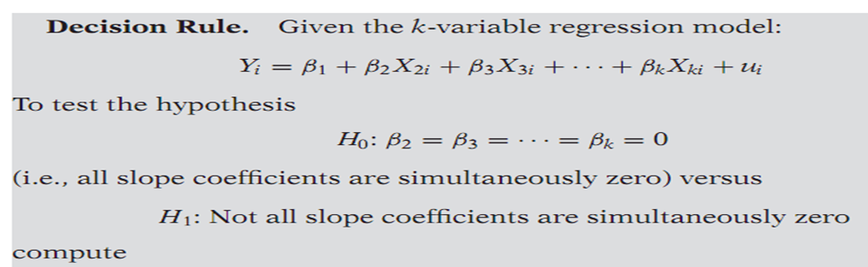
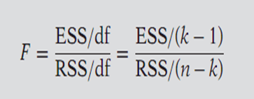
F-test-Testing the Overall Signiﬁcance of a Multiple Regression
For certain reasons we cannot use the usual t test to test the joint hypothesis.
However, this joint hypothesis can be tested by the F-test which can be demonstrated as follows.

Slide 6
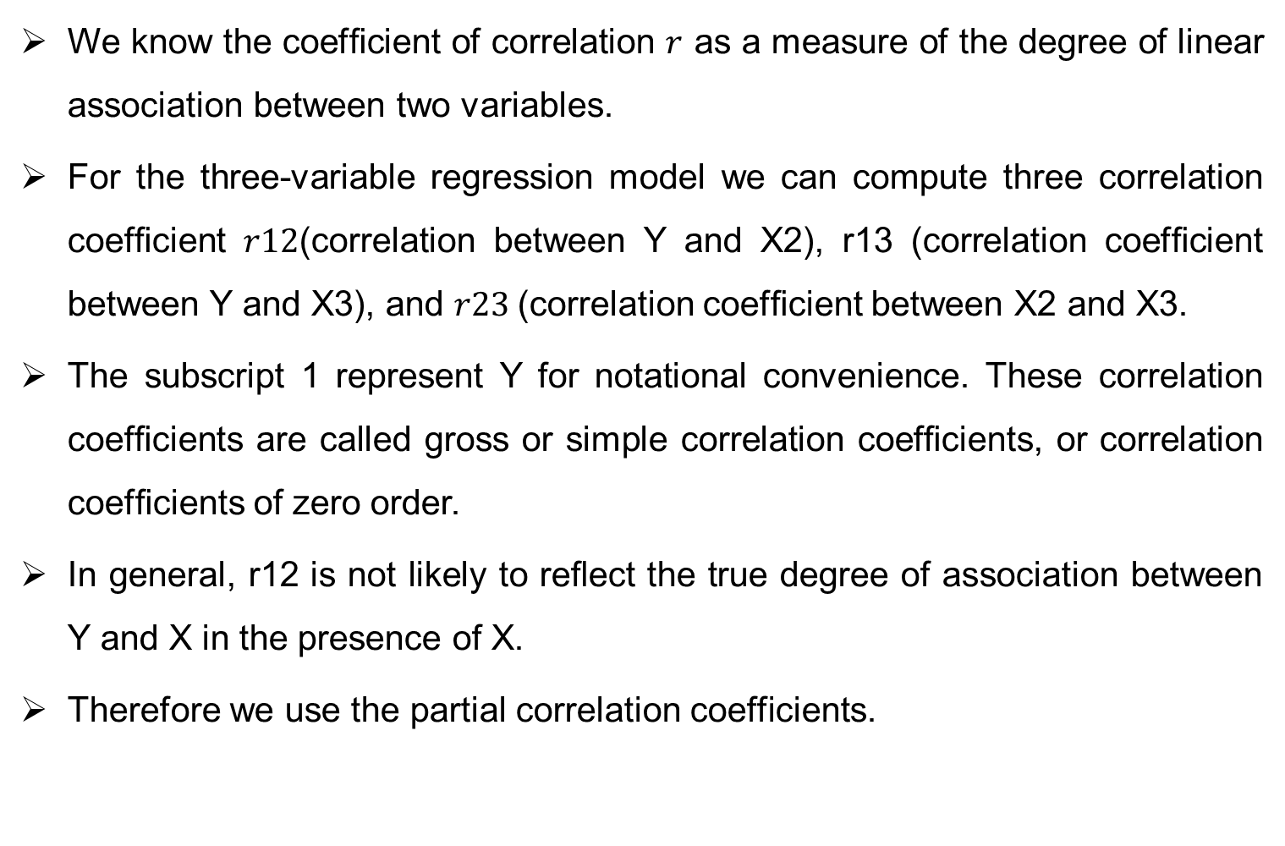
Partial Correlation
We know the coefﬁcient of correlation $r$as a measure of the degree of linear association between two variables.
For the three-variable regression model we can compute three correlation coefﬁcient $r12$(correlation between Y and X2), r13 (correlation coefﬁcient between Y and X3), and $r23$(correlation coefﬁcient between X2 and X3.
The subscript 1 represent Y for notational convenience. These correlation coefﬁcients are called gross or simple correlation coefﬁcients, or correlation coefﬁcients of zero order.
In general, r12 is not likely to reﬂect the true degree of association between Y and X in the presence of X.
Therefore we use the partial correlation coefficients.

Slide 7
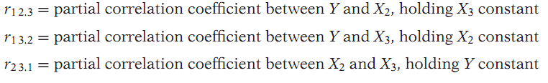
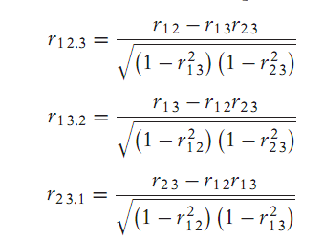
Partial coefficients…

Slide 8
A journey through the course
Quantitative Technique:
            How the Quantitative Techniques
            Data
            Sampling
            Population
            Sampling
            Probability
            Non probability
            Derivatives
  Regression:
            Correlation
            Assumptions
            OLS Estimators
            BLUE
            Coefficient of determination
            Problems
            Standardize variables
            Eviews

Slide 9
A journey through the course …
Hypothesis Testing
Dummy Variables:
              ANOVA Models
              ANCOVA Models
              Dummy Variable Trap
Qualitative Response Models:
              LPM
              LOGIT
              PROBIT
              Ordinal Logit and Probit
              Multinomial Logit and Probit
              Panel data
              Simultaneous equation models

Slide 10
THANK YOU
THANK YOU

