Slide 1
Lecture 31
Summary of previous lecture
PANEL DATA

Slide 2
Topics for today
PANEL DATA
FEM & REM

Slide 3
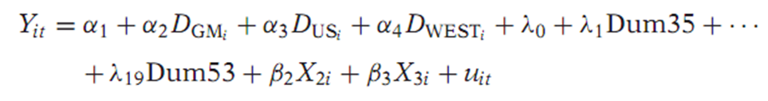
FEM
3- Slope coefﬁcients constant but the intercept varies over individuals as well as time.
To consider this possibility consider the following model.
Suppose when we run this regression, we ﬁnd the company dummies as well as the coefﬁcients of the X are individually statistically signiﬁcant.
And interestingly none of the time dummies is significant.
The overall conclusion that emerges is that perhaps there is pronounced
individual company effect but no time effect.
In other words, the investment functions for the four companies are the same except for their intercepts.

Slide 4

FEM…
4- All Coefﬁcients vary across Individuals
Here we assume that the intercepts and the slope coefﬁcients are different for all individual, or cross-section, units.
This is to say that the investment functions of GE, GM, US, and WEST are all different.
We can easily extend our LSDV model to take care of this situation.
In the model we have introduce the interactive dummies. The γ’s are the differential slope coefﬁcients.
If one or more of the γ’s coefﬁcients statistically signiﬁcant, it will tell us that one or more slope coefﬁcients are different from the base group.
If all the differential intercept and all the differential slope coefﬁcients are statistically signiﬁcant then
The conclusion is that the investment functions of General Motors, United States Steel, and Westinghouse are different from that of General Electric.

Slide 5
A Caution on the Use of the Fixed Effects, or LSDV, Model.
Although easy to use, the LSDV model has some problems.
1- If we introduce too many dummy variables, we will run up against the degrees of freedom problem.
2- With so many variables in the model, there is always the possibility of Multicollinearity which might make precise estimation of one or more parameters difﬁcult.
3- We can also include variables such as sex, color, and ethnicity, which are time invariant too because an individual’s sex color, or ethnicity does not change over time.
Hence, the LSDV approach may not be able to identify the impact of such time-invariant variables.
4- We have to think carefully about the error term u as our discussion so far are based on the assumption that the error term follows the classical assumptions, namely, uit∼ N(0, σ2).
Since the i index refers to cross-sectional observations and t to time series observations, the classical assumption for uit may have to be modiﬁed.

Slide 6
There are several possibilities
1. We can assume that the error variance is the same for all cross section units or we can assume that the error variance is Heteroscedastic.
2. For each individual we can assume that there is no autocorrelation over time. Thus, for example, we can assume that the error term of the investment function for General Motors is non-autocorrelated.
3- For a given time, it is possible that the error term for General Motors
is correlated with the error term for, say, U.S. Steel or both U.S. Steel and Westinghouse. Or, we could assume that there is no such correlation.
4. We can think of other permutations and combinations of the error term.
Allowing for one or more of these possibilities will make the analysis that much more complicated. The problems may be alleviated- REM

Slide 7

Estimation of panel data regression models
The Random Effects Model (REM)
Although straightforward to apply, ﬁxed effects, or LSDV, modeling can be expensive in terms of degrees of freedom if we have several cross-sectional units.
If the dummy variables do in fact represent a lack of knowledge about the (true) model, why not express this ignorance through the disturbance term uit
This is precisely the approach suggested by the proponents of the so called error components model (ECM) or Random effects model (REM).

Slide 8

REM
Instead of treating β1i as ﬁxed, we assume that it is a random variable with a mean value of β.
And the intercept value for an individual company can be expressed as
Where εi is a random error term with a mean value of zero and variance of σ2ε.
This mean that the four ﬁrms included in our sample are a drawing from a much larger universe of such companies and that they have a common mean value for the intercept ( = β)
The individual differences in the intercept values of each company are reﬂected in the error term εt

Slide 9


REM
The composite error term wit, consists of two components, εi which is the cross-section, or individual-speciﬁc, error component, and uit, which is the combined time series and cross-section error component.
Notice carefully the difference between FEM and ECM. In FEM each cross-sectional unit has its own (ﬁxed) intercept value, in all N such values
for N cross-sectional units.
In REM, on the other hand, the intercept β1 represents the mean value of all the (cross-sectional) intercepts and the error component ε represents the (random) deviation of individual intercept from this mean value.
However, keep in mind that εi is not directly observable; it is what is known as an unobservable, or latent, variable.

Slide 10
FIXED EFFECTS (LSDV) VERSUS RANDOM EFFECTS MODEL
Which model is better, FEM or ECM?
The answer to this question hinges around the assumption one makes about the likely correlation between the individual, or cross-section speciﬁc, error component εi and the X regressors.
If it is assumed that εi and the X’s are uncorrelated, ECM may be appropriate, whereas if εi and the X’s are correlated, FEM may be appropriate.
Keeping this fundamental difference in the two approaches in mind, what more can we say about the choice between FEM and ECM?

Slide 11
FEM Vs. REM
If T (the number of time series data) is large and N (the number cross-sectional units) is small, there is likely to be little difference in the values the parameters estimated by FEM and ECM.
Hence the choice here is based computational convenience. On this score, FEM may be preferable.
When N is large and T is small, the estimates obtained by the two methods can differ signiﬁcantly.
If the individual error component correlated, then the ECM estimators are biased, whereas those obtained from FEM are unbiased.
If N is large and T is small, and if the assumptions underlying ECM hold, ECM estimators are more efﬁcient than FEM estimators.

Slide 12
FEM Vs. REM
Is there a formal test that will help us to choose between FEM and ECM?
Yes, Hausman test can serve this job.
The null hypothesis underlying the Hausman test is that the FEM and ECM estimators do not differ substantially.
The test statistic developed by Hausman has an asymptotic χ2 distribution.
If the null hypothesis is rejected, the conclusion is that ECM is not appropriate and that we may be better off using FEM, in which case statistical inferences will be conditional on the ε in the sample.
Although an improvement over cross-section data, panel data do not provide a cure-all for all of an estimation problems.

Slide 13
Simultaneous Regression Models
By now we were concerned exclusively with single equation models.
The cause-and-effect relationship, if any, in such models therefore ran from the X’s to the Y.
But in many situations, such a one-way or unidirectional cause-and-effect relationship is not meaningful.
This occurs if Y is determined by the X’s, and some of the X’s are, in turn, determined by Y.
In short, there is a two way, or simultaneous, relationship between Y and (some of) the X’s, which makes the distinction between dependent and explanatory variables of dubious value.
In simultaneous models there is more than one equation—one for each of the mutually, or jointly, dependent or endogenous variables.

Slide 14
Simultaneous Regression Models
What happens if the parameters of each equation are estimated by applying, say, the method of OLS, disregarding other equations in the system?
One of the crucial assumptions of the method of OLS is that the Explanatory X variables are nonstochastic.
If this conditions is not met, then, the least-squares estimators are not only biased but also inconsistent
That is, as the sample size increases indeﬁnitely, the estimators do not converge to their true value.

Slide 15
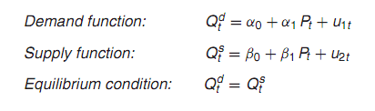
Simultaneous regression model
Now it is not too difﬁcult to see that P and Q are jointly dependent variables.
A shift in the demand curve changes both P and Q.
Therefore, a regression of Q on P would violate an important assumption of the classical linear regression model, namely, the assumption of no correlation between the explanatory variable(s) and the disturbance term.

Slide 16

Jarque Berra (JB)test- A test of normality
The JB test of normality is an asymptotic, or large-sample, test.
It is based on the OLS residuals.
This test ﬁrst computes the Skewness and kurtosis measures of the OLS residuals and uses the following test statistic.
Where n = sample size, S = skewness coefﬁcient, and K = kurtosis coefﬁcient.
For a normally distributed variable, S= 0 and K = 3.
Therefore, the JB test of normality is a test of the joint hypothesis that S and K are 0 and 3,respectively.
Under the null hypothesis that the residuals are normally distributed, Jarque and Bera showed that asymptotically the JB statistic follows the chi-square distribution with 2 df.
If the computed p value of the JB statistic is sufﬁciently low, we reject the hypothesis that the residuals are normally distributed and vice versa.

Slide 17
Example JB- test
Suppose the value of the JB is 0.7769.
The p value of obtaining such a value from the chi-square distribution with 2 df is about 0.68, which is quite high.
In other words, we may not reject the normality assumption.
Of course, bear in mind the warning about the sample size.

Slide 18
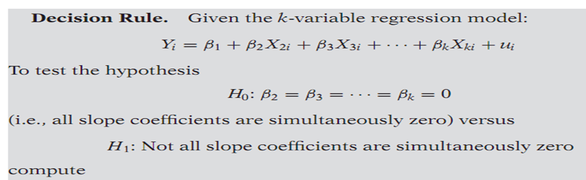
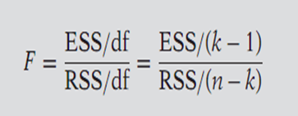
F-test-Testing the Overall Signiﬁcance of a Multiple Regression
For certain reasons we cannot use the usual t test to test the joint hypothesis.
However, this joint hypothesis can be tested by the F-test which can be demonstrated as follows.

Slide 19
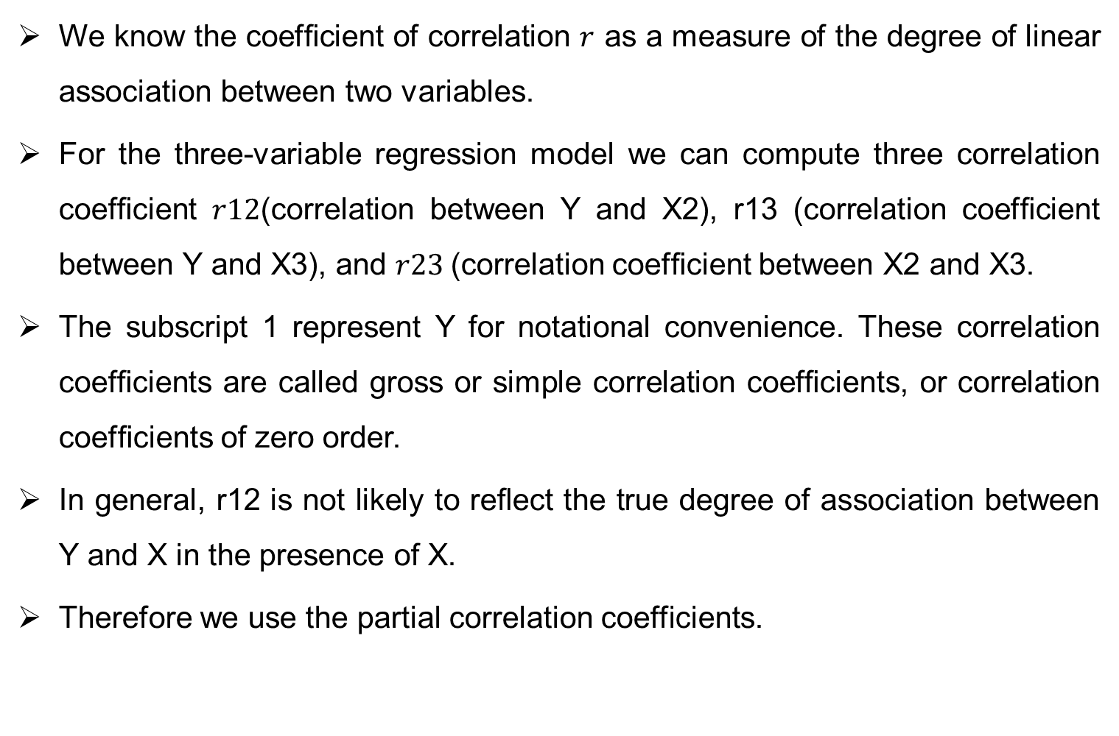
Partial Correlation
We knowthe coefﬁcient of correlation $r$as a measure of the degree of linear association between two variables.
For the three-variable regression model we can compute three correlation coefﬁcient $r12$(correlation between Y and X2), r13 (correlation coefﬁcient between Y and X3), and $r23$(correlation coefﬁcient between X2 and X3.
The subscript 1 represent Y for notational convenience. These correlation coefﬁcients are called gross or simple correlation coefﬁcients, or correlation coefﬁcients of zero order.
In general, r12 is not likely to reﬂect the true degree of association between Y and X in the presence of X.
Therefore we use the partial correlation coefficients.

Slide 20
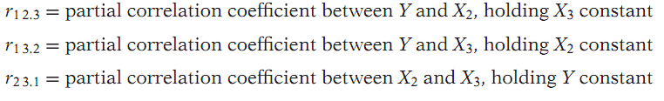
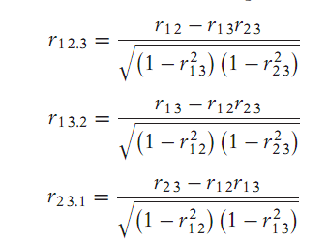
Partial coefficients…

Slide 21
A journey through the course
Quantitative Technique:
            Sampling
            Population
            Sampling
            Probability
            Non probability
            Derivatives
  Regression:
            Assumptions
            Estimators
            BLUE
            Coefficient of determination
            Problems

Slide 22
A journey through the course …
Dummy Variables:
              ANOVA Models
              ANCOVA Models
              Dummy Variable Trap
Qualitative Response Models:
              LPM
              LOGIT
              PROBIT
              Ordinal Logit and Probit
              Multinomial Logit and Probit
              Panel data
              Simultaneous equation models

