Slide 1
LECTURE 30
PREVEVIOUS SUMMARY
PANEL DATA

Slide 2
FOOD FOR TODY
PANEL DATA ………..
FEM
REM

Slide 3
FEM…
How do we actually allow for the (ﬁxed effect) intercept to vary between companies?
Dummy variable technique- the differential intercept dummies.
Where D2i= 1 if the observation belongs to GM, 0 otherwise; D3i= 1 if the observation belongs to US, 0 otherwise; and D4i= 1 if the observation belongs to WEST, 0 otherwise.
Since we have four company's, we have used 3 dummies to avoid dummy variable trap.
Here there is no dummy for GE.
The differential intercept coefﬁcients, tell by how much the intercepts of GM, US, and WEST differ from the intercept of GE.
In short, GE becomes the comparison company.
Of course, researcher is free to choose any company as the comparison company.

Slide 4
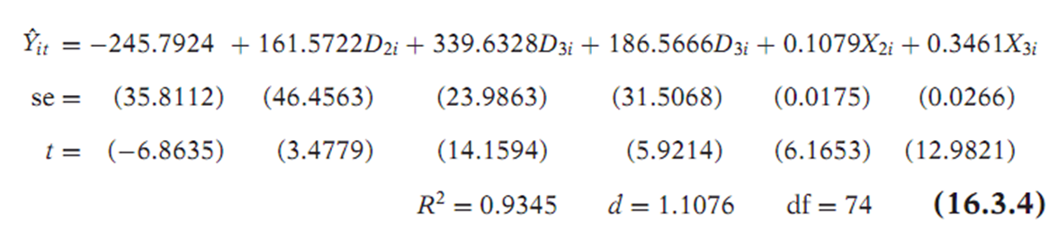
Example- LSDV
All the estimated coefﬁcients are individually highly signiﬁcant, as the p values of the estimated t coefﬁcients are extremely small.
The intercept values of the four companies are statistically different.
Values are −245.7924 for GE, −84.220 (=−245.7924 + 161.5722) for GM, 93.8774 (=−245.7924 + 339.6328) for US, and −59.2258 ( =−245.7924 + 186.5666) for WEST.
Which model is better?
See the statistical signiﬁcance of the estimated coefﬁcients.
Durbin–Watson d value is much higher, suggesting that previous model was misspeciﬁed.
The increased R2 value, however, should not be surprising as we have more variables in model.

Slide 5

FEM
A formal test for the comparisons of the two models. In relation to latter model former model is a restricted model in that it imposes a common intercept on all the companies.
Therefore, we can use the restricted F test.
The present instance the F value is:
Clearly, the F value of 66.9980 (for 3 numerator df and 74 denominator df) is highly signiﬁcant and, therefore, the restricted regression seems invalid.

Slide 6
FEM…
2- Time effect:
Dummies can be used for time effect in the sense that the function shifts over time because of factors such as technological changes, changes in government regulatory and/or tax policies.
Such time effects can be easily accounted for if we introduce time dummies, one for each year.
Since we have data for 20 years, from 1935 to 1954, we can introduce 19 time dummies.
Where Dum35 takes a value of 1 for observation in year 1935 and 0 other-
wise, etc.
We are treating the year 1954 as the base year, whose intercept value is given by λ0

Slide 7
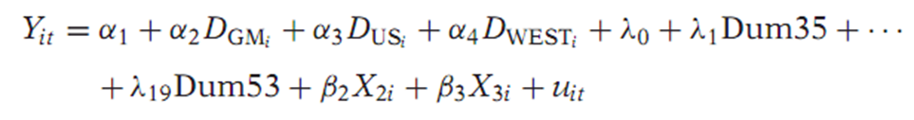
FEM
3- Slope coefﬁcients constant but the intercept varies over individuals as well as time.
To consider this possibility consider the following model.
When we run this regression, we ﬁnd the company dummies as well as the coefﬁcients of the X are individually statistically signiﬁcant.
Interestingly none of the time dummies is significant.
The overall conclusion that emerges is that perhaps there is pronounced
individual company effect but no time effect.
In other words, the investment functions for the four companies are the same except for their intercepts.

Slide 8

FEM…
4- All Coefﬁcients Vary across Individuals
Here we assume that the intercepts and the slope coefﬁcients are different for all individual, or cross-section, units.
This is to say that the investment functions of GE, GM, US, and WEST are all different.
We can easily extend our LSDV model to take care of this situation.
In the model we have introduce the interactive dummies. The γ’s are the differential slope coefﬁcients.
If one or more of the γ’s coefﬁcients statistically signiﬁcant, it will tell us that one or more slope coefﬁcients are different from the base group.
If all the differential intercept and all the differential slope coefﬁcients are statistically signiﬁcant then
The conclusion is that the investment functions of General Motors, United States Steel, and Westinghouse are different from that of General Electric.

Slide 9
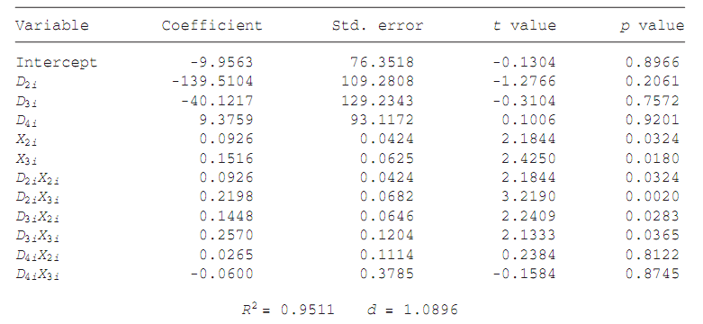

Slide 10
A Caution on the Use of the Fixed Effects, or LSDV, Model.
Although easy to use, the LSDV model has some problems.
1- If we introduce too many dummy variables, we will run up against the degrees of freedom problem.
2- With so many variables in the model, there is always the possibility of Multicollinearity which might make precise estimation of one or more parameters difﬁcult.
3- We can also include variables such as sex, color, and ethnicity, which are time invariant too because an individual’s sex color, or ethnicity does not change over time.
Hence, the LSDV approach may not be able to identify the impact of such time-invariant variables.
4- We have to think carefully about the error term u
We have presented so far are based on the assumption that the error term follows the classical assumptions, namely, uit∼ N(0, σ2).
Since the i index refers to cross-sectional observations and t to time series observations, the classical assumption for uit may have to be modiﬁed.

Slide 11
There are several possibilities
1. We can assume that the error variance is the same for all cross section units or we can assume that the error variance is Heteroscedasticit.
2. For each individual we can assume that there is no autocorrelation over time. Thus, for example, we can assume that the error term of the investment function for General Motors is non-autocorrelated.
3- For a given time, it is possible that the error term for General Motors
is correlated with the error term for, say, U.S. Steel or both U.S. Steel and Westinghouse. Or, we could assume that there is no such correlation.
4. We can think of other permutations and combinations of the error term.
Allowing for one or more of these possibilities will make the analysis that much more complicated. The problems may be alleviated- REM

Slide 12

Estimation of panel data regression models
The Random Effects Model (REM)
Although straightforward to apply, ﬁxed effects, or LSDV, modeling can be expensive in terms of degrees of freedom if we have several cross-sectional units.
If the dummy variables do in fact represent a lack of knowledge about the (true) model, why not express this ignorance through the disturbance term uit
This is precisely the approach suggested by the proponents of the so called error components model (ECM) or Random effects model (REM).

Slide 13

REM
Instead of treating β1i as ﬁxed, we assume that it is a random variable with a mean value of β.
And the intercept value for an individual company can be expressed as
Where εi is a random error term with a mean value of zero and variance of σ2ε.
What we are essentially saying is that the four ﬁrms included in our sample are a drawing from a much larger universe of such companies and that they have a common mean value for the intercept ( = β)
The individual differences in the intercept values of each company are reﬂected in the error term ε

Slide 14


REM
The composite error term wit, consists of two components, εi which is the cross-section, or individual-speciﬁc, error component, and uit, which is the combined time series and cross-section error component.
Notice carefully the difference between FEM and ECM. In FEM each cross-sectional unit has its own (ﬁxed) intercept value, in all N such values
for N cross-sectional units.
In REM, on the other hand, the intercept β1 represents the mean value of all the (cross-sectional) intercepts and the error component ε represents the (random) deviation of individual intercept from this mean value.
However, keep in mind that εi is not directly observable; it is what is known as an unobservable, or latent, variable.

