Slide 1
Lecture 3
What we are going to cover today?
Data
Data types
How to present data?
Tips for collecting data

Slide 2
Data
Data: Collection of information is called data
Primary Data- That you or your colleagues collect specifically for the purpose of answering your research question.
Secondary Data: Existing data collected for another purpose that you employ to answer your research question.

Slide 3
Advantages and Disadvantages
PRIMARY
SECONDARY
Exactly elements are collected
Intervention can be tested
Data quality
Minimum number of missing values
More relevant sample selection
Adaptability
Disadvantage
Unethical
Less expensive
Less time consuming
More range- it covers more range of variables
No responsibility about quality
Disadvantages
Missing values

Slide 4
SOME MORE TYPES OF DATA
Cross section: Collected at one point of time about many objects.
Time series/ longitudinal: follow up of one object for many time period.
Panel data: Mix up of cross section and time series.
More informative data.

Slide 6
How to Present Data
Data can be presented in many way, like graphs and tables
Graphs: Graphics are instruments for showing information.
Graphical excellence
presentation of complex ideas communicated with clarity
Precision- is that which gives to the viewer the greatest number of ideas in the shortest time with the least ink in the smallest space.
Rules of thumbs:
1- Integrated
2- Induce the reviewer to think
3- Make comparisons
4- Be simple as possible
5- Show only important information

Slide 7
Presentation of data- some food for thought
Who is the audience?
How much information will you present?
What kinds of information will you present?
How interested are the audience about data?
What do they already know?
What are your goals in presenting the data?
How much time do you have?

Slide 8
Tabular presentation
“An informative table supplements rather than duplicates - the text.”
Rules of thumbs for good table
Tables need a comprehensive and descriptive title (Variables, Geography, Time)
Right justify numbers in tables
Use commas to delineate thousands
Use numeric signs where necessary (percent signs (%), dollar signs ($), etc.)
Always use the same number of decimal places
Use gridlines to separate table elements
Use Italics and bold to identify column headings
Note: give source of all graphs and tables

Slide 9
Some Designing Guidelines
To enhance quality:
use a properly chosen format
  (Line graphs, Bar charts, charts, pie charts)
  Use words, numbers, and graphics together where applicable
  Display an accessible complexity of detail
  Have a story to tell about the data (systematic)
  Produce technical details with care

Slide 10
Power point presentation guidelines
Use PowerPoint if the audience is larger than 100 people
Light text on a dark background shows up best
Use contrasting colors
Write only basic concepts/an outline on the slide
Keep phrases/sentences short
Do not read off the slide
Use large font size (18 pts. or larger)

Slide 11
Components of a Presentation- general
Title: Explains what presentation is about- attractive, suitable and eye catching- it should be self explanatory
Start with general demographics of the sample if audience doesn’t know this.
Present findings/data
What did you learn? Depending on audience, this may need to be very explicit.
Summary of findings (if presenting a lot)

Slide 12
Surveys
A survey involves interviews with a large number of respondents using a predesigned questionnaire.
Four basic survey methods
Person-administered surveys- an interviewer reads questions, either face-to-face or over the telephone, to the respondent and records his or her answers.
Computer-assisted surveys- computer technology plays an essential role in the interview work
Self-administered surveys- the respondent completes the survey on his or her own
Mixed-mode (hybrid) surveys- a combination of two or more methods

Slide 13
Guidelines for Interview- some tips
Ask only necessary questions, clear, unambiguous.
Do not ask stupid questions that you cannot answer yourself. It is better to ask total values rather than percentages and rates/ratios.
Do not ask embarrassing questions on delicate topics. For example, land conflicts, maternal history, contraceptive use. Then how to get this information- Talk to informed people, use of female enumerators.
Ask the relevant person- for example mother know the childcare better than the father.

Slide 14
Guidelines for Interview- some tips……
5- Avoid open questions. Give options based on the information collected in the pre survey.
6- Be consistent- use the same words, codes, IDs, etc.
7- Esthetic is useful- format, tables should be attractive.
8- Be logical in your questionnaire- the questions should be logically arranged.
9- Respect your respondents- they give you time for which they are not bound.
10- Ensure anonymity
11- Be suitably dressed and polite.

Slide 15
Summary/Conclusion
Importance of data
Does the presentation of data matters?
Tips for conducting survey interviews

Slide 17
SAMPLING-SOME BASIC TERMINOLOGY
Population - The group about which a researcher is interested to draw inferences.
It may be large as well as small
Infinite population: uncountable, for example no. of fish in the sea
Finite population: countable, for example no. of student in COMSATS in 2012.
Sample
A representative subset of the population from which generalizations are made about the population.
Simply it is a part of the population
Sampling- Process by which the selected sample is chosen.
It is applied in all the field of sciences
Sampling unit: Any basic item which is selected to collect information
For example, individual, Household, student, class, department, university.

Slide 18
Terminology…
Parameter: a descriptive measure related to the population or a numerical quantity derived from the population- it is denoted by Greek letters.
Statistics: a descriptive measure related to the sample or a numerical quantity derived from the sample- it is denoted by small alphabets.
Non Sampling Errors: an error that is due to sampling design.
Sampling errors: the difference between the value obtained and the actual value.
It arises even the sample is chosen in a proper way- it reduces as the size of sample increases.

Slide 19
Why sampling/ the rationale
Most of the time impossible/difficult to study the whole population
A- limited time- travelling
B- limited resources- cost
C- Many studies due to resource saving
Two basic aims of sampling
1- To get maximum information about the population by studying only a small part of it i.e., sampling.
2- To get the reliability of the estimates. It is obtained by estimating the standard error of estimates.

Slide 20
Sampling Design
Usually used with survey-based research
Four stages are involved:
Identify the sampling frame- a complete list of population from which sample is to be drawn
Determine the sample size- time, money, heterogeneous
Select a sampling procedure- random-non random
Check whether the sample is representative of the population

Slide 21
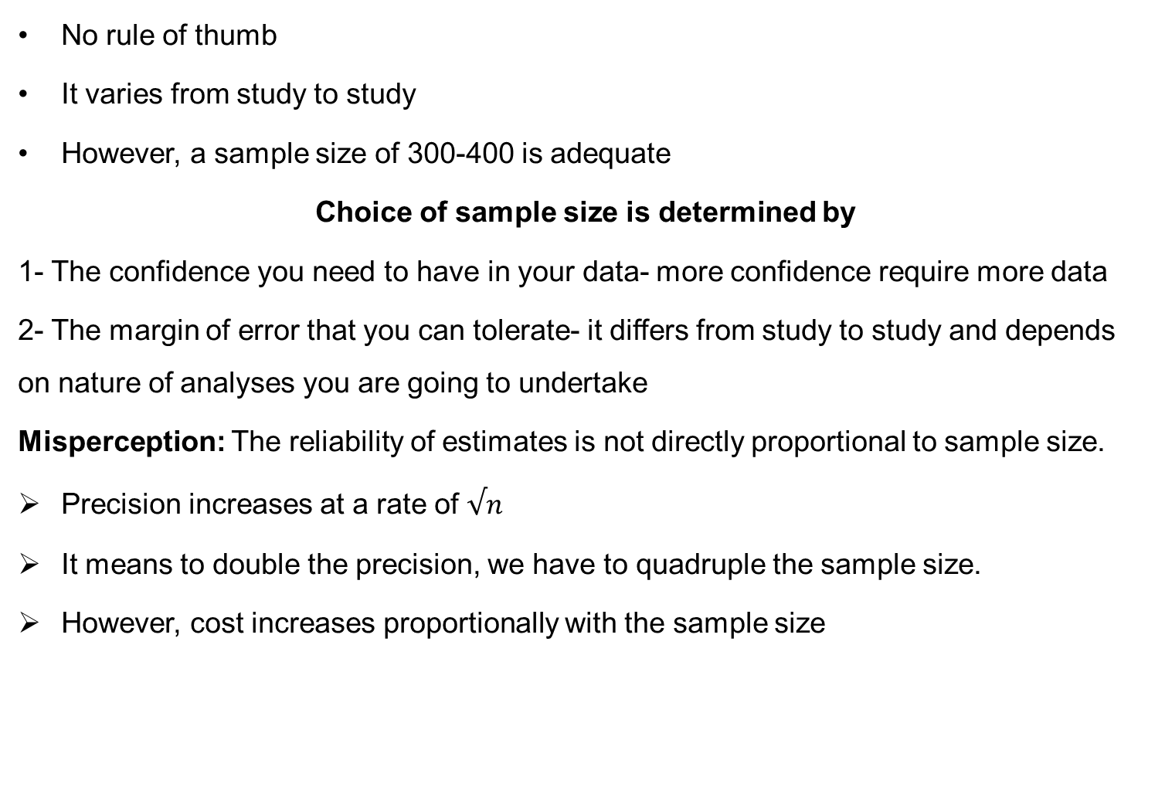
Sample size-How large is large Enough?
No rule of thumb
It varies from study to study
However, a sample size of 300-400 is adequate
Choice of sample size is determined by
1- The confidence you need to have in your data- more confidence require more data
2- The margin of error that you can tolerate- it differs from study to study and depends on nature of analyses you are going to undertake
Misperception: The reliability of estimates is not directly proportional to sample size.
Precision increases at a rate of $√n$
It means to double the precision, we have to quadruple the sample size.
However, cost increases proportionally with the sample size

Slide 22
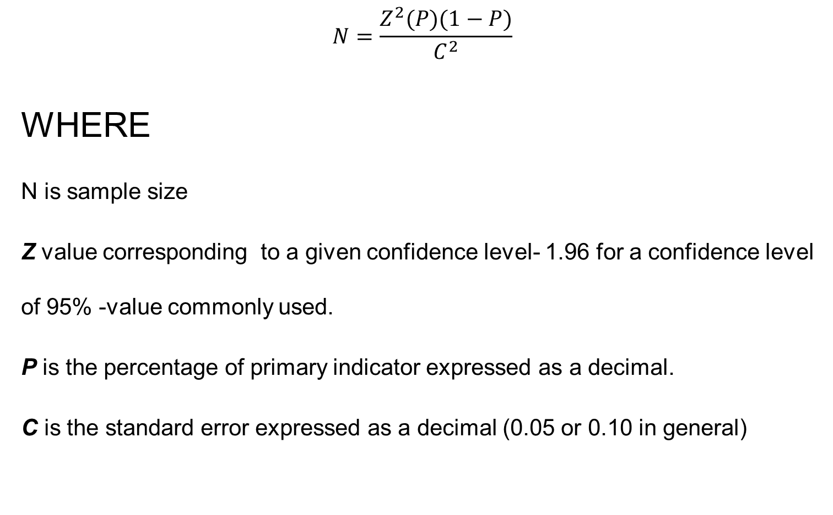
A simple formula to compute sample size
$$N=\frac{Z^{2}(P)(1−P)}{C^{2}}$$
WHERE
N is sample size
Z value corresponding to a given confidence level- 1.96 for a confidence level of 95% -value commonly used.
P is the percentage of primary indicator expressed as a decimal.
C is the standard error expressed as a decimal (0.05 or 0.10 in general)

Slide 23
Different sampling procedures/techniques
Probability sampling:
Any method of sample based on the theory of probability at any stage of the procedure.
Non probability Sampling:
That is totally based on the discretion of the researcher under some circumstances.

Slide 24
Probability sampling-the types
1- Random Sampling or Simple Random Sampling
When each and every unit of the population has equal probability of being included in the sample example: a lottery system.
When to use Simple random sample
Have an accurate and easily accessible sampling frame that lists the entire population, preferably stored on a computer.
Not suitable for face-to-face data collection methods if the population covers a large geographical area.

Slide 25
2- Stratified Random Sampling
This is a form of random sampling in which units are divided into groups or categories (homogenous) that are mutually exclusive. These groups are called strata.
Within each stratum simple or systematic random is selected.
Grouping by age, sex, urban and rural.
Advantages:
a- it provides more accurate impression of the population.
b- it is an improvement over random sampling when the population is more heterogeneous.
Disadvantages:
a- if not properly designed, overlapping, the accuracy of the results decreases.

Slide 26
3- Systematic sampling
A form of random sampling involving a system which means there is gap, interval or no sampling between each selected units
When to use systematic sampling
It is used when the population that we want to study is connected to an identified site, e.g.
patients attending a clinic.
Houses that are ordered along a road
Customers who walk one by one through an entrance
Advantages:
Sufficiently random to obtain reliable estimates
It facilitates the selection of sampling units
Disadvantages:
It is not fully random because after the first step each unit is selected with a fixed interval.
it could be problematic if particular characteristics arise. For example every 10th house in the sector may be corner house.

Slide 27
4- Cluster/area Sampling
Clusters are formed by breaking down the area to be surveyed into smaller areas.
Then a few of smaller areas are selected randomly.
Then units/respondents are selected randomly or systematically.
When to use:
It is used when the population is widely dispersed across the regions. For example universities, villages.
Advantages:
When no suitable sampling framework, this is the suitable method.
Time and money is saved to avoid travelling.
Do not need a complete frame of the population, need a complete list of clusters.
Disadvantages:
Cluster may contain similar units.
Stratum is homogeneous, cluster should be as heterogeneous as possible

Slide 28
Non-Probability Sampling
It is a process in which the personal judgment determines rather the statistical procedure which unit is to be selected. It is also called non. Random sampling.
Survey respondents are contact by opportunity.
Quota Sampling: In this techniques interviewer is asked to select a person with certain characteristics.
The purpose is to make sample more representative of the population: for example age group.
Advantages:
it is the only method if the field work is to be completed quickly
An alternative when there is no suitable random framework
Lower cost as the survey is carried rapidly.
Disadvantages:
Sampling error can not be estimated as it is not a random sampling.
Identifying the unit is difficult. For example age can be judged by only observance.

Slide 29
2- Purposive Sampling
In this techniques population is divided into groups by keeping a purpose in mind.
First a criteria is laid down and then it is tried to find the homogenous clusters.

Slide 30
3- Snow ball sampling:
Used when the population is hidden, for example sex workers and drug addictor.
First key informants are identified that help in reaching the respondents.
With the help of that respondents further are contacted.
The sample increases as it rolls down.
The process continues till the requirement.

Slide 31
Which techniques to use
No rule of thumb
Depends on the ground realities
Purpose of the researcher
Resource
Time
Nature of the study

Slide 32
Correlation
Correlation: The degree of relationship/association between the variables under consideration is measure through the correlation analysis.
The measure of correlation called the correlation coefficient.
1- It can be positive as well as negative
2- it ranges from correlation ( -1 ≤ r ≤ +1)
3- It is symmetrical in nature; that is, the coefficient of correlation between X and Y(rXY) is the same as that between Y and X(rYX).
4- It is independent of the origin and scale; that is, if we define X*i = aXi + C and Y*i = bYi + d, where a > 0, b > 0, and c and d are constants. Then r between X* and Y* is the same as that between the original variables X and Y.

Slide 33
Causation versus correlating
Causation
Correlation
Cause and effect
ASymmetric
Y=f(x) is not equal to x=f(y)
Dependent random and independent non-random
Linear Association
Symmetric
rxy=ryx
Both variables are random

Slide 34
Notation
Dependent variable Independent variable
Explained variable Explanatory variable
Predictand Predictor
Regressand Regressor
Response Stimulus
Endogenous Exogenous
Outcome Covariate
Controlled variable Control variable
LHS RHS

