Slide 1
Lecture 27
Summary of previous lecture
QUALITATIVE RESPONSE VARIABLES

Slide 2
Topics for today
ALTERNATIVE TO LPM
LOGIT
PROBIT
TOBIT
DURATION

Slide 3
LPM- alternatives
Therefore, one can easily use the CDF to model regressions where the response variable is dichotomous, taking 0–1 values.
The practical question now is, which CDF?
For although all CDFs are S shaped, for each random variable there is a unique CDF.
For historical as well as practical reasons, the CDFs commonly chosen to represent the 0–1 response models are
(1) the logistic- it give rise to the Logit model
(2) the normal-it gives rise to the Probit (or Normit) model.

Slide 4
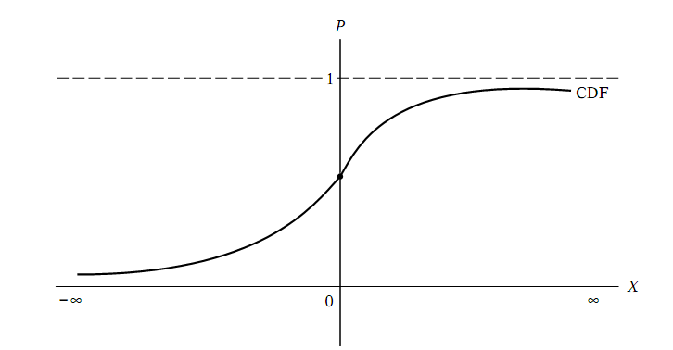
Cumulative distribution function
Notes:
The CDF of a random variable X is simply the probability that it takes a value less than or equal to X0, where X0 is some speciﬁed numerical value of X.

Slide 5



Logit Model
LPM for home ownership ad family income is
But consider the following representative of
The house ownership.
For ease of composition
It is easy to verify that as Zi ranges from −∞to+∞, Pi ranges between 0 and 1.
and that Pi is nonlinearly related to Zi (i.e.,Xi)
But it seems that in satisfying these requirements, we have created an estimation problem because P is nonlinear not only in X but also in the β’s.
This means that we cannot use the familiar OLS procedure to estimate the parameters.

Slide 6


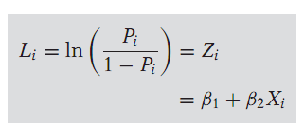
Logit model
If Pi, the probability of owning a house then (1 − Pi) the probability of not owning a house, is;
Therefore it can be written.
Now Pi/(1 − Pi) is simply the odds ratio in favor of owning a house
The ratio of the probability that a family will own a house to the probability that it will not own a house.
Thus, if P = 0.8, it means that odds are 4 to 1 in favor of the family owning a house.
Taking the natural log of the ratio leads to

Slide 7
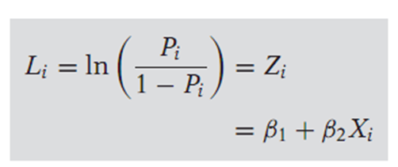
Logit Model
L, the log of the odds ratio, is not only linear in X, but also linear in the parameters.
L is called the logit, and hence the name logit model for models like.
Features of the logit model.
1. As P goes from 0 to 1 (i.e., as Z varies from −∞to+∞), the logit L goes from −∞ to +∞.
That is, although the probabilities (of necessity) lie between 0 and 1, the logits are not so bounded.
2. Although L is linear in X, the probabilities themselves are not. This property is in contrast with the LPM model where the probabilities increase linearly with X.
3. Although we have included only a single X variable, or regressor, in the preceding model, one can add as many regressors as may be dictated by the underlying theory.

Slide 8
Features of logit model
4. If L, the logit, is positive, it means that when the value of the regressor(s) increases, the odds that the regressand equals 1 (meaning some event of
interest happens) increases. If L is negative, the odds that the regressand equals 1 decreases as the value of X increases.
5. The slope coefficient, measures the change in L for a unit change in X that is, it tells how the log-odds in favor of owning a house change as income changes by a unit, say, $1000.
The intercept is the value of the log odds in favor of owning a house if income is zero. Like most interpretations of intercepts, this interpretation may not have any physical meaning.
6. Whereas the LPM assumes that Pi is linearly related to Xi, the logit model assumes that the log of the odds ratio is linearly related to Xi.

Slide 9

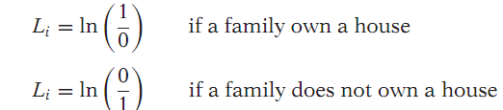
Estimation of the Logit model
For estimation purposes we use the model.
To estimate, we need, apart from Xi, the values of the regressand, or logit, L.
This depends on the type of data we have for analysis. We only discuss the data at the individual, or micro, level.
If we have data on individual families, OLS estimation is infeasible. Pi= 1 if a family owns a house and Pi= 0 if it does not own a house.
But if we put these values directly into the logit Li we obtain:
Obviously, these expressions are meaningless. Therefore, if we have data at the micro, or individual, level, we cannot apply OLS.
In this situation we may have to resort to the Maximumlikelihood (ML) method to estimate the parameters

Slide 10
The probit model
To explain the behavior of a dichotomous dependent variable it is necessary to use a suitably chosen CDF.
The logit model uses the cumulative logistic function,. But this is not the only CDF that one can use.
In some applications, the normal CDF has been found useful.
The estimating model that emerges from the normal CDF is popularly known as the probit model.
Sometimes it is also known as the normit model.
The model may be derived on the same basis as in case of Logit model. (see any of the recommended book for detail)

Slide 11
Logit and probit models
Although in some cases LPM, logit, and probit give qualitatively similar results.
We will conﬁne our attention to logit and probit models because of the problems with the LPM noted earlier.
Between logit and probit, which model is preferable?
In most applications the models are quite similar.
The main difference being that the logistic distribution has slightly fatter tails.
That is to say, the conditional probability P approaches zero or one at a slower rate in logit than in probit.
Therefore, there is no compelling reason to choose one over the other.
In practice many researchers choose the logit model because of its comparative mathematical simplicity.

Slide 12
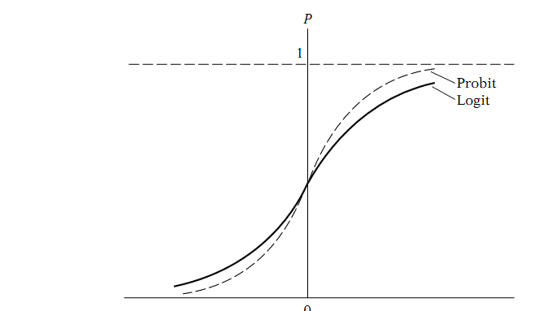

Slide 13
The tobit model
An extension of the probit model is the tobit model.
To explain this model consider home ownership example.
In the probit model our concern was with estimating the probability of owning a house as a function of income variable.
In the tobit model our interest is in ﬁnding out the amount of money a person or family spends on a house in relation to socioeconomic variables.
Now we face a dilemma here: If a consumer does not purchase a house, obviously we have no data on housing expenditure
for such consumers;
We have such data only on consumers who actually purchase a house.

Slide 14
Tobit model…
Thus consumers are divided into two groups.
n consumers about whom we have information on the regressors as well as the regressand
Another consisting of n consumers about whom we have information only on the regressors but not on the regressand.
A sample in which information on the regressand is available only for some observations is known as a censored sample.
The tobit model is also known as a censored regression model.
Some authors call such models limited dependent variable regression models because of the restriction put on the values taken by the regressand.

Slide 15
Ordinal Logit and Probit Models
We discuss below very brieﬂy some other models in this area.
In the bivariate logit and probit models our interest was in modeling a yes or no response variable.
But often the response variable, or regressand, can have more than two outcomes.
For example in survey-type research the responses are on a Likert-type scale, such as “strongly agree,” “somewhat agree,” or “strongly disagree.”
Very often these responses are coded as 0, 1, 2, 3...
These are ordinal scales in that there is clear ranking among the categories but we cannot say that 2 is twice 1 or 3 is three times 1.
To study such phenomena the bivariate logit and probit models can be extended to take into account multiple ranked categories.
The mathematics become quite involved.
Software packages Eviews and Shazam have routines to estimate ordered logit and probit models.

Slide 16
Multinomial Logit and Probit Models
In the ordered probit and logit models the response variable has more than two ordered, or ranked, categories.
But there are situations where the regressand is unordered.
For example, the choice of transportation mode to work. The choices may be bicycle, motorbike, car, bus, or train.
Although these are categorical responses, there is no ranking or order.
They are essentially nominal in character.
For another example, consider occupational classiﬁcations, such as unskilled, semiskilled, and highly skilled.
Again, there is no order here.
The techniques of multinomial logit or probit models can be employed to study such nominal categories.

