Slide 1
Lecture 26
Summary of previous lecture
Introduction of dummy variable

Slide 2
Topics for today
Dummy Variable

Slide 3
Caution in the Use of Dummy Variables
Although they are easy to incorporate in the regression models, one must use the dummy variables carefully.
1- If a qualitative variable has m categories, introduce
only (m − 1) dummy variables.
If more than one qualitative variables then: For each qualitative regressors the number of dummy variables introduced must be one less than the categories of that variable.
If the rule is not followed then: Dummy variable trap, that is, the situation of perfect Multicollinearity.

Slide 5
Caution in the Use of Dummy Variables..
2- The category for which no dummy variable is assigned is known as the base, benchmark, control, comparison, reference, or omitted category. And all comparisons are made in relation to the benchmark category.
3- The intercept value (β1) represents the mean value of the benchmark category.
4- The coefficients attached to the dummy variables are known as the differential intercept coefficients because they tell by how much the value of the intercept differs from the intercept coefficient of the benchmark category.
5- If a qualitative variable has more than one category, the choice of the benchmark category is strictly up to the researcher.
Of course, this will not change the overall conclusion .

Slide 7

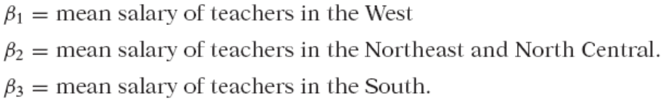
Caution in the Use of Dummy Variables..
6- Dummy variable trap can be avoided. Introduce as many dummy variables as the number of categories of that variable and do not introduce the intercept in such a model.
Now the interpretation changes. All the coefficients with the intercept suppressed, and allowing a dummy variable for each category, we obtain directly the mean values of the various categories.

Slide 8
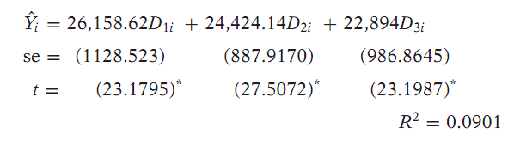
As many dummy as many categories

Slide 9
Which method is better to use DV?
Which is a better method of introducing a dummy variable: A- Introduce a dummy for each category and omit the intercept term.
B- include the intercept term and introduce only (m − 1) dummies.
Most researchers find the equation with an intercept more convenient because it allows them makes a difference between the categories.
T and F test are used in the previous way which test whether the category or categories are significant/relevant.

Slide 10
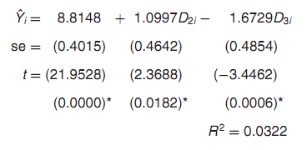

ANOVA models with two qualitative variables
There are two qualitative regressors, each with two categories. Hence we have assigned a single dummy variable for each category.
Which is the benchmark category here?
Obviously, it is unmarried, non-South residence.
Therefore, all comparisons are made in relation to this group.
The mean hourly wage in this benchmark is about $8.81.
Compared with this, the average hourly wage of those who are married is higher by about $1.10, for an actual average wage of $9.91 ( = 8.81 + 1.10).
By contrast, for those who live in the South, the average hourly wage is lower by about $1.67, for an actual average hourly wage of $7.14.

Slide 11
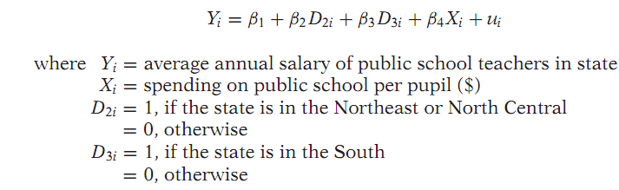
ANOVA VS.ANCOVA MODELS
If all the explanatory variables are nominal or categorical variable then it is ANOVA.
If the explanatory variables are mixture of nominal and ratio scale then it is ANCOVA.
ANCOVA models are an extension of the ANOVA models in that they provide a method of statistically controlling the effects of quantitative regressors.

Slide 12
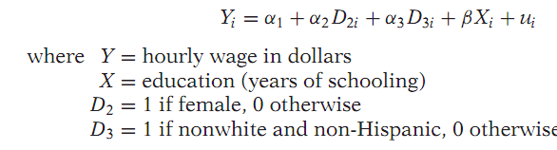
Interaction Effects Using Dummy Variables
Dummy variables are a ﬂexible tool that can handle a variety of interesting problems.
Implicit in this model is the assumption that the differential effect of the gender dummy D2 is constant across the two categories
of race.
Likewise the differential effect of the race dummy D2 is also constant across the two sexes.

Slide 13

Interactive effect of dummies…
In many applications such an assumption may be unrealistic.
A female nonwhite/non-Hispanic may earn lower wages than a male nonwhite/non-Hispanic.
In other words, there may be interaction between the two qualitative
variables D2 and D3
Therefore their effect on mean Y may not be simply additive but multiplicative.
Which is the mean hourly wage function for female nonwhite/non-Hispanic
workers.

Slide 14
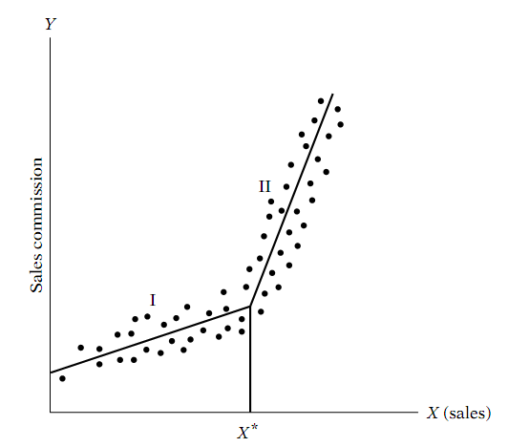
Piecewise linear regression- another use of dummy variables
How a hypothetical company remunerates its sales representatives.
It pays commissions based on sales in such a manner that up to a certain level, the target, or threshold, level X* , there is one (stochastic) commission
structure and beyond that level another.
Thus, we have a piecewise linear regression
consisting of two linear pieces or segments.
The technique of dummy variable
can be used to estimate the two
slopes of the two segments of the
piecewise linear regression.

Slide 15


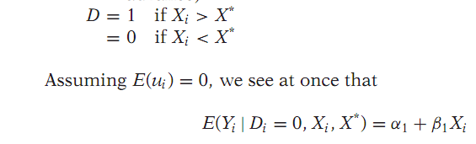
Piecewise regression- the procedure
The piecewise linear regression is an example of a more general class of functions known as spline functions.

Slide 16

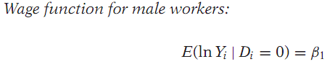
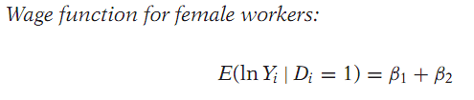
SOME TECHNICAL ASPECTS OF THE DV TECHNIQUE
The Interpretation of DV in Semi-logarithmic Regressions.
Log–lin models, where the regressand is logarithmic and the regressors are linear.
B1 gives the mean log hourly earnings and the “slope” coefﬁcient gives the difference in the mean log hourly earnings of male and females.

