Slide 1
Lecture 25
Summary of previous lecture
Specification Bias
Detection methods

Slide 2
Topics for today
Model selection criteria
Dummy Variable

Slide 3





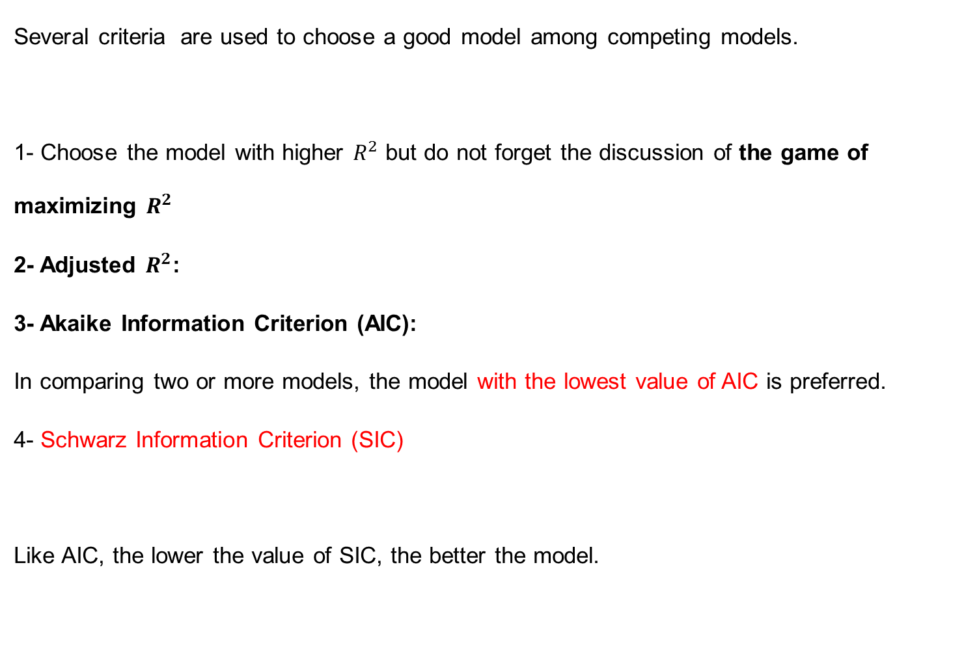
Model selection criteria
Several criteria are used to choose a good model among competing models.
1- Choose the model with higher $R^{2}$ but do not forget the discussion of the game of maximizing $R^{2}$
2- Adjusted $R^{2}$:
3- Akaike Information Criterion (AIC):
In comparing two or more models, the model with the lowest value of AIC is preferred.
4- Schwarz Information Criterion (SIC)
Like AIC, the lower the value of SIC, the better the model.

Slide 4
A Word of Caution about Model Selection Criteria
These criteria should be considered as an adjunct to the various speciﬁcation tests.
Some of the criteria are purely descriptive and may not have strong theoretical properties.
Now a days they are frequently used by the practitioner.
Therefore the reader should be aware of them.
No one of these criteria is necessarily superior to the others.
Modern packages report all these criteria.

Slide 5
A word to the practitioner
There is no question that model building is an art as well as a science.
A practical researcher may be bewildered by theoretical niceties and an array of diagnostic tools.
Some commands in selection of model: The researcher should’
Use common sense and theory
know the context (do not perform ignorant statistical analysis).
Inspect the data.
Look long and hard at the results.
Beware the costs of data mining.
Be willing to compromise (do not worship textbook prescriptions).
Not confuse statistical signiﬁcance with practical signiﬁcance).
Confess in the presence of sensitivity (that is, anticipate criticism)

Slide 6
Dummy variable regression models
We know generally variables have four types;
Ratio scale (i)X1/X2 (ii)(X1-X2) (iii) X1≤ X2, Interval Scale, ordinal scale, and nominal scale.
By know we encountered ratio scale variables.
But this should not give the impression that regression models can deal only with ratio scale variables.
Regression models can also handle other types of variables mentioned previously.
Today we consider models that may involve not only ratio scale variables but also nominal scale variables.
Such variables are also known as indicator variables, categorical variables, qualitative variables, or dummy variables.

Slide 7
The nature of Dummy Variables
In regression analysis the dependent variable is frequently influenced not only by ratio scale variables (e.g., income, output, prices, costs, height, temperature) but also by variables that are essentially qualitative, or nominal scale, in nature, such as sex, race, color, religion, nationality, geographical region, political upheavals, and party affiliation.
For example, holding all other factors constant, female workers are found to earn less than their male counterparts or nonwhite workers are found to earn less than whites.
This shows that qualitative variables are not less important and should be included in the regression analysis.

Slide 9
Nature of dummy variables….
DV variables usually indicate the presence or absence of a "quality” or an attribute.
How to quantify? Construct artificial variables that take on values of 1 or 0, 1 indicating the presence or absence.
Dummy variables are thus essentially a device to classify data into mutually exclusive categories such as male or female.
How to incorporate in regression models: Dummy variables can be incorporated in regression models just as easily as quantitative variables.
In other words a regression model may contain regressors that are all exclusively dummy, or qualitative, in nature.
Such models are called Analysis of Variance (ANOVA) models

Slide 10
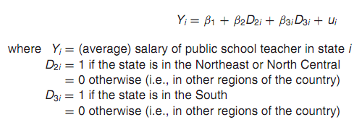
Example of ANOVA model: Salaries of public school teachers by region
Suppose there are three regions namely: (1) North East or North Central (2) South and (3) West
Question: Does the average annual salary of public school teachers differs among the three geographical regions of the country.
Simple arithmetic average of salary is: $24,424, $22,894 , and $26,158.
Number look different but are they statistically different from each other.
To see this consider the following model;
What does the
Model tells us

Slide 11



Example …
The mean salary of public school teachers in the West is given by the intercept, β1
The “slope” coefﬁcients β2 and β3 tell by how much the mean salaries of teachers in the Northeast and North Central and in the South differ from the mean salary of teachers in the West.
How do we know if these differences are statistically signiﬁcant?

Slide 12
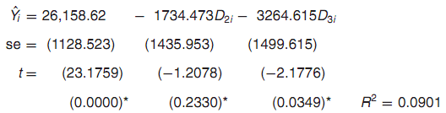
Example
The actual mean salaries in the last two regions can be easily obtained by adding these differential salaries to the mean salary of teachers in the West.
The overall conclusion is, that statistically the mean salaries of public school teachers in the west and north east and north west are about the same.
However the mean salary of teachers in the South is statistically signiﬁcantly lower by about $3265.
Diagrammatic view

Slide 13
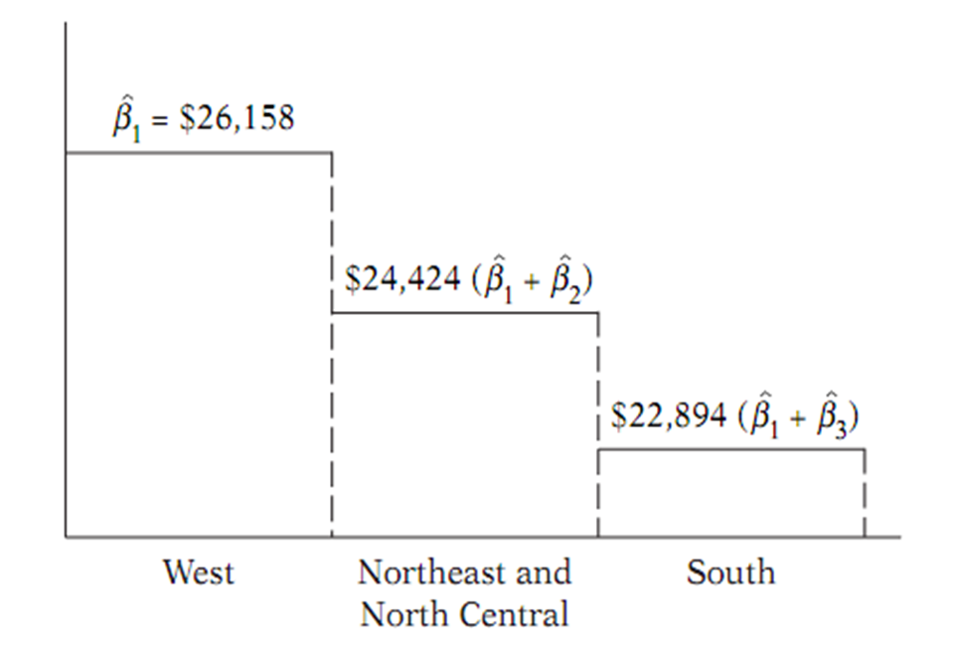
Diagram
Conclusion: It is clear that all one has to do is see if the coefficient attached to the various dummy variables are individually statistically signiﬁcant.

