Slide 1
Lecture 23
Summary of previous lecture
Auto correlation
Specification Bias

Slide 2
Topics for today
Specification Bias
Criteria to choose a good model
Types of specification bias
Tests of specification bias.

Slide 3
Model specification …
According to Hendry and Richard, a model chosen for empirical analysis should satisfy the following criteria
Be data admissible: predictions made from the model must be logically possible:
Be consistent with theory: it must make good theoretical sense.
Have weakly exogenous regressors: regressors must be uncorrelated with the error term.
Exhibit parameter constancy: the values of the parameters should be stable otherwise forecasting will be difficult.
Exhibit data coherency: The residuals estimated from the model must be purely random
Be encompassing: Other models cannot be an improvement over the chosen model.

Slide 5





Specification bias…
Assume the correct model is;
Where Y = total cost of production and X = output.
But due to any reason researcher adopt the model:
This is omission of a necessary variable
Another researcher use the model
This is inclusion of unnecessary or irrelevant case.
Another uses the model
This is wrong functional form
Another employs the model:
Error of measurement:
* Mean proxy of the variable

Slide 7
Types of specification Bias
Omission of a relevant variable(s)
Inclusion of an unnecessary variable(s)
Adopting the wrong functional form
Errors of measurement

Slide 8
Consequences of model specification error
Whatever the sources of speciﬁcation errors, what are the consequences?
For simplicity: three variable model
Over fitting a model
Under fitting a model

Slide 9


Under fitting a model- omitting a relevant variable
Suppose the true model is
But for any reason we fit the model;
The consequences of omitting variable X3 are;

Slide 10
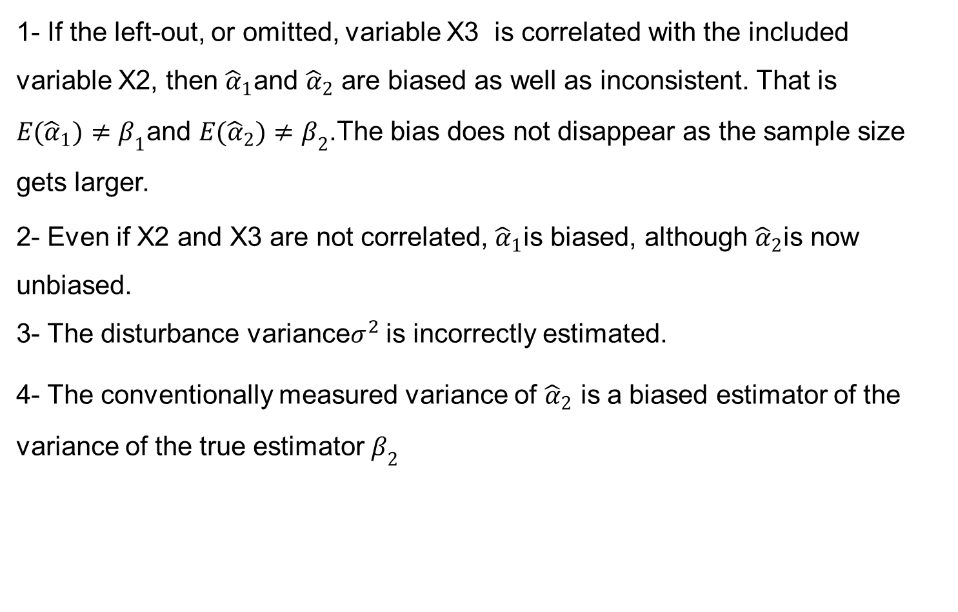
Consequences…..
1- If the left-out, or omitted, variable X3 is correlated with the included variable X2, then ${\hat{α}}_{1}$and ${\hat{α}}_{2}$ are biased as well as inconsistent. That is $E({\hat{α}}_{1})≠β_{1}$and $E({\hat{α}}_{2})≠β_{2}$.The bias does not disappear as the sample size gets larger.
2- Even if X2 and X3 are not correlated, ${\hat{α}}_{1}$is biased, although ${\hat{α}}_{2}$is now unbiased.
3- The disturbance variance$σ^{2}$ is incorrectly estimated.
4- The conventionally measured variance of ${\hat{α}}_{2}$ is a biased estimator of the variance of the true estimator $β_{2}$

Slide 12
Consequences….
5- In consequence, the usual conﬁdence interval and hypothesis-testing procedures are likely to give misleading conclusions.
6- The forecasts based on the incorrect model and the forecast (conﬁdence) intervals will be unreliable.
Conclusion: Once a model is formulated on the basis of the relevant theory, one is ill advised to drop a variable from such a model.

Slide 13


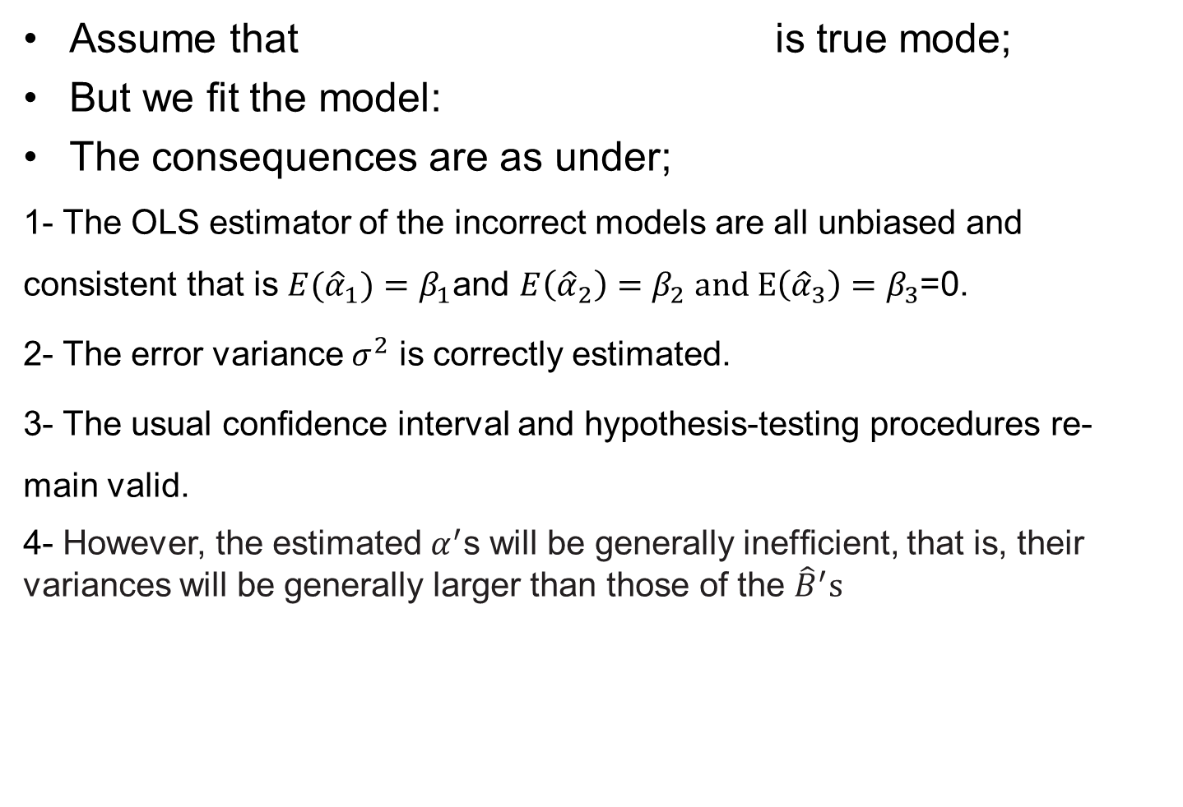
Inclusion of an Irrelevant Variable (Over ﬁtting a Model)
Assume that is true mode;
But we fit the model:
The consequences are as under;
1- The OLS estimator of the incorrect models are all unbiased and consistent that is $E({\hat{α}}_{1}){=β}_{1}$and $E\left({\hat{α}}_{2}\right)=β_{2} and E\left({\hat{α}}_{3}\right)=β_{3}$=0.
2- The error variance $σ^{2}$ is correctly estimated.
3- The usual conﬁdence interval and hypothesis-testing procedures re- main valid.
4- However, the estimated $α^{′}$s will be generally inefﬁcient, that is, their variances will be generally larger than those of the ${\hat{B}}^{′}s$

Slide 14
Over fitting versus under fitting
Over fitting of the model
Under fitting of the model
Unbiased
Consistent
The error variance is correctly estimated
The conventional hypothesis-testing methods are still valid.
The only penalty for the inclusion of the superﬂuous variable is that the estimated variances of the coefﬁcients are larger.
Biased
Inconsistent
The error variance is incorrectly estimated
Usual hypothesis-testing procedures become invalid.
Conclusion: The best approach is to include only explanatory variables that, on theoretical grounds, directly inﬂuence the dependent variable.

Slide 15
Test of Specification Error
We do not deliberately set out to commit such errors.
Very often speciﬁcation biases arise due to:
From our inability to formulate the model as precisely as possible
The underlying theory is weak.
We do not have the right kind of data to test the model.
The practical questions is how to detect specification bias.
Because if we found the reason
Remedial measures are available.
Example: if model is under fitted just include the omitted variable& (vice versa)

Slide 17

Detecting the Presence of Unnecessary Variables
Suppose we develop a k-variable model to explain a phenomenon:
We do not totally sure that, say, the variable Xk really belongs in the model.
One simple way to ﬁnd this out is to test the signiﬁcance of the estimated βk with the usual t test
But suppose that we are not sure whether, say, X3 and X4 legitimately belong in the model.
This can be easily ascertained by the F test.
We will discuss F test at later stage.
Thus, detecting the presence of an irrelevant variable (or variables) is not a difﬁcult task.

Slide 18
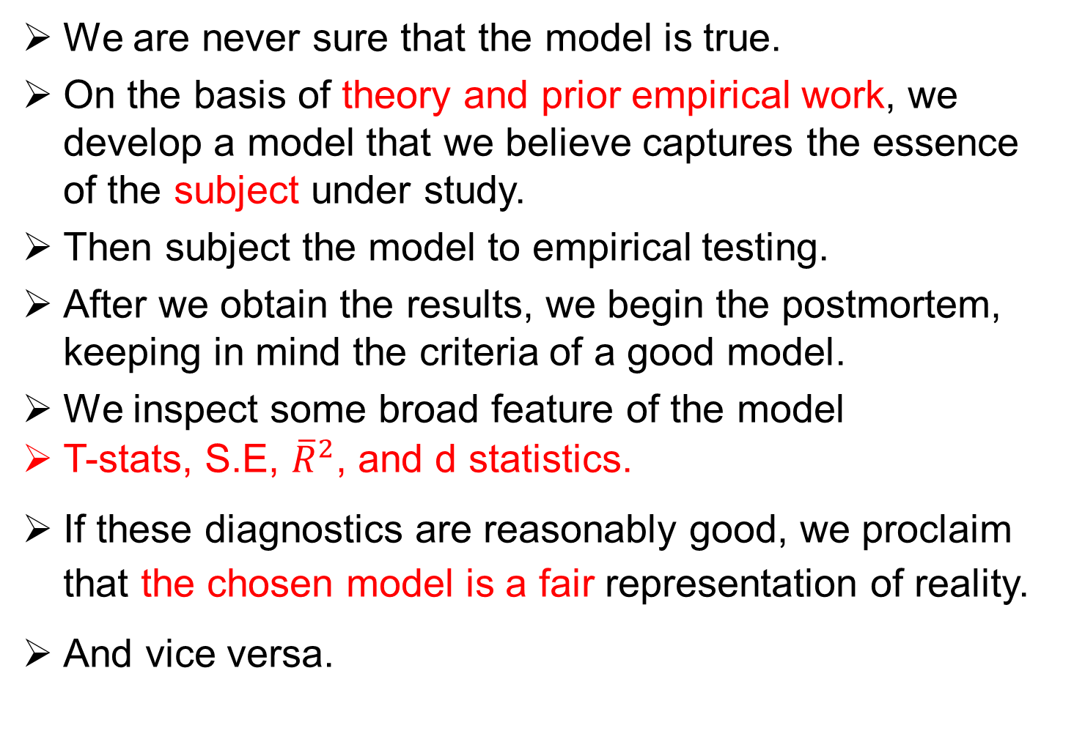
Test of specification bias- Omitted variable
We are never sure that the model is true.
On the basis of theory and prior empirical work, we develop a model that we believe captures the essence of the subject under study.
Then subject the model to empirical testing.
After we obtain the results, we begin the postmortem, keeping in mind the criteria of a good model.
We inspect some broad feature of the model
T-stats, S.E, ${\overline{R}}^{2}$, and d statistics.
If these diagnostics are reasonably good, we proclaim that the chosen model is a fair representation of reality.
And vice versa.

Slide 19



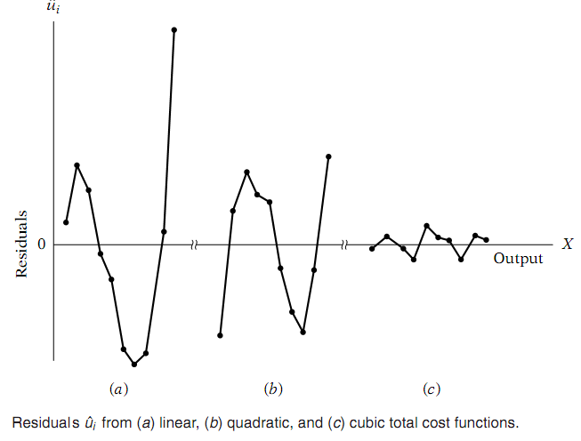
Formal Methods to detect model adequacy (omitted variable)
1- Examination of residuals: Residuals can also be examined, especially in cross sectional data, for model speciﬁcation errors, such as omission of an important variable or incorrect functional form.
Suppose the true cost model is
But a researcher fits the model:
Another fits the model:
The utility of examining the
residual plot is thus clear
If there are speciﬁcation errors,
the residuals will exhibit noticeable
patterns.

Slide 21
Specification test …
Durban Watson statistics (d):
To use the Durbin–Watson test for detecting model speciﬁcation error(s), the procedure is as follows
1. From the assumed model, obtain the OLS residuals.
2. If it is believed that the assumed model is mis-speciﬁed because it excludes a relevant explanatory variable, say, Z from the model, order the residuals obtained in Step 1 according to increasing values of Z.
Note: The Z variable could be one of the X variables included in the assumed model or it could be some function of that variable, such as X2 or X3.
3. Compute the d statistic from the residuals thus ordered by the usual
d formula.
4. From the Durbin–Watson tables, if the estimated d value is signiﬁcant,
then one can accept the hypothesis of model mis-speciﬁcation.

Slide 22

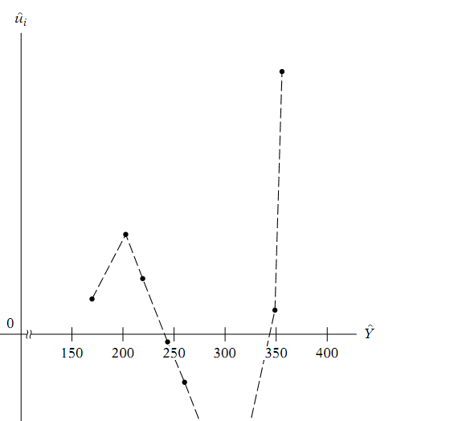

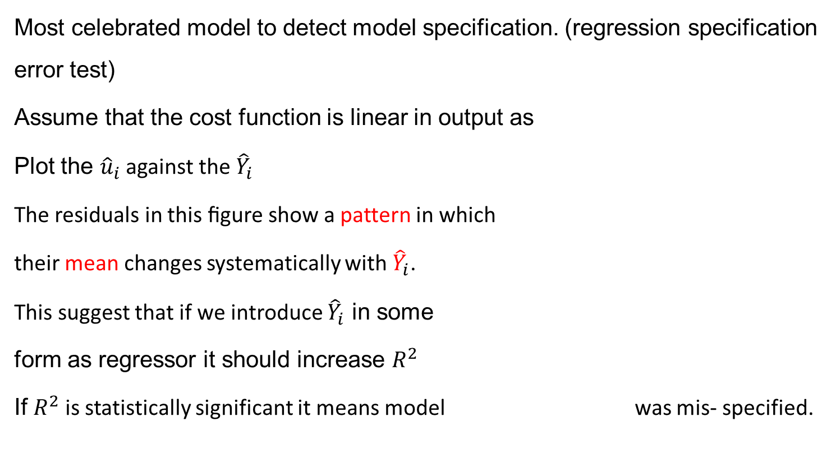
Ramsey’s RESET Test……
Most celebrated model to detect model specification. (regression specification error test)
Assume that the cost function is linear in output as
Plot the ${\hat{u}}_{i}$ against the ${\hat{Y}}_{i}$
The residuals in this ﬁgure show a pattern in which
their mean changes systematically with ${\hat{Y}}_{i}$.
This suggest that if we introduce ${\hat{Y}}_{i}$ in some
form as regressor it should increase $R^{2}$
If $R^{2}$ is statistically significant it means model was mis- specified.

Slide 24


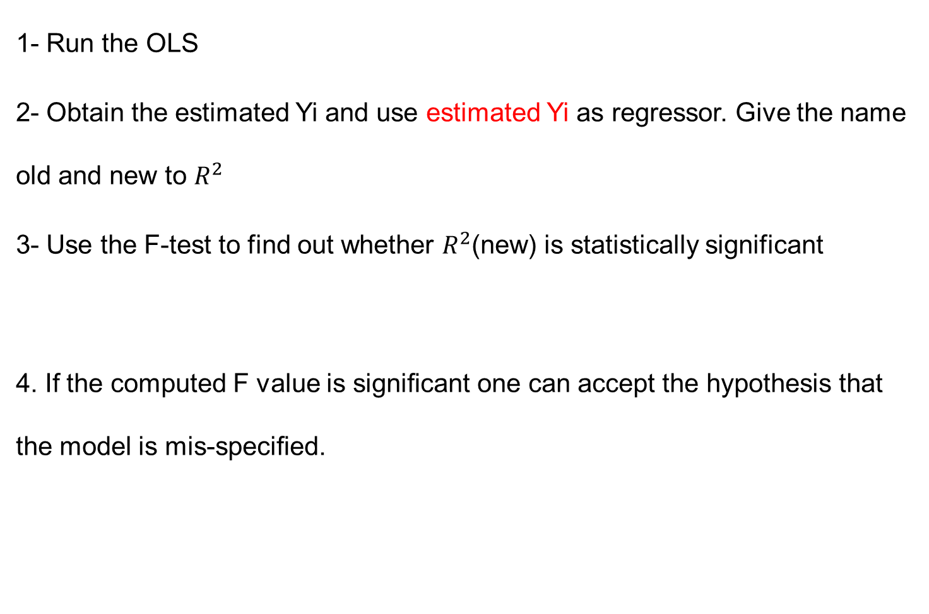
Procedure OF RESET TEST…
1- Run the OLS
2- Obtain the estimated Yi and use estimated Yi as regressor. Give the name old and new to $R^{2}$
3- Use the F-test to find out whether $R^{2}$(new) is statistically significant
4. If the computed F value is signiﬁcant one can accept the hypothesis that the model is mis-speciﬁed.

Slide 25
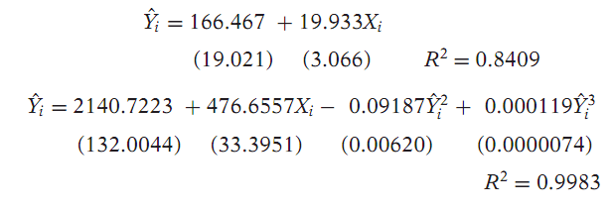

Example
Suppose we have the following resutls.

Slide 26




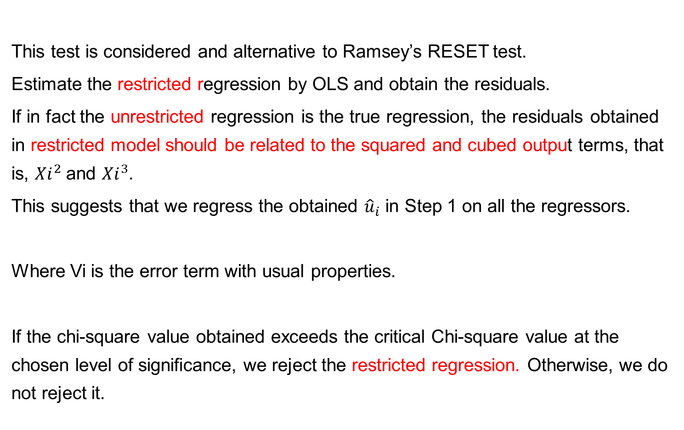
Lagrange Multiplier test (LM) test
This test is considered and alternative to Ramsey’s RESET test.
Estimate the restricted regression by OLS and obtain the residuals.
If in fact the unrestricted regression is the true regression, the residuals obtained in restricted model should be related to the squared and cubed output terms, that is, ${Xi}^{2}$ and ${Xi}^{3}$.
This suggests that we regress the obtained ${\hat{u}}_{i}$ in Step 1 on all the regressors.
Where Vi is the error term with usual properties.
If the chi-square value obtained exceeds the critical Chi-square value at the chosen level of signiﬁcance, we reject the restricted regression. Otherwise, we do not reject it.

Slide 27

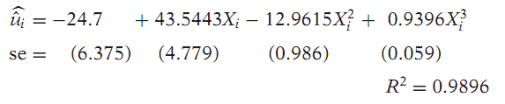
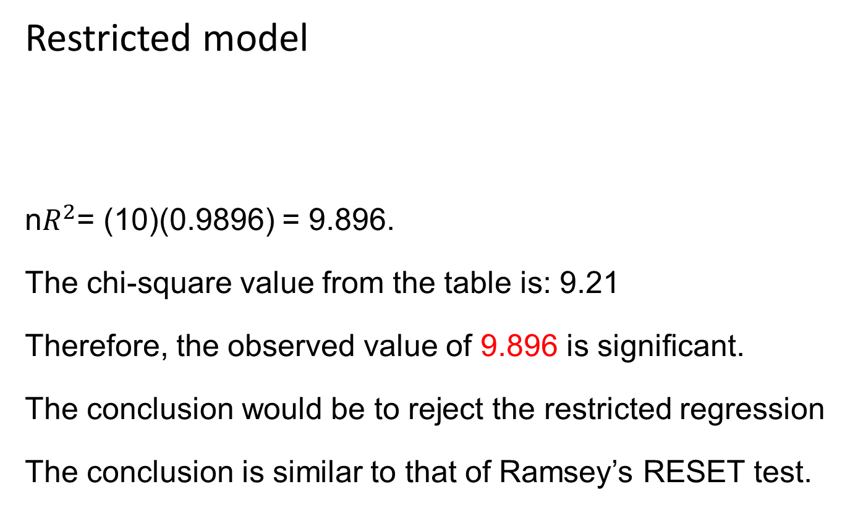
Example of LM test …
Restricted model
n$R^{2}$= (10)(0.9896) = 9.896.
The chi-square value from the table is: 9.21
Therefore, the observed value of 9.896 is signiﬁcant.
The conclusion would be to reject the restricted regression
The conclusion is similar to that of Ramsey’s RESET test.

Slide 28
Error of measurement
By now we assumed implicitly that the dependent variable Y and the explanatory variables, the X’s, are measured without any errors.
In practice it is not true. (nonresponse errors, reporting errors).
Whatever the reasons, error of measurement is a potentially troublesome problem
Error in the measurement of dependent variable:
It still give unbiased estimates of the parameters and their variances.
However the estimated variances are now larger than in the case where there are no such errors of measurement.

Slide 29
Measurement error….
Error in the explanatory variables.
Measurement errors in explanatory variables pose a serious problem.
The consistent estimates of the parameters become impossible.
However as we know if they are present only in the dependent variable, the estimators remain unbiased and hence they are consistent too.

Slide 30





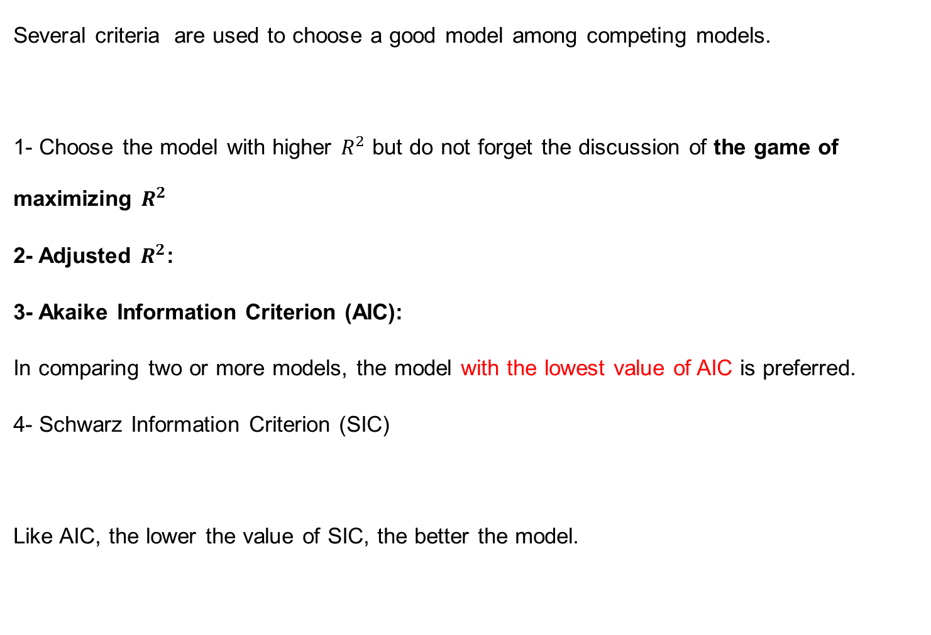
Model selection criteria
Several criteria are used to choose a good model among competing models.
1- Choose the model with higher $R^{2}$ but do not forget the discussion of the game of maximizing $R^{2}$
2- Adjusted $R^{2}$:
3- Akaike Information Criterion (AIC):
In comparing two or more models, the model with the lowest value of AIC is preferred.
4- Schwarz Information Criterion (SIC)
Like AIC, the lower the value of SIC, the better the model.

Slide 31
A Word of Caution about Model Selection Criteria
These criteria should be considered as an adjunct to the various speciﬁcation tests.
Some of the criteria are purely descriptive and may not have strong theoretical properties.
Now a days they are frequently used by the practitioner.
Therefore the reader should be aware of them.
No one of these criteria is necessarily superior to the others.
Modern packages report all these criteria.

Slide 33
A word to the practitioner
There is no question that model building is an art as well as a science.
A practical researcher may be bewildered by theoretical niceties and an array of diagnostic tools.
Some commands in selection of model: The researcher should’
Use common sense and theory
know the context (do not perform ignorant statistical analysis).
Inspect the data.
Look long and hard at the results.
Beware the costs of data mining.
Be willing to compromise (do not worship textbook prescriptions).
Not confuse statistical signiﬁcance with practical signiﬁcance).
Confess in the presence of sensitivity (that is, anticipate criticism)

Slide 35
Dummy variable regression models
We know generally variables have four types;
Ratio scale (i)X1/X2 (ii)(X1-X2) (iii) X1≤ X2, Interval Scale, ordinal scale, and nominal scale.
By know we encountered ratio scale variables.
But this should not give the impression that regression models can deal only with ratio scale variables.
Regression models can also handle other types of variables mentioned previously.
Today we consider models that may involve not only ratio scale variables but also nominal scale variables.
Such variables are also known as indicator variables, categorical variables, qualitative variables, or dummy variables.

Slide 36
The nature of Dummy Variables
In regression analysis the dependent variable is frequently influenced not only by ratio scale variables (e.g., income, output, prices, costs, height, temperature) but also by variables that are essentially qualitative, or nominal scale, in nature, such as sex, race, color, religion, nationality, geographical region, political upheavals, and party affiliation.
For example, holding all other factors constant, female workers are found to earn less than their male counterparts or nonwhite workers are found to earn less than whites.
This shows that qualitative variables are not less important and should be included in the regression analysis.

Slide 37
Nature of dummy variables….
DV variables usually indicate the presence or absence of a "quality” or an attribute.
How to quantify? Construct artificial variables that take on values of 1 or 0, 1 indicating the presence or absence.
Dummy variables are thus essentially a device to classify data into mutually exclusive categories such as male or female.
How to incorporate in regression models: Dummy variables can be incorporated in regression models just as easily as quantitative variables.
In other words a regression model may contain regressors that are all exclusively dummy, or qualitative, in nature.
Such models are called Analysis of Variance (ANOVA) models

Slide 38
Caution in the Use of Dummy Variables
Although they are easy to incorporate in the regression models, one must use the dummy variables carefully.
1- If a qualitative variable has m categories, introduce
only (m − 1) dummy variables.
If more than one qualitative variables then: For each qualitative regressors the number of dummy variables introduced must be one less than the categories of that variable.
If the rule is not followed then: Dummy variable trap, that is, the situation of perfect Multicollinearity.

Slide 39
Caution in the Use of Dummy Variables..
2- The category for which no dummy variable is assigned is known as the base, benchmark, control, comparison, reference, or omitted category. And all comparisons are made in relation to the benchmark category.
3- The intercept value (β1) represents the mean value of the benchmark category.
4- The coefficients attached to the dummy variables are known as the differential intercept coefficients because they tell by how much the value of the intercept differs from the intercept coefficient of the benchmark category.
5- If a qualitative variable has more than one category, the choice of the benchmark category is strictly up to the
researcher. Of course, this will not change the overall conclusion .

Slide 40

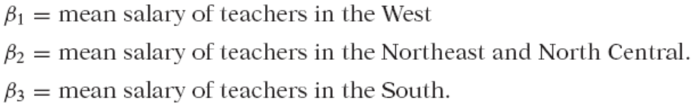
Caution in the Use of Dummy Variables..
6- Dummy variable trap can be avoided. Introduce as many dummy variables as the number of categories of that variable and do not introduce the intercept in such a model.
Now the interpretation changes. All the coefficients with the intercept suppressed, and allowing a dummy variable for each category, we obtain directly the mean values of the various categories.

Slide 41
Which method is better to use DV
Which is a better method of introducing a dummy variable: A- Introduce a dummy for each category and omit the intercept term. B- include the intercept term and introduce only (m − 1) dummies.
Most researchers find the equation with an intercept more convenient because it allows them makes a difference between the categories.
T and F test are used in the previous way which test whether the category or categories are significant/relevant.

Slide 42
ANOVA VS.ANCOVA MODELS
If all the explanatory variables are nominal or categorical variable then it is ANOVA.
If the explanatory variables are mixture of nominal and ratio scale then it is ANCOVA.
ANCOVA models are an extension of the ANOVA models in that they provide a method of statistically controlling the effects of quantitative regressors.

Slide 43



SOME TECHNICAL ASPECTS OF THE DV TECHNIQUE
The Interpretation of DV in Semi-logarithmic Regressions.
Log–lin models, where the regressand is logarithmic and the regressors are linear.
The percentage change in the regressand for a unit change in the regressor.
What happens if a regressor is a dummy variable.
Where Y = hourly wage rate and D = 1 for female and 0 for male. How do we interpret such a model?
Wage function for male workers:
For male workers:
if we take the antilog of β1, what we obtain is not the mean hourly wages of male workers, but their median wages. As you know, mean, median, and mode are the three measures of central tendency of a random variable. And if
we take the antilog of (β1 + β2), we obtain the median hourly wages of
female workers.

Slide 44
What happens if the dependent variable is DV
So for we discussed the regressand is quantitative and the regressors are quantitative or qualitative or both.
But regressand can also be qualitative or dummy. E.g., decision to participate in the labor force.
Can we still use OLS to estimate regression models where the regressand is dummy? Yes, mechanically, we can do so.
But there are several statistical problems that one faces in such models.
There are alternatives to OLS estimation that do not face these problems.
Dichotomous dependent variable models: where the dependent dummy have two categories.
Polytomous Dependent Variable: where dependent dummy have more than one category.

