Slide 1
Lecture 22
Summary of previous lecture
Auto correlation
Nature
Reasons
Consequences
Detection

Slide 2
Topics for today
Autocorrelation
Detection
Removal methods
Specification Bias

Slide 3
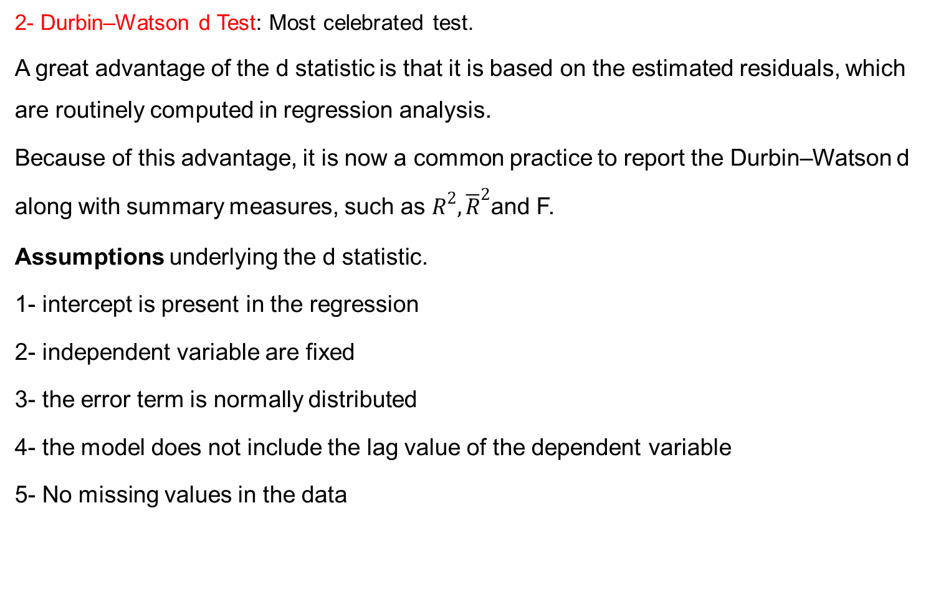
Detection of Autocorrelation…
2- Durbin–Watson d Test: Most celebrated test.
A great advantage of the d statistic is that it is based on the estimated residuals, which are routinely computed in regression analysis.
Because of this advantage, it is now a common practice to report the Durbin–Watson d along with summary measures, such as $R^{2}, {\overline{R}}^{2}$and F.
Assumptions underlying the d statistic.
1- intercept is present in the regression
2- independent variable are fixed
3- the error term is normally distributed
4- the model does not include the lag value of the dependent variable
5- No missing values in the data

Slide 4
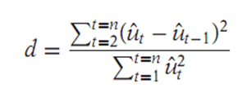
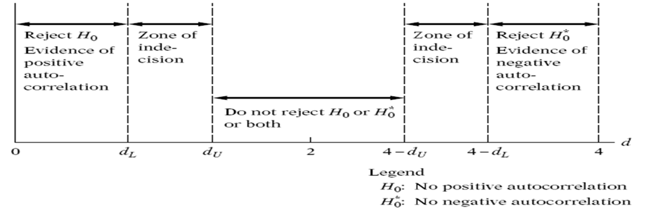
Detection of Autocorrelation…

Slide 5
Autocorrelation detection method…
Rule of thumb
If d is found to be 2 in an application, one may assume that there is no ﬁrst-order Autocorrelation, either positive or negative.
The closer d is to 0, the greater the evidence of positive serial correlation.
The closer d is to 4, the greater the evidence of negative serial correlation.
Procedure:
1. Run the OLS regression and obtain the residuals.
2. Compute d from the formula
3. For the given sample size and given number of explanatory variables, ﬁnd out the critical dL and du values.
4. Now follow the decision rules.

Slide 6
Detection Autocorrelation
3- The Breusch–Godfrey (BG) Test:
It is a general test
Consult any of the standard book
There are also other tests of detection of Autocorrelation

Slide 7
Remedial Measure
1- Change the functional form
2- Generalized least-square (GLS) method:
3- Newey–West (for large sample)
4- In some situations we can continue to use the OLS method.

Slide 8
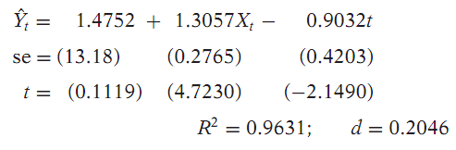
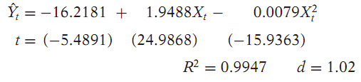
Pure versus model misspecification autocorrelation
Autocorrelation occurring from other than the model specification bias.
How we come to know?
Example:
Change model:
The solution is GLS and FGLS Methods

Slide 10





Generalized Least Square Method...
For simplicity assume the two variable model:
Assume error term follow the scheme
If is known :
If the given relation holds true at time t, it also holds true at time (t − 1).
Apply OLS on the transformed variables. The estimators will be BLUE. This is GLS

Slide 12

GLS….
When is not known:
Apply first difference model:
As ranges between -1 to 1:
Suppose is equal to 1 the previous model becomes:
Now run the regression
The is highly debatable: ignoring all
The model is with out intercept
It may help in getting rid of autocorrelation along with making the series stationary.

Slide 14
Model specification bias
CLRM assumes that model is correctly specified
What are the criteria in choosing a model for empirical analysis?
What types of model speciﬁcation errors is one likely to encounter in practice?
What are the consequences of speciﬁcation errors?
How does one detect speciﬁcation errors?
What remedies can one adopt and with what beneﬁts?
How does one evaluate the performance of competing models?

Slide 15
Model specification …
According to Hendry and Richard, a model chosen for empirical analysis should satisfy the following criteria
Be data admissible: predictions made from the model must be logically possible:
Be consistent with theory: it must make good theoretical sense.
Have weakly exogenous regressors: regressors must be uncorrelated with the error term.
Exhibit parameter constancy: the values of the parameters should be stable otherwise forecasting will be difficult.
Exhibit data coherency: The residuals estimated from the model must be purely random
Be encompassing: Other models cannot be an improvement over the chosen model.

