Slide 1
Lecture 20
Summary of previous lecture
Heteroscedasticity
Nature
Reasons
Consequences
Detection
Remedial measure

Slide 2
What we are going to cover today
Heteroscedasticity
Methods of detection
Remedial measure

Slide 3


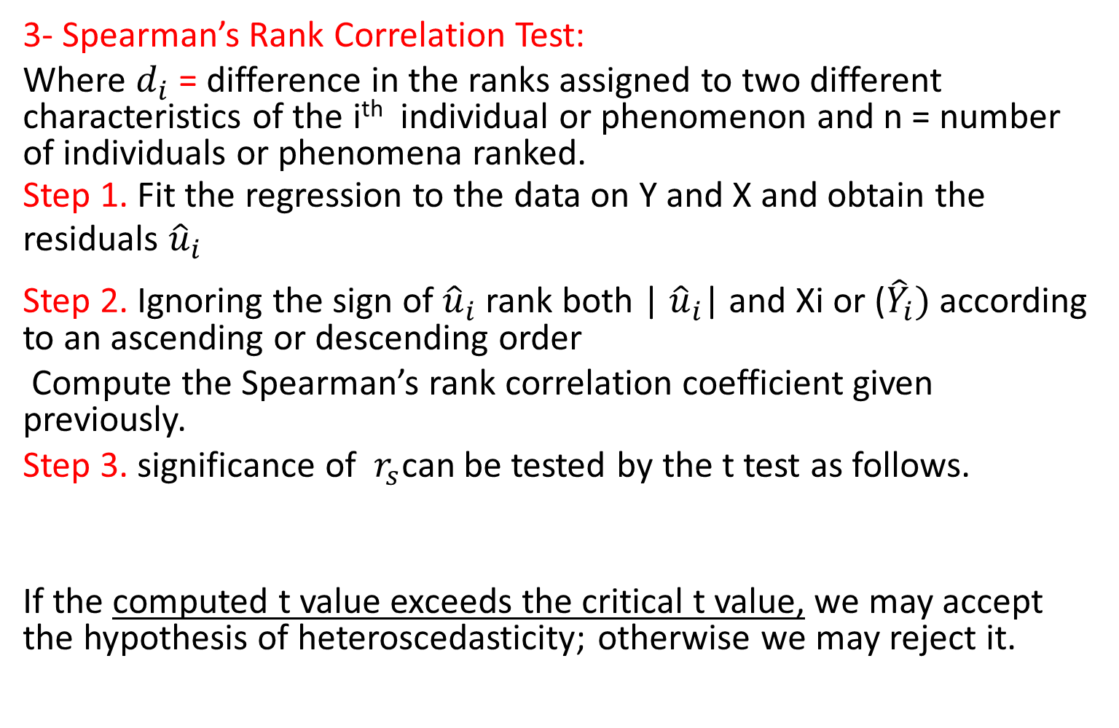
Formal Methods…
3- Spearman’s Rank Correlation Test:
Where $d_{i}$ = difference in the ranks assigned to two different characteristics of the i^{th} individual or phenomenon and n = number of individuals or phenomena ranked.
Step 1. Fit the regression to the data on Y and X and obtain the residuals ${\hat{u}}_{i}$
Step 2. Ignoring the sign of ${\hat{u}}_{i}$ rank both | ${\hat{u}}_{i}$| and Xi or (${\hat{Y}}_{i})$according to an ascending or descending order
Compute the Spearman’s rank correlation coefficient given previously.
Step 3. significance of $r_{s}$can be tested by the t test as follows.
If the computed t value exceeds the critical t value, we may accept the hypothesis of heteroscedasticity; otherwise we may reject it.

Slide 5

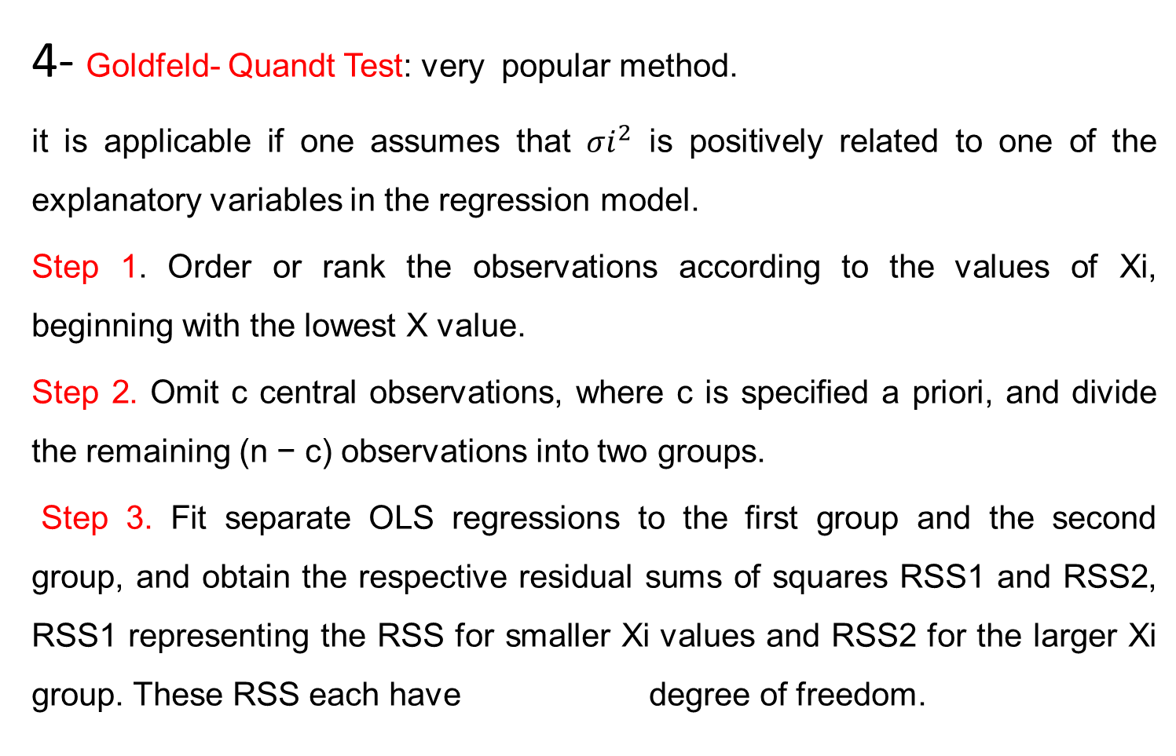
Formal Methods…
4- Goldfeld- Quandt Test: very popular method.
it is applicable if one assumes that ${σi}^{2}$ is positively related to one of the explanatory variables in the regression model.
Step 1. Order or rank the observations according to the values of Xi, beginning with the lowest X value.
Step 2. Omit c central observations, where c is specified a priori, and divide the remaining (n − c) observations into two groups.
Step 3. Fit separate OLS regressions to the first group and the second group, and obtain the respective residual sums of squares RSS1 and RSS2, RSS1 representing the RSS for smaller Xi values and RSS2 for the larger Xi group. These RSS each have degree of freedom.

Slide 6

Goldfeld- Quandt Test
Step 4. Compute the ratio:
If in an application the computed λ (= F) is greater than the critical F at the chosen level of significance, we can reject the hypothesis of homoscedasticity, that is, we can say that heteroscedasticity is very likely.
Things to remember:
1- The choice of c value is critical and debatable
2- if more than one independent variable ranking of observation can be made according to any of the Xi variable.

Slide 8


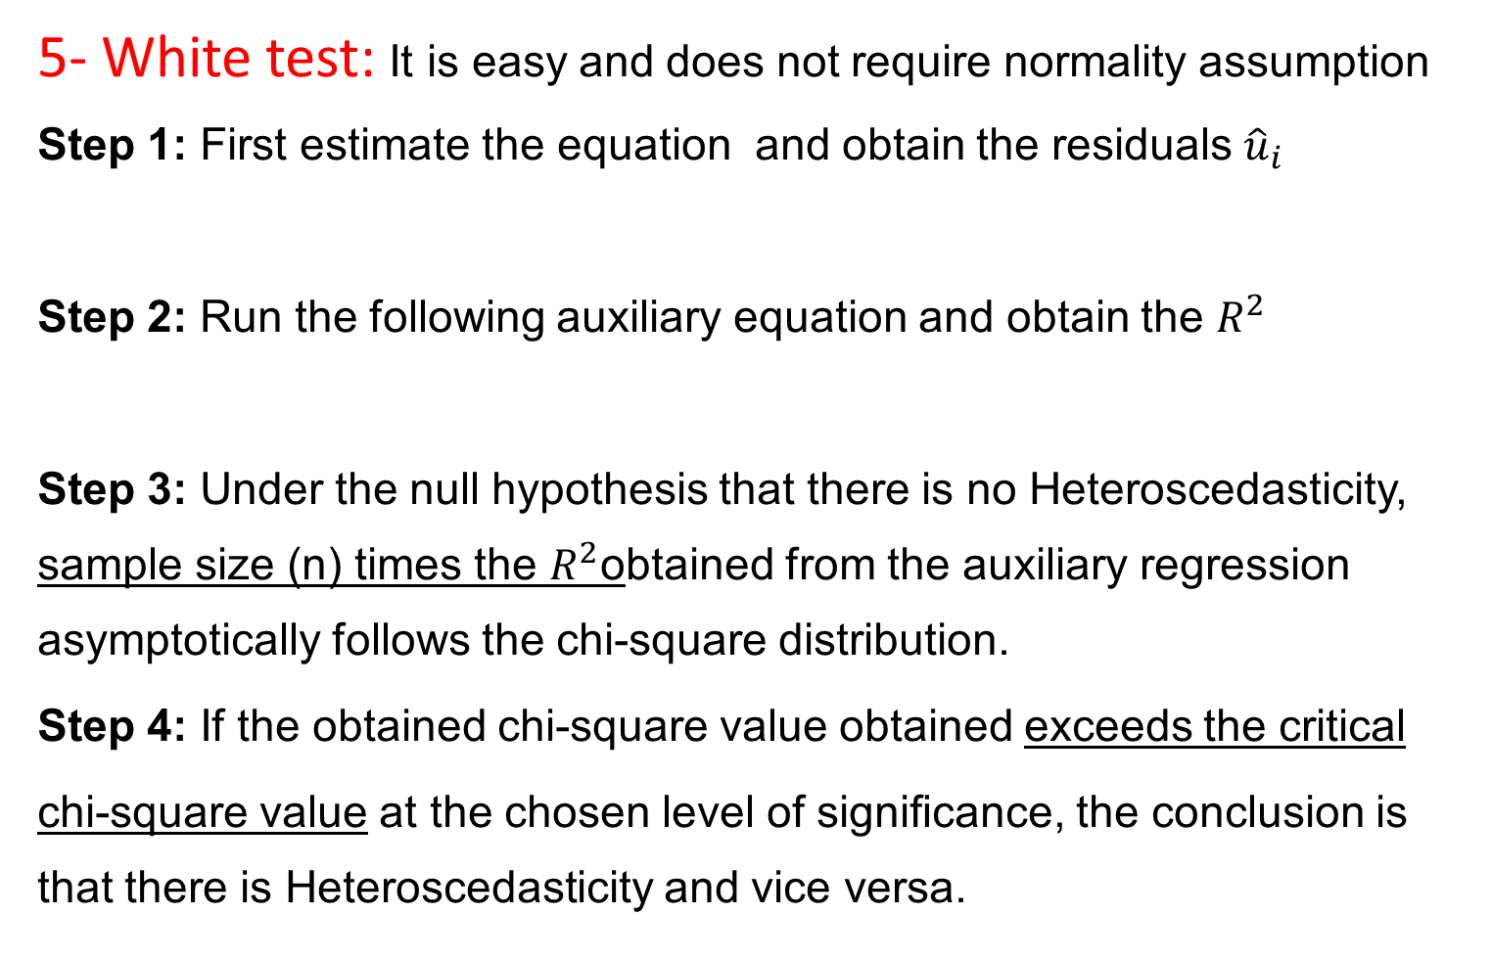
General test of Heteroscedasticity
5- White test: It is easy and does not require normality assumption
Step 1: First estimate the equation and obtain the residuals ${\hat{u}}_{i}$
Step 2: Run the following auxiliary equation and obtain the $R^{2}$
Step 3: Under the null hypothesis that there is no Heteroscedasticity, sample size (n) times the $R^{2}$obtained from the auxiliary regression asymptotically follows the chi-square distribution.
Step 4: If the obtained chi-square value obtained exceeds the critical
chi-square value at the chosen level of signiﬁcance, the conclusion is that there is Heteroscedasticity and vice versa.

Slide 9
Other Tests of Heteroscedasticity
Breusch–Pagan–Godfrey Test,
Koenker–Bassett (KB) test,

Slide 10
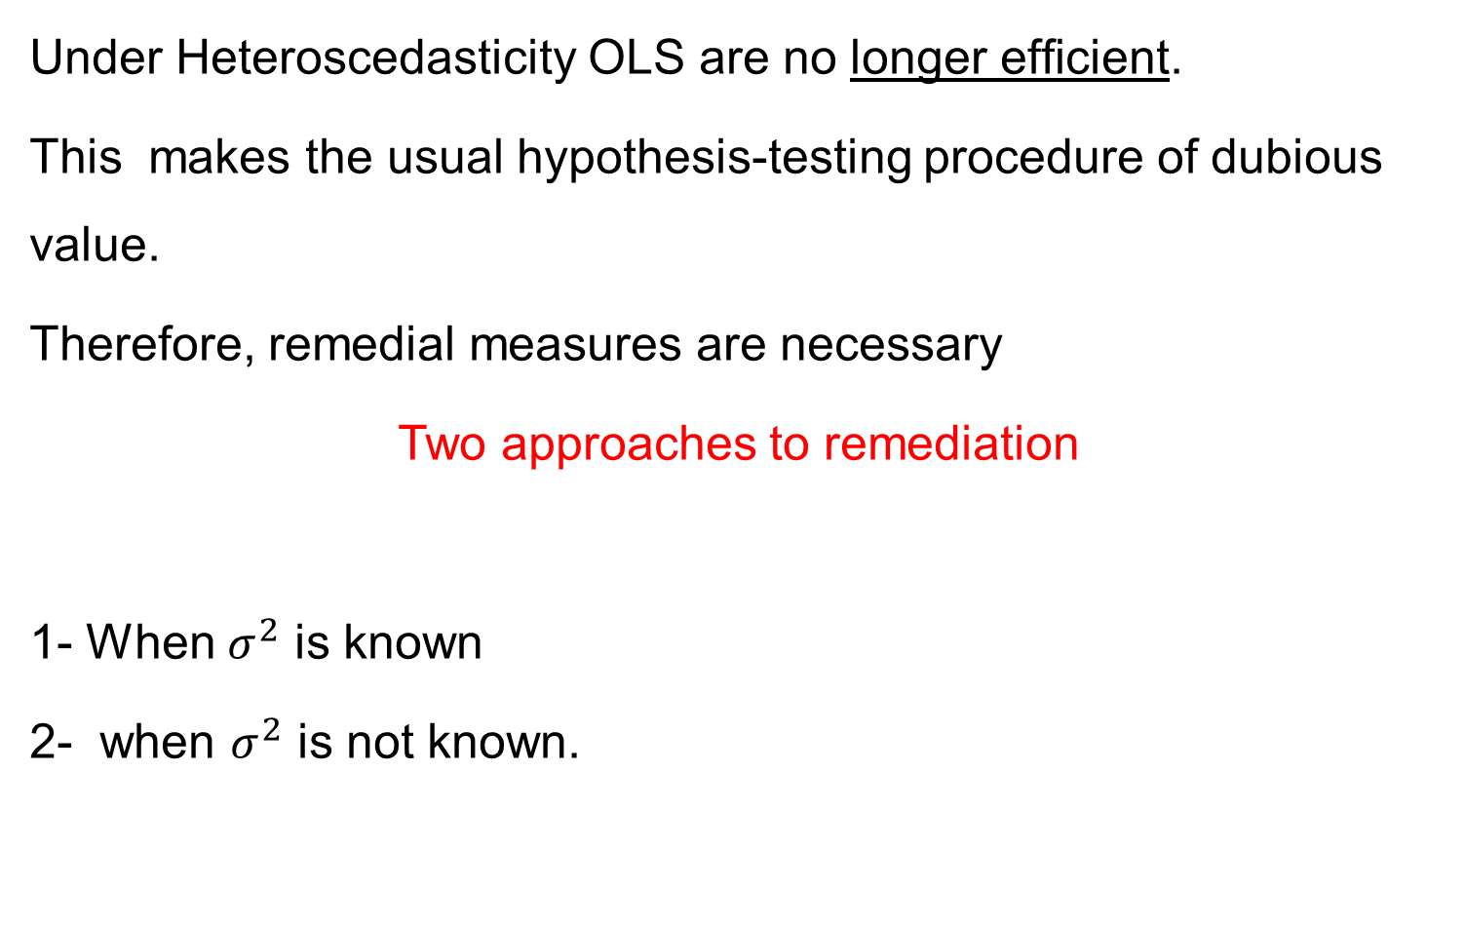
Remedial Measures
Under Heteroscedasticity OLS are no longer efﬁcient.
This makes the usual hypothesis-testing procedure of dubious value.
Therefore, remedial measures are necessary
Two approaches to remediation
1- When $σ^{2}$ is known
2- when $σ^{2}$ is not known.

Slide 11

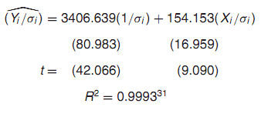
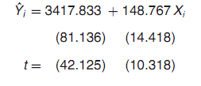
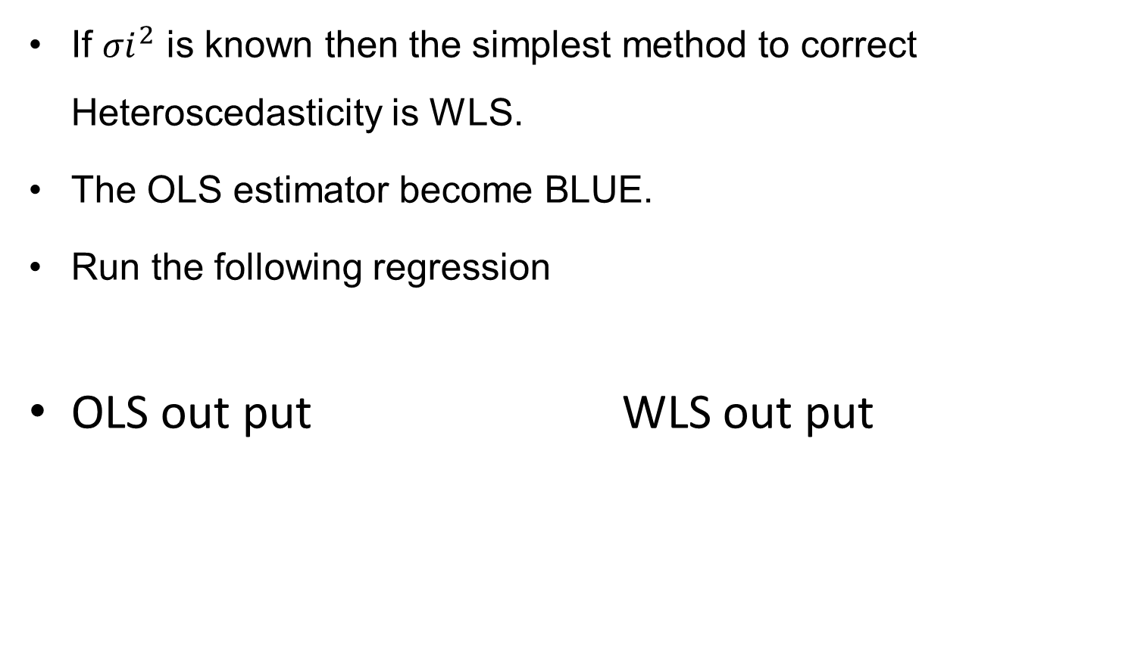
When ${σi}^{2}$is known
If ${σi}^{2}$ is known then the simplest method to correct Heteroscedasticity is WLS.
The OLS estimator become BLUE.
Run the following regression
OLS out put WLS out put

Slide 13
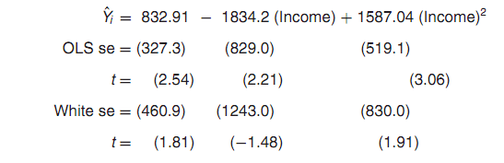
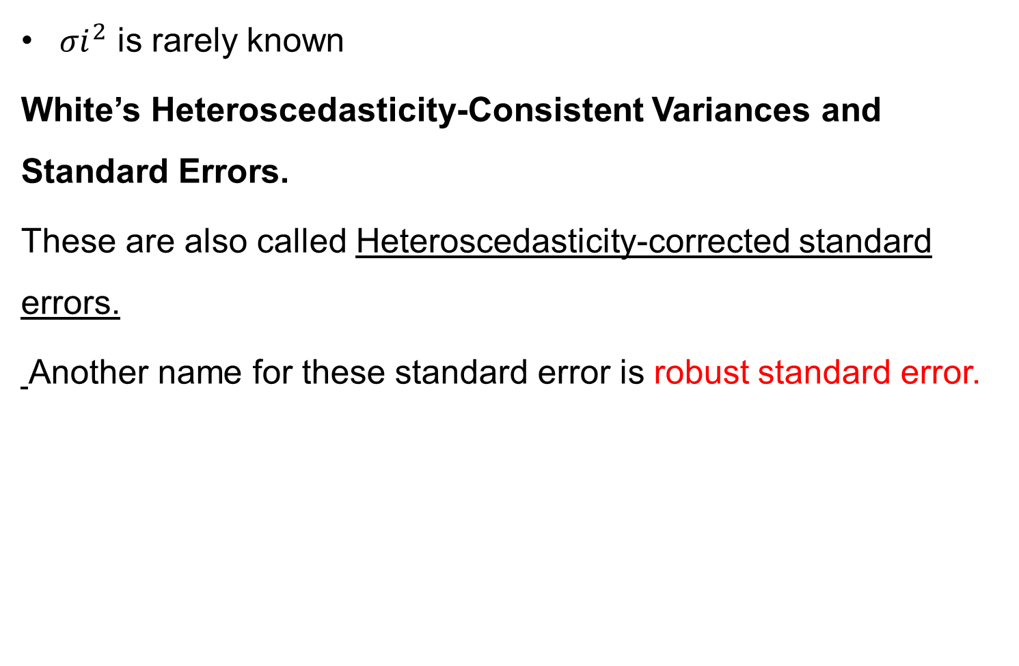
When ${σi}^{2}$is not known
${σi}^{2}$ is rarely known
White’s Heteroscedasticity-Consistent Variances and Standard Errors.
These are also called Heteroscedasticity-corrected standard errors.
Another name for these standard error is robust standard error.

