Slide 1
Lecture 19
Summary of previous Lecture
Multicollinearity
Degree not presence
Sources
Detection
Remedies

Slide 2
Today Discussion
Heteroscedasticity
Nature
Reasons
Consequences
Detection
Remedial measure

Slide 3

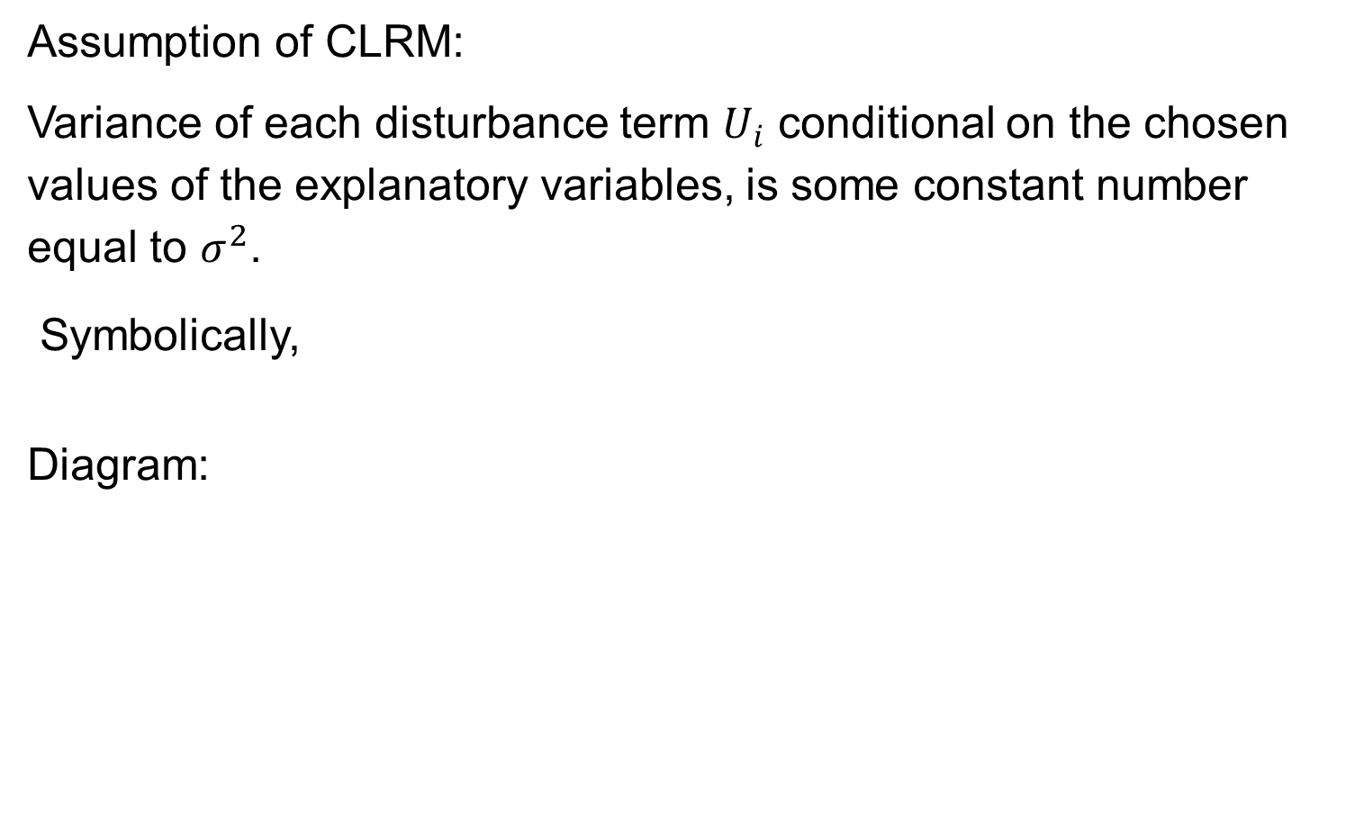
HETEROSCEDASTICITY
Assumption of CLRM:
Variance of each disturbance term $U_{i}$ conditional on the chosen values of the explanatory variables, is some constant number equal to $σ^{2}$.
Symbolically,
Diagram:

Slide 4
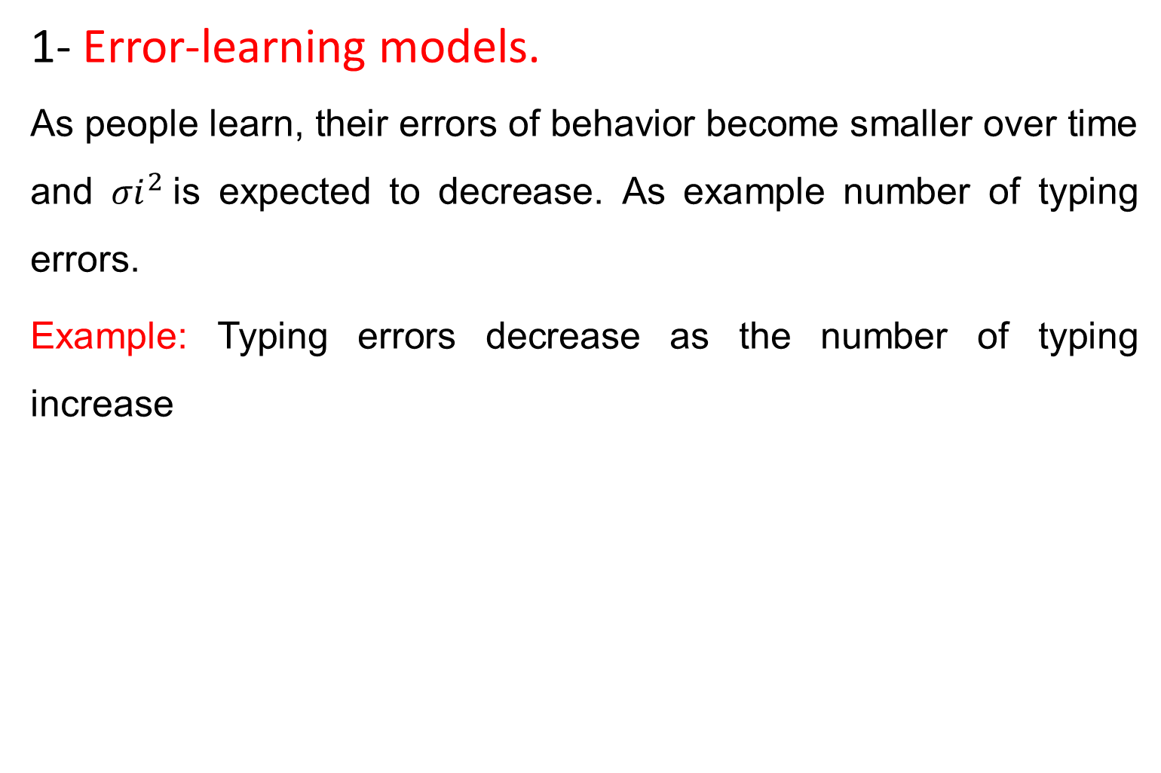
Why Heteroscedasticity- reasons
1- Error-learning models.
As people learn, their errors of behavior become smaller over time and ${σi}^{2}$is expected to decrease. As example number of typing errors.
Example: Typing errors decrease as the number of typing increase

Slide 5
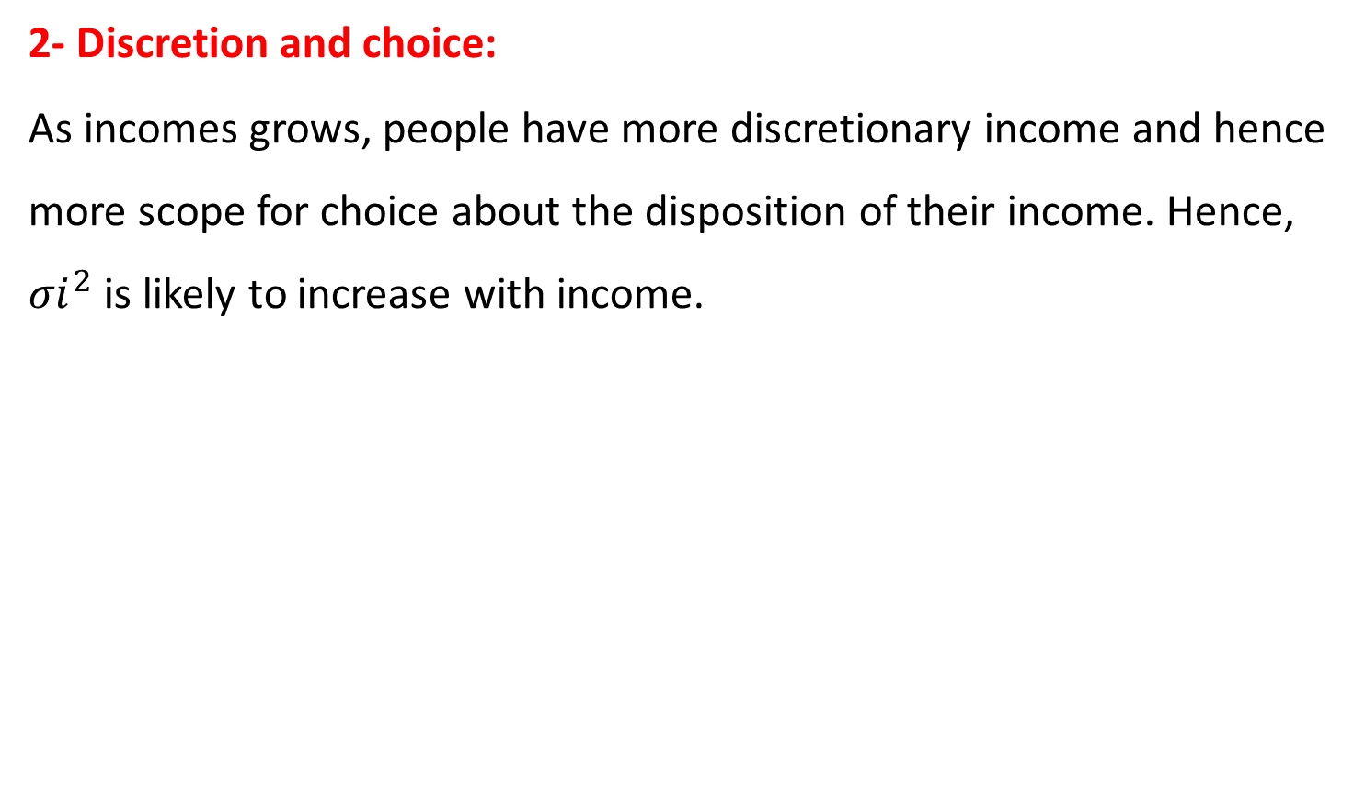
Reasons….
2- Discretion and choice:
As incomes grows, people have more discretionary income and hence more scope for choice about the disposition of their income. Hence, ${σi}^{2}$ is likely to increase with income.

Slide 6
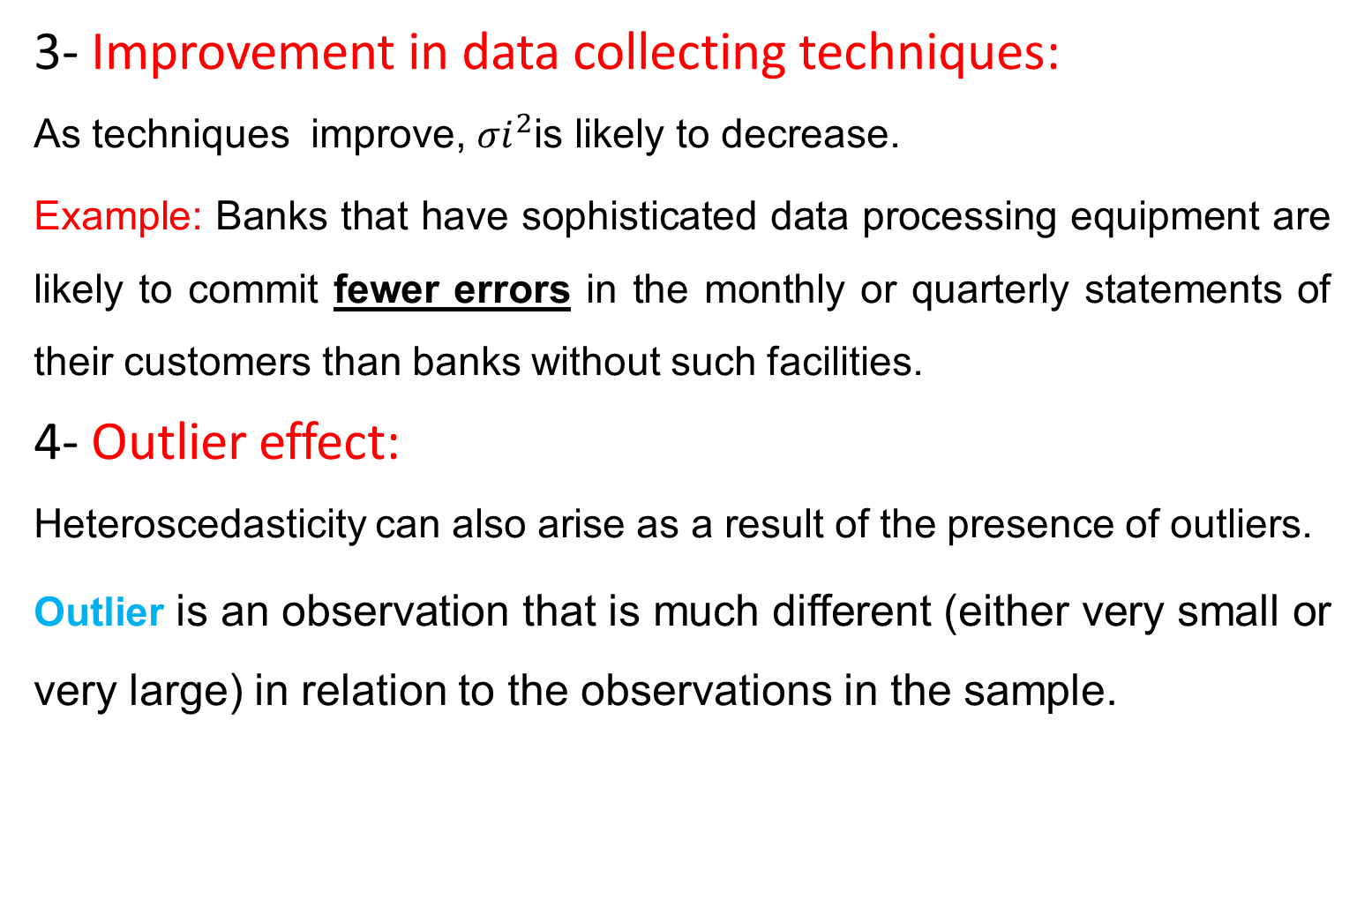
Reasons……..
3- Improvement in data collecting techniques:
As techniques improve, ${σi}^{2}$is likely to decrease.
Example: Banks that have sophisticated data processing equipment are likely to commit fewer errors in the monthly or quarterly statements of their customers than banks without such facilities.
4- Outlier effect:
Heteroscedasticity can also arise as a result of the presence of outliers.
Outlier is an observation that is much different (either very small or very large) in relation to the observations in the sample.

Slide 8
Reasons……
5-Specification bias:
Heteroscedasticity may arise from violating Assumption, correctly specified.
Example: Omission of important variables:
The demand function.
The residuals obtained from the regression may give the distinct impression that the error variance may not be constant.
6- Skewness: Skewness in the distribution of one or more regressors included in the model.
Examples: economic variables such as income, and wealth
It is well known that the distribution of income and wealth in most societies is uneven, with the bulk of the income and wealth being owned by a few at the top

Slide 10
Reasons...
7- Other sources:
incorrect data transformation (e.g., ratio or first difference transformations)
incorrect functional form (e.g., linear versus log–linear models).
Notes:
It is interesting that OLS are Blue in the presence of Multicollinearity while not BLUE in case of Hetroscedasticity despite in both cases parameters have larger variance and consequently larger variances. The reason is that in case of MC though OLS parameters have larger standard errors i.e., yet these are smaller as compare to parameters estimated by other methods like Maximum Likelihood. While in heteroscedasticity the parameters estimated by other methods may have lower variances than the OLS estimators.

Slide 11
Implications of Heteroscedasticity
OLS is still unbiased.
OLS is no longer efficient; some other linear estimator will have a lower variance.
Estimated Standard Errors will be incorrect; C.I.’s and hypothesis tests will be incorrect.
The solution is GLS and WLS.

Slide 12
Tests for Heteroscedasticity
Like Multicollinearity, there are no hard-and-fast rules for detecting heteroscedasticity, only a few rules of thumb.
In most cases Heteroscedasticity may be a matter of intuition, educated guesswork, prior empirical experience, or sheer speculation.
Two approaches
Informal and Formal Methods
Informal methods:
1- Nature of the Problem:
The nature of the problem under consideration suggests whether heteroscedasticity is likely to be encountered.
For example cross-sectional data involving heterogeneous units, heteroscedasticity may be the rule.

Slide 13
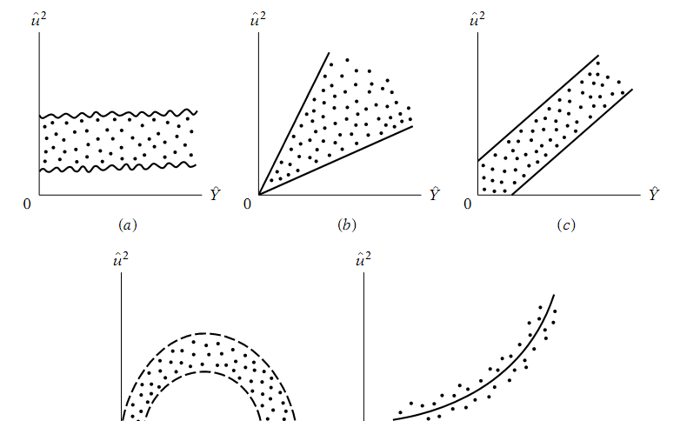
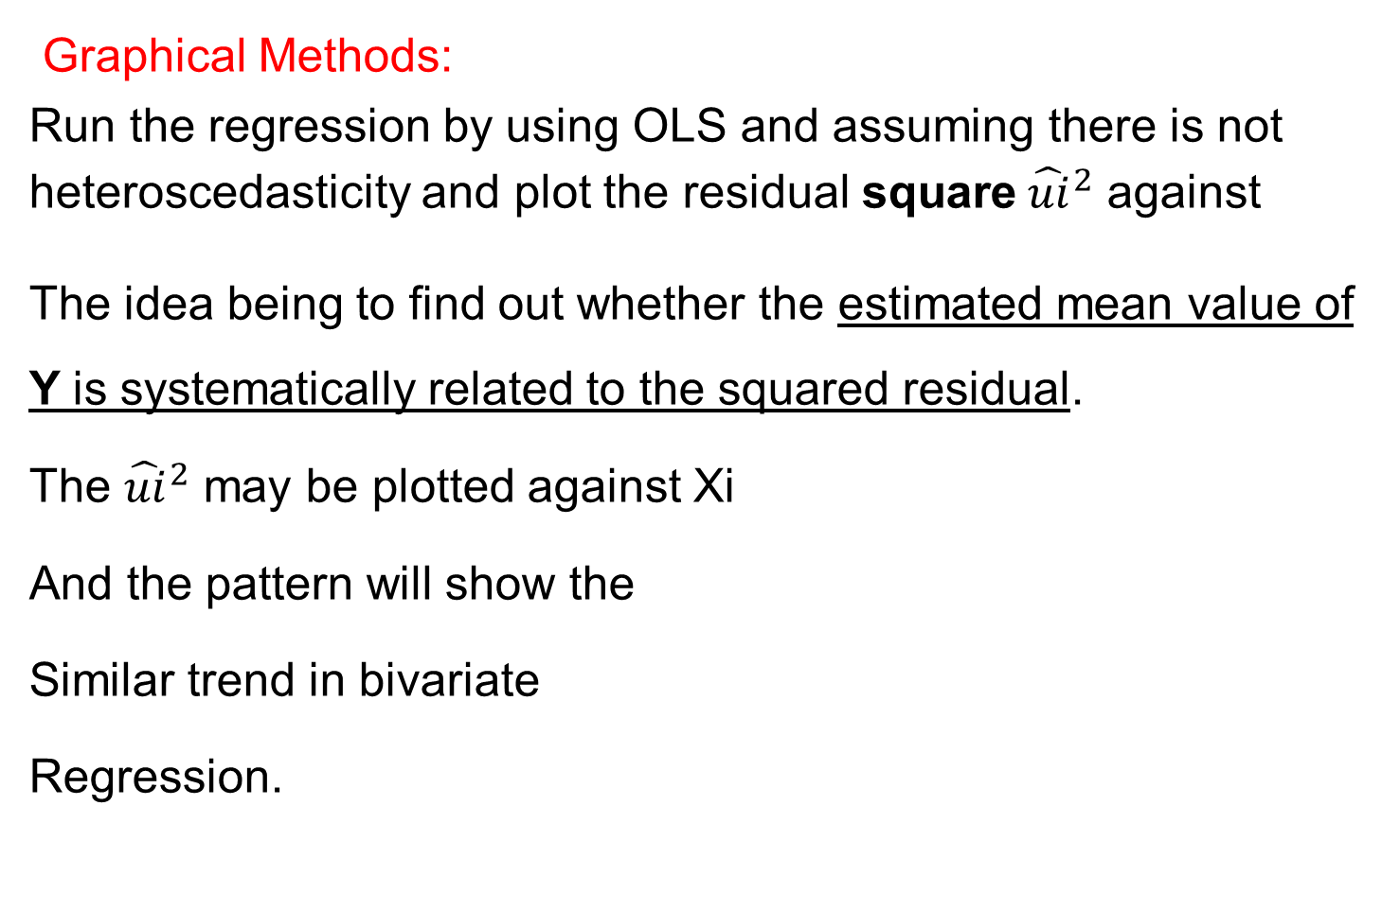
Informal Methods
Graphical Methods:
Run the regression by using OLS and assuming there is not heteroscedasticity and plot the residual square ${\hat{ui}}^{2}$ against
The idea being to find out whether the estimated mean value of Y is systematically related to the squared residual.
The ${\hat{ui}}^{2}$ may be plotted against Xi
And the pattern will show the
Similar trend in bivariate
Regression.

Slide 14

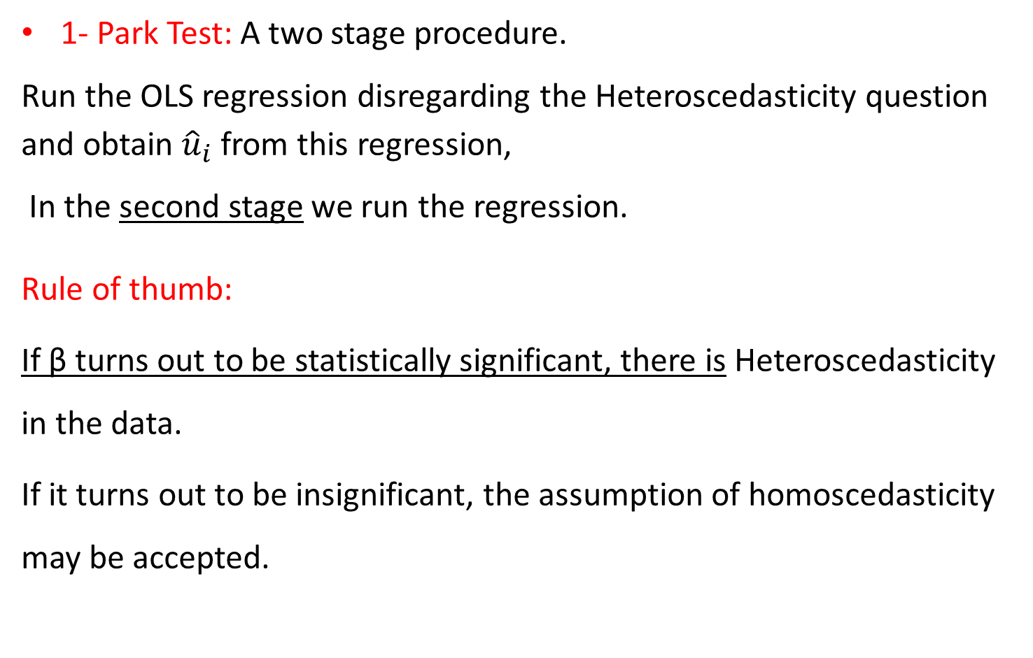
Formal Methods
1- Park Test: A two stage procedure.
Run the OLS regression disregarding the Heteroscedasticity question and obtain ${\hat{u}}_{i}$from this regression,
In the second stage we run the regression.
Rule of thumb:
If β turns out to be statistically significant, there is Heteroscedasticity in the data.
If it turns out to be insignificant, the assumption of homoscedasticity may be accepted.

Slide 17
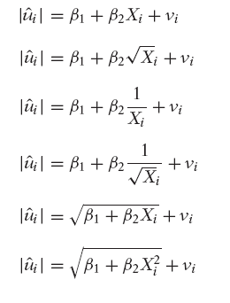
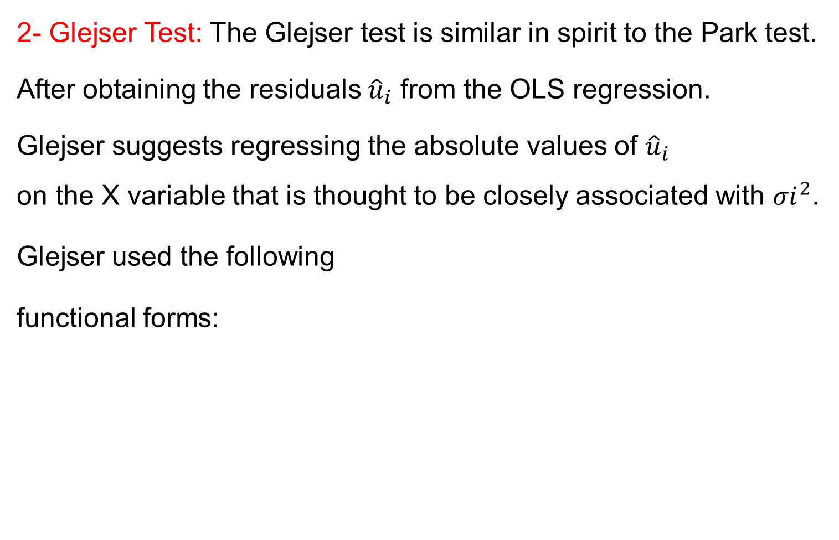
Formal Methods….
2- Glejser Test: The Glejser test is similar in spirit to the Park test.
After obtaining the residuals ${\hat{u}}_{i}$ from the OLS regression.
Glejser suggests regressing the absolute values of ${\hat{u}}_{i}$
on the X variable that is thought to be closely associated with ${σi}^{2}$.
Glejser used the following
functional forms:

