Slide 1
Lecture 18

Slide 2
Summary of previous lecture
Multicollinearity
Sources
Consequences
Detection

Slide 3

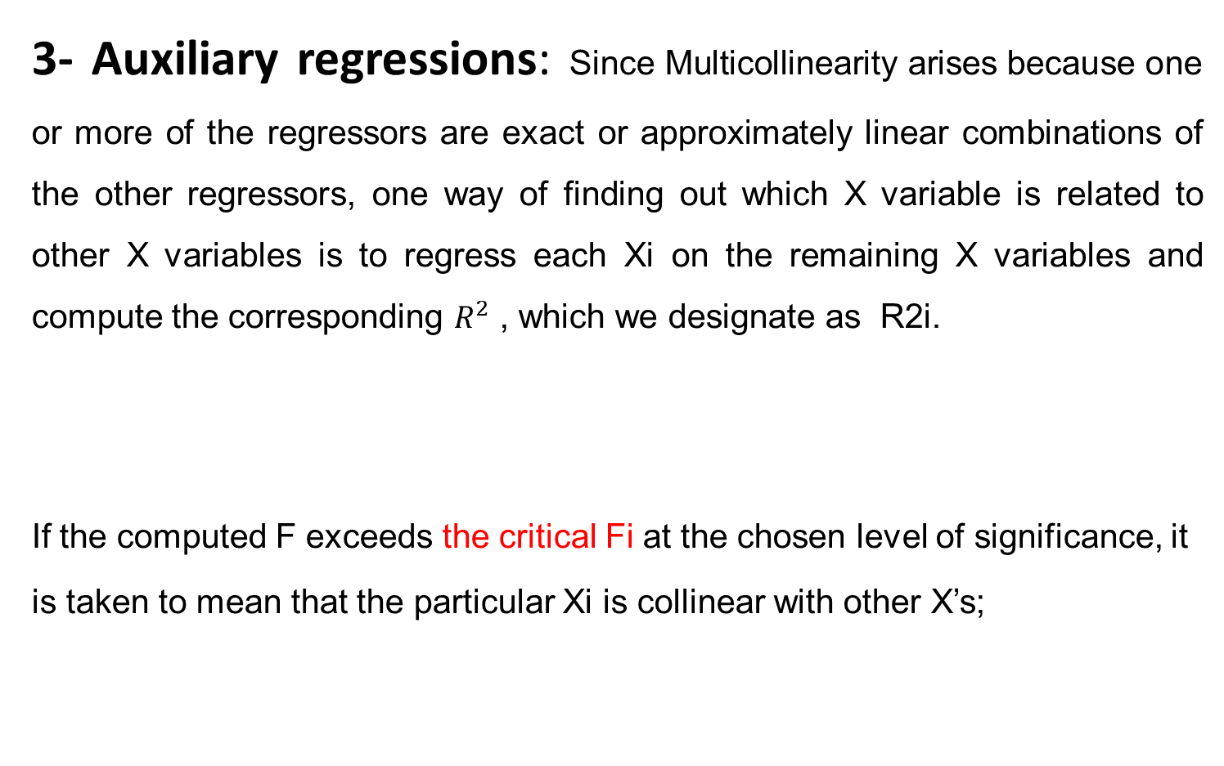
Rules to detect Multicollinearity…..
3- Auxiliary regressions: Since Multicollinearity arises because one or more of the regressors are exact or approximately linear combinations of the other regressors, one way of finding out which X variable is related to other X variables is to regress each Xi on the remaining X variables and compute the corresponding $R^{2}$ , which we designate as R2i.
If the computed F exceeds the critical Fi at the chosen level of significance, it is taken to mean that the particular Xi is collinear with other X’s;

Slide 5

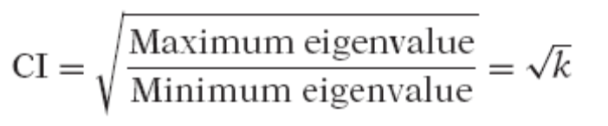
Rules to detect Multicollinearity
4- Eigenvalues and condition index: Statistical software report the eigenvalues of the regression. From these eigenvalues, we can derive what is known as the condition number k defined as
and the condition index (CI) defined as;
Rule of Thumb: If k is between 100 and 1000 there is moderate to strong Multicollinearity and if it exceeds 1000 there is severe Multicollinearity.
Alternatively, if the CI (= √k) is between 10 and 30, there is moderate to strong Multicollinearity and if it exceeds 30 there is severe Multicollinearity.
Example:

Slide 7

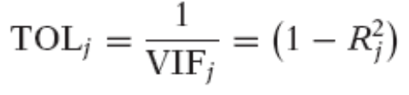
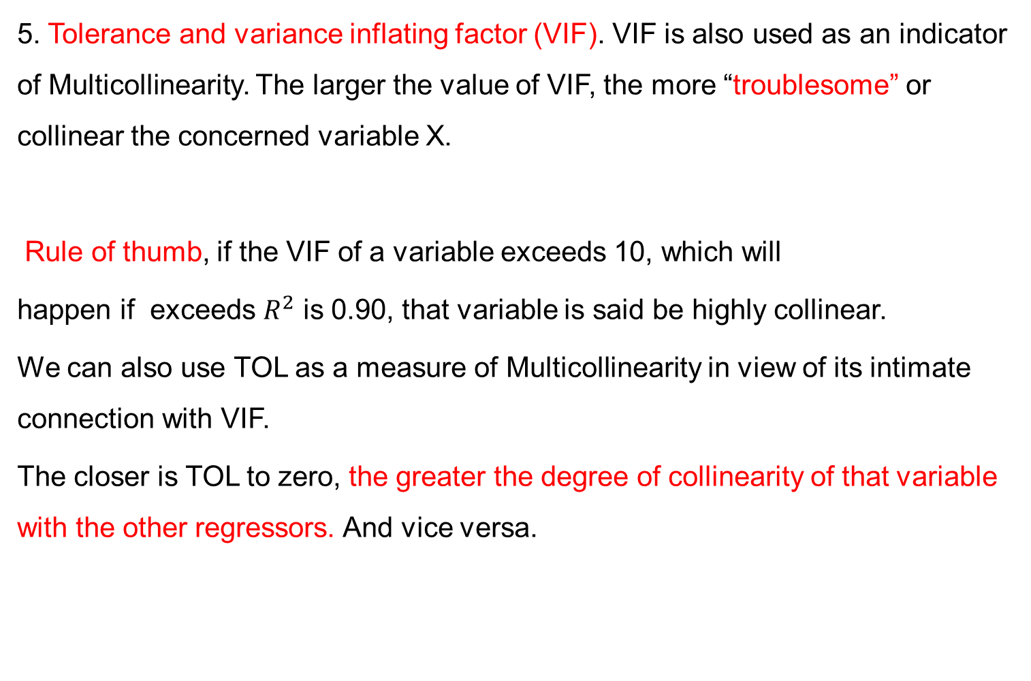
Rules to detect Multicollinearity
5. Tolerance and variance inflating factor (VIF). VIF is also used as an indicator of Multicollinearity. The larger the value of VIF, the more “troublesome” or collinear the concerned variable X.
Rule of thumb, if the VIF of a variable exceeds 10, which will
happen if exceeds $R^{2}$ is 0.90, that variable is said be highly collinear.
We can also use TOL as a measure of Multicollinearity in view of its intimate connection with VIF.
The closer is TOL to zero, the greater the degree of collinearity of that variable with the other regressors. And vice versa.

Slide 9
Remedial Measures
What can be done if Multicollinearity is serious?
We have two choices: (1) do nothing (2) follow some rules of thumb.
1- Do Nothing: The “do nothing” school of thought is expressed by Blanchard.
When students run their first ordinary least squares (OLS) regression, the first problem that they usually encounter is that of Multicollinearity.
They blame OLS and resort to new and often creative techniques.
Multicollinearity is God’s will, not a problem with OLS or statistical technique in general.
What Blanchard is saying is that Multicollinearity is essentially a data
deficiency problem.
We have no choice over the data that is available for empirical analysis.

Slide 10


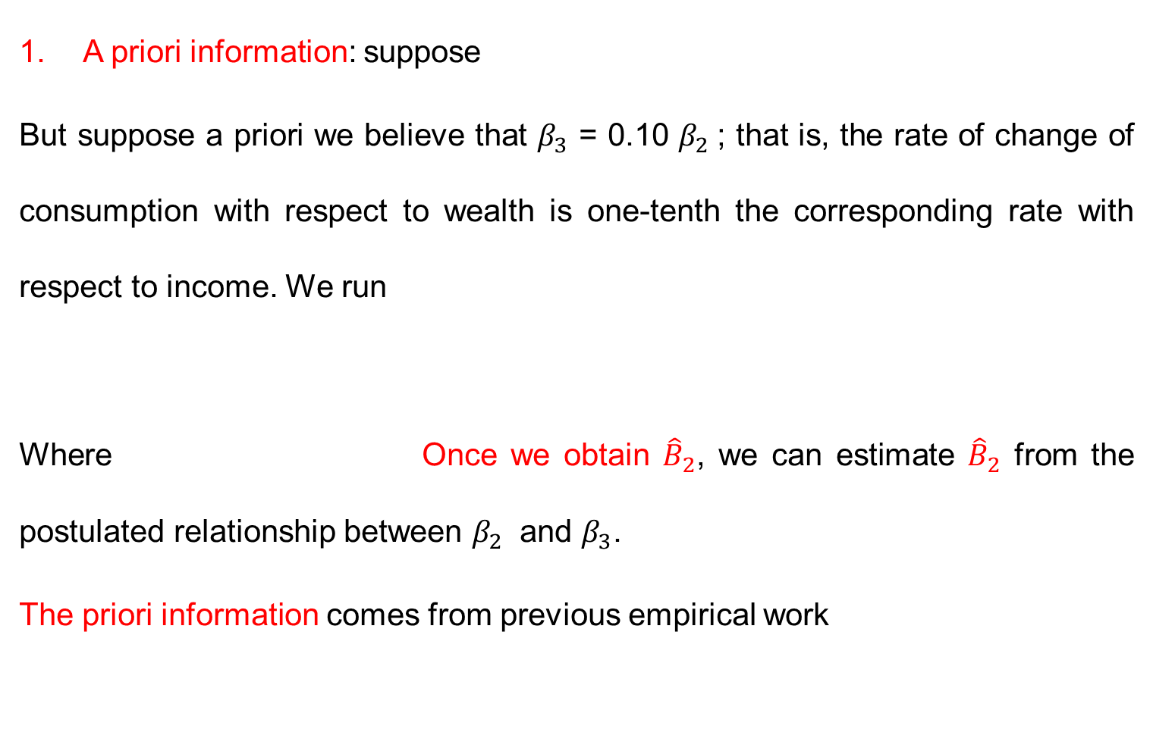
Rule-of-Thumb Procedures
A priori information: suppose
But suppose a priori we believe that $β_{3}$ = 0.10 $β_{2}$; that is, the rate of change of consumption with respect to wealth is one-tenth the corresponding rate with respect to income. We run
Where Once we obtain ${\hat{B}}_{2}$, we can estimate ${\hat{B}}_{2}$ from the postulated relationship between $β_{2}$ and $β_{3}$.
The priori information comes from previous empirical work

Slide 12
Rule-of-Thumb Procedures…..
2. Combining cross-sectional and time series data.
A variant of a priori information technique is the combination of cross-sectional and time-series data, known as pooling the data.

Slide 13
Rule-of-Thumb Procedures…..
3. Dropping a variable(s) and specification bias: To deal with severe Multicollinearity, one of the “simplest” things to do is to drop one of the collinear variables. Example consumption–income–wealth .
But in dropping a variable from the model we may be committing a specification bias or specification error.
Specification bias arises from incorrect specification of the model used in the analysis. Thus, dropping the wealth variable would constitute specification bias.
Hence the remedy may be worse than the disease in some situations

Slide 15

Rule-of-Thumb Procedures…..
4. Transformation of variables.
A- First difference transformation Example: consumption, income, wealth
The first difference regression model often reduces the severity of Multicollinearity.
The error term Vt may not satisfy one of the assumptions.
Therefore, the remedy may be worse than the disease.
B: Ratio Transformation:
Example: GDP, TAXES,

Slide 17
Rule-of-Thumb Procedures…..
5. Additional or new data: Since Multicollinearity is a sample feature. Sometimes simply increasing the size of the sample (if possible) may soften the collinearity problem.
Unfortunately, economists seldom can obtain additional data without bearing large costs.

Slide 18
Rule-of-Thumb Procedures…..
6. Reducing collinearity in polynomial regressions:
A special feature of these models is that the explanatory variable(s) appear with various powers.
One practice is that if the explanatory variable are expressed in the deviation form, Multicollinearity is substantially reduced.
But even then the problem may persist
In which case one may want to consider techniques such as
orthogonal polynomials.

Slide 19
Rule-of-Thumb Procedures…..
7. Other methods of remedying Multicollinearity. Multivariate statistical techniques such as factor analysis and principal components or techniques such as ridge regression are often employed to “solve” the problem of Multicollinearity.

Slide 20
IS MULTICOLLINEARITY NECESSARILY BAD?
Maybe not if the objective is prediction only
In general it is not a serious issue particularly in the large sample.

