Slide 1
Lecture 17
Summary of previous Lecture
Eviews

Slide 2
Today discussion
R-Square
Adjusted R- Square
Game of Maximizing Adjusted R- Square
Multiple regression model
Problem of Estimation

Slide 3
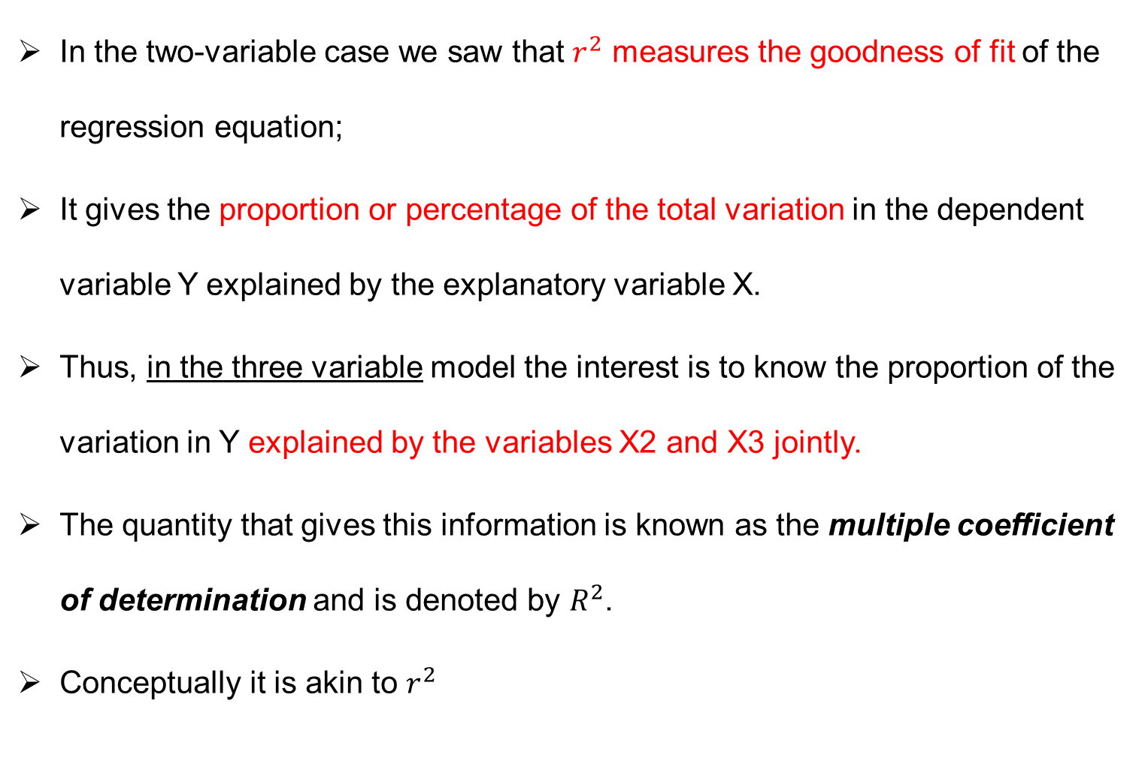
Measure of goodness of fit $R^{2}$
In the two-variable case we saw that $r^{2}$ measures the goodness of fit of the regression equation;
It gives the proportion or percentage of the total variation in the dependent variable Y explained by the explanatory variable X.
Thus, in the three variable model the interest is to know the proportion of the variation in Y explained by the variables X2 and X3 jointly.
The quantity that gives this information is known as the multiple coefficient of determination and is denoted by $R^{2}$.
Conceptually it is akin to $r^{2}$

Slide 4
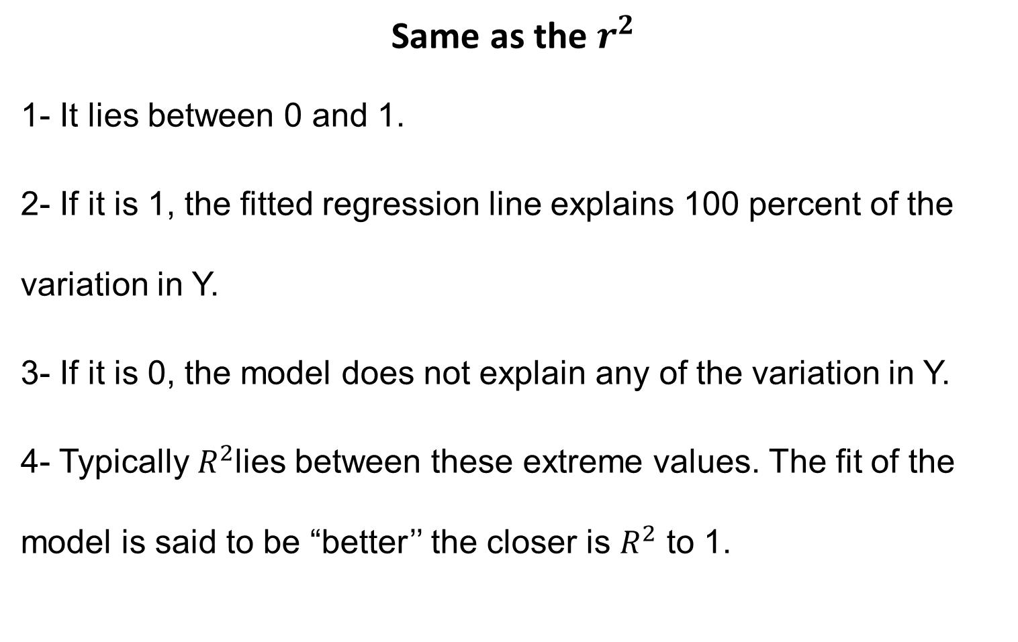
Properties of $R^{2}$
Same as the $r^{2}$
1- It lies between 0 and 1.
2- If it is 1, the fitted regression line explains 100 percent of the variation in Y.
3- If it is 0, the model does not explain any of the variation in Y.
4- Typically $R^{2}$lies between these extreme values. The fit of the model is said to be “better’’ the closer is $R^{2}$ to 1.

Slide 5
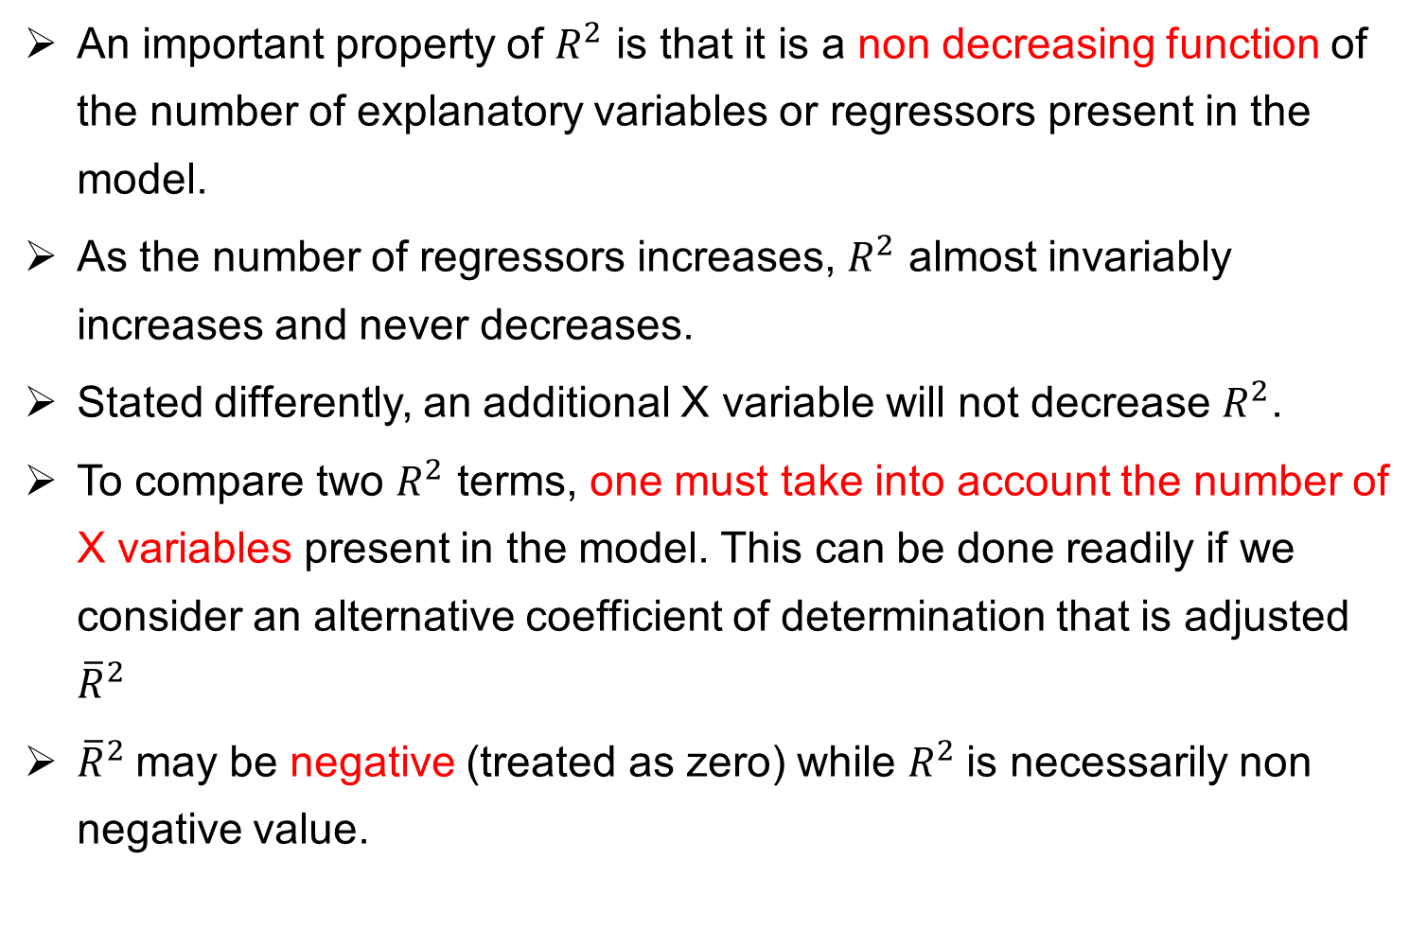
$R^{2}$AND THE ADJUSTED (${\overline{R}}^{2}$)
An important property of $R^{2}$ is that it is a non decreasing function of the number of explanatory variables or regressors present in the model.
As the number of regressors increases, $R^{2}$ almost invariably increases and never decreases.
Stated differently, an additional X variable will not decrease $R^{2}$.
To compare two $R^{2}$ terms, one must take into account the number of X variables present in the model. This can be done readily if we consider an alternative coefficient of determination that is adjusted ${\overline{R}}^{2}$
${\overline{R}}^{2}$may be negative (treated as zero) while $R^{2}$is necessarily non negative value.

Slide 6
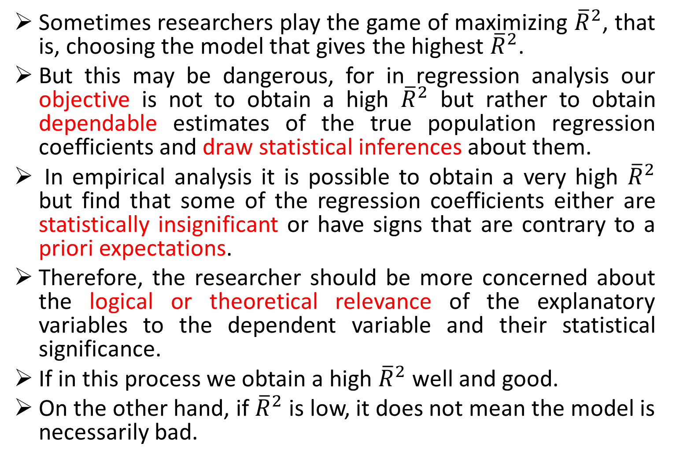
The “Game’’ of Maximizing ${\overline{R}}^{2}$
Sometimes researchers play the game of maximizing ${\overline{R}}^{2}$, that is, choosing the model that gives the highest ${\overline{R}}^{2}$.
But this may be dangerous, for in regression analysis our objective is not to obtain a high ${\overline{R}}^{2}$ but rather to obtain dependable estimates of the true population regression coefficients and draw statistical inferences about them.
In empirical analysis it is possible to obtain a very high ${\overline{R}}^{2}$ but find that some of the regression coefficients either are statistically insignificant or have signs that are contrary to a priori expectations.
Therefore, the researcher should be more concerned about the logical or theoretical relevance of the explanatory variables to the dependent variable and their statistical significance.
If in this process we obtain a high ${\overline{R}}^{2}$ well and good.
On the other hand, if ${\overline{R}}^{2}$ is low, it does not mean the model is necessarily bad.

Slide 8
Problem of regression analysis
CLRM assumes no Multicollinearity among the regressors included in the regression model.
We will discuss:
What is the nature of Multicollinearity?
Is Multicollinearity really a problem?
What are its practical consequences?
How does one detect it?
What remedial measures can be taken to alleviate the problem of Multicollinearity?

Slide 9
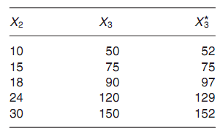
Nature of Multicollinearity
MC means the existence of a “perfect,” or exact, linear relationship among some or all explanatory variables of a regression model:
Example:

Slide 10
Ballantine view of MC

Slide 12
Logic behind Assuming No MC in the CLRM
1- If Multicollinearity is perfect, the regression coefficients of the X variables are indeterminate and their standard errors are infinite.
2- If Multicollinearity is less than perfect the regression coefficients, although determinate, possess large standard errors (in relation to the coefficients themselves), which means the coefficients cannot be estimated with great precision or accuracy.

Slide 13
Sources of Multicollinearity
Four sources of Multicollinearity;
1- The data collection method employed, for example, sampling over a limited range of the values taken by the regressors in the population.
2- Constraints on the model or in the population being sampled. For example, in the regression of electricity consumption on income (X2) and house size (X3) there is a physical constraint in the population in that families with higher incomes generally have larger homes than families with lower incomes.
3- Model specification, for example, adding polynomial terms to a regression model, especially when the range of the X variable is small.

Slide 14
Sources of MC ……
4- An over determined model. This happens when the model has more explanatory variables than the number of observations.
5- Regressors included in the model share a common trend: Variable increase or decrease over time. Thus, in the regression of consumption expenditure on income, wealth, and population, the regressors income, wealth, and population may all be growing over time at more or less the same rate, leading to collinearity among these variables.

Slide 15
Theoretical Consequences of Multicollinearity
If the assumptions of the classical model are satisfied, the OLS estimators of the regression estimators are BLUE.
If Multicollinearity is very high, as in the case of near Multicollinearity, the OLS estimators still retain the property of BLUE.
Then what is the Multicollinearity fuss all about?
No statistical answer can be given
Results: In large sample Multicollinearity is not a serious issue.

Slide 16
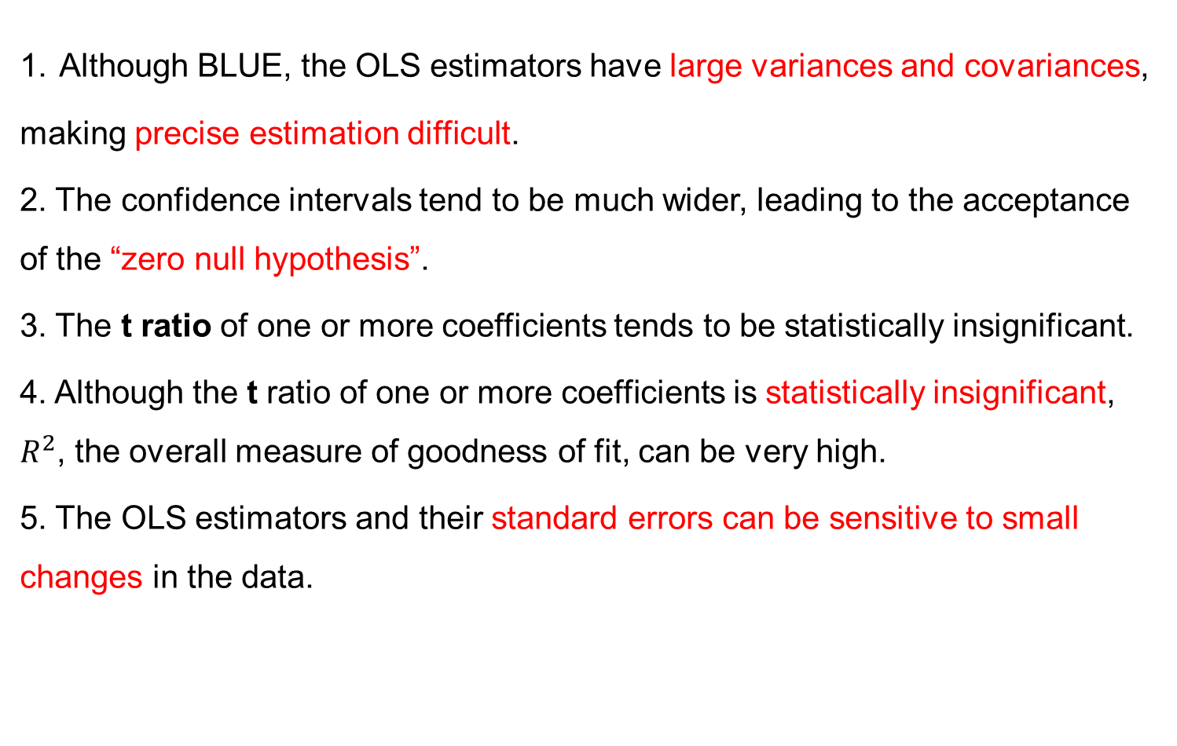
Practical Consequences of Multicollinearity
1. Although BLUE, the OLS estimators have large variances and covariances, making precise estimation difficult.
2. The confidence intervals tend to be much wider, leading to the acceptance of the “zero null hypothesis”.
3. The t ratio of one or more coefficients tends to be statistically insignificant.
4. Although the t ratio of one or more coefficients is statistically insignificant, $R^{2}$, the overall measure of goodness of fit, can be very high.
5. The OLS estimators and their standard errors can be sensitive to small changes in the data.

Slide 18
Detection of Multicollinearity
Multicollinearity is a question of degree and not of kind. Presence and absence of Multicollinearity is not the issue, the issue is its degree, high or low.
It is a feature of the sample and not of the population as it refers to the condition of the explanatory variables that are assumed to be no stochastic. So it is problem of sample not population.
No unique method of detecting it or measuring its strength.
Some rule of thumbs.

Slide 19
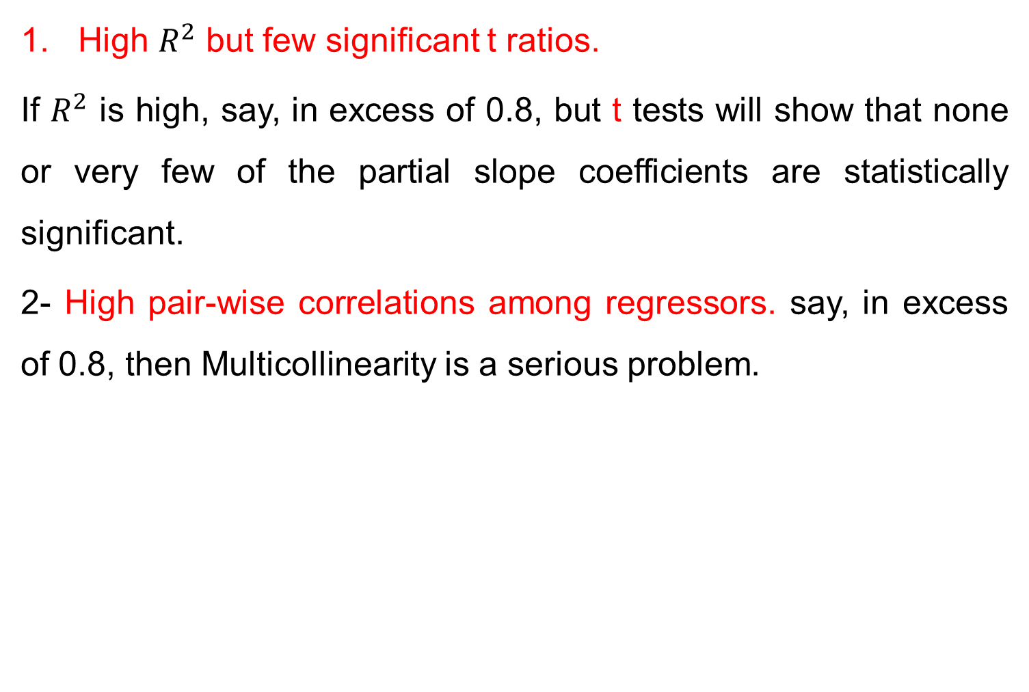
Rules to detect Multicollinearity
High $R^{2}$ but few significant t ratios.
If $R^{2}$ is high, say, in excess of 0.8, but t tests will show that none or very few of the partial slope coefficients are statistically significant.
2- High pair-wise correlations among regressors. say, in excess of 0.8, then Multicollinearity is a serious problem.

Slide 20

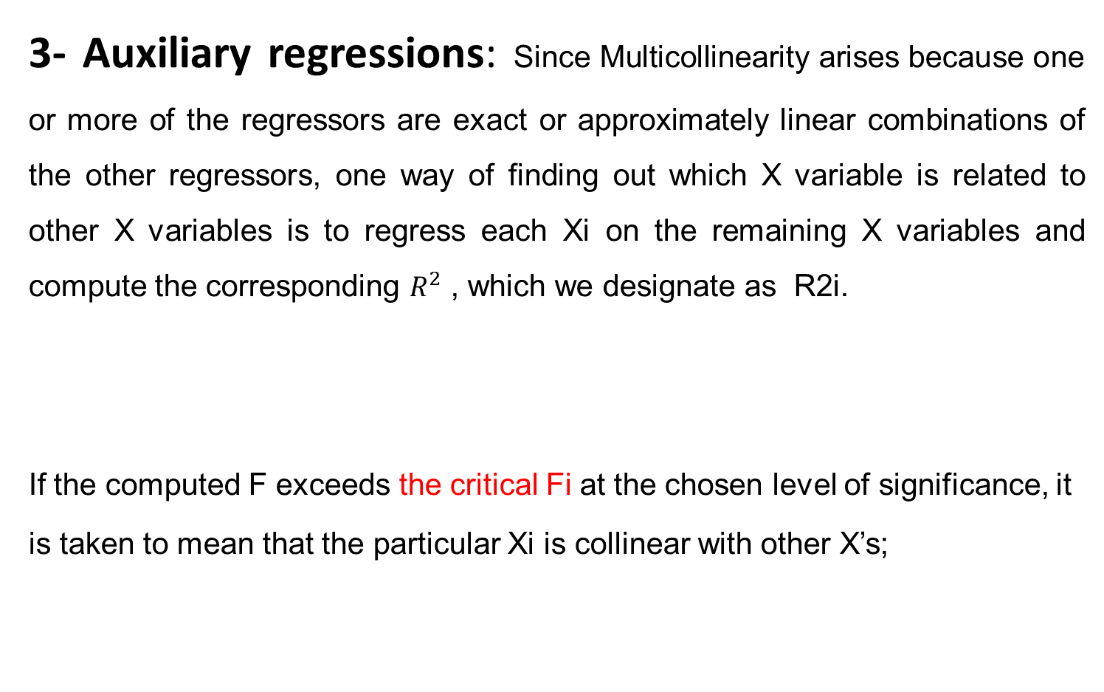
Rules to detect Multicollinearity…..
3- Auxiliary regressions: Since Multicollinearity arises because one or more of the regressors are exact or approximately linear combinations of the other regressors, one way of finding out which X variable is related to other X variables is to regress each Xi on the remaining X variables and compute the corresponding $R^{2}$ , which we designate as R2i.
If the computed F exceeds the critical Fi at the chosen level of significance, it is taken to mean that the particular Xi is collinear with other X’s;

