Slide 1
Lecture 15
Summary of previous Lecture
Standardized variables
Functional forms

Slide 2
Today discussion
Functional forms of model
Multiple regression model

Slide 3
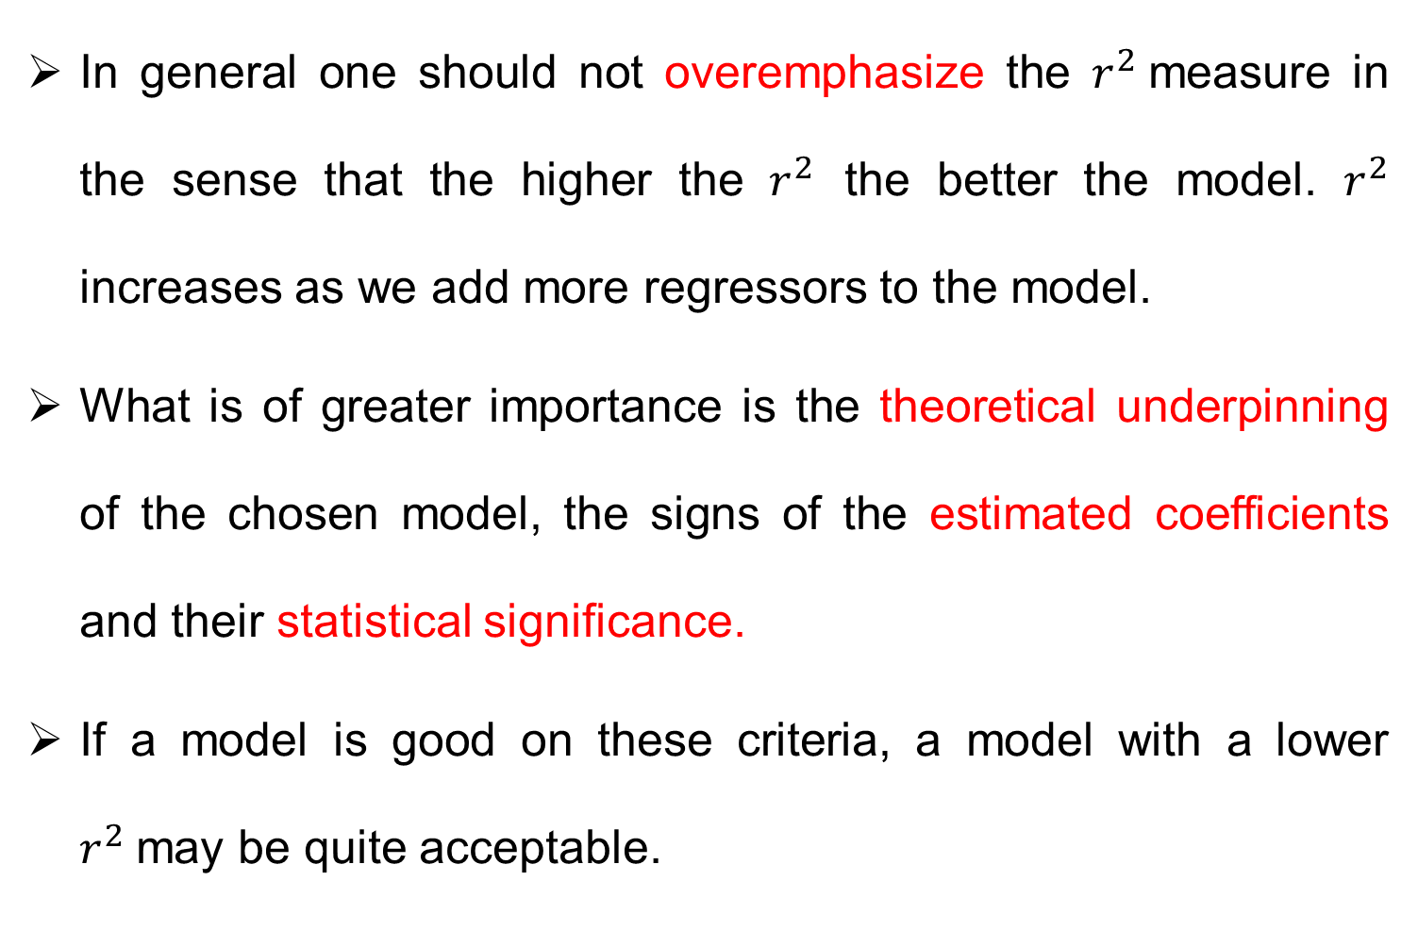
Choice of functional form- general comments
In general one should not overemphasize the $r^{2}$measure in the sense that the higher the $r^{2}$ the better the model. $r^{2}$ increases as we add more regressors to the model.
What is of greater importance is the theoretical underpinning of the chosen model, the signs of the estimated coefficients and their statistical significance.
If a model is good on these criteria, a model with a lower $r^{2}$may be quite acceptable.

Slide 5





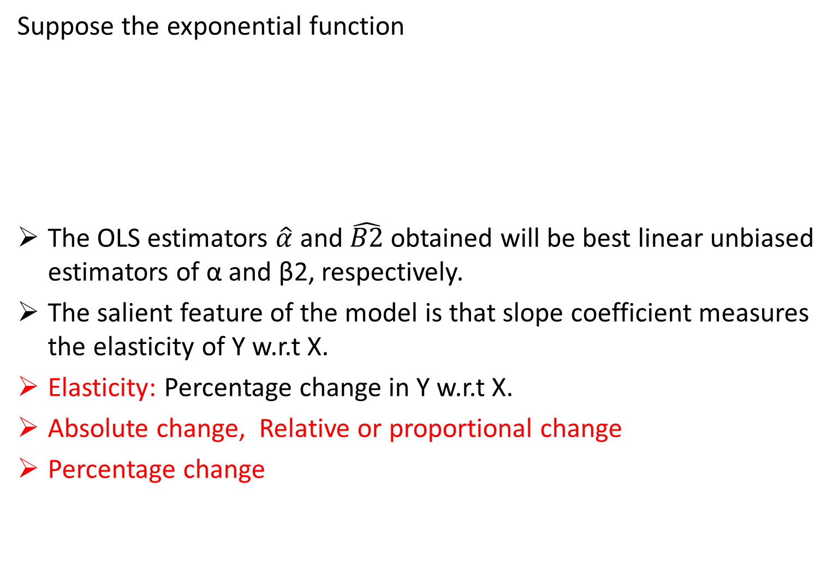
The log-linear model or double log model
Suppose the exponential function
The OLS estimators $\hat{α}$ and $\hat{B2}$ obtained will be best linear unbiased estimators of α and β2, respectively.
The salient feature of the model is that slope coefficient measures the elasticity of Y w.r.t X.
Elasticity: Percentage change in Y w.r.t X.
Absolute change, Relative or proportional change
Percentage change

Slide 7

Interpretation of log linear model
The elasticity of EXDUR with respect to PCEX is 1.90.
Interpretation? It suggests that if total personal
expenditure goes up by 1 percent, on average, the
expenditure on durable goods goes up by about 1.90 percent.

Slide 8

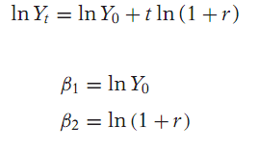


Semi log or Lin log or log Lin model
Economists, businesspeople, and governments are often interested in finding out the rate of growth of certain economic variables, such as population, money supply, employment and productivity.
Where r is the compound rate of growth of Y.
Such models are called semi-log models.

Slide 10


Log-linear model
A model in which regressand is logarithmic will be called a log linear model
Interpretation: The slope coefficient measures the relative change in Y for a given absolute change in the value of the regressor.
Example:
Expenditure on services increased at the rate of 0.743 percent per quarter.
Roughly, this is equal to an annual growth rate of 2.97 percent.

Slide 12
Multiple Regression Model
Bivariate model is inadequate in practice as regression model is not only confine to two variables.
For example demand theory.
The simple extension is three variable regression.
Models in which the dependent variable, or regressand, Y depends on two or more explanatory variables, or regressors is called Multiple regression model.

Slide 14

Three variable model- notations
General form of three variable regression model is.
The coefficients are partial regression coefficients.
All the assumptions of the CLRM hold:
The interpretation of the coefficients is the same as in simpler regression model
The meaning of partial coefficients: β2 measures the change in the mean value of Y, holding the value of X constant.
OLS method is used to estimate the parameter.

Slide 15
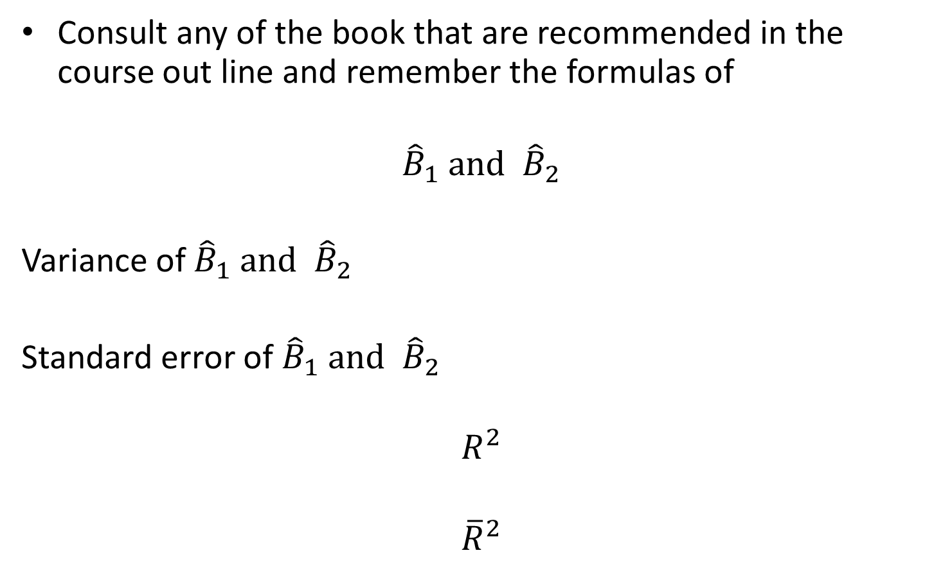
Formulas
Consult any of the book that are recommended in the course out line and remember the formulas of
$${\hat{B}}_{1} and {\hat{B}}_{2}$$
Variance of ${\hat{B}}_{1} and {\hat{B}}_{2}$
Standard error of ${\hat{B}}_{1} and {\hat{B}}_{2}$
$$R^{2}$$
$${\overline{R}}^{2}$$

