Slide 1
Lecture 13
Summary of previous Lecture
Hypothesis testing
How to form null and alternative hypothesis
The p-value
Let the researcher decide at which value to reject or not to reject the null hypothesis.

Slide 2
Topics for today
Regression through the origin
Units of measurement
Functional form of the linear regression model

Slide 3

Regression Through the Origin
Sometimes the underlying theory dictates that the intercept term be absent from the model.
For example:
Cost analysis theory, where it is postulated that the variable cost of production is proportional to output
Another theory states that the rate of change of prices is proportional to the rate of change of the money supply.

Slide 5

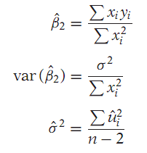


Diagram and formulas in case when regression through the origin
Without intercept without intercept
Two differences in formulas
Raw sum of squares Degree of freedom

Slide 6
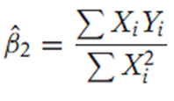

Derivation of ${\hat{B}}_{2}$

Slide 8
Notable features of Regression through the origin
Two special features
1- Residual sum of square is not necessarily equal to zero as in case of conventional (with intercept).
2- Coefficient of determination/goodness of fit which is nonnegative for the conventional model, can on occasions turn out to be negative for the interceptless model.
Why this happens?

Slide 9


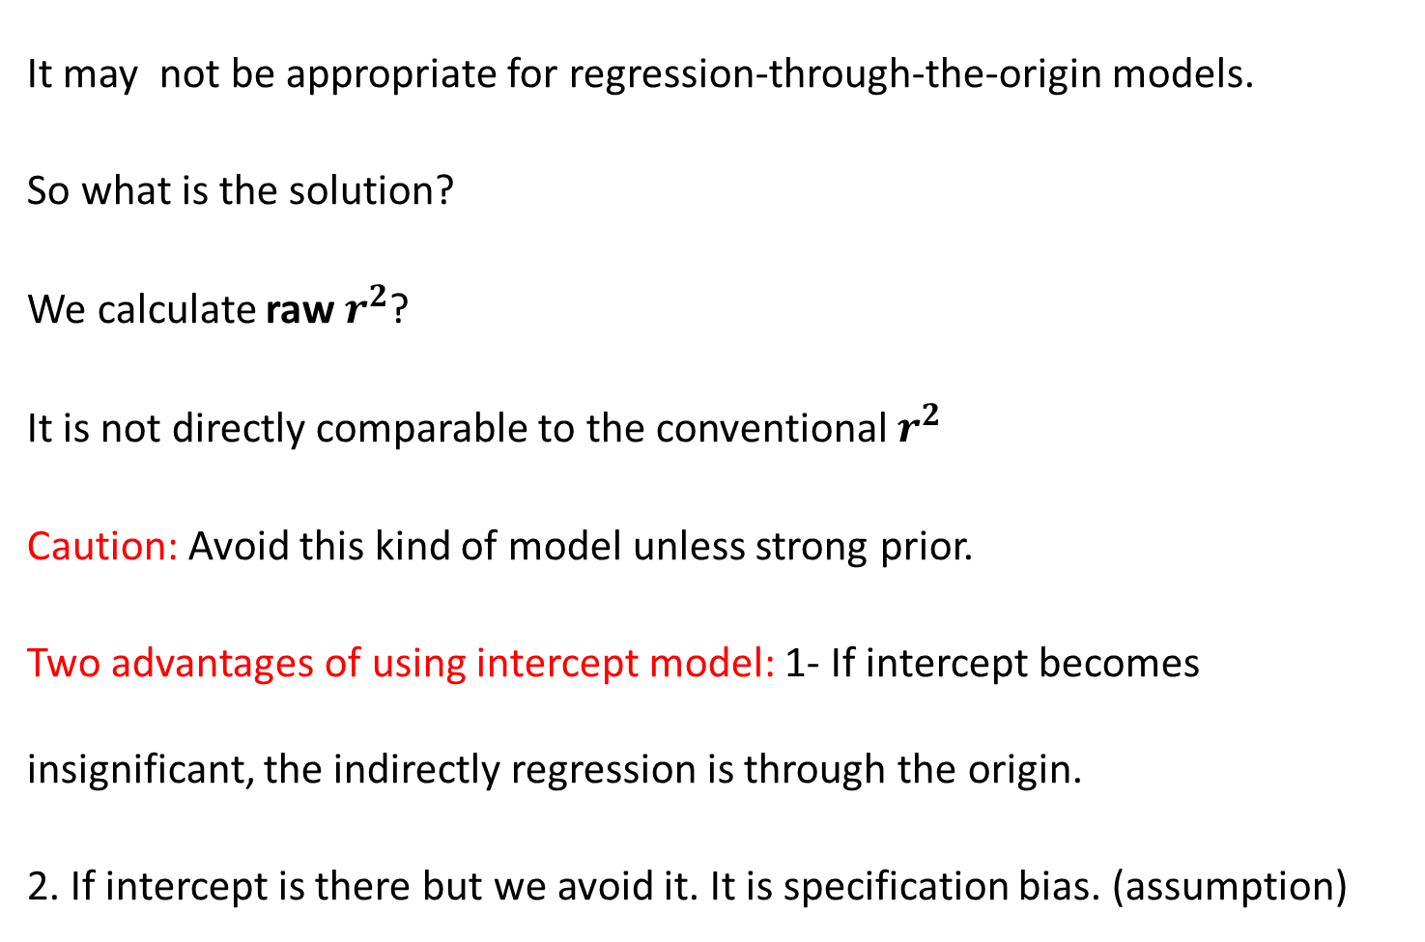
Goodness of fit for Interceptless Model
It may not be appropriate for regression-through-the-origin models.
So what is the solution?
We calculate raw $r^{2}$?
It is not directly comparable to the conventional $r^{2}$
Caution: Avoid this kind of model unless strong prior.
Two advantages of using intercept model: 1- If intercept becomes insignificant, the indirectly regression is through the origin.
2. If intercept is there but we avoid it. It is specification bias. (assumption)

Slide 10
SCALING AND UNITS OF MEASUREMENT
Do the units in which the Regressand and regressor(s) are measured make any difference in the regression results? ………………..if yes
Then what is the sensible course to follow in choosing units of measurement for regression analysis.
Example: suppose researcher A uses data of GDP in Million while the researcher B uses the same series in Billion.
The result differ however interesting relation exists between the estimates if the scaling factor say the w’s, are known.

Slide 11
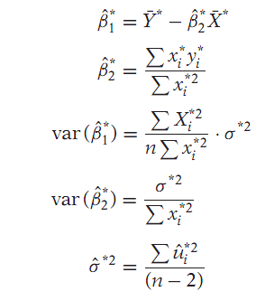
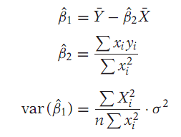
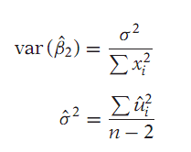
Relationship…………
Suppose

Slide 12
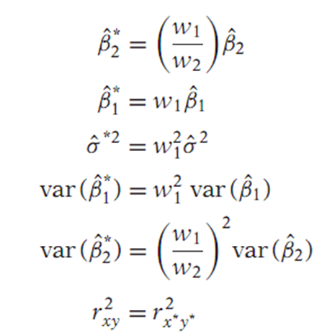
Relationships …..
From the some relationship can easily be established.
Given the regression results based on one scale of measurement, one can derive the results based on another scale of measurement once the scaling factors, the w’s, are known.

