Slide 1
Lecture 12
Summary of previous Lecture
Point and interval estimation
Area under the normal curve
The t-distribution

Slide 2
Confidence interval for variance
It follows the Chi-square distribution

Slide 3
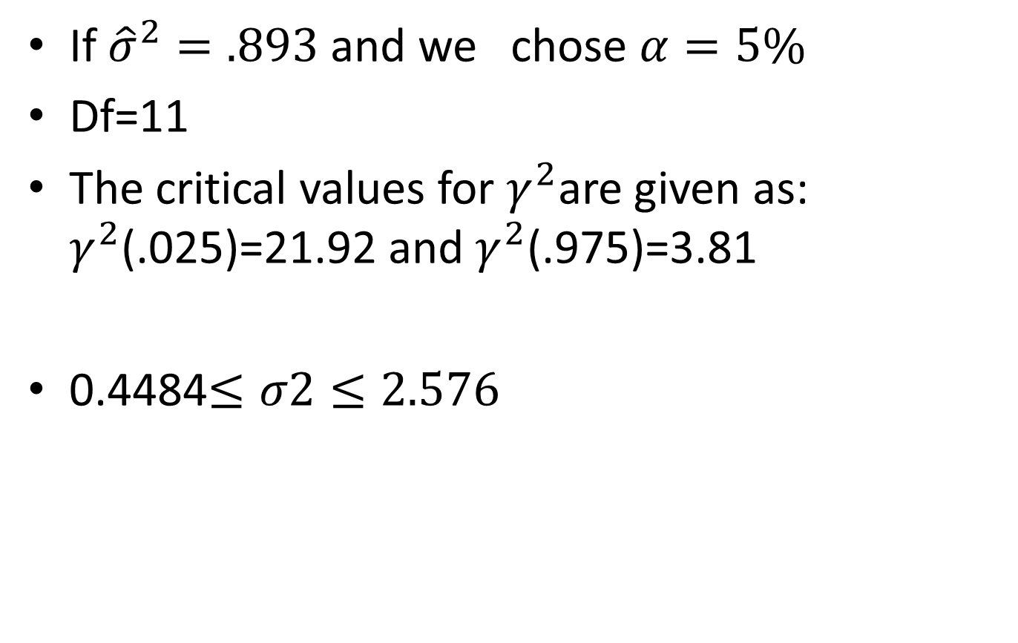
Example
If ${\hat{σ}}^{2}=.893$ and we chose $α=5\%$
Df=11
The critical values for $γ^{2}$are given as: $γ^{2}$(.025)=21.92 and $γ^{2}$(.975)=3.81
0.4484$≤σ2≤2.576$

Slide 4
Hypothesis testing
What we test: Is a given observation or finding compatible with some stated hypothesis or not?
The word “compatible,” means “sufficiently” close to the hypothesized value so that we do not reject the stated hypothesis.
The null hypothesis: H0.
The null hypothesis is usually tested against an alternative hypothesis (also known as maintained hypothesis) denoted by H1.
The alternative hypothesis may be simple or composite
For example, H1: β2 = 1.5 is a simple hypothesis.
H1: β2 is not equal to 1.5 is a composite hypothesis.

Slide 5
Theory of Hypothesis Testing
It is concerned with developing rules or procedures for deciding whether to reject or not reject the null hypothesis.
Two approaches for devising such rules
Confidence interval and Test of significance.
Both these approaches assume that the variable (statistic or estimator) under consideration has some probability distribution.

Slide 6
THE CONFIDENCE-INTERVAL APPROACH
Two-Sided or Two-Tail Test:
Alternative hypothesis is composite and bidirectional
It shows that we do not have a strong or theoretical expectation about the direction in which the alternative hypothesis should move from the null hypothesis.
If β2 under H0 falls within the 100(1 − α)% confidence interval, we do not reject the null hypothesis;
If it lies outside the interval, we may reject it

Slide 7
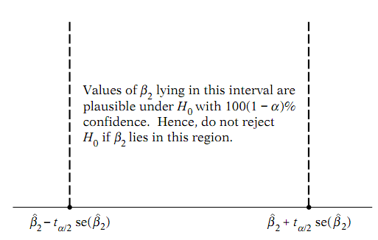
Rule of Thumb
Decision Rule: Construct a 100(1 − α)% confidence interval for β2. If the β2 under H0 falls within this confidence interval, do not reject H0, but if it falls outside this interval, reject H0.
Make diagram:
Type 1 error: Rejecting of the true Null hypothesis
Type 2 error: Accepting a false Null hypothesis or failure to reject a false null hypothesis.

Slide 8
Rejection or acceptance of H0
When we reject the null hypothesis, we say that our finding is statistically significant.
On the other hand, when we do not reject the null hypothesis, we say that our finding is not statistically significant.
It is better to leave it to the researcher to decide whether a statistical finding is “significant,” “moderately significant,” or “highly significant.”

Slide 9
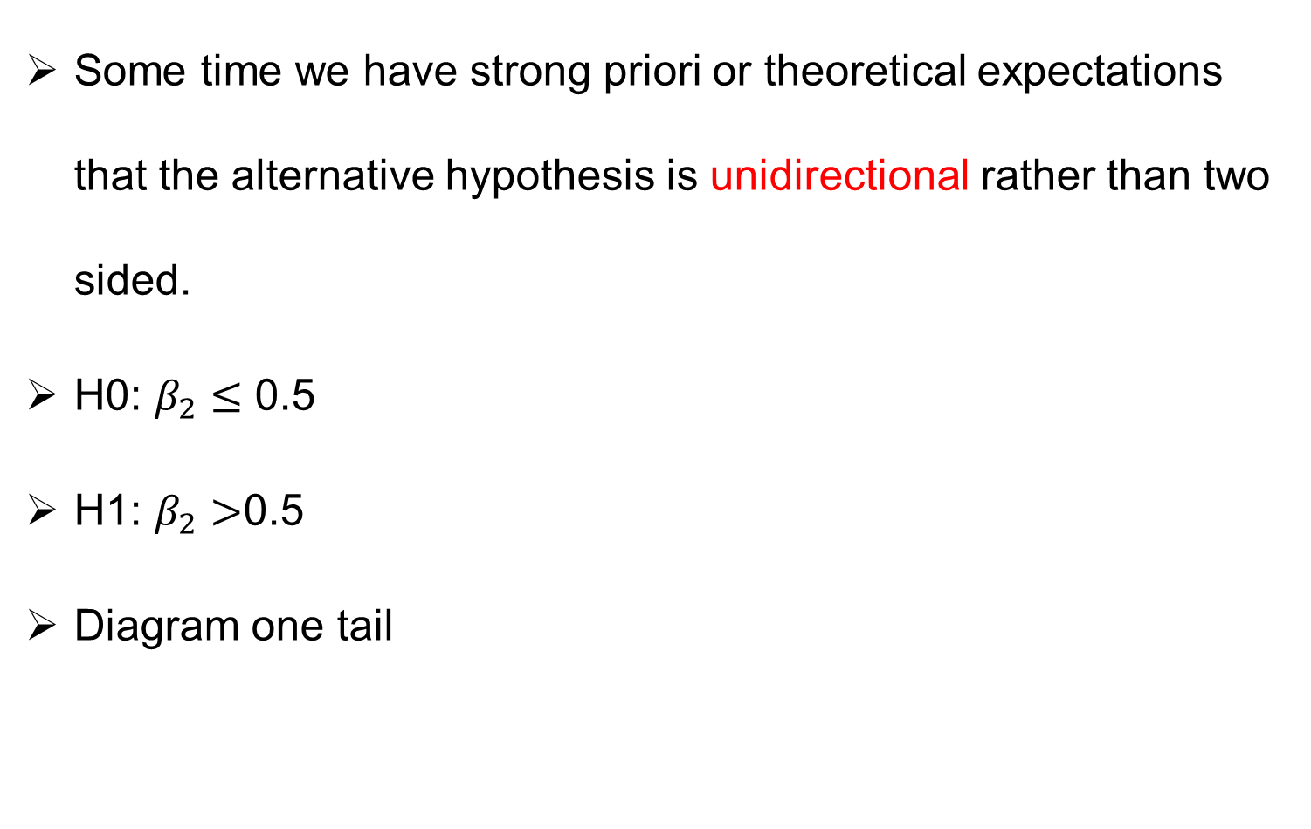
One sided or one Tail Test
Some time we have strong priori or theoretical expectations that the alternative hypothesis is unidirectional rather than two sided.
H0: $β_{2}≤$ 0.5
H1: $β_{2}>$0.5
Diagram one tail

Slide 10
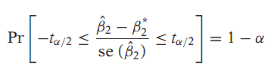
Test-of-significance approach
Testing the Significance of Regression Coefficients: The t Test
Broadly speaking, a test of significance is a procedure by which sample results are used to verify the truth or falsity of a null hypothesis.
The decision to accept or reject H0 is made on the basis of the value of the test statistic obtained from the data at hand.

Slide 12
Confidence interval vs. test of Significance Approach
In the confidence-interval procedure we try to establish a range or an interval that has a certain probability of including the true but unknown β2.
In the test-of-significance approach we hypothesize some value for β2 and try to see whether the computed βˆ2 lies within reasonable (confidence) limits around the hypothesized value.

Slide 13

Practically Easy
In practice no need to compute the confidence interval just compute the t value from t=
See whether it lies between the critical t values or outside them.

Slide 14
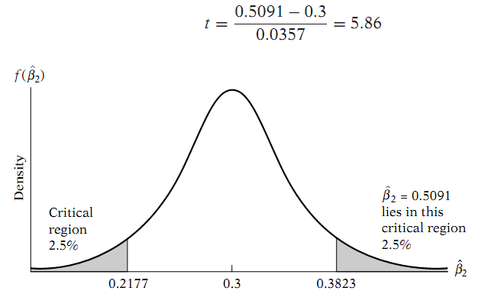

Slide 15
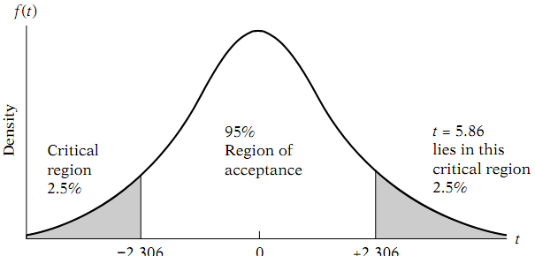

Slide 16
Forming Null and Alternative Hypothesis
Given the null and the alternative hypotheses, testing them for statistical signiﬁcance is not a mystery.
But how does one formulate these hypotheses?
There are no hard-and-fast rules.
Very often the phenomenon under study will suggest the nature of the null and alternative hypotheses.
Thus, theoretical expectations or prior empirical work or both can be relied upon to formulate hypotheses.
It is extremely important that the researcher establish these hypotheses before carrying out the empirical investigation.
May be the temptation to form hypotheses that justify one’s results.
Such a practice should be avoided at all costs, at least for the sake of scientiﬁc objectivity.

Slide 17
The Exact Level of Signiﬁcance: The p Value
The major drawback of the classical approach to hypothesis testing is its arbitrariness in selecting α.
However, once a test statistic is obtained why not simply ﬁnd out the actual probability of obtaining a value of the test statistic as much as or greater than that obtained.
This probability is called the p-value.
Many statistical packages report p-value along with t-values.
Let the researcher decide at which p-value to reject or not to reject the null hypotheses.
Risk lovers versus risk averse

Slide 18
Summary
Hypothesis testing
How to form null and alternative hypothesis
The p-value
Let the researcher decide at which value to reject or not to reject the null hypothesis.

