Slide 1
Lecture 10
Summary of previous Lecture
Assumptions of CLRM
Standard Error or precision of estimates
Co variance

Slide 2
Topics For Today
Gauss-Markov Theorem
Coefficient of determination
Monte Carlo Experiment

Slide 3
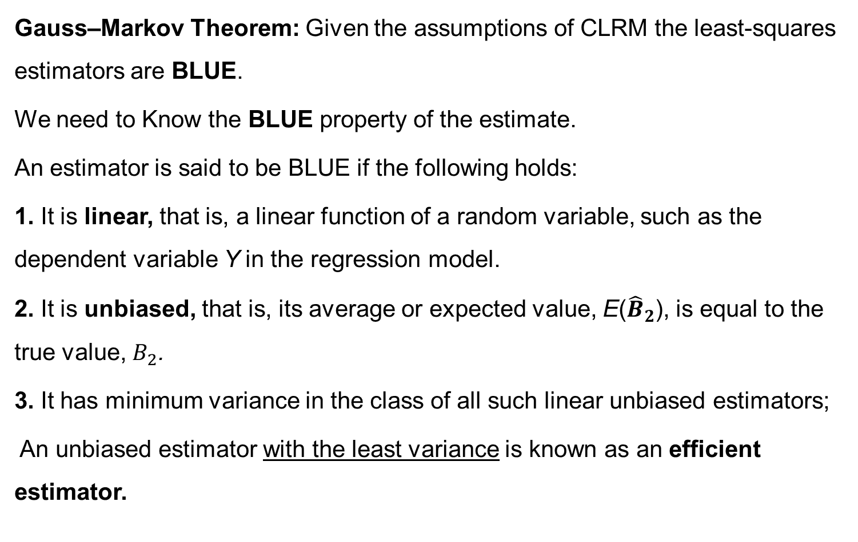
Properties of OLS- Gauss Markov Theorem
Gauss–Markov Theorem: Given the assumptions of CLRM the least-squares estimators are BLUE.
We need to Know the BLUE property of the estimate.
An estimator is said to be BLUE if the following holds:
1. It is linear, that is, a linear function of a random variable, such as the dependent variable Y in the regression model.
2. It is unbiased, that is, its average or expected value, E(${\hat{B}}_{2}$), is equal to the true value, $B_{2}$.
3. It has minimum variance in the class of all such linear unbiased estimators;
An unbiased estimator with the least variance is known as an efficient estimator.

Slide 5
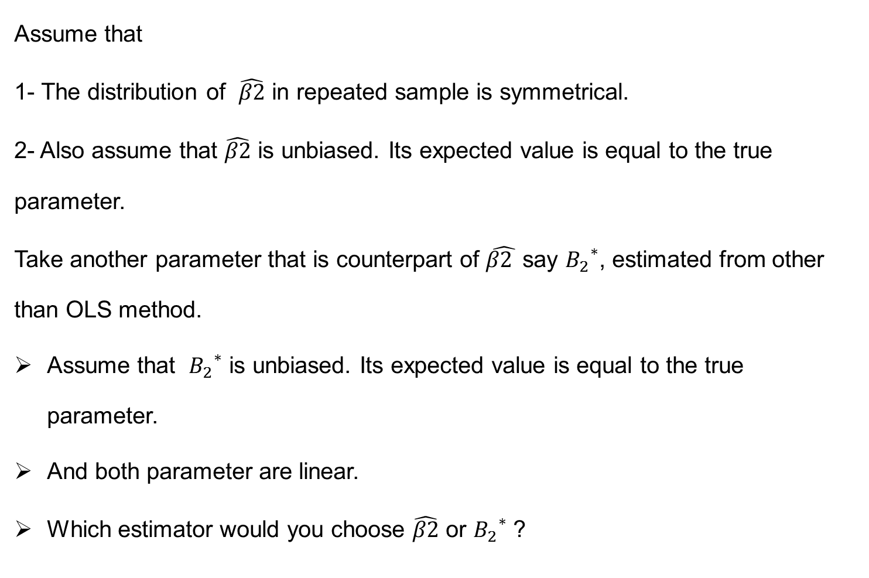
Graphical representation of G-M Theorem
Assume that
1- The distribution of $\hat{β2}$ in repeated sample is symmetrical.
2- Also assume that $\hat{β2}$ is unbiased. Its expected value is equal to the true parameter.
Take another parameter that is counterpart of $\hat{β2 }$say ${B_{2}}^{∗}$, estimated from other than OLS method.
Assume that ${B_{2}}^{∗}$ is unbiased. Its expected value is equal to the true parameter.
And both parameter are linear.
Which estimator would you choose $\hat{β2}$ or ${B_{2}}^{∗}$ ?

Slide 6
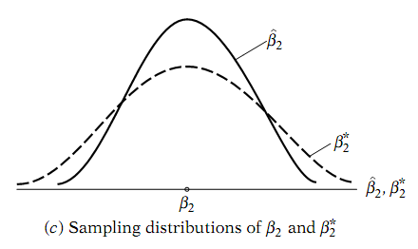
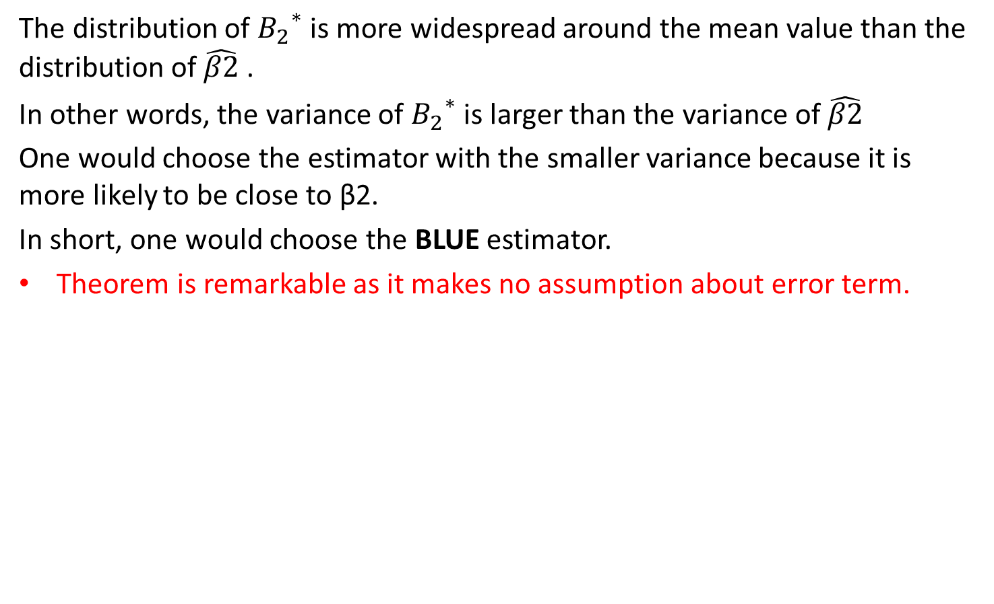
Graphical representation of G-M Theorem …
The distribution of ${B_{2}}^{∗}$is more widespread around the mean value than the distribution of $\hat{β2}$ .
In other words, the variance of ${B_{2}}^{∗}$is larger than the variance of $\hat{β2}$
One would choose the estimator with the smaller variance because it is more likely to be close to β2.
In short, one would choose the BLUE estimator.
Theorem is remarkable as it makes no assumption about error term.

Slide 8

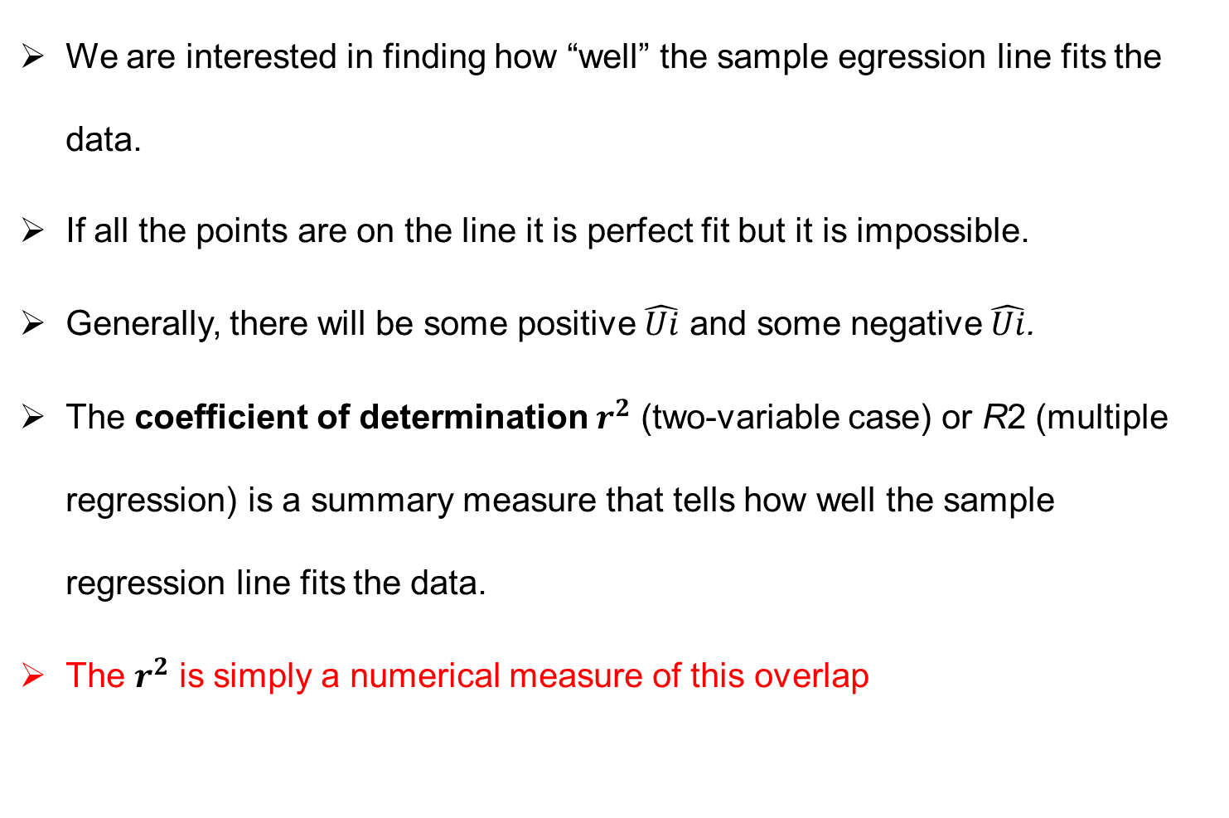
The coefficient of determination $r^{2}$- a measurement of goodness of fit.
We are interested in finding how “well” the sample egression line fits the data.
If all the points are on the line it is perfect fit but it is impossible.
Generally, there will be some positive $\hat{Ui}$ and some negative $\hat{Ui}$.
The coefficient of determination $r^{2}$ (two-variable case) or R2 (multiple regression) is a summary measure that tells how well the sample regression line fits the data.
The $r^{2}$ is simply a numerical measure of this overlap

Slide 9
Vann Diagram or Ballantine view showing $r^{2}$

Slide 10

Various Sums of Squares
Total sum of squares or TSS=
It is combination of explained sum of squares
ESS ( ) and Residual sum of Square RSS ( )
Thus
TSS=ESS+RSS
The quantity just obtained is called coefficient of determination or measure of goodness of fit. It has two properties
1- It is a non negative quantity
2- It ranges between 0 and 1.

Slide 11
Diagram showing TSS, ESS, RSS

Slide 12
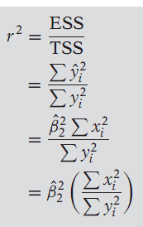
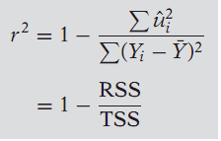


Other formulas to estimate $r^{2}$

Slide 13

How to find that OLS are unbiased- Monte Carlo Experiment
In practice how does one know that the BLUE property holds.
Monte Carlo experiments provides the answer.
Consider the following two variable PRF
A Monte Carlo experiment proceeds as follow
Suppose the true values of the parameters are as follows: β1 = 60 and
β2 = 0.75
2. We choose the sample size, say n = 25.
3. We ﬁx the values of X for each observation. In all we will have 25 X values.
4. Suppose we go to a random number table, choose 25 values, and call them Ui

Slide 15
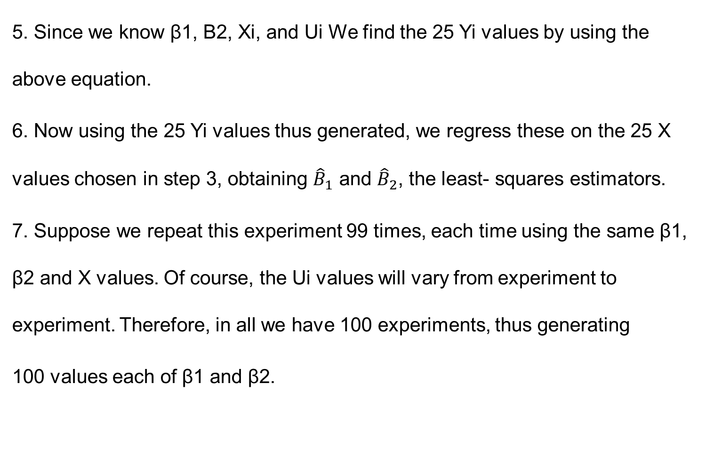
Monte Carlo Experiment…
5. Since we know β1, B2, Xi, and Ui We find the 25 Yi values by using the above equation.
6. Now using the 25 Yi values thus generated, we regress these on the 25 X values chosen in step 3, obtaining ${\hat{B}}_{1}$ and ${\hat{B}}_{2}$, the least- squares estimators.
7. Suppose we repeat this experiment 99 times, each time using the same β1, β2 and X values. Of course, the Ui values will vary from experiment to experiment. Therefore, in all we have 100 experiments, thus generating
100 values each of β1 and β2.

Slide 16
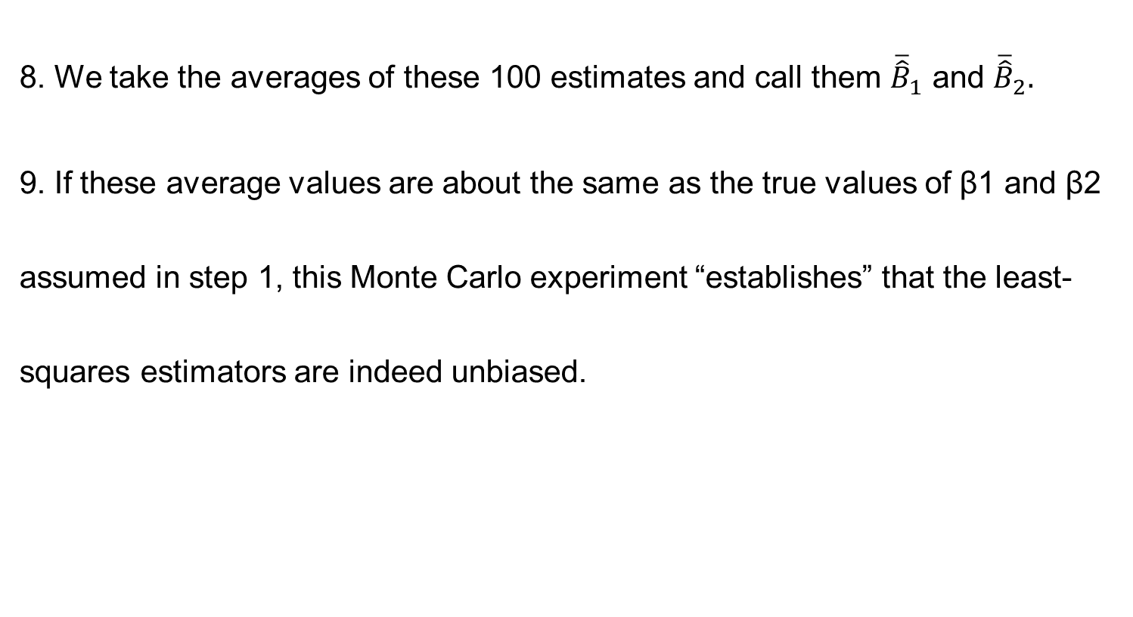
Monte-Carlo Experiment
8. We take the averages of these 100 estimates and call them ${\overline{\hat{B}}}_{1}$ and ${\overline{\hat{B}}}_{2}.$
9. If these average values are about the same as the true values of β1 and β2 assumed in step 1, this Monte Carlo experiment “establishes” that the least-squares estimators are indeed unbiased.

Slide 17
Summary
Gauss-Markov Theorem
Coefficient of determination
Monte Carlo Experiment

