Slide 1
Research Methodology
      Lecture No : 6
      (Hypothesis Development)

Slide 2
Recap
We learned to develop Hypotheses statements
Directional ,non Directions
Relationship or Group Difference type
Null and Alternate statements

Slide 3
Statistical Notations
When testing the group differences we need to
Obtain the Mean of the focus variable by each group.
Example:
Mean Motivation Level of a group is obtained and it is denoted by
μ(Motivation of a group)
We need to compare the Mean Motivation Level of Men vs Women
μ(Motivation-Men) Vs μ(Motivation-Women)

Slide 4
First we state our Null Hypothesis
  i.e. There is no difference between the mean motivational level of men vs the mean motivation of women
So the for the Null Hypothesis we use the following notations
  Ho: μ(Motivation-Men) - μ(Motivation-Women)=0

Slide 5
Based on the prior knowledge/ literature we can develop different types of variables
So the for the possible Alternative Hypothesis we have one of the following statements and its notations
  (a) The mean motivational level of men more then mean motivation of women
  Ha: μ(Motivation-Men) > μ(Motivation-Women)

Slide 6
  (b) The mean motivational level of men is less then mean motivation of women
  Ha: μ(Motivation-Men) < μ(Motivation-Women)
  (c) There is no difference between the mean motivational level of men vs the mean motivation of women
  Ha: μ(Motivation-Men) ≠ μ(Motivation-Women)

Slide 7
When testing the relationship between two variables
We find the Correlation between the two variables
It is denoted by “ρ”
Either ρ >0 ρ <0 ρ =0
For the Null Hypothesis statement we state that
There is no relationship between stress and satisfaction
Ho: ρ =0

Slide 8
Based on the available literature we can have different alternate statements
The possible Alternative Hypothesis we can have notations
  (a)There is a positive relationship between stress and job satisfaction.
  Ha: ρ>0

Slide 9
  (b) There is a negative relationship between stress and job satisfaction.
  Ha: ρ<0
  (c) i.e. The is a relationship between stress and job satisfaction
  Ha: ρ≠0

Slide 10
Summarized Table of Statistical Notations for Hypotheses
 | Relationship |  | Group Difference
 | Ho: | Ha: | Ho: | Ha:
Directional | ρ=0 | ρ>0 OR ρ<0 | µa=µb | µa>µb OR µa<µb
Non-Directional | ρ=0 | ρ#0 | µa=µb | µa # µb

Slide 11
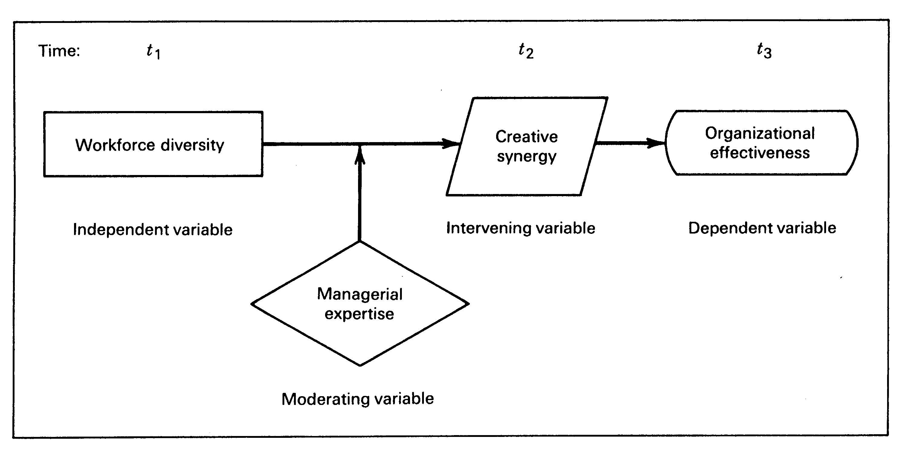
Example 1:

Slide 12
In this example we identified that workforce diversity is transformed into creative synergy which leads to organizational effectiveness. We also said that the synergy would be possible when the organization have experienced managers to handle diverse workforce.
Based on this information we just develop the hypothesis statements

Slide 13
Ha1: The workforce diversity is related to creative synergy.
Ha2: The higher the creative synergy the more the organization effectiveness
Ha3: The creative synergy mediates the relationship between workforce diversity and organization effectiveness.
Ha4: The relationship between workforce diversity and creative synergy is moderated by managerial expertise.

Slide 14
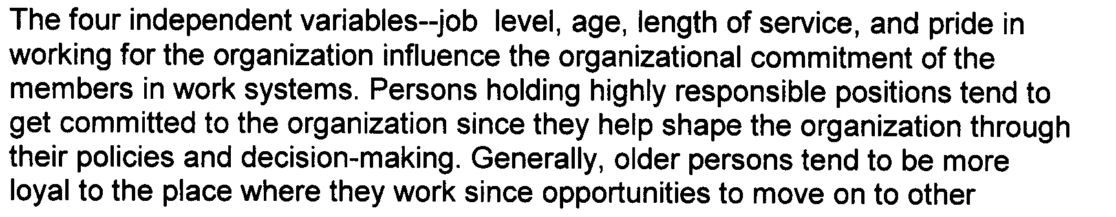
Example:2

Slide 15
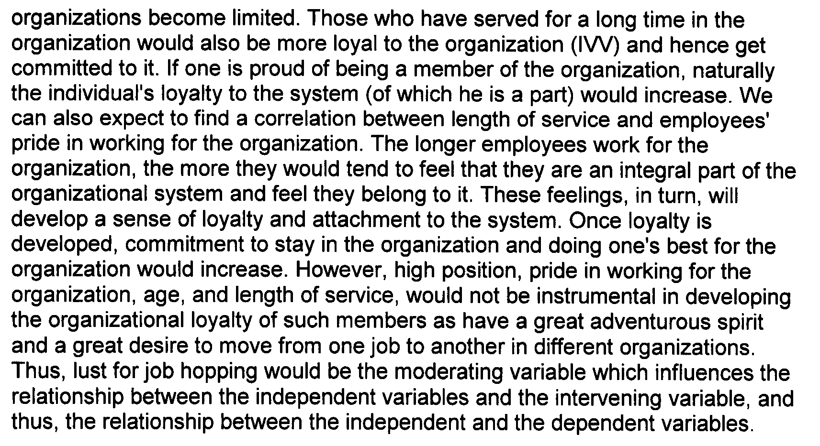

Slide 16
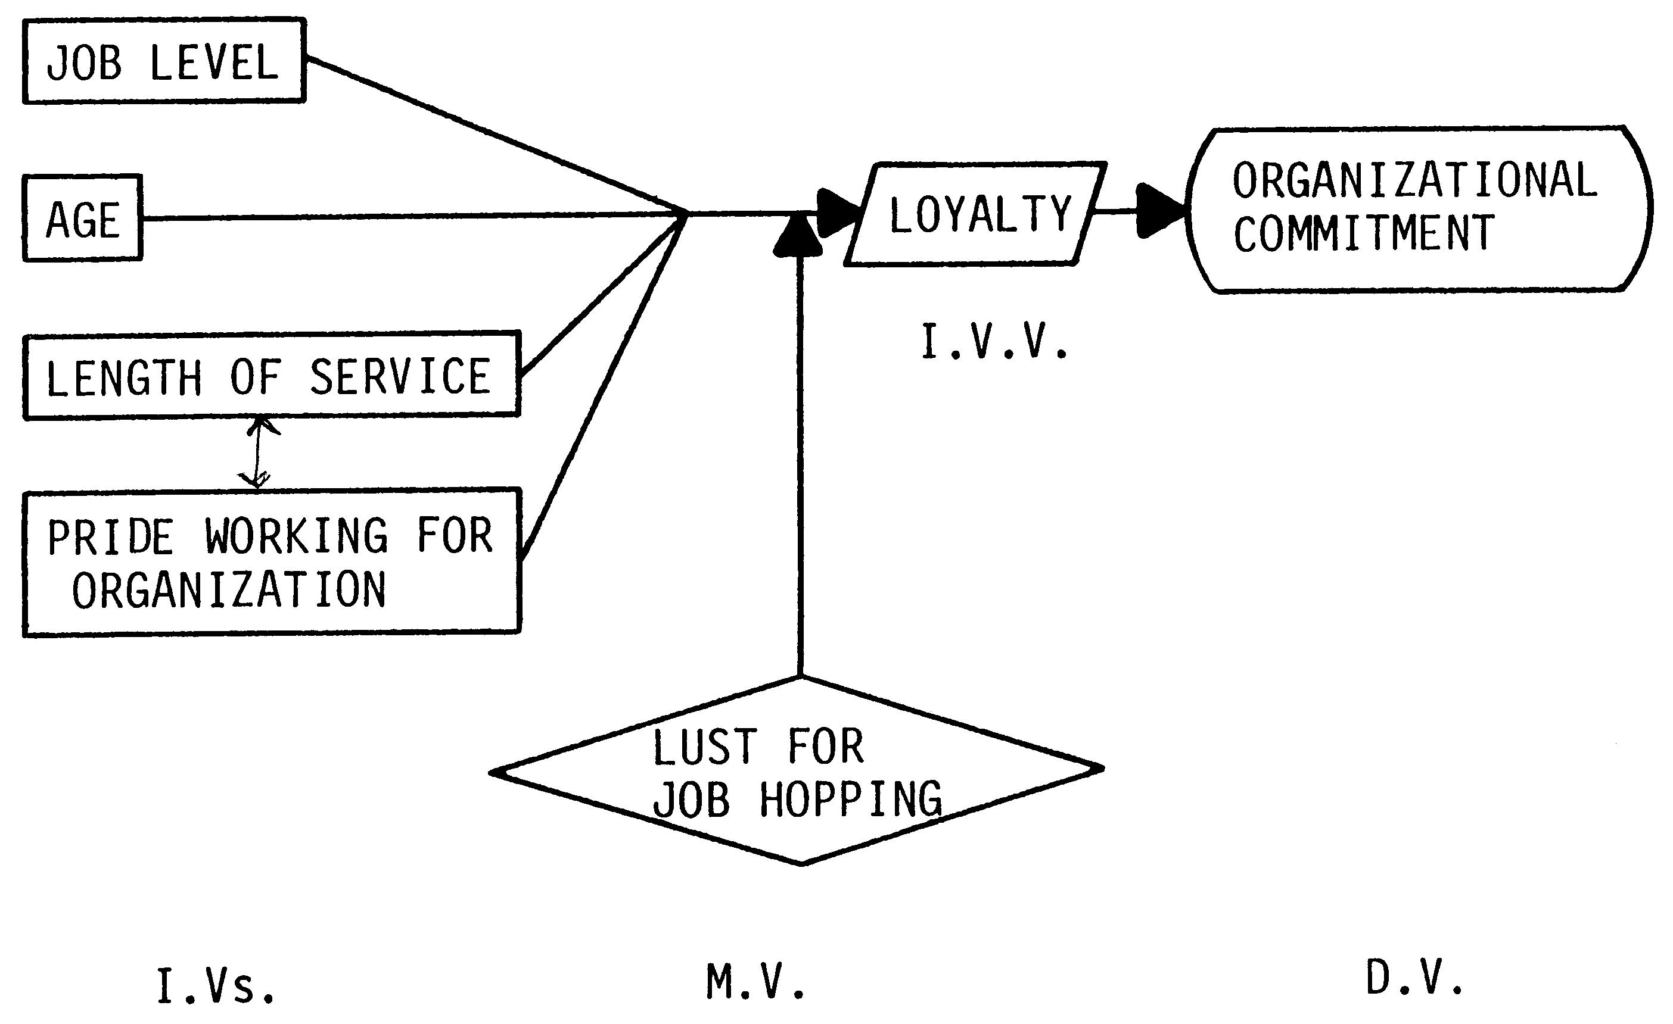

Slide 17
Different Hypotheses statements could be generated
Ha1:The more the loyalty the higher the organization commitment
Ha2:Loyality acts as an intervening variable between job level, age, length of service, pride of working for the organization.
  Ha2.1: Loyalty mediates the relationship between age and organization commitment
  Ha2.2: Loyalty mediates the relationship between length of service and organization commitment

Slide 18
  Ha2.3: Loyalty mediates the relationship between job level and organization commitment.
  Ha2.4: Loyalty mediates the relationship between pride working for organization and organization commitment.

Slide 19
  Ha3.: Only employees who do not have lust for job hopping, would job level, age, length of service, pride working for organization be related to Loyalty for the organization .
Ha3.1: Lust for job hopping would moderate the relationship between job level and Loyalty.
Ha3.2: Lust for job hopping would moderate the relationship between age and Loyalty.
Ha3.2: Lust for job hopping would moderate the relationship between length of service and Loyalty.
Etc…

Slide 20
An other research question might be poised
Does the blue collar worker are more loyal or white collar ?
To find the answer to this question a hypothesis statement could be generated as follows
Ha4: There is difference between the loyalty level between the blue collar workers(labor) and white collar workers(officers)

Slide 21
Steps Following the Hypothesis testing
State the null and the Alternate hypotheses
Choose appropriate test based on the data collected (parametric like Pearson correlation, t test, ANOVA)
non parametric like spearman ‘s rank correlation, Kendall’s X2)
Determine the level of significance desired
  Usually set to 0.05 can be more or less

Slide 22
See the output results of generated from the software. See if the differences are significant or the relationship significant.
If the differences/relationship are not significant then we accept the null hypotheses other wise accept the alternate
In case the you are using tables check if the calculated values larger than the critical value, the null hypotheses is rejected and alternate accepted
( More practice would be covered in later sections of the course)

Slide 23
Deductive and Inductive Hypothesis
The hypothesis generating and testing can be done both through Deduction and Induction.
In deduction we first develop the theoretical model, then generate hypothesis statements, data is collected and then hypothesis are tested.
In induction new hypothesis are generated based on the data already collected, which then is tested

Slide 24
In the initial session we discussed the case of the Hawthorne experiments, where new hypothesis were developed after the data already collected did not substantiated any of the original hypotheses.
New Hypotheses might be developed after the data is collected.
Creative insights might compel researchers to test a new hypothesis from exiting data which when substantiated would add to new knowledge and help build theory.

Slide 25
Hypothesis testing with Qualitative Research: negative case analysis
Hypothesis testing can also be tested with qualitative data.
Example:
After interview we develop the theoretical framework that unethical practices by employees are a function of their ability to discriminate between right and wrong, or due to need for money, or the organization indifference to such practices.
Search for data prove the hypothesis to be false

Slide 26
When no support is found an there is this case where an individual is deliberately engage in the unethical practices even though he is able to discriminate from right from wrong, and is not in need for money, and the organization would not be indifferent to his behavior.
He simply wants to get back to the systems because the system would not listen to his advice.
This new discovery is different from the previous hypothesis is know as negative case method and enables to revise their theory.

Slide 27
RECAP
Hypothesis notations
Examples on how to develop hypothesis statements
Steps to test the hypothesis statements
Hypothesis testing through inductive method
Hypothesis testing with qualitative research

