Slide 1
Research Methodology
      Lecture No : 5
  (Theoretical Framework - Hypothesis Development)

Slide 2
Recap
Types of Variables
  Independent, Dependent, Moderating, Mediating( Intervening)
Examples of relationships with each other
Developing of Theoretical Framework
  Variables, logical Relationships, Directions, Explanations
We wanted to break down a problem into easily measurable into testable cases.

Slide 3
Exercise
A production manager is concerned about the low output levels of his employee. The articles that he reads on job performance frequently mentioned three variables as important to job performance: skill required by job, rewards and satisfaction. In several of the articles it was also indicated that only if the rewards were attractive to the recipients, did satisfaction, and job performance increase not otherwise.

Slide 4
Theoretical Framework
( Description and Discussion of the Variables)
In this section of theoretical framework we need to provide the description of the variables and their relationships with different variables. For example..
Rewards are two types, intrinsic and extrinsic ….., where as job enrichment is making the job more challenging and utilizes all the skills of the employee…when the.. . …Rewards are known to enhance the satisfaction of employees which leads to higher organization performance ……… But for some employees the rewards are not attractive hence does not contribute to the satisfaction of employee ….etc

Slide 5
Theoretical Framework
(Schematic Diagram)
Job Enrichment
Employee Satisfaction
Organization Performance
Rewards
Attraction for rewards

Slide 6
Research Questions
Does job enrichment and rewards influence the performance ?
Does the satisfaction intervenes the relationship between rewards and performance?
Does the satisfaction intervenes the relationship between job enrichment and performance?
Does attractiveness of the rewards moderate the relationship between rewards and satisfaction.

Slide 7
Hypotheses Development
The research problem could be better solved when we formulate the appropriate research questions.
The logically placed relationships need to be tested.
So we develop statements which would be easily testable
Formulating such testable statements is called hypothesis development.

Slide 8
Hypothesis Statements
A hypothesis can be defined as a logically speculated relationship between two or more variables expressed in the form of a test able statement.
Different Hypotheses statements can be drawn from the theoretical framework developed earlier.
E.g.
Ha1: Job Enrichment leads to higher job satisfaction
Ha2: If rewards are offered the job satisfaction level be high
Ha3: Organization performance is effected by job enrichment through satisfaction

Slide 9
The logical relationships have been now stated in a testable format.
We need to statistically examine the relationship between the variables “ Rewards” and “satisfaction” or “Job Enrichment” and “Satisfaction”
We need to also statistically establish that the satisfaction mediates the relationship between rewards , job enrichment and organization performance

Slide 10
We need to statistically see if there is positive correlation between these variables is significant (large enough) then we would state that the hypotheses have been substantiated(proved)
In social sciences we call a relationship statistically significant when we are confident that 95 times out of 100, the observed relationship will hold true.

Slide 11
It is through data analysis our logical relationships are tested.
In case our hypothesis are not proved then we would search for possible reasons. May be some other variables which influence the relationship e.g. some moderating variables.
It is again the literature which can provide us with the directions. Hence a good literature review is important.

Slide 12
Hypotheses Statement Formats
Hypotheses statements could be to test
  Difference between groups
  Relationship between variables
The statements could be in the shape of
  Proposition (suggestion)
  If-then Else statement
Theses statements could be direction or non directional

Slide 13
Examples of different formats of Hypotheses statements
Difference between groups
  There is difference between the motivation level of men and women
Relationship between variables
  There is a relationship between age and job satisfaction

Slide 14
Proposition style
  Employees who are more healthy will take sick leaves less frequently
If-then else style
  If employees are more healthy, then they will take sick leave less frequently

Slide 15
Directional
  The greater the stress experienced on the job , the lower the job satisfaction of the employees
  The motivation level of women is more then motivation level of men
  The age and job satisfaction are negatively related
Non Directional
  There is a relations between stress and job satisfaction
  There is a difference between motivation level of men and women.

Slide 16
The way the statements are formulated is dependent on the state of the research.
When little support from the previous research is available then a more guarded approach is used to form the hypothesis statements.
i.e. the direction of the relationship or the statement on the clear differences are avoided.
But where ever direction is known from the previous literature it is better to state the directional hypotheses.

Slide 17
Null and Alternative Hypotheses
Null hypothesis is a proposition that states a definite, exact relationship between two variables. i.e. it states that the population correlation between two variables is equal to zero or some definite number or the difference between the two groups is zero
The alternative hypothesis is the opposite of the null hypothesis. It is a statement expressing a relationship between two variables or indicating difference between groups.

Slide 18
Null is stated as no significant relationship between the variables or no significant difference between the groups exists.
Alternate is stated as there is a significant relationship between variables or significant difference exists between the groups.

Slide 19
The null hypotheses are formed with the objective of rejection.
As when we reject the null hypothesis then all other alternate hypotheses can be supported.

Slide 20
It is the theory which gives us the faith that the alternative hypotheses are true.
Therefore we need to have strong literature support for developing our theory on which are alternate hypothesis are based

Slide 21
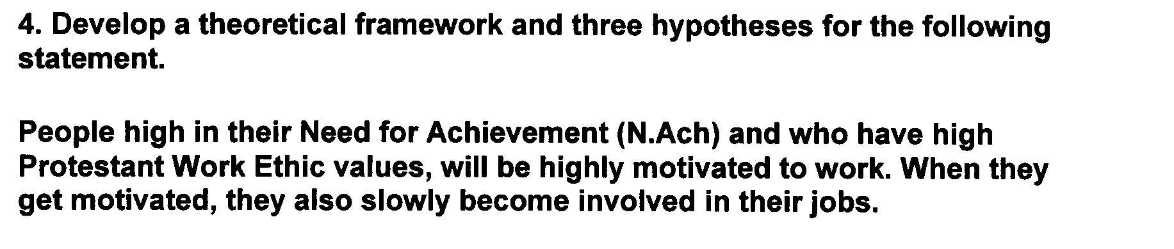
Exercise

Slide 22
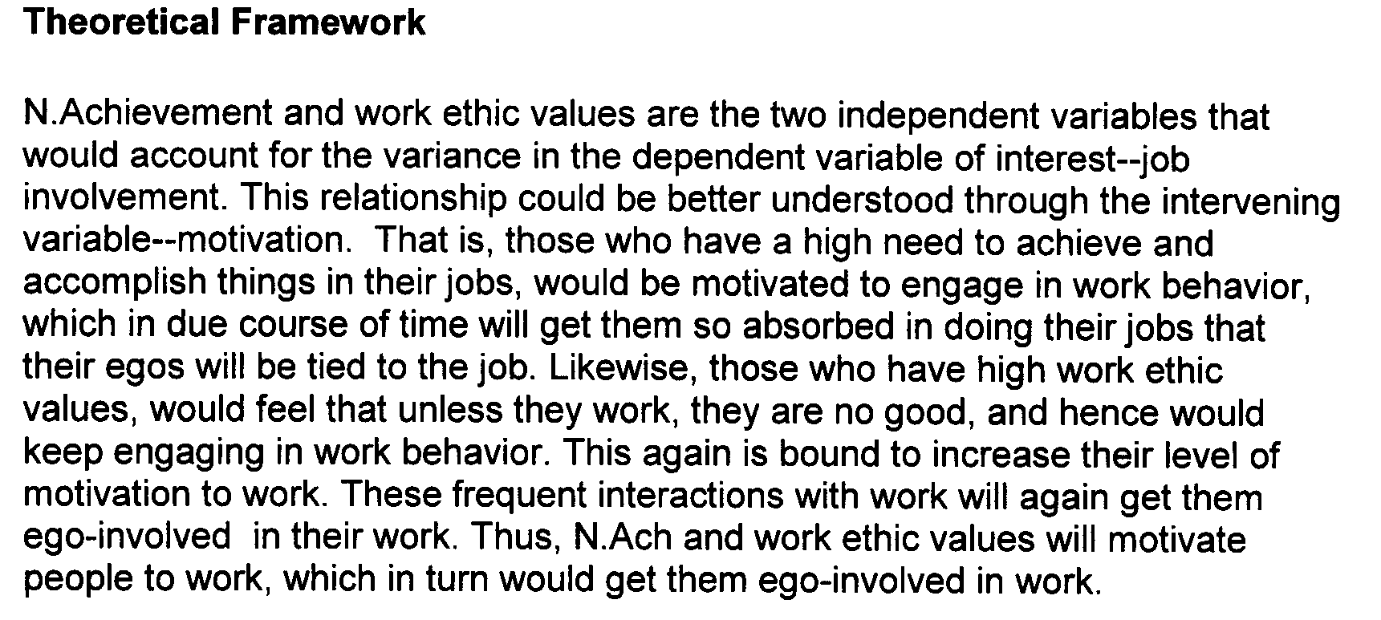

Slide 23
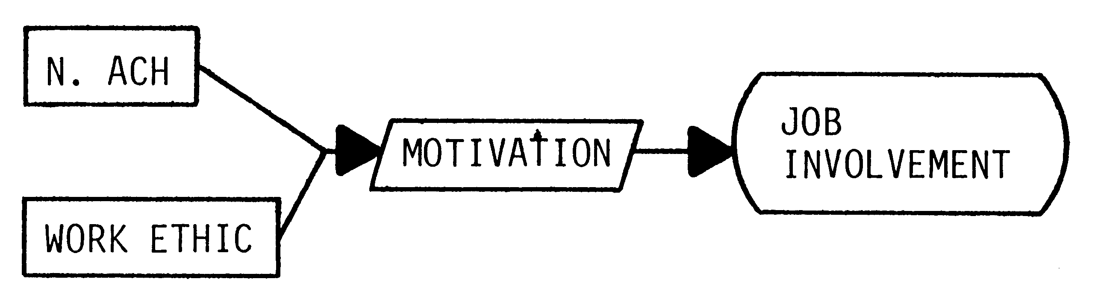

Slide 24
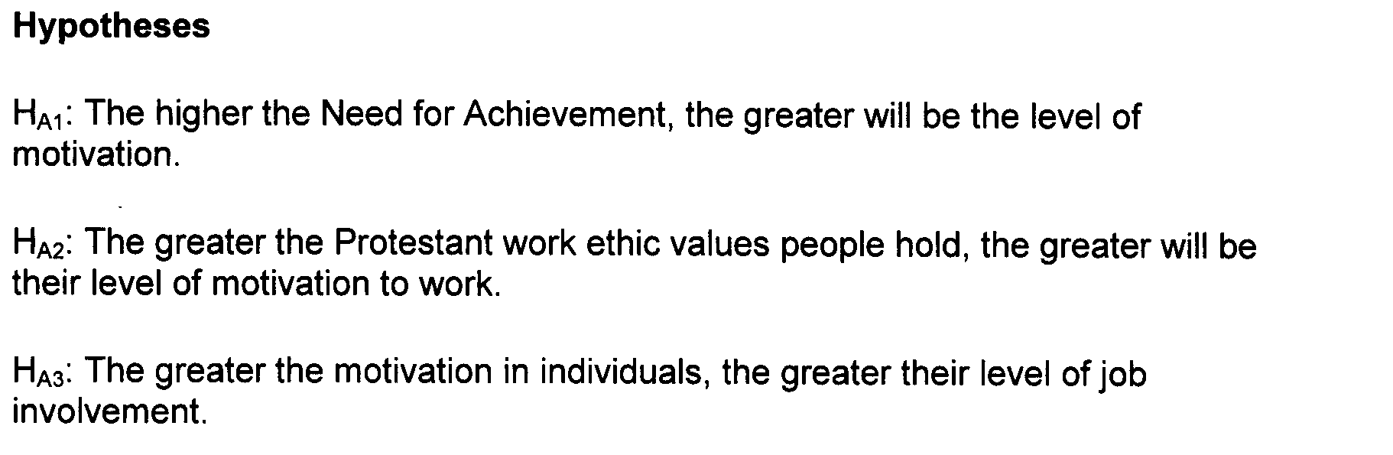

Slide 25
A fourth and fifth hypothesis can be developed that is
HA4: Motivation mediates the relationship between need for achievement and job involvement
HA5: Motivation mediates the relationship between work ethic values and job involvement

Slide 26
RECAP
Keeping in view the literature review we develop research questions to address the research problem.
In order statistically respond to the research questions we develop the Hypotheses statements.
These statements are stated in such way that they can be easily testable
Hypotheses statement are written in directional, non directional formats for testing group differences, relationship between variables.
We develop null and alternate hypotheses

