Slide 1
Research Methodology
      Lecture No : 4
      (Theoretical Framework)

Slide 2
Recap
Literature Review involves searching and documenting
There are different formats of Documenting (APA)
There is a structure of review (importance, objectives, definitions, relationships identified, gaps)
Theoretical framework is representation of your belief on how variables related and why
Variables are of 4 different kinds

Slide 3
Theoretical Framework
After conducting literature review, survey and defining the problem (research questions)
We develop our theoretical framework
Theoretical framework is a conceptual model of how we theorarize the relationships among several factors that have been identified to the problem.
  Problem is depleting sales
  Factors influencing are quality of products, price, competition etc ( based on the literature)

Slide 4
Based on the previous literature we discuss the interrelationship between the different variables which are of interest to us and concerns the problem.
By developing this kind of conceptual framework would help us claim and test certain relationships.
i.e. From this framework we develop hypothesis statements which are then tested to find out if our theory was valid or not

Slide 5
Quality
Sales
Price
Competition

Slide 6
Types of Variables
Dependent
  (Criterion Variable)
  primary interest
  Describe or explain the variability or predict it.
  We study what variables influence dependent variable
  So by studying these we might able to find a solution of the problem
  E.g. Sales are low , employee loyalty is dropping

Slide 7
Independent
  (Predictor variable)
  Which influences the dependent variable
  The influence might be positive or negative
  When independent variable is present the dependent variable is also present.
  With each unit of increase in independent variable there is an increase or decrease in the dependent variable
  E.g. Advertising on sales, recognition on loyalty

Slide 8
Exercise : List the independent variable
A manager believes that good supervision and training would increase the production level of the workers.

Slide 9
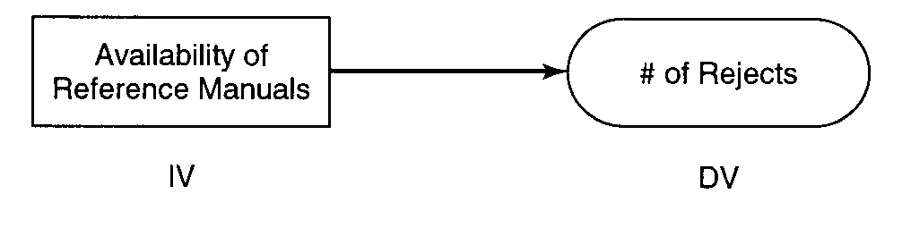

Slide 10
Moderating Variables
Moderating Variables have strong contingent (conditional) effect on the independent – dependent variables relationship.
i.e. in the presences of the a third variable the relationship between the independent and dependent is modified

Slide 11
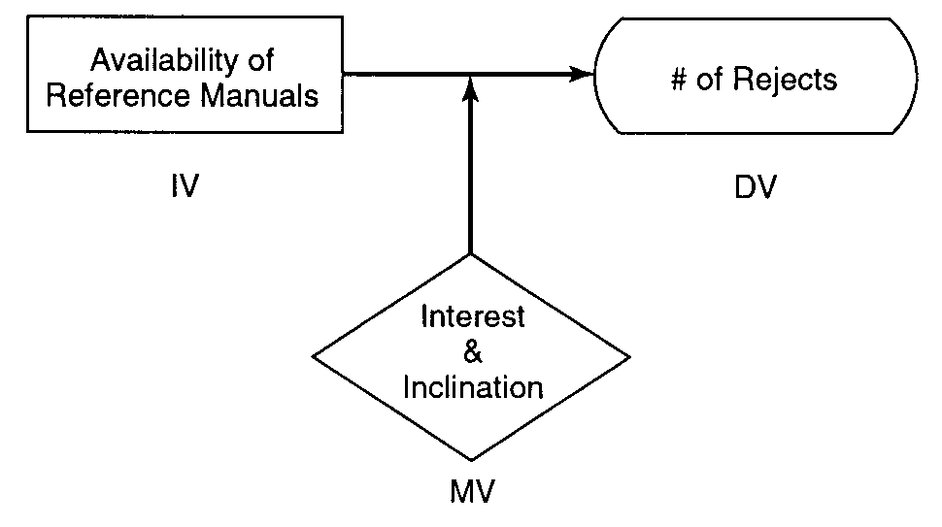

Slide 12
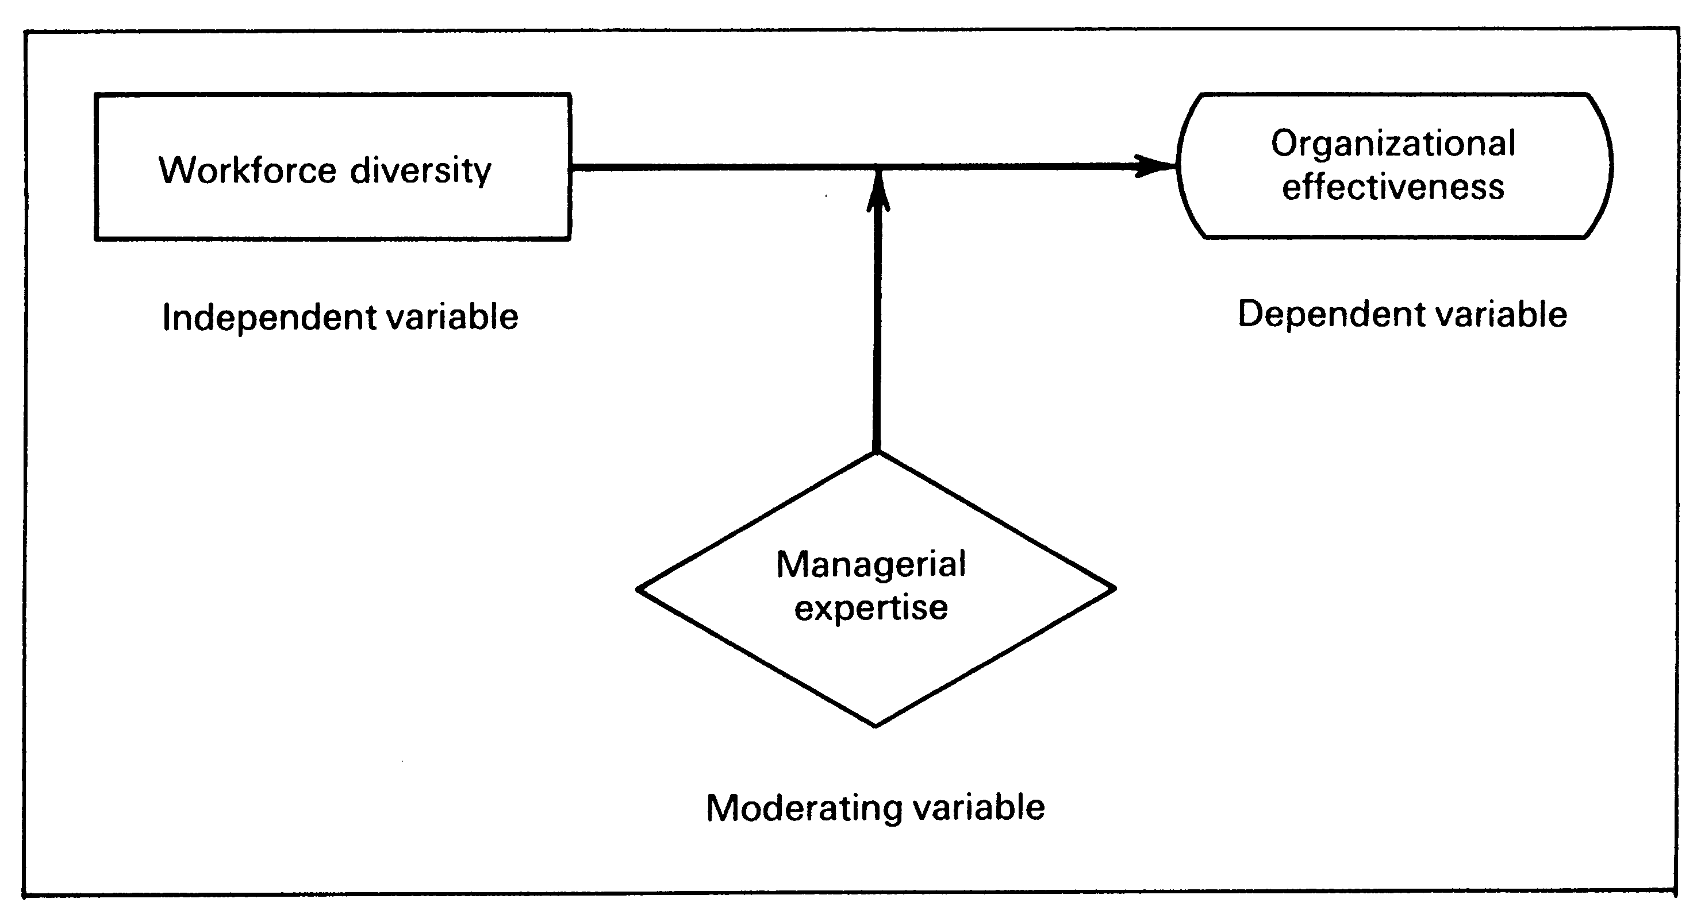

Slide 13
Distinction between Independent and Moderating Variable
Some times one gets confused as to when a variable is to be treated as independent variable and when it becomes a moderating variable

Slide 14
Situation A
Quality of Training Programs
Willingness to learn new ways
Growth Need of employee

Slide 15
Situation B
Willingness to learn new ways
Quality of Training Prog
High/Low
Growth Need

Slide 16
Both the scenarios have 3 variables
First scenario training programs and growth needs are independent variables that influence the dependent variable
Second scenario dependent variable stays the same growth need becomes the moderating variables

Slide 17
i.e. only those who have high growth need will become more willing to learn new things when quality of the trainings is increased.
Hence the relationship between dependent and independent variable become contingent (conditional) on the existence of the moderator.

Slide 18
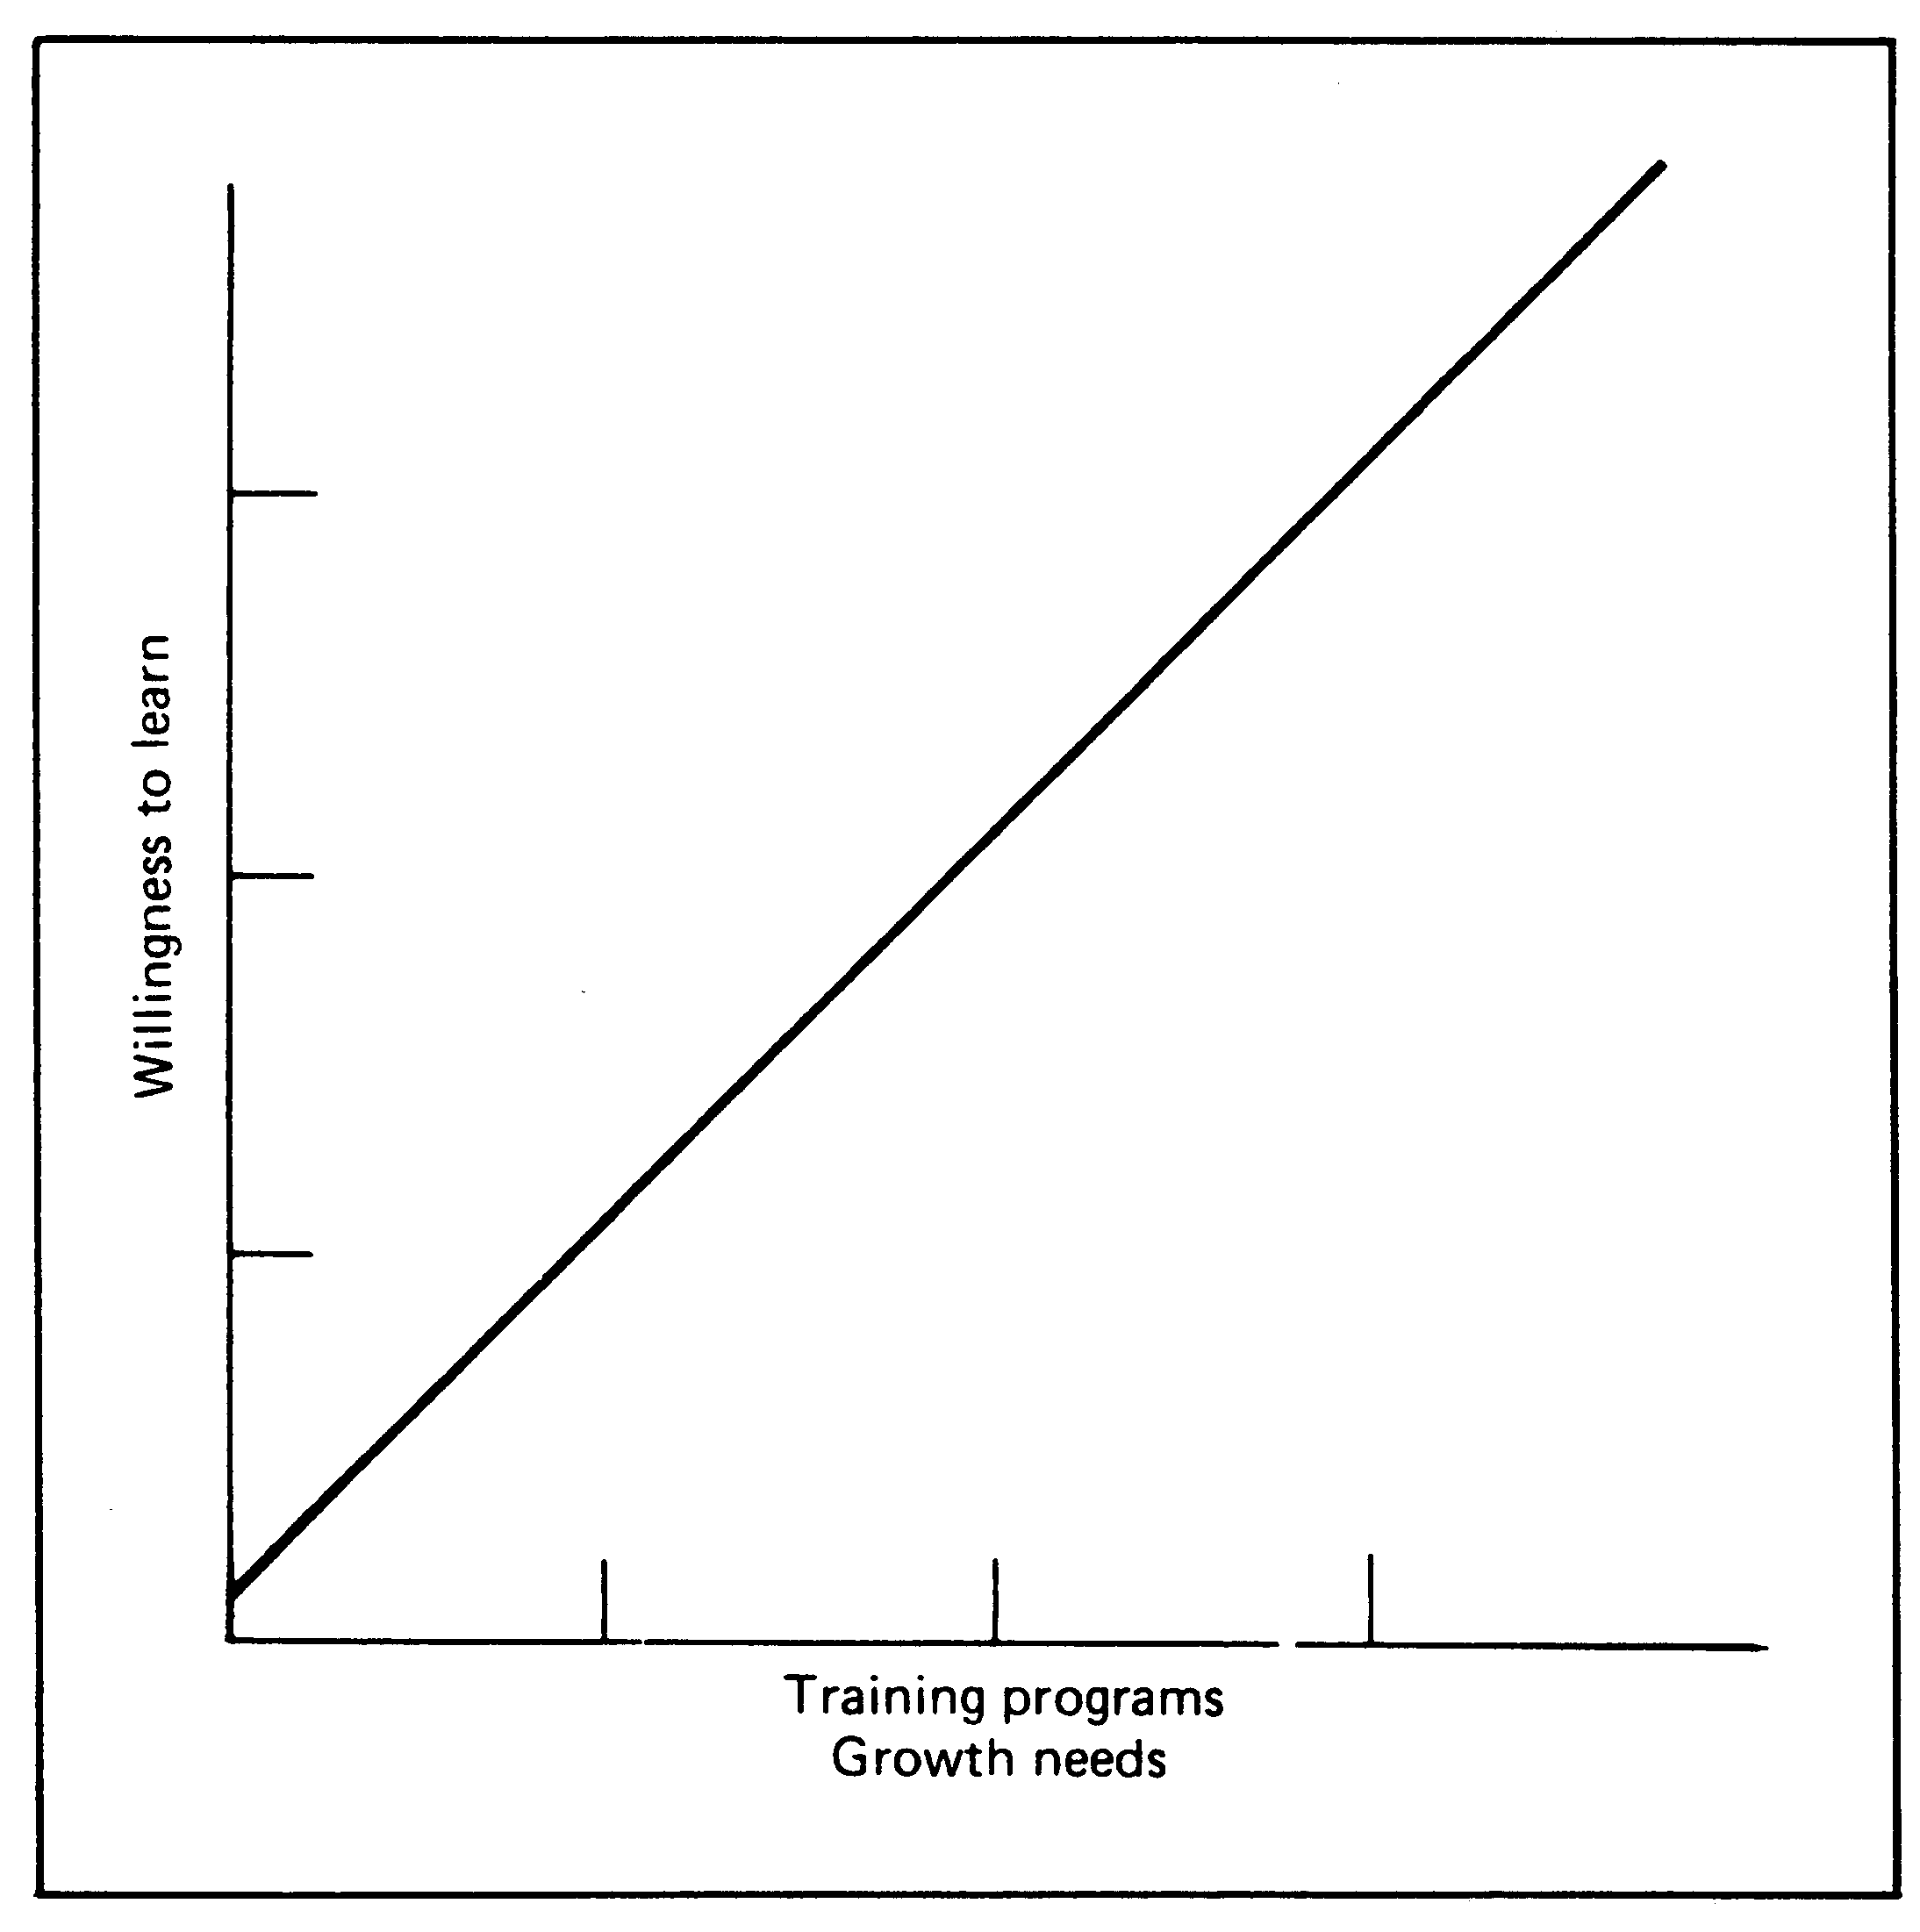
The linear effect of training and growth need on willingness

Slide 19
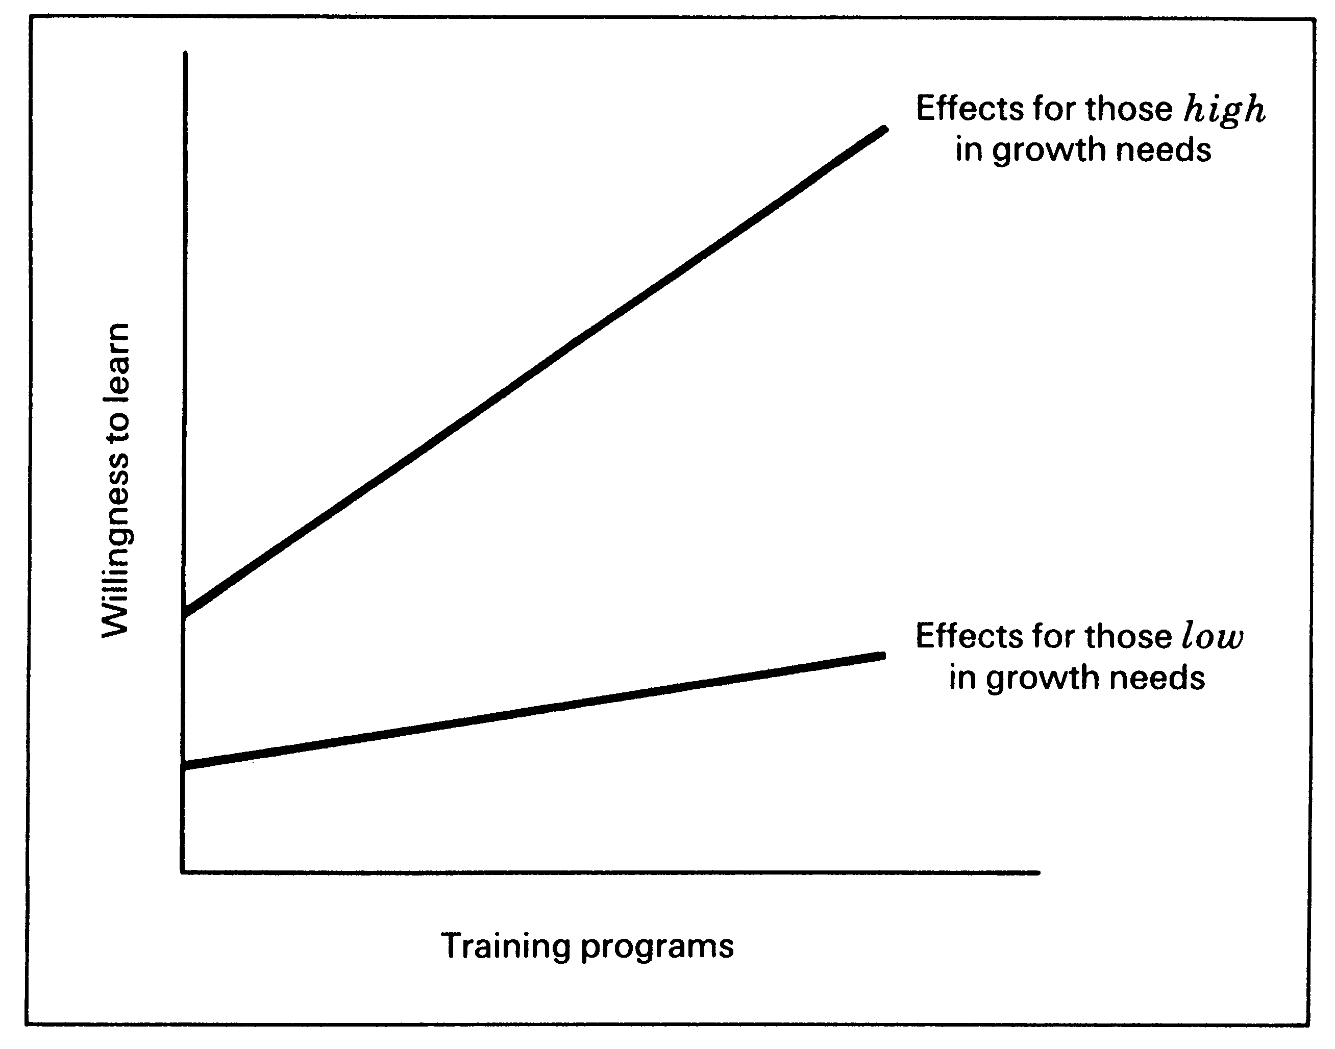
The effect of training is contingent on high/low growth need (slope/intensity)

Slide 20
Mediating/Intervening
A variable which surfaces between the time the independent variable operates to influence the dependent variable.
Temporal /sequential quality
Surfaces as a function of the independent variable

Slide 21
Exam diff
Exam Performance

Slide 22
Exam Difficulty
Stress
Exam Performance

Slide 23
Workforce Diversity
Organization Effectiveness

Slide 24
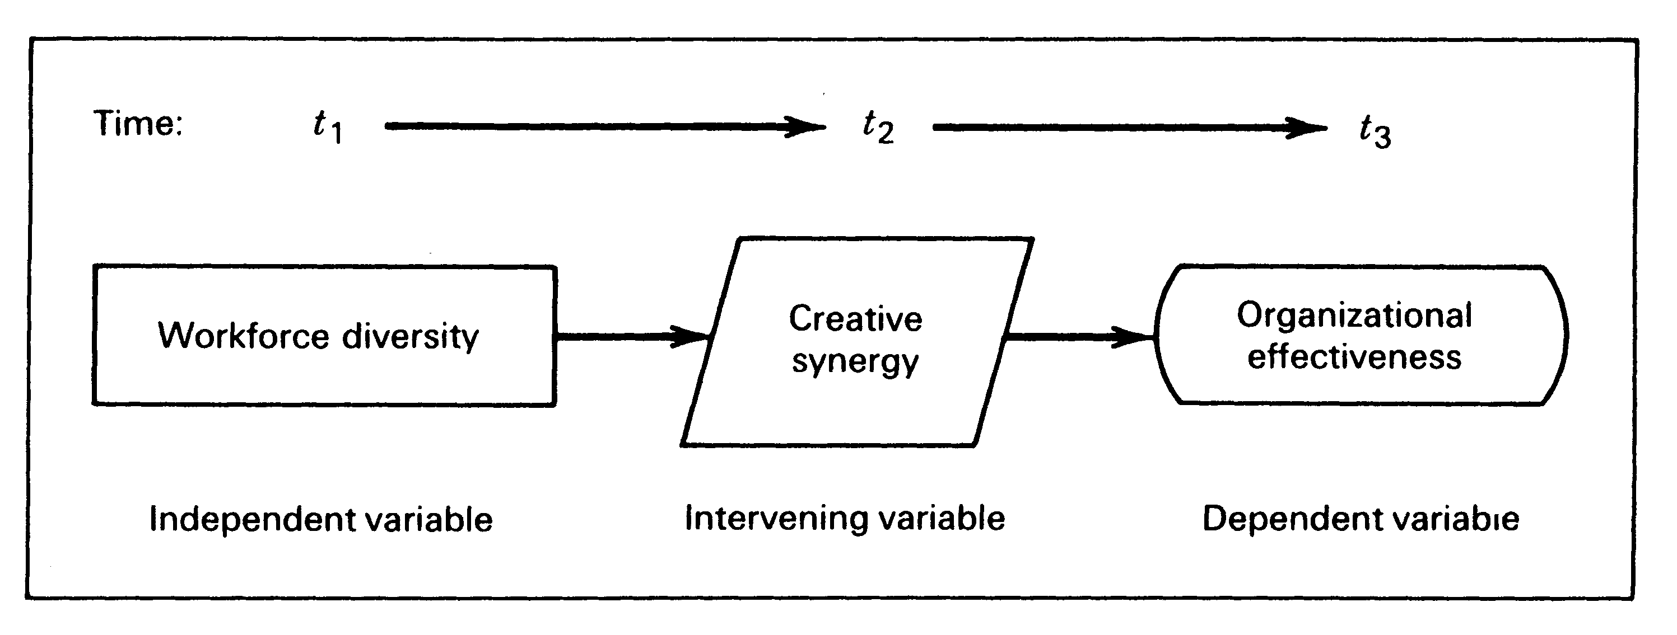

Slide 25
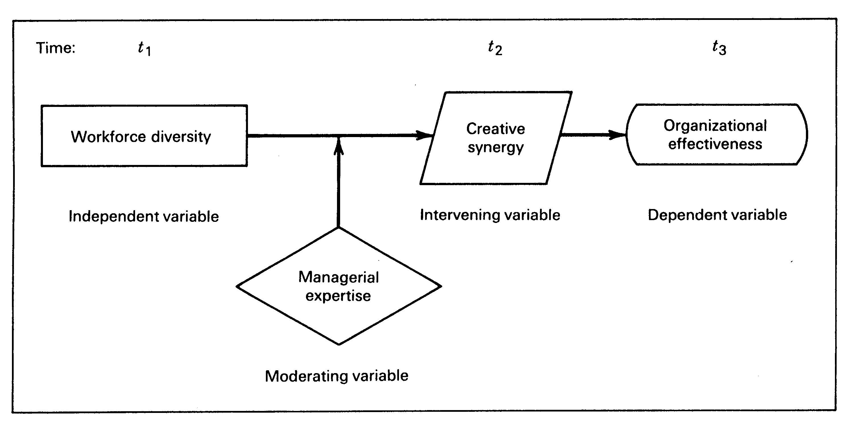
Integrating Moderating, Mediating Variables

Slide 26
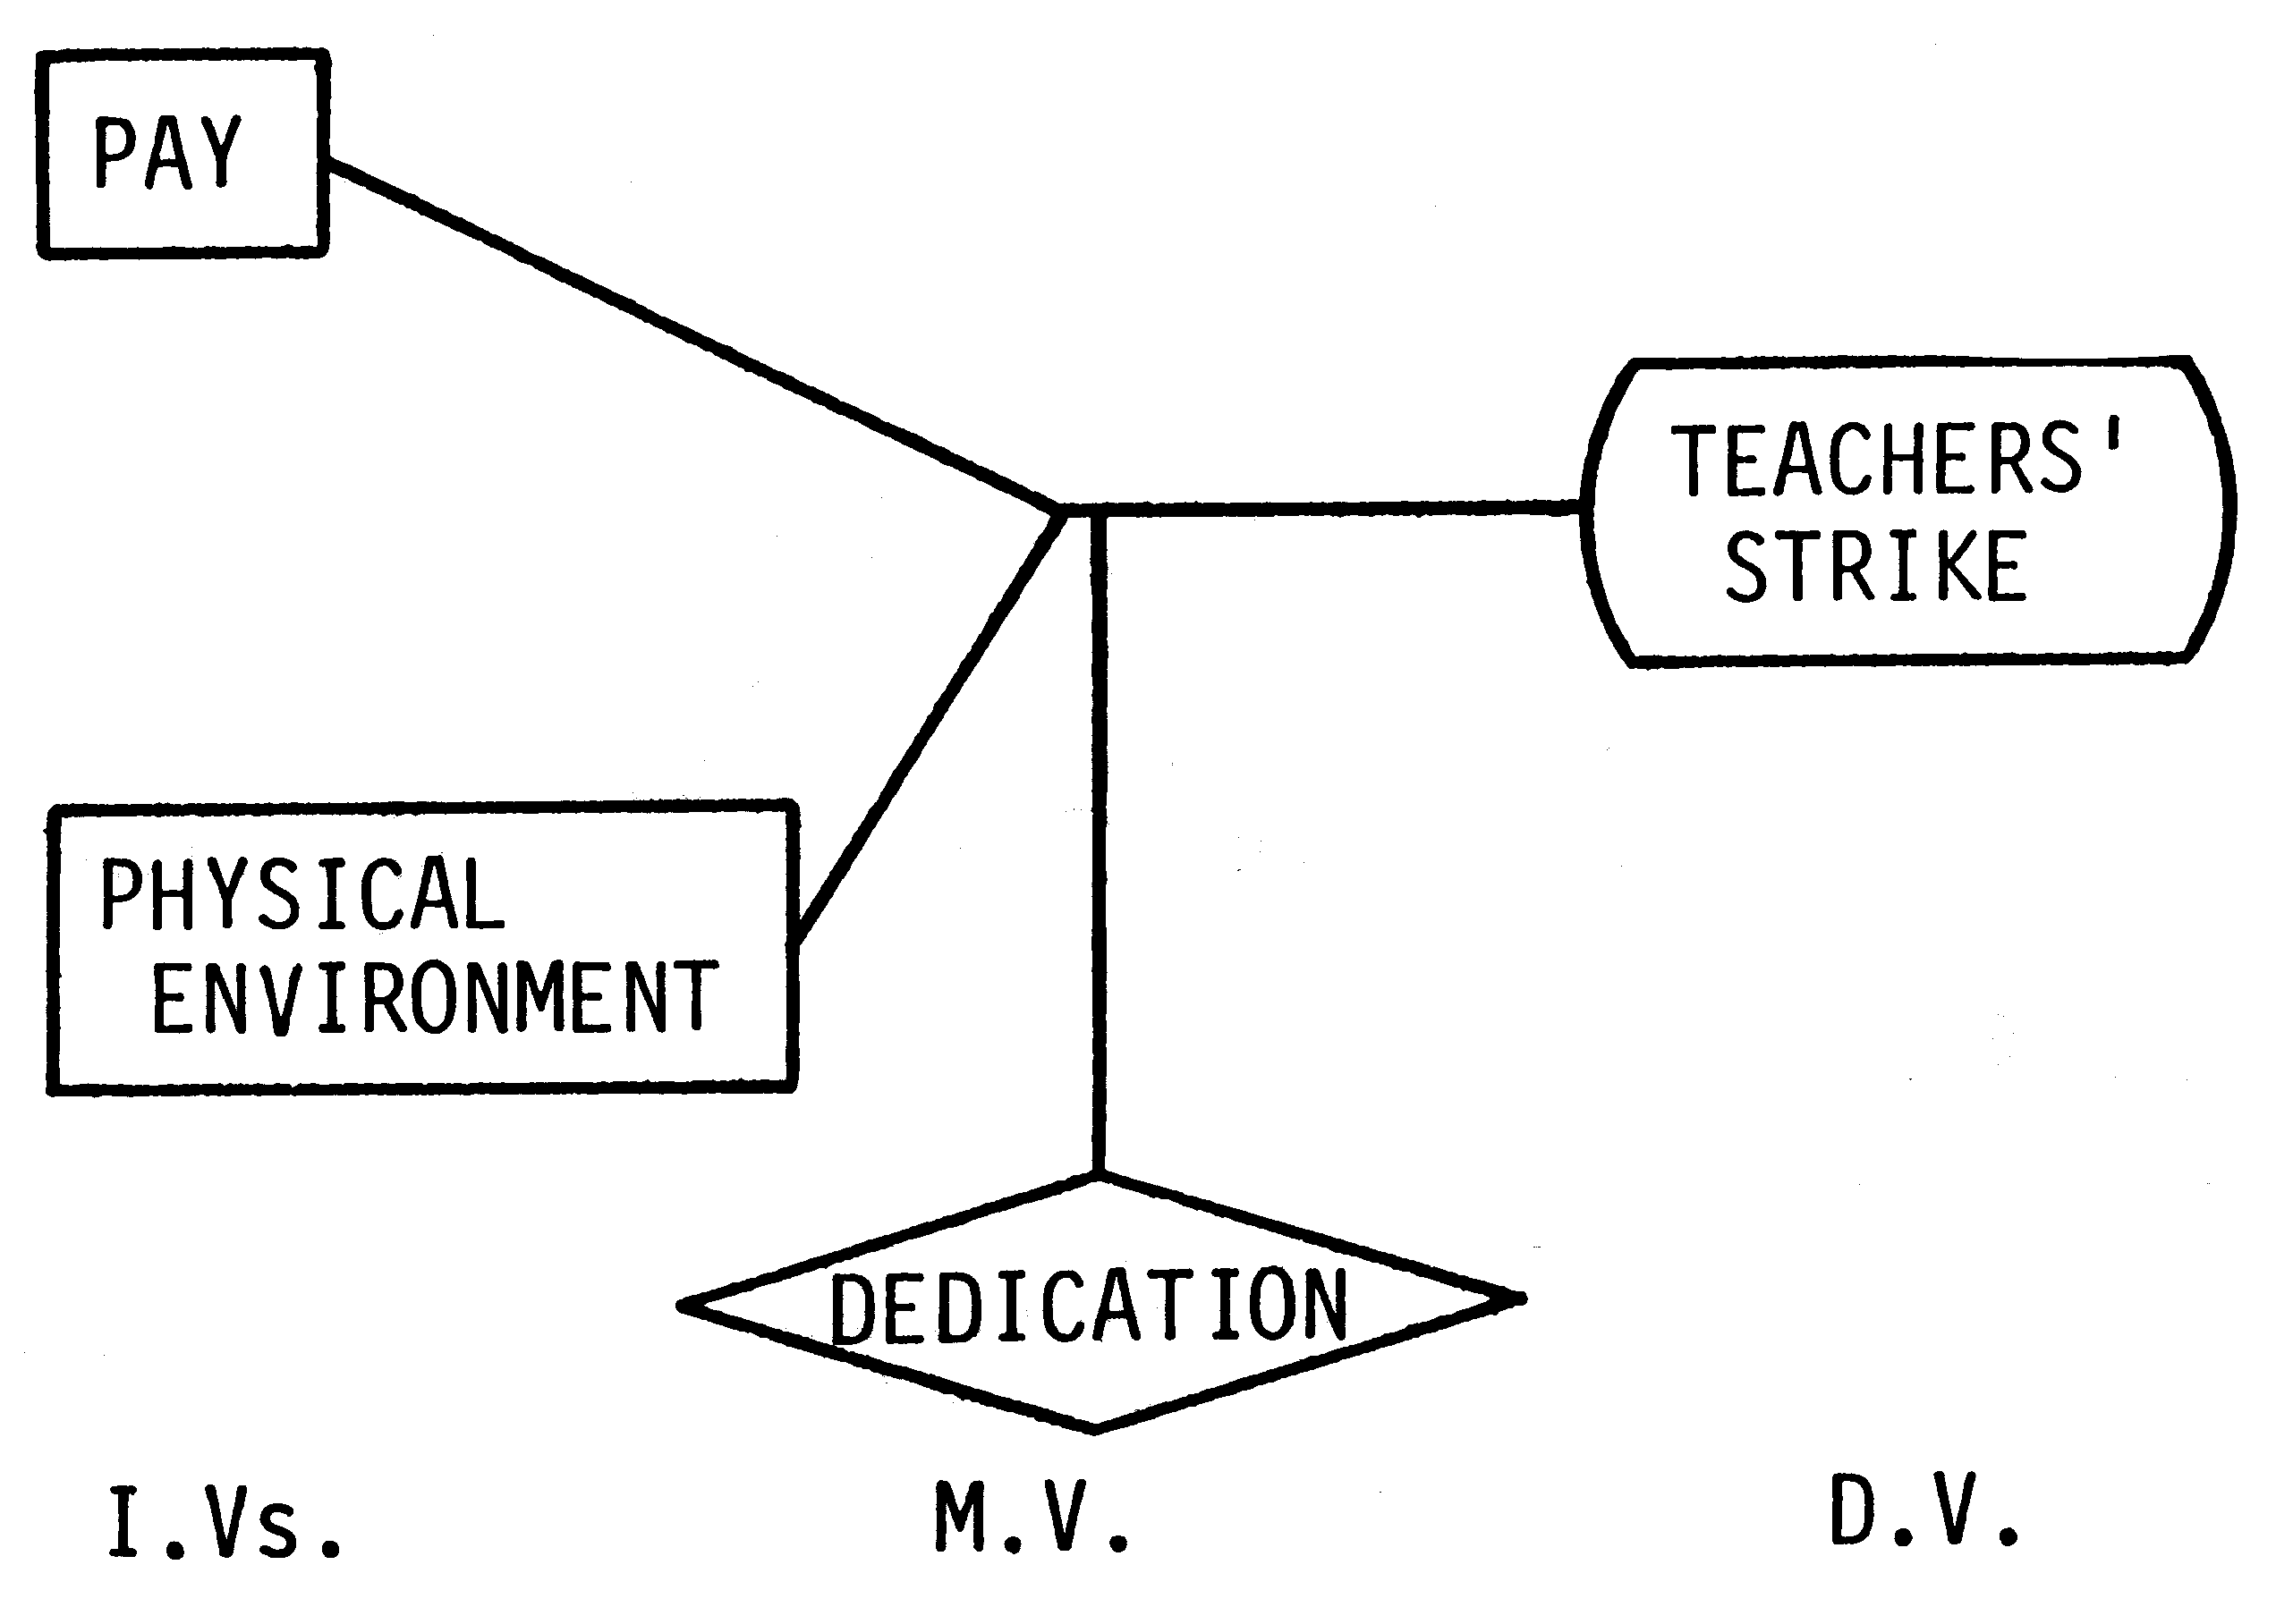

Slide 27
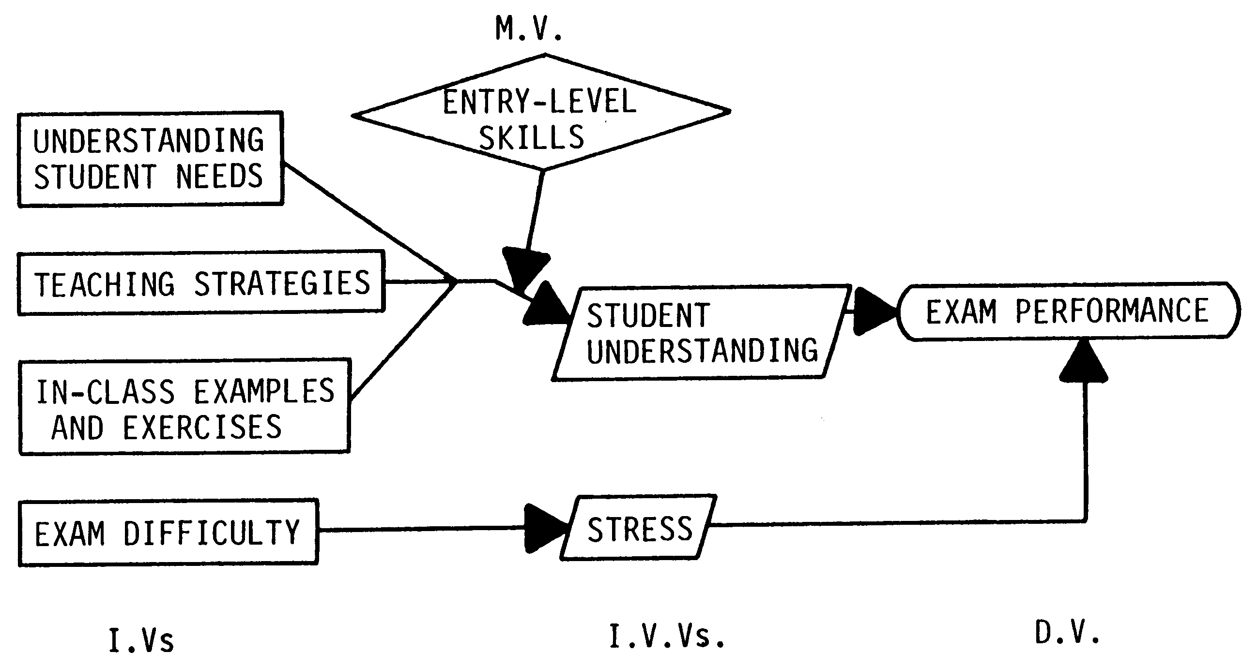

Slide 28
Theoretical Framework
Is a conceptual model
Foundation of the research
Logically developed, described and elaborated network of association as a result of interviews, observation and literature survey.
  So we identify a problem
  Identify the important variables from literature etc.
  Logically developing network of associations and elaborate
  Generate hypotheses and later tested

Slide 29
Components of Theoretical Framework
Identification of variables ( name and type)
Discussion how and why these variables are related
Direction of the relationship need to be theorized and discussed (positive/negative)
Discussion on why these relationships exists, support from previous research.
A schematic diagram
Note: Must read example on page 93

Slide 30
Recap
Types of Variables
  Independent, Dependent, Moderating, Mediating( Intervening)
Examples of their relationships with each other
Developing of Theoretical Framework
  Variables, logical Relationships, Directions, Explanations

