Slide 1
Research Methodology
      Lecture No :32
      (Revision Chapters 8,9,10,11,SPSS)

Slide 2
Data Collection
The Data is collected from primary and secondary sources
The primary data collect via
Observation, panels, interviews, questionnaires etc
Interview are structure and unstructured
While interviewing there are certain guidelines
There are structured and unstructed interviews
There are some advantages / disadvantages of face to face vs telephone interviews .

Slide 3
Questionnaire Design
Questionnaires
Personally Administered Questionnaires
Mail questionnaires
Guide line for wordings
  Content and purpose (Subjective vs Objective)
  Language and wording ( slang/technical)
  Types of formats (open / closed ended)
  Positively worded and Negatively worded
  Bias/ Favoritism(Leading, loaded, ambiguous, double barrel, socially desirable)
Length of the question
Funneling

Slide 4
Sampling
Sampling is the process of selecting the right individuals
Sample is used to represent the whole data or population
Sampling process include defining population, sample frame, sampling design, sample size and sampling process

Slide 5
Sampling
Simple random sampling and restricted sampling are two basic types of probability sampling.
Probability: Probability of selection is known
Non Probability : Probability is not known

Slide 6
Sampling
Precision we estimate the population parameter to fall within a range, based on sample estimate.
Confidence is the certainty that our estimate will hold true for the population.
Sample size.
Some sampling designs are more efficient than the others.
The knowledge about sampling is used for different managerial implications.

Slide 7
Types of Sampling Designs
Sampling Designs
Non-probability
Probability
Convenience
Judgmental
Quota
Snowball
Simple Random
Systematic
Stratified
Cluster
Other Sampling
Techniques

Slide 8
Experimental Design
Causal vs Correlations
Experimental Design
Field Experiment vs Lab Experiments

Slide 9
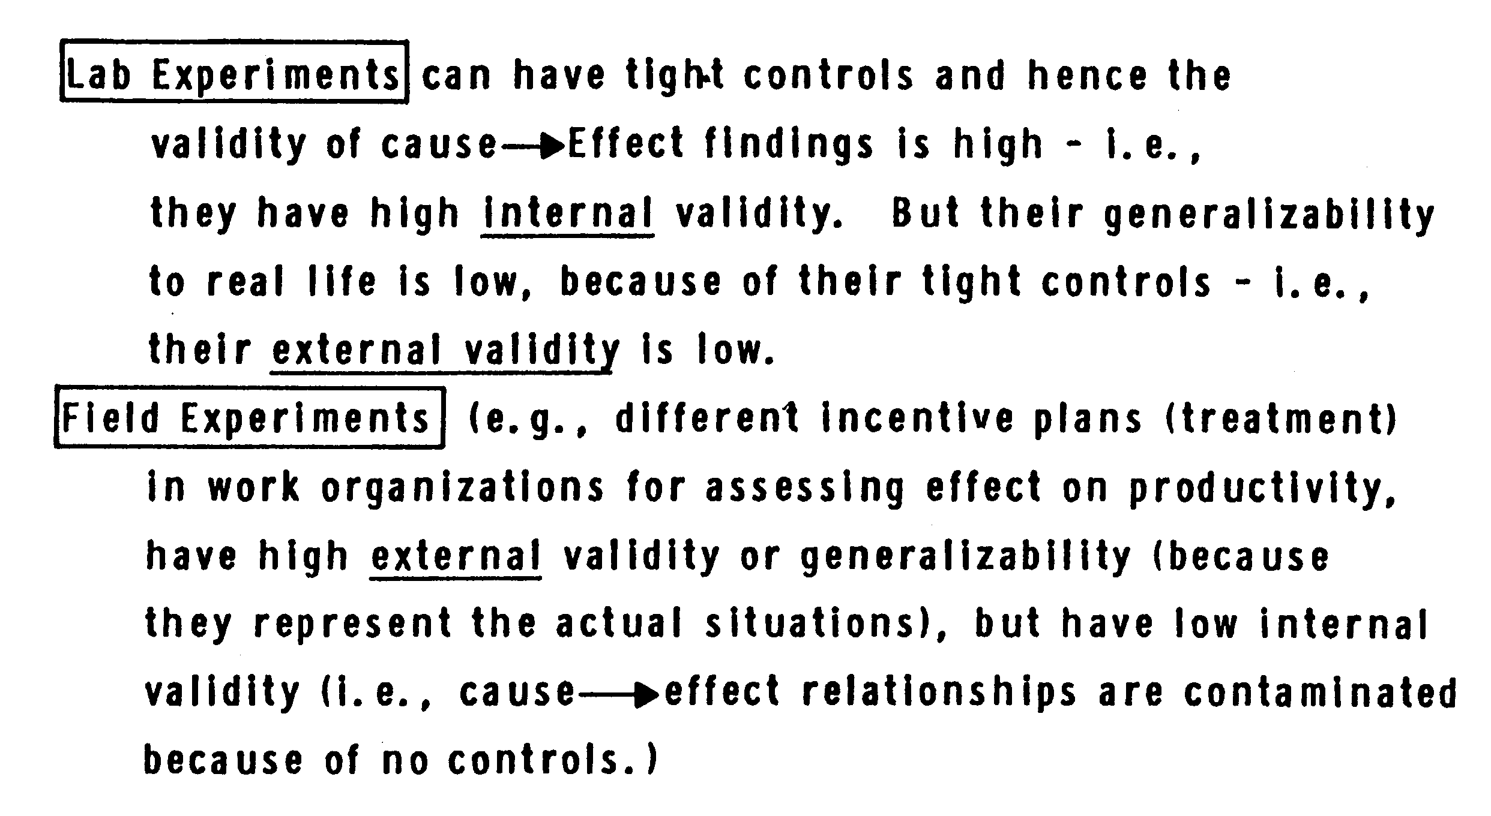
Experimental Design

Slide 10
Experimental Designs
When to use experimental designs
Pretest and Posttest Experimental Group Design
Posttests only with Experimental and Control Group
Pretest and Posttest Experimental and Control Group Design
Solomon Four Group Design

Slide 11
(Data Analysis)
Getting Data Ready
Questionnaire checking involves eliminating unacceptable questionnaires.
These questionnaires may be incomplete, instructions not followed, missing pages, past cutoff date or respondent not qualified.
Editing looks to correct illegible, incomplete, inconsistent and ambiguous answers.
Coding typically assigns alpha or numeric codes to answers that do not already have them so that statistical techniques can be applied.

Slide 12
Cleaning data for consistencies. Inconsistencies may arise from faulty logic, out of range or extreme values.
Statistical adjustments applies to data that requires weighting and scale transformations.

Slide 13
(DATA ANALYSIS)
Hypotheses Testing using SPSS
How to use SPSS for Data entry
  Defining variables
  Assigning them values
  Assigning sizes and constraints
  Data entry using data from coded Questionnaires
  Serial number the questionnaire
How to generate simple descriptive summaries

Slide 14
SPSS
Frequency refers to number of times various sub categorizes occur in the same pattern.
Frequencies can also be visually displayed as bar charts, histograms, or pie charts.
Histogram is graphical bar chart.
The stem-and-leaf presents actual data values that can be inspected directly.

Slide 15
SPSS
A boxplot reduces the detail of the stem-and-leaf display.
Cross-tabulation is a technique for comparing data from two or more categorical variables.
Percentages serve two purposes in data presentation.

Slide 16
SPSS
Three measures of central tendency: mean, median and mode.
Dispersion is the variability.
Three measures of dispersion are: range, variance and standard deviation.
Correlation
Goodness of data is measured by reliability and validity.
SPSS Cronbach Alpha (Reliability) Factor Analysis (Validity)

Slide 17
SPSS-Hypotheses Testing
Hypothesis testing(Difference between groups, Relationship)
Null and Alternate Hypotheses
Choose appropriate test
Significance
Group difference
  Testing single mean
  Testing two related means (ratio)
  Testing two related samples when data is in ordinal / nominal
  Testing two in unrelated means
  Testing when more than two groups on their mean scores

Slide 18
Hypothesis Testing
Hypothesis testing the relationship/Association
Correlations
Regression

Slide 19
Research Proposal
The purpose of the study
The specific problem to be investigated/problem statement/ Research Questions
The scope of the study/what is covered and not covered.
The relevance of the study/importance
The research design offering detail on
  Sampling, data collection methods, data analysis,
Time frame
The budget

Slide 20
Research Report Layout
Title
Introduction
A literature review
Research Questions
Theoretical Framework
Hypothesis
Method section
  Study Design (cross sectional , …)
  Population and Sample

Slide 21
  Variables and measures
  Their reliability and Validity
Data Collection
Data Analysis
Discussion of Results
Recommendations

Slide 22
Final Words
You have by now developed basic research skills not necessarily become an expert.
But as a managers / students should be able differentiate between good or bad research.
You also by now recognized research is an integral part of the organization reality and can improve the organization.
Should be able to appreciate that for any problem a scientific way to address is by identifying its factors and collecting data systematically on it so that the results would be have some credibility in the industry and academia as well

Slide 23
By now you should be able to logically conceptualize the relationships among variables
And able to carry out a small research project
With this WISH YOU BEST OF LUCK

