Slide 1
Research Methodology
      Lecture No :31
      (Revision Chapter 1,2,3,4,5,6,7)

Slide 2
Introduction
  Overview of the course :
    Business research is an organized and deliberate process through which organization effectively learn new knowledge and help improve performance.

Slide 3
Introduction
  Overview of the course :
    Business research is an organized and deliberate process through which organization effectively learn new knowledge and help improve performance.

Slide 4
Introduction
  Objectives of the course :
    To understand and develop a systematic approach to business research
    To emphasis on the relationship between theory , research and practice
    To Integrate different research activities in an orderly fashion

Slide 5
  Outcomes of the course are :
    To formulate research questions
    Develop theoretical framework
    Develop hypotheses
    Learn to select from different research methodologies
    Develop skills for data analysis and interpretation.

Slide 6
Research is a
  Systematic effort to investigate a problem
Types of research
  Applied (solve a current problem of org)
  Basic (improve understanding of a problem)
Research Philosophical Choice
  Deduction / Induction
Why managers should know about research
  Identify problems , discriminate b/w good and bad research, appreciate the multiple influences of different factors ,etc.

Slide 7
Hall Marks of Scientific Research.
  Purposive, Rigor, Testability, Reliability, Precision/confidence, Objectivity, Generalizbility, Parsimony
Building Blocks of Scientific Research
  Observation, identification of problem area, Theoretical Framework, Hypothesis, Construct, Concepts operations definitions, Research Design, Data Collection , Analysis, Interpretation, implementation/refinement of theory

Slide 8
Problem/Literature/Question
Identification of the broad problem area
  Preliminary information gathering through interviews and literature survey
  Problem definition
Literature Review involves searching and documenting
  There is a structure of review (importance, objectives, definitions, relationships identified, gaps)
  There are different formats of Documenting (APA)
Based on the gaps identify your research objectives/problem definition/research questions

Slide 9
Theoretical Framework and Variables
Theoretical framework is representation of your belief on how variables related and why
Variables are of 4 different kinds
  Independent, Dependent, Moderating, Mediating( Intervening)

Slide 10
Hypotheses
In order statistically respond to the research questions we develop the Hypotheses statements.
These statements are stated in such way that they can be easily testable
Hypotheses statement are written in directional, non directional formats for testing group differences, relationship between variables.
We develop null and alternate hypotheses

Slide 11
Summarized Table of Statistical Notations for Hypotheses
 | Relationship |  | Group Difference
 | Ho: | Ha: | Ho: | Ha:
Directional | ρ=0 | ρ>0 OR ρ<0 | µa=µb | µa>µb OR µa<µb
Non-Directional | ρ=0 | ρ#0 | µa=µb | µa # µb

Slide 12
Research Design
We covered some of the research design elements
We talked about the research purpose
  (exploratory, descriptive, hypothesis testing)
Type of investigation
  (causal, correlations)
Extent of researcher's interference
  (High, moderate, low)

Slide 13
The Research Design
Purpose of the
study
Exploratory
Description
Hypotheses
Testing
Types of
Investigation
Establishing:
-Casual
relationship
- Correlation's
- Group
difference
ranks, etc.
Extent of
Researcher
interference
Minimal: studying
events as they
normally occur
Manipulation
Study setting
contrived
non-contrived
Measurement
& Measures
Operational Definition
scaling
categorizing
coding
1. Feel for
data
2.Goofiness
of data
3. Hypothesis
Testing
Problem Statement
Units of analysis
(population to be
studied)
individuals
dyads
groups
organizations
\machines
etc
Sampling
design
Probability/
Non-probability
Sample size (n)
Time horizon
one-shot
(cross-sectional)
Longitudinal
Data collection
method
Observation
Interview
Questionnaire
Physical
measurement
Un-obstructive

Slide 14
Opertionalization
Measurement is necessary to give answers or to the research question , or to test our hypotheses.
The opeationalizing of certain subjective variables are necessary for measurement.
The abstract concepts are broken down to dimensions and its elements.
Questions are formulated on them
Not to confuse dimensions with antecedents

Slide 15
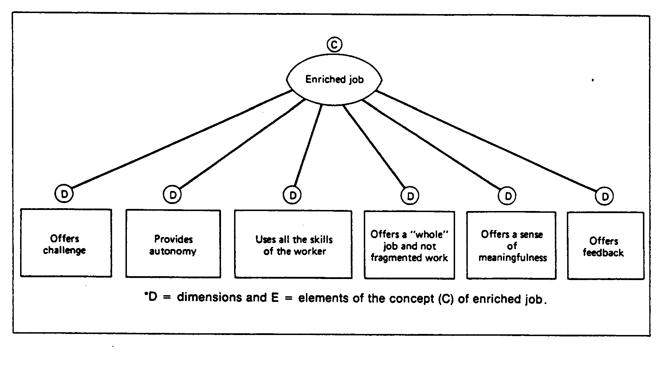

Slide 16
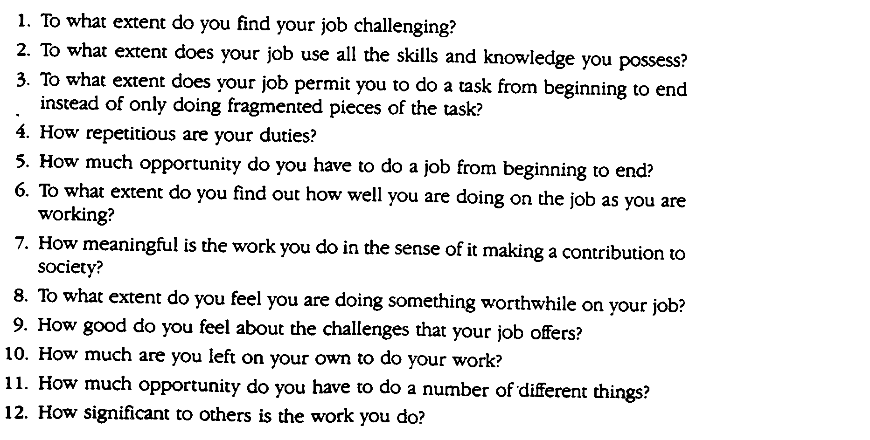
Research Question/Items for the five Dimensions

Slide 17
Scales
Measurement means that scales are used.
Scales are a set of symbols or numbers, assigned by rule to individuals, their behaviors, or attributes associated with them
Nominal , Ordinal, Interval, Ratio

Slide 18
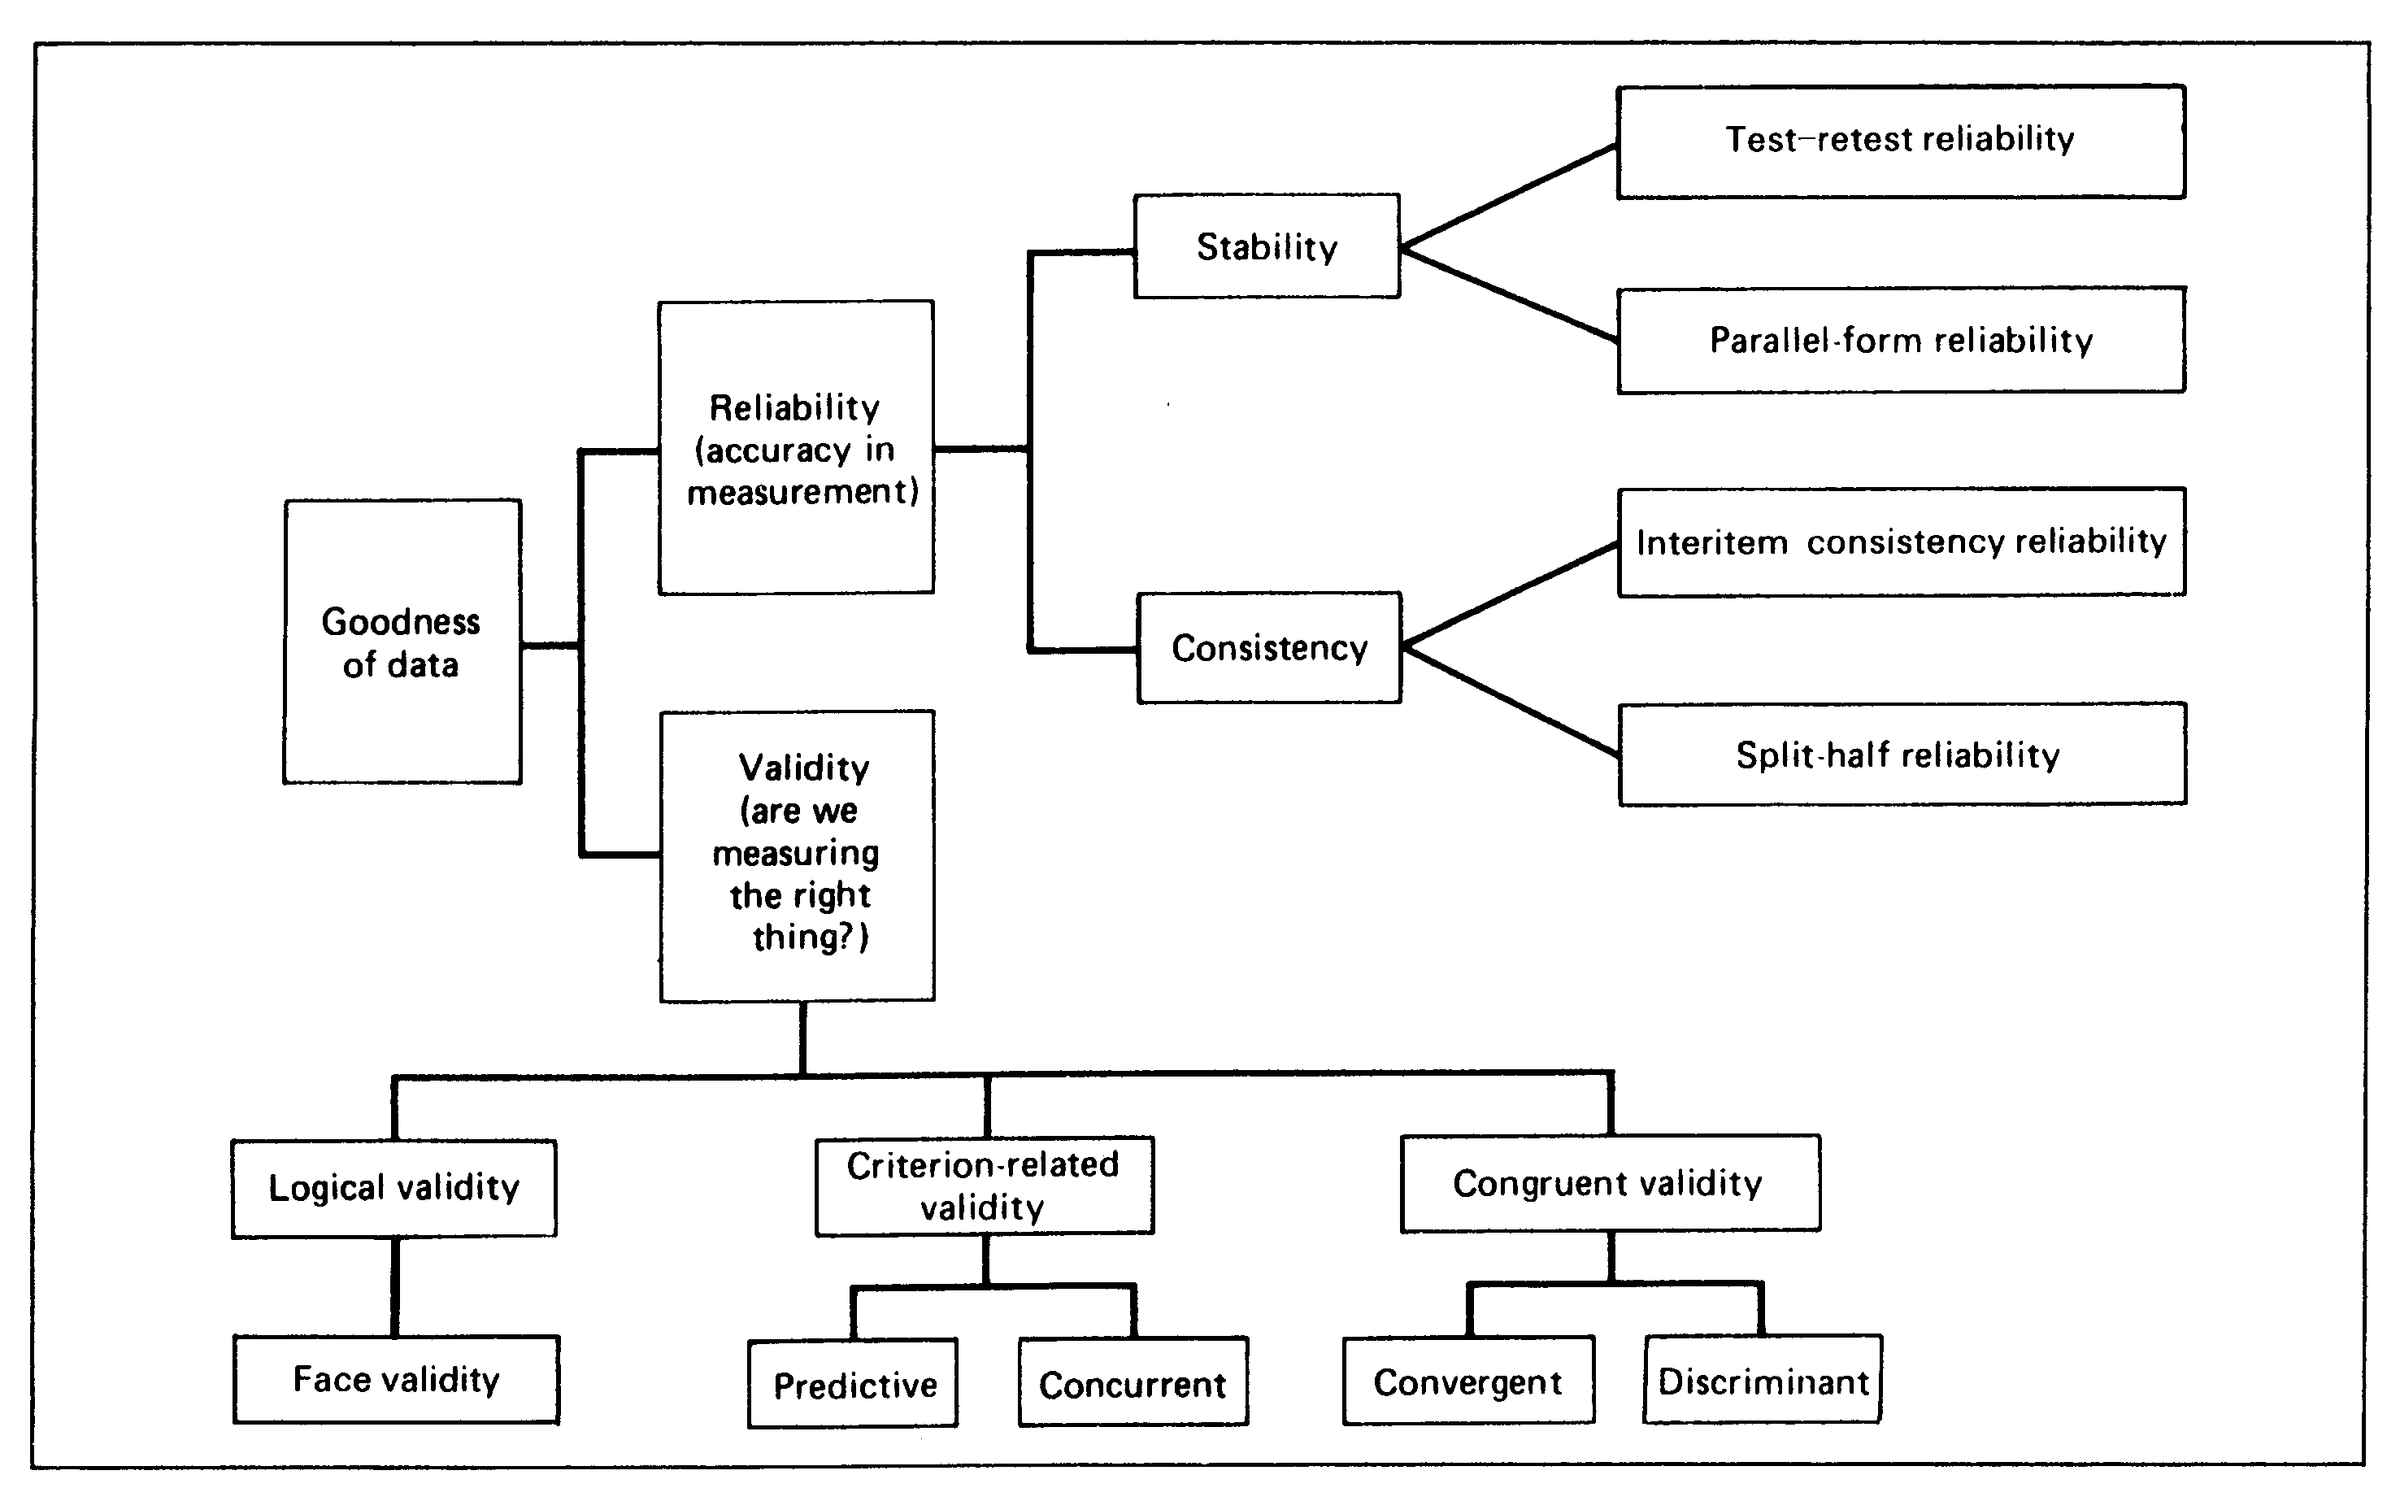
Goodness of Data
Four types of scales are used in research, each with specific applications and properties. The scales are
Nominal
Ordinal
Interval
Ratio

