Slide 1
Course Overview
Collecting Data
Exploring Data
Probability Intro.
Inference
Comparing Variables
Relationships between Variables
Means/Variances
Proportions
Regression/Correlation
Contingency Tables

Slide 2
Statistical Inference
Inferential Statistics deals with procedures for making inferences about the characteristics that describes the larger group of data, called population, from the knowledge derived from only a part of the data, known as Sample.
Numerical quantities describing a population are called parameters.
A numerical quantity computed from a sample, is called a statistic.

Slide 3
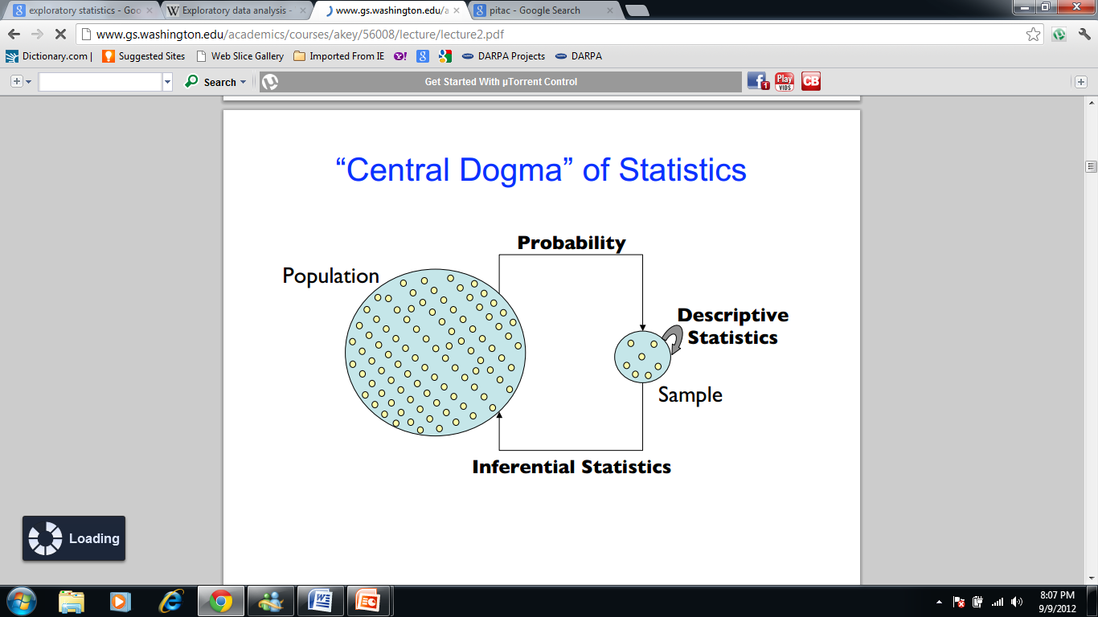
Statistical Inference

Slide 4
Statistical Inference
Estimation
Testing of Hypothesis
Point Estimation
Interval Estimation

Slide 5
Hypothesis Testing
INTRODUCTION
Hypothesis testing is a very important phase of Statistical Inference. It is a procedure which enables us to decide on the basis of information obtained from sample data whether to accept or reject a statement (assertion, claim, belief or assumption) about the value of a population parameter. Such a statement which may or may not be true, is called Statistical hypothesis. We accept the hypothesis as being true, when it is supported by the sample data and we reject the hypothesis when the sample data fail to support it.
Examples of Statistical hypothesis are (i) a judge assumes that a person charged with crime is innocent and subject this assumption(hypothesis) to a verification by reviewing the evidence and hearing testimony before reaching to a verdict (ii) a pharmaceutical company claims about a medicine (iii) a company claims that average return across all investment is 20 % and so on. To test such claims , sample data are collected and analyzed. On the basis of sample findings the hypothesized value of the population parameter is either accepted or rejected.

Slide 6
Basic concepts associated with hypothesis testing
Null and Alternative Hypothesis:
Any hypothesis which is to be tested for the possible rejection under the assumption that it is true is called null hypothesis. A null hypothesis is denoted by A null hypothesis should always be precise such as “the given coin is unbiased” or “a drug is ineffective in curing a particular disease ” or “difference between two teaching methods is zero”.
An alternative hypothesis is any hypothesis other than the null hypothesis. It is denoted by
Test Statistic
A sample statistic which provides a basis for testing a null hypothesis, is called a test statistic. Every test statistic has a probability (sampling) distribution which gives the probability of obtaining a specified value of the test statistic when the null hypothesis is true. It is important to remember that a test statistic does not prove the hypothesis to be correct but it furnishes an evidence against the hypothesis. The sampling distributions of the most commonly used test statistics are normal, t, chi-square, or F.

Slide 7
Basic concepts associated with hypothesis testing
Acceptance and Rejection Region:
All possible values which a test statistic may assume can be divided into two mutually exclusive groups: one group consisting of values which appear to be consistent with the null hypothesis, and the other having values which are unlikely to occur if is true. The first group is called acceptance region and other group is called rejection region(critical region). The value(s) that separates the critical region from the acceptance region, is called the Critical value(s).
Level of Significance
The significance level of a test is the probability used as standard for rejecting a null hypothesis when it is assumed to be true. This probability is equal to some pre-assigned value, denoted by .
The most frequently used values of are 0.05, 0.01.By we mean that there are about 5 chances in 100 of incorrectly rejecting a true null hypothesis, or we can say that we are 95 % confident in making the correct decision.

Slide 10
Basic concepts associated with hypothesis testing
One-tailed and two-tailed tests:
A test for which the entire rejection region is located in only one of the two tails either in the left tail or in the right tail of the sampling distribution of the test statistic, is called one-tailed test. If the rejection region is divided equally between the two tails of the sampling distribution of the test statistic, the test is referred to as Two-tailed test.
Type I and Type II Errors:
When we perform a hypothesis test, we derive the evidence from the sample in the form of a test statistic. There is possibility that the sample evidence may lead us to make a wrong decision. We may reject a null hypothesis when it is actually true or we may accept a null hypothesis when it is actually false. The former type is called Type I error and the latter, Type II error.

Slide 13
General procedure for Testing Hypothesis

Slide 14
Is the Population normal?
No
Yes
Is sample Size,
Is the population s.d known?
No
Yes
No
Yes
Use t-test statistic
Use z-test statistic
Use non-parametric tests
Use z-test statistic

