Slide 1
The Method of Moving Averages
Lecture#31

Slide 2
3. The Method of Moving Averages
To k-period moving averages are defined as the averages calculated by using the k consecutive values of the observed series, then repeating the operation by dropping one value at the beginning and including the first value after the preceding total, and so on, moving on one value to calculate each successive average. This process is continued till the last k consecutive values have been averaged.

Slide 3
Moving Average Trend
These averages values are plotted on the graph of the original values and the line connecting these points is the moving average trend, which smoothes out periodic fluctuations of the seasonal and cyclical types present in the series. The line may be continued in the general direction indicated by the original plotting for the purposes of future estimates.

Slide 5
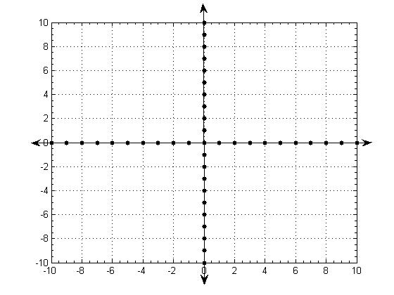
Moving Average Trends

Slide 6
Example
Compute the 4-quarter centered moving average for the following table showing the number of bags of fertilizer sold by a certain dealer. Also Plot these data as a time series.
 |  | Quarters
Year | I | II | III | IV
1979 | 72 | 98 | 79 | 106
1980 | 79 | 122 | 101 | 143
1981 | 94 | 141 | 128 | 160
1982 | 125 | 143 | 135 | 187

