Slide 1
Analyzing The Secular Trend
Lecture#30
MGT 601

Slide 2
Analyzing the Secular Trend
Time series analysis is used to detect patterns of change in statistical information over regular intervals of the time. We project these patterns to arrive at an estimate for the future.
To measure a trend which can be represented as a straight line or some type of smooth curve, the following methods are used.
The method of freehand curve.
The method of semi-averages.
The method of moving averages.
The method of least-squares.

Slide 6
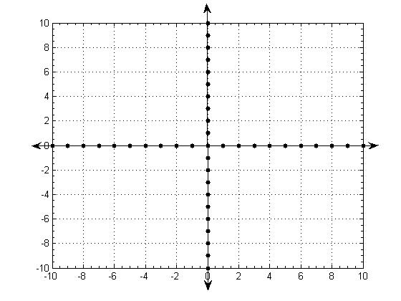
Graph Showing Annual Profits & The Semi-Average Trend

Slide 8
Graph Showing Number Of Patients & The Semi-Average Trend

