Slide 1
Time Series Analysis
Lecture#29
MGT 601

Slide 2
Time Series Analysis
Introduction:
A time series consists of numerical data collected, observed or recorded at regular intervals of time each hour, day, week, month, quarter or year. More specifically, it is any set of data in a chronological order.
Examples of time series data are the hourly temperature recorded at a locality for a period of years, the weekly prices of wheat in Lahore, the monthly consumption of electricity in a certain town, the monthly total of passengers carried by rail, the quarterly sales of a certain fertilizer, the annual rainfall at Islamabad for a number of years, the enrolment of students in a university over a number of years and so forth.

Slide 3
Introduction (continue)
The observations in a time series, denoted by
are associated with equal intervals of time (t).In order to examine The first step is to plot the given series on a graph, taking time intervals (t) along X-axis, as the independent variable, and the observed values on the Y-axis, as the dependent variable. Table 1 is an example of time series data.

Slide 4
Example 1.1
The following table shows the number of bags of fertilizer sold by a certain dealer. Plot these data as a time series and comment on the graph.
 |  | Quarters
Year | I | II | III | IV
1979 | 72 | 98 | 79 | 106
1980 | 79 | 122 | 101 | 143
1981 | 94 | 141 | 128 | 160
1982 | 125 | 143 | 135 | 187

Slide 5
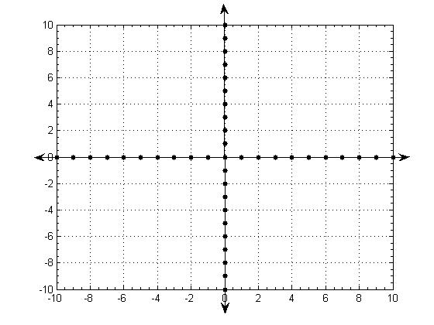
Historigram (Sales of Fertilizer for 4 years )

Slide 6
Components of a Time Series
Time series refer to any group of statistical information accumulated at regular intervals. A typical time series may be regarded as composed of four basic types of movements (changes, or variations), usually called components of a time series.
Secular trend
Seasonal variation
Cyclical fluctuations
Irregular or random variations
All four of the above components are not necessarily present in all time series. Thus , we can describes the overall variation in a single time series in terms of these four different kinds of variation.

Slide 7
Components of a Time Series
Secular trend
A Secular trend is a long-term movement that persists for many years and indicates the general direction of the change of observed values.
With the first type of change, Secular trend, the value of the variable tends to increase or decrease over a long period of time.
The steady increase in the cost of living things recorded by Consumer Price Index is an example of Secular trend.

Slide 8
Secular trend
It refers to a smooth broad movement of a time series in the same direction, showing a gradual rise or fall within data.
Analyzing the trend components helps in ascertaining the rate of change to be used for further estimates. It also helps in business planning and in studying the other variations.

Slide 9
Graph Showing the Long Term Trend

Slide 10
Components of a Time Series (Continue)
2. Seasonal Variation
Seasonal variation are mainly caused by the change in seasons, are short-term movements occurring in a periodic manner. These fluctuations are repeated with more or less the same intensity within a specific period of one year or shorter.

Slide 11
The main causes for seasonal variations are the weather conditions, the religious festivals and the social customs. Examples of seasonal variations are the prices of wheat which fall after the harvesting season and rise before the sowing time, the sales of soft drinks which are high in the summer and low in winter, investments in saving certificate are high in May and June but low in other months.

Slide 12
Graph Showing Sales by Quarters for 4 Years

Slide 13
Components of a Time Series
3. Cyclical Fluctuations
The third type of variation seen in the time series is cyclical fluctuations. The most common example of cyclical fluctuations is the business cycle. Over time, there are years when the business cycle hits a peak above the trend line. At other time, business activity is likely to slump, hitting a low point below the trend line. Note that cyclical movements do not follow any regular pattern but move in a somewhat unpredictable manner.

Slide 14
Graph Showing Phases of a Cycle

Slide 15
Components of a Time Series
4. Irregular variations
These variations are irregular and unsystematic in nature. They occur in a completely unpredictable manner as they are caused by some unusual events such as floods, strikes, earthquakes, wars, political events, locusts, fires etc. Irregular variations describe such movements. The effects of the Middle East conflict in 1973, the Iranian situation in 1979-1981, the collapse of OPEC in 1986, and the Iraqi situation in 1990 on gasoline prices in the United States are examples of Irregular variation.

Slide 17
Analyzing the Secular Trend
Time series analysis is used to detect patterns of change in statistical information over regular intervals of the time. We project these patterns to arrive at an estimate for the future.
To measure a trend which can be represented as a straight line or some type of smooth curve, the following methods are used.
The method of freehand curve.
The method of semi-averages.
The method of moving averages.
The method of least-squares.

