Slide 1
Use SPSS for solving the problems
Lecture#21

Slide 2
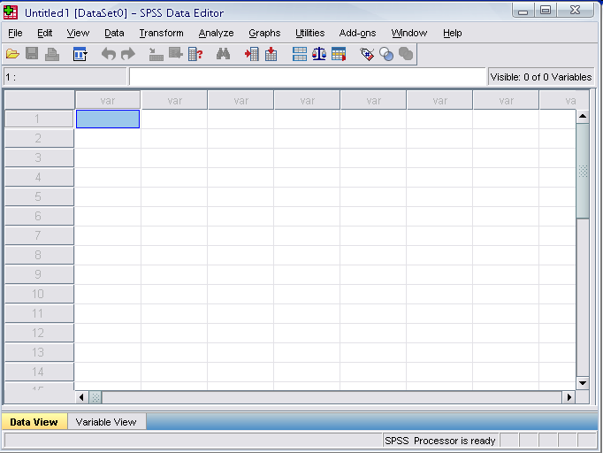
Opening SPSS
The default window will have the data editor
There are two sheets in the window:
1. Data view 2. Variable view

Slide 3
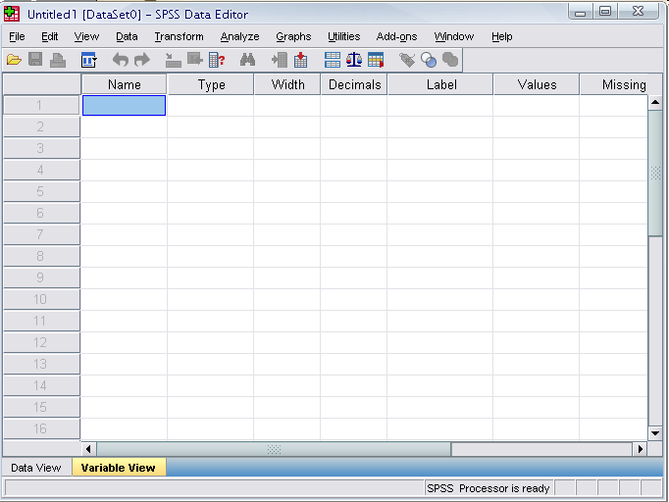
Data View window
The Data View window
This window shows the actual data values and the name of the variables.
Click on the tab labeled Variable View
Click
Notes:
This window shows the actual data values and the name of the variables.

Slide 4
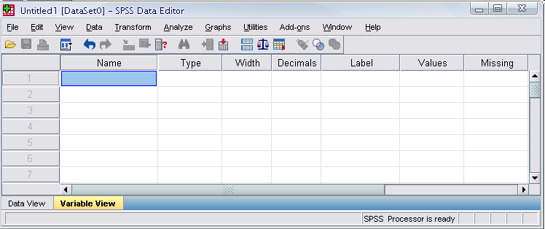

Variable view window
Name
  The first character of the variable name must be alphabetic
  Variable names must be unique, and have to be less than 64 characters.
  Spaces are NOT allowed.

Slide 5
Variable View window: Type
Type
  Click on the ‘type’ box. The two basic types of variables that you will use are numeric and string. This column enables you to specify the type of variable.

Slide 6
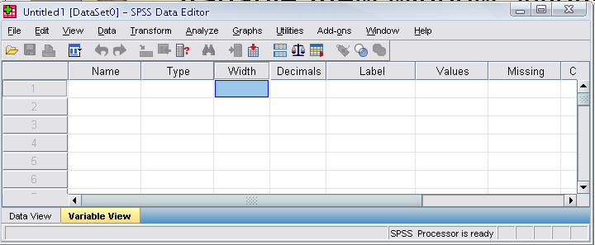
Variable View window: Width
Width
  Width allows you to determine the number of characters SPSS will allow to be entered for the variable

Slide 7
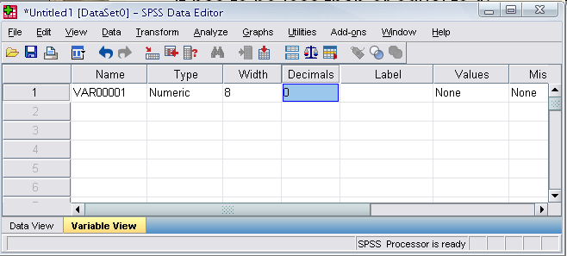
Variable View window: Decimals
Decimals
  Number of decimals
  It has to be less than or equal to 16

Slide 8
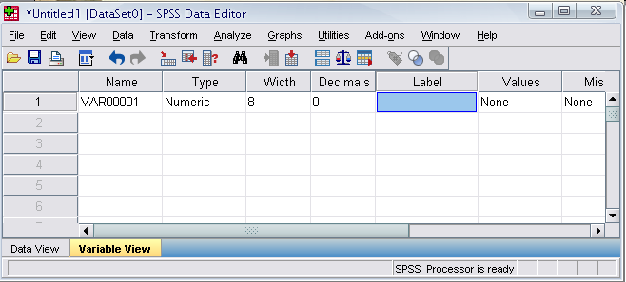
Variable View window: Label
Label
  You can specify the details of the variable
  You can write characters with spaces up to 256 characters

Slide 9
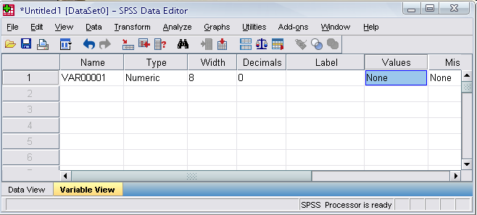
Variable View window: Values
Values
  This is used and to suggest which numbers represent which categories when the variable represents a category

Slide 10
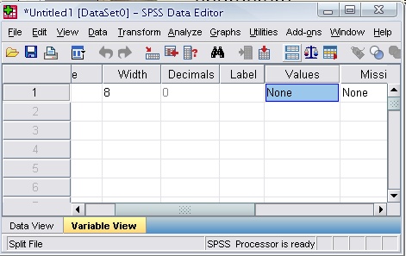
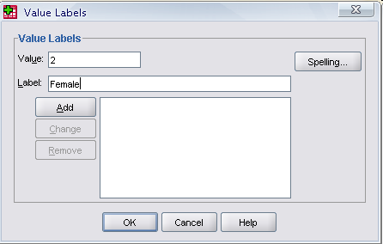
Defining the value labels
Click the cell in the values column as shown below
For the value, and the label, you can put up to 60 characters.
After defining the values click add and then click OK.
Click

Slide 11
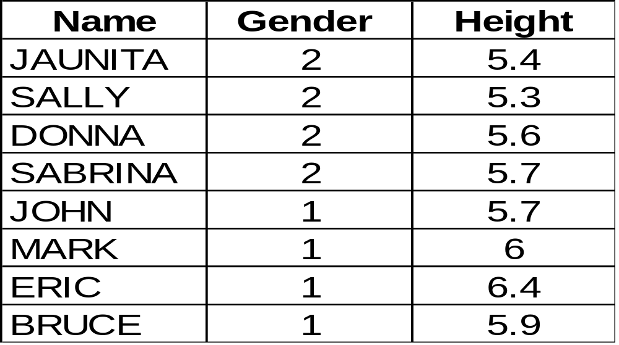
Practice 1
How would you put the following information into SPSS?
Value = 1 represents Male and Value = 2 represents Female

Slide 12
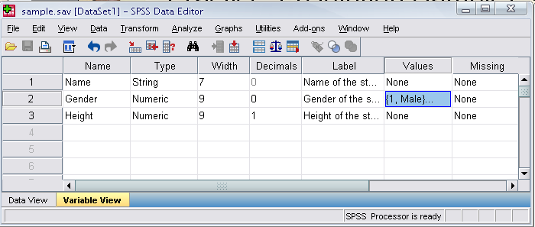
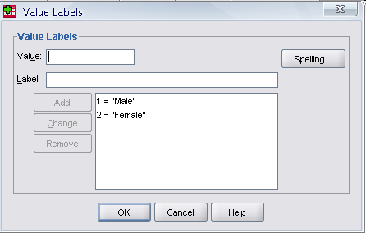
Practice 1 (Solution Sample)
Click

Slide 13
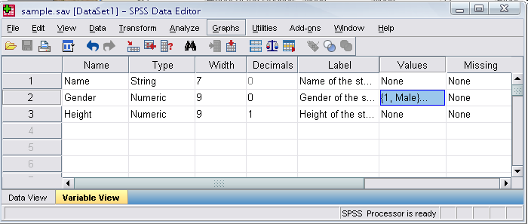
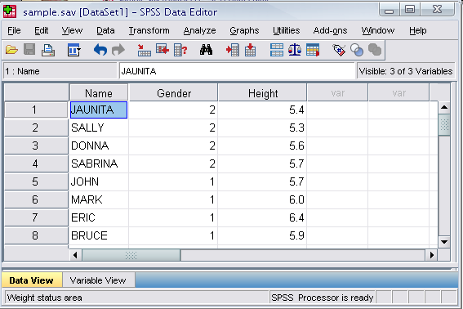
Click

Slide 14
Saving the data
To save the data file you created simply click ‘file’ and click ‘save as.’ You can save the file in different forms by clicking “Save as type.”
Click

