Slide 1
LECTURE 02
Descriptive Statistics MGT 601

Slide 2
Descriptive Statistics
Table 1: Wages of 120 workers in Dollars
67 63 57 85 67 60 75 55 67 68 51 54
45 57 64 68 67 86 63 60 98 83 76 70
56 50 74 74 67 77 61 85 66 66 60 61
58 56 56 57 60 60 63 64 85 80 75 75
57 58 59 58 58 61 62 91 74 72 57 73
61 86 64 91 64 64 61 62 69 57 81 66
65 81 82 76 77 81 76 66 62 63 62 63
60 60 72 72 79 70 70 58 78 58 71 76
60 60 65 65 66 65 73 73 71 73 66 73
67 68 69 68 73 68 74 68 67 76 52 79

Slide 3
Frequency distribution
Wages | No of workers
45-51 52-58 59-65 | 3 18 33
66-72 73-79 80-86 87-93 94-100 | 29 23 11 2 1
Total | 120

Slide 4
Frequency distribution
Class Boundaries | f
44.5-51.5 51.5-58.5 58.5-65.5 | 3 18 33
65.5-72.5 72.5-79.5 79.5-86.5 86.5-93.5 93.5-100.5 | 29 23 11 2 1
Total | 120
Relative frequency | Cumulative frequency
0.025 0.150 0.275 | 3 3+18=21 21+33=54
0.242 0.191 0.092 0.017 0.008 | 54+29=83 83+23=106 106+11=117 117+2=119 119+1=120
Midpoints (X)
48 55 62
69 76 83 90 97

Slide 5
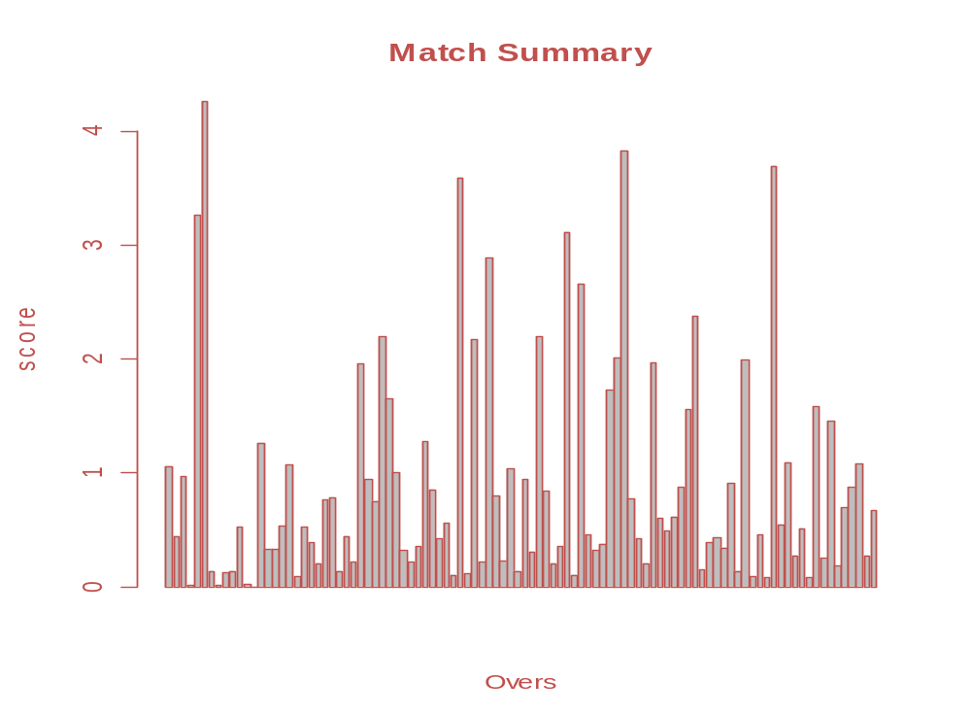

Slide 6
Graphical Presentation of Data
One of the important functions of Statistics is to present complex and unorganized (raw) data in such a manner that it would easily be understandable at a glance. This is often best accomplished by presenting the data in a pictorial (or graphical) form.
Types of Graphs
Histogram
Frequency polygon
Frequency curve
Cumulative frequency polygon (Ogive)
We will use the frequency distribution (table) for presenting these graphs.

Slide 7
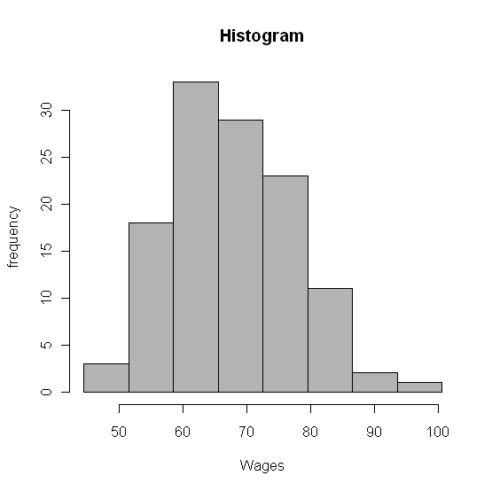

Slide 8
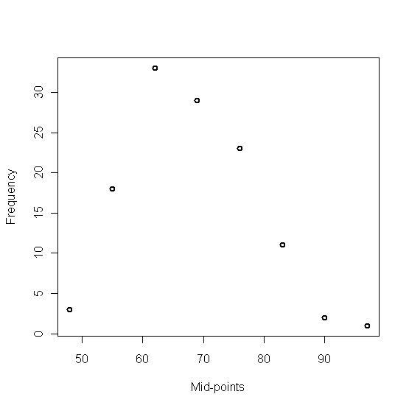
Frequency Polygon

Slide 9
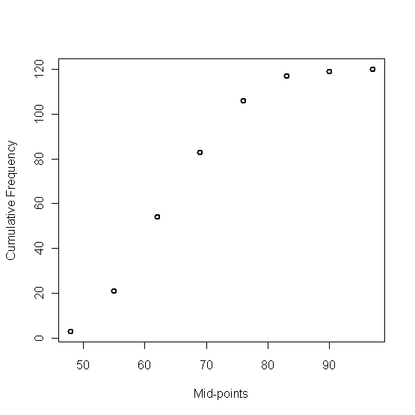
Cumulative Frequency Polygon (Ogive)

Slide 10
Measures of Central Tendency
Introduction
For practical purposes the condensation of data set into a frequency distribution and the visual presentation are not enough. Particularly, when two or more different data sets are to be compared.
A data set can be summarized in a single value. Such a value, usually somewhere in the center and representing the entire data set, is a value at which the data have the tendency to concentrate. The tendency of the observations to cluster in the central part of the data set is called Central Tendency and the methods of computing this central value are called Measures of Central Tendency.
Main measures of Central Tendency or Averages
Arithmetic Mean
Median
Mode

Slide 11
Mean=67.658
Class limits | f
45-51 52-58 59-65 | 3 18 33
66-72 73-79 80-86 87-93 94-100 | 29 23 11 2 1
Total | 120
Mid-Points (X)
48 55 62
69 76 83 90 97
fX
144 990 2046
2001 1748 913 180 97
8119

Slide 12
Median=66.948
Class Boundaries | f
44.5-51.5 51.5-58.5 58.5-65.5 | 3 18 33
65.5-72.5 72.5-79.5 79.5-86.5 86.5-93.5 93.5-100.5 | 29 23 11 2 1
Total | 120
Cumulative frequency
3 3+18=21 21+33=54
54+29=83 83+23=106 106+11=117 117+2=119 119+1=120

Slide 13
Mode=64.026
Class Boundaries | f
44.5-51.5 51.5-58.5 58.5-65.5 | 3 18 33
65.5-72.5 72.5-79.5 79.5-86.5 86.5-93.5 93.5-100.5 | 29 23 11 2 1

Slide 14
Measures of Dispersion
Introduction
It is quite possible that two or more data sets may have the same average (mean, median, mode) but their individual observations may differ considerably from the average. Thus a value of central tendency does not adequately describe the data. We therefore need some additional information concerning how the data are dispersed about the average. This is done by measuring the dispersion by which we mean the extent to which the observations in a sample or in a population vary about their mean. A quantity that measures this characteristic, is called a measure of dispersion, scatter, or variability.

Slide 15
Main Measures of Dispersion
Range
Quartile Deviation.
Mean Deviation.
Standard Deviation/Variance.

Slide 16
Standard Deviation
Class limits | f
45-51 52-58 59-65 | 3 18 33
66-72 73-79 80-86 87-93 94-100 | 29 23 11 2 1
Total | 120
X
48 55 62
69 76 83 90 97
-19.658 -12.658 -5.658 1.342 8.342
15.342 22.342 29.342

Slide 17
Statistical Package for the Social Sciences - (SPSS)
Originally it is an acronym of Statistical Package for the Social Science but now it stands for Statistical Product and Service Solutions
One of the most popular statistical packages which can perform highly complex data manipulation and analysis with simple instructions

Slide 18
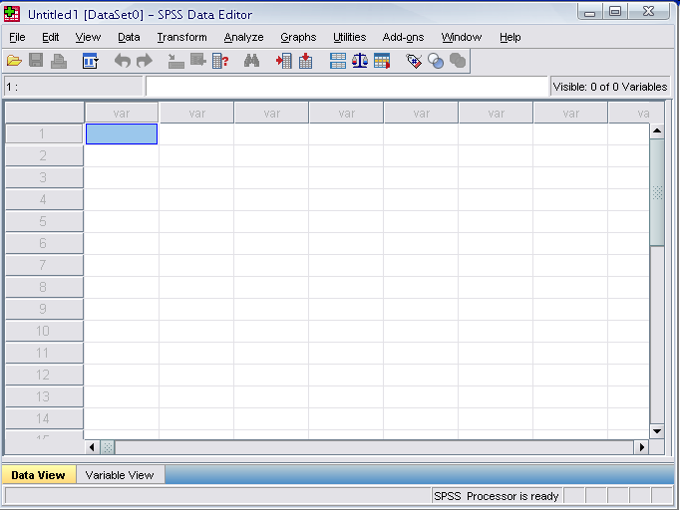
Opening SPSS
The default window will have the data editor
There are two sheets in the window:
1. Data view 2. Variable view

Slide 19
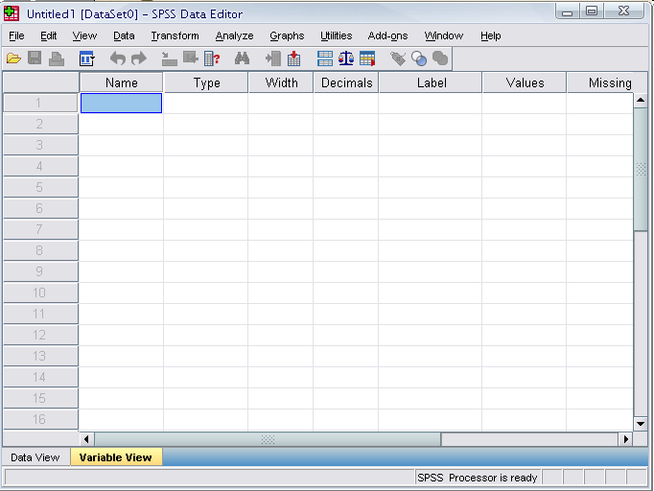
Data View window
The Data View window
This window shows the actual data values and the name of the variables.
Click on the tab labeled Variable View
Click
Notes:
This window shows the actual data values and the name of the variables.

Slide 20
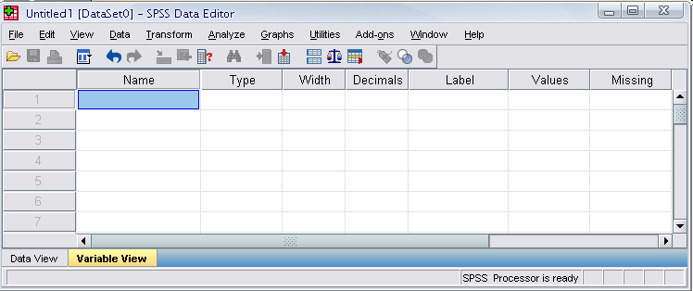

Variable view window
Name
  The first character of the variable name must be alphabetic
  Variable names must be unique, and have to be less than 64 characters.
  Spaces are NOT allowed.

Slide 21
Variable View window: Type
Type
  Click on the ‘type’ box. The two basic types of variables that you will use are numeric and string. This column enables you to specify the type of variable.

Slide 22
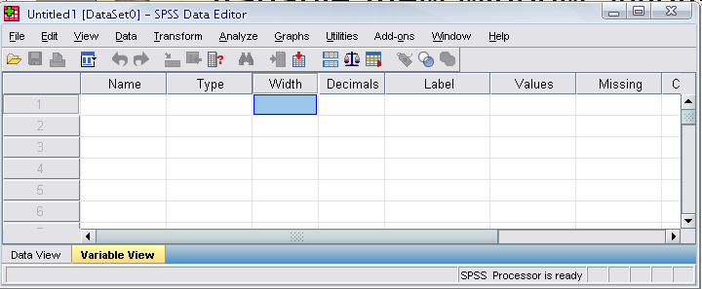
Variable View window: Width
Width
  Width allows you to determine the number of characters SPSS will allow to be entered for the variable

Slide 23
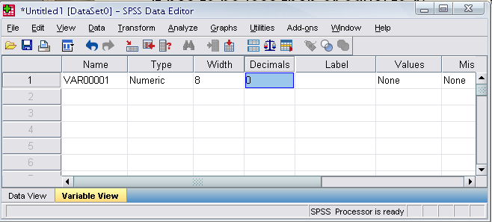
Variable View window: Decimals
Decimals
  Number of decimals
  It has to be less than or equal to 16

Slide 24
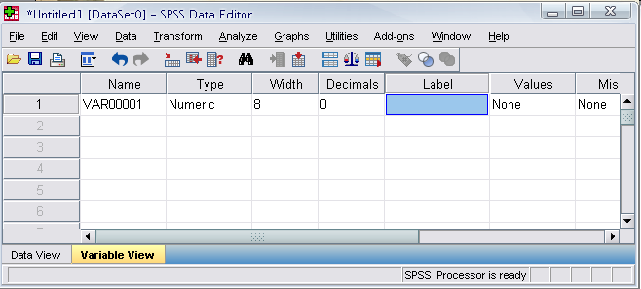
Variable View window: Label
Label
  You can specify the details of the variable
  You can write characters with spaces up to 256 characters

Slide 25
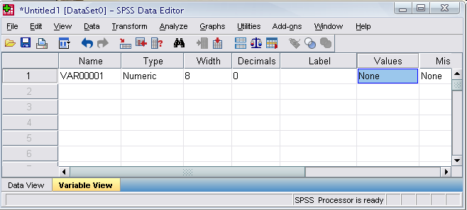
Variable View window: Values
Values
  This is used and to suggest which numbers represent which categories when the variable represents a category

Slide 26
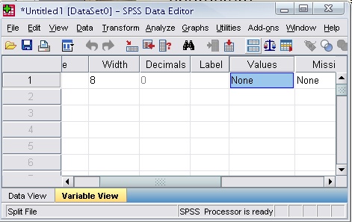
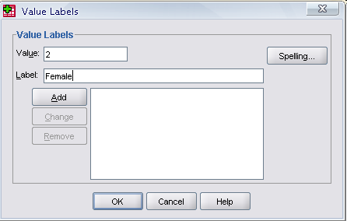
Defining the value labels
Click the cell in the values column as shown below
For the value, and the label, you can put up to 60 characters.
After defining the values click add and then click OK.
Click

Slide 27
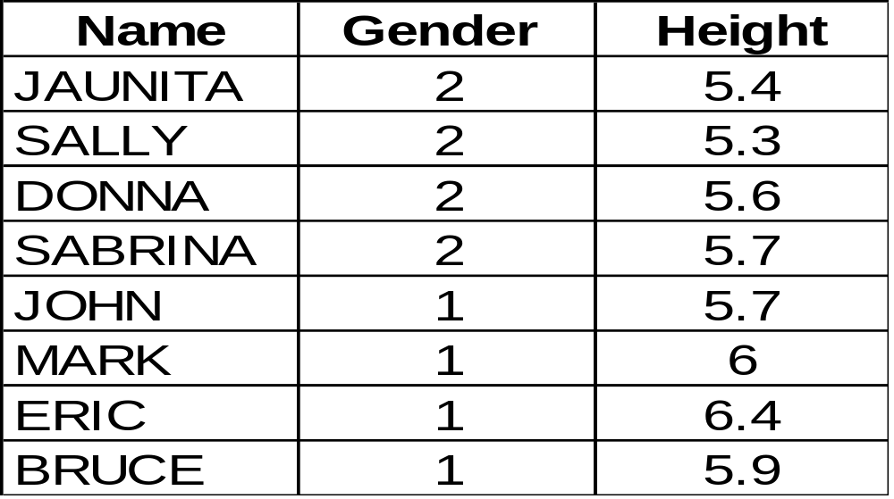
Practice 1
How would you put the following information into SPSS?
Value = 1 represents Male and Value = 2 represents Female

Slide 28
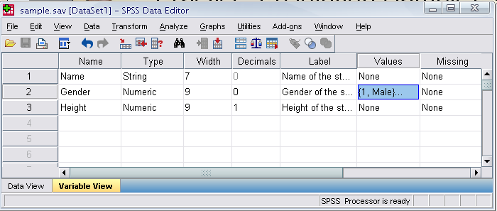
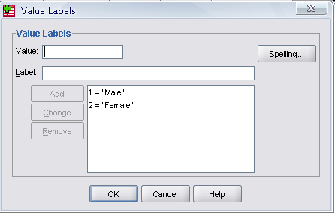
Practice 1 (Solution Sample)
Click

Slide 29
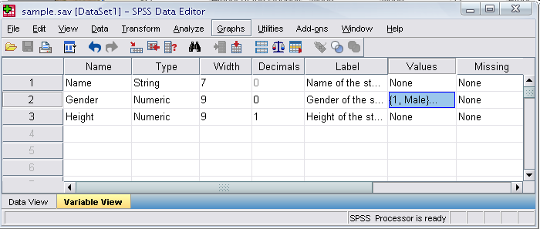
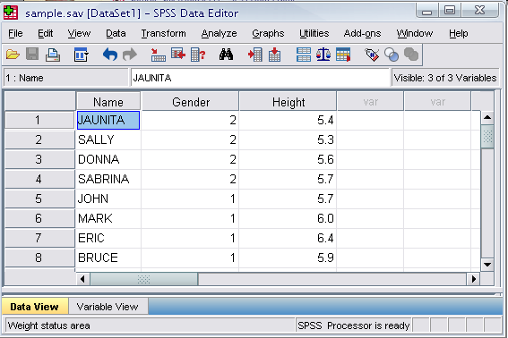
Click

Slide 30
Saving the data
To save the data file you created simply click ‘file’ and click ‘save as.’ You can save the file in different forms by clicking “Save as type.”
Click

