Slide 1
Simple Linear Regression
LECTURE 16
MGT601

Slide 2
Simple Linear Regression
Introduction
Many problems in Engineering, Management, Health Sciences and other Sciences involve exploring the relationships between two or more variables.
For example we may be interested in studying the relationship between blood pressure and age, height and weight, yield of rice and water level, no of hrs. of study and GPA, in a chemical process, suppose that the yield of the product is related to the process-operating temperature.
The nature and strength of relationships between such variables may be examined by regression and correlation analysis, two statistical techniques that, although related, serve different purposes.

Slide 3
Introduction to Regression Analysis
Regression analysis is used to:
  Predict the value of a dependent variable based on the value of independent variable(s)
  Explain the changes in the dependent variable due to independent variable(s)
Dependent variable: the variable we wish to explain
Independent (Explanatory)variable: the variable used to explain the dependent variable

Slide 4
Types of Regression Models
1 Explanatory
Regression
2+ Explanatory
Models
Variable
Variables
Simple
Multiple
Non-
Non-
Linear
Linear
Linear
Linear
Notes:
24

Slide 5
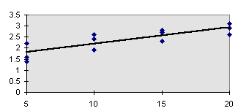
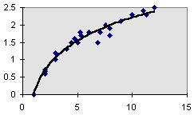
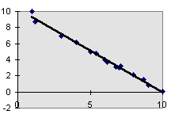
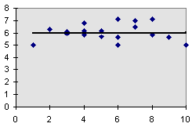
Types of Regression Models
Positive Linear Relationship
Non-linear Relationship
Negative Linear Relationship
No Relationship

Slide 6

Linear Regression Analysis…
If we only have one independent variable, the model is
which is referred to as simple linear regression. We would be interested in estimating β₀ and β₁ from the data we collect.

Slide 7
Population Linear Regression
The population regression model:
Population Slope
Coefficient
Random Error term, or residual
Population
y intercept
Independent Variable
Dependent Variable
Linear component
Random Error
component

Slide 8
Population Linear Regression
(continued)
y
Observed Value of y for x_{i}
ε_{i}
Slope = β₁
Predicted Value of y for x_{i}
Random Error for this x value
Intercept = β₀
x_{i}
x

Slide 9
Estimated Regression Model
The sample regression line provides an estimate of the population regression line
Estimated (or predicted) y value
Estimate of the regression
intercept
Estimate of the regression slope
Independent variable
The individual random error terms e_{i} have a mean of zero

Slide 10
Estimating the Coefficients
The estimates are determined by
  drawing a sample from the population of interest,
  calculating sample statistics.
  producing a straight line that cuts into the data.
y
w
The question is:
Which straight line fits best?
w
w
w
w
w w w w
w
w w
w w
w
x

Slide 11
The best line is the one that minimizes
the sum of squared vertical differences
between the points and the line.
Sum of squared differences =
(2 - 1)² +
(4 - 2)² +
(1.5 - 3)² +
(3.2 - 4)² = 6.89
Sum of squared differences =
(2 -2.5)² +
(4 - 2.5)² +
(1.5 - 2.5)² +
(3.2 - 2.5)² = 3.99
Let us compare two lines
4
(2,4)
w
The second line is horizontal
3
w
(4,3.2)
2.5
2
w
(1,2)
(3,1.5)
The smaller the sum of
squared differences
the better the fit of the
line to the data.
w
1
1
2
3
4

Slide 12
Coefficient Equations
Prediction equation
Sample slope
Sample Y - intercept

Slide 13
Derivation of Parameters
Least Squares (L-S):
Minimize squared error

Slide 14
Derivation of Parameters
Least Squares (L-S):
Minimize squared error

Slide 15
Simple Linear Regression Example
A real estate agent wishes to examine the relationship between the selling price of a home and its size (measured in square feet)
A random sample of 10 houses is selected
  Dependent variable (y) = house price in $1000s
  Independent variable (x) = square feet

Slide 16

Sample Data for House Price Model
House Price in $1000s (y) | Square Feet (x)
245 | 1400
312 | 1600
279 | 1700
308 | 1875
199 | 1100
219 | 1550
405 | 2350
324 | 2450
319 | 1425
255 | 1700

Slide 17
Sample Data for House Price Model
Use SPSS for solving the above example and write the results here.

Slide 18
Graphical Presentation
House price model: scatter plot and regression line
Slope
= 0.10977
Intercept
= 98.248

Slide 19
Interpretation of the Intercept
is the estimated average value of Y when the value of X is zero (if x = 0 is in the range of observed x values).
  Here, no houses had 0 square feet, = 98.24833 just indicates that, for houses within the range of sizes observed, $98,248.33 is the portion of the house price not explained by square feet.

Slide 20
Interpretation of the Slope Coefficient,
measures the estimated change in the average value of Y as a result of a one-unit change in X.
  Here, = .10977 tells us that the average value of a house increases by .10977($1000) = $109.77, on average, for each additional one square foot of size.

