Slide 1
Management, Organizational Policies & Practices
Lecture 23
Dr. Amna Yousaf
PhD (HRM)
University of Twente, the Netherlands

Slide 2
Recap Lecture 22
What is Power?
Contrasting leadership and power
Basis of power
Dependency – the key to power
Power Tactics
Factors Influencing the Choice and Effectiveness of Power Tactics
Political Behavior
Determinants of Political Behavior
Influences of Political Behavior
Organizational Policies and Resource Allocations

Slide 3
Ethics, Justice and Fair Treatment
Lecture 23

Slide 4

Learning Goals
Explain what is meant by ethical behavior at work.
Discuss important factors that shape ethical behavior at work.
Describe at least four specific ways in which management can influence ethical behavior at work.
Employ fair disciplinary practices.
List at least four important factors in managing dismissals effectively.
© 2005 Prentice Hall Inc. All rights reserved.
14–4

Slide 5
Ethics and Fair Treatment at Work
Ethics
  The principles of conduct governing an individual or a group; specifically, the standards you use to decide what your conduct should be.
  Ethical behavior depends on the person’s frame of reference.

Slide 6
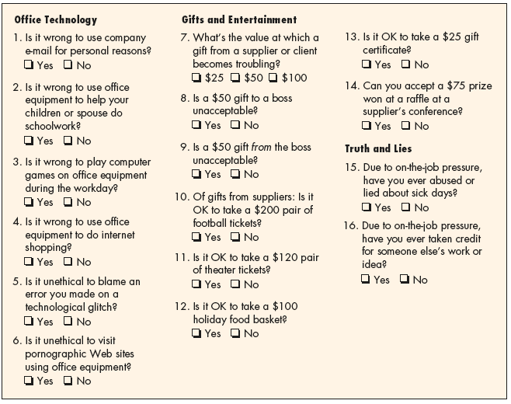
The Wall Street Journal Workplace-Ethics Quiz
Source: Wall Street Journal, October 21, 1999, pp. B1–B4; Ethics Officer Association, Belmont, MA; Ethics Leadership Group, Wilmette, IL; surveys sampled a cross-section of workers at large companies and nationwide.
Figure 14–1

Slide 7
Factors affecting ethical decisions
Normative judgments
  Judging something as good or bad, right or wrong, better or worse.
Moral standards (Morality)
  Society’s accepted standards for behaviors that have serious consequences to its well-being.
    Behaviors that cannot be established or changed by decisions of authoritative bodies.
    Behaviors that override self-interest.

Slide 8
Ethics and Fair Treatment at Work (cont’d)
Ethics and the law
  Law is not best guide about what is ethical
  An example is dismissing a 58-year-old employee with 30 years’ tenure without notice or cause may be unethical but definitely legal
An behavior may be legal but unethical.
An behavior may be illegal but ethical.
An behavior may be both legal and ethical.
An behavior may be both illegal and unethical.

Slide 9
Ethics, Fair Treatment, and Justice
Distributive justice
  The fairness and justice of a decision’s result.
Procedural justice
  The fairness of the process by which the decision was reached.
Interactional (interpersonal) justice
  The manner in which managers conduct their interpersonal dealings with employees.

Slide 10
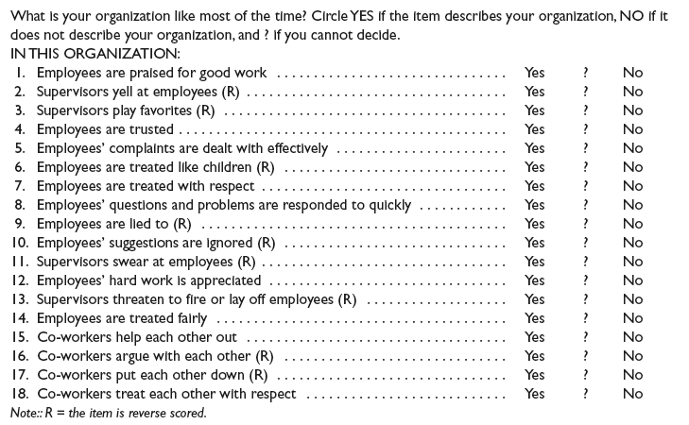
Perceptions of Fair Interpersonal Treatment Scale
Sources: Michelle A. Donovan et al., “The Perceptions of Their Interpersonal Treatment Scale: Development and Validation of a Measure of Interpersonal Treatment in the Workplace,” Journal of Applied Psychology 83, no. 5 (1998), p. 692. Copyright © 1997
by Michelle A. Donovan, Fritz Drasgow, and Liberty J. Munson at the University of Illinois at Urbana-Champaign. All rights reserved.
Figure 14–2

Slide 11
What Shapes Ethical Behavior at Work?
Individual factors
Organizational factors
The boss’s influence
Ethics policies and codes
The organization’s culture
Coworker Influence

Slide 12
Employees and Ethical Dilemmas
Questions employees should ask when faced with ethical dilemmas:
  Is the action legal?
  Is it right?
  Who will be affected?
  Does it fit the company’s values?
  How will it “feel” afterwards?
  How will it look in the newspaper?
  Will it reflect poorly on the company?

Slide 13
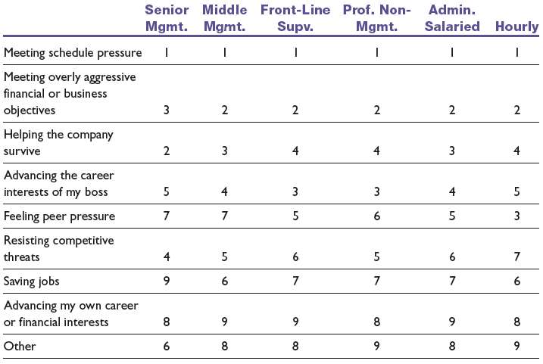
Principal Causes of Ethical Compromises
Note: 1 is high, 9 is low.
Sources: O.C. Ferrell and John Fraedrich, Business Ethics, 3rd ed. (New York: Houghton Mifflin, 1997), p. 28; adapted from Rebecca Goodell, Ethics in American Business: Policies, Programs, and Perceptions (1994), p. 54. Permission provided courtesy of the Ethics Resource Center, 1120 6th Street NW, Washington, DC: 20005.
Table 14–1

Slide 14
The Ethics Code
Having one indicates that the company is serious about ethics
May or may not work, e.g. Enron

Slide 15
What Is Organizational Culture?
Organization culture
  The characteristic values, traditions, and behaviors a company’s employees share.
How is culture is revealed?
  Ceremonial events
  Written rules and spoken commands.
  Office layout
  Organizational structure
  Dress codes
  Cultural symbols and behaviors
  Figureheads

Slide 16
The Manager’s Role in Creating Culture
Clarify expectations for values to be followed.
Use signs and symbols to signal the importance of values.
Provide physical (the firm’s rewards) support for values.
Use stories to illustrate values.
Organize rites and ceremonies reinforcing values

Slide 17
Management Role in Fostering Ethics and Fair Treatment
Why treat employees fairly?
  “They’re not employees, they’re people”
    Management guru Peter Drucker
  Avoidance of employee litigation
  Enhanced employee commitment
  Enhanced satisfaction with the organization, with jobs, and with leaders
  Increased organizational citizenship behaviors

Slide 18
Management Ethics Activities
Staffing and selection
  Fostering the perception of fairness in the processes of recruitment and hiring of people.
    Formal procedures
    Interpersonal treatment
    Providing explanation
Training
  How to recognize ethical dilemmas.
  How to use ethical frameworks (such as codes of conduct) to resolve problems.
  How to use HR functions (such as interviews and disciplinary practices) in ethical ways.

Slide 19
Management Ethics Activities (cont’d)
Performance appraisal
  Appraisals that make it clear the company adheres to high ethical standards by measuring and rewarding employees who follow those standards.
Reward and disciplinary systems
  The organization swiftly and harshly punishes unethical conduct.
Workplace aggression and violence
  Taking care that HR actions do not foster perceptions of inequities that translate into dysfunctional behaviors by employees.

Slide 20
Protecting Whistleblowers
Protecting Whistleblowers
  Whistleblowers give warning of serious wrongdoings within their organization
  Laws are set up to protect them in states such as Victoria and South Australia

Slide 21
Building Two-Way Communications
Perceptions of fair treatment depend on:
  Engagement—involving individuals in the decisions that affect them by asking for their input and allowing them to refute the merits of others’ ideas and assumptions
  Explanation—ensuring that everyone involved and affected understands why final decisions are made and the thinking that underlies the decisions
  Expectation clarity—making sure everyone knows up front by what standards they will be judged and the penalties for failure.

Slide 22
Two Way Communication Programs
Speak-Up Programs: Communication program that allows employees to register their questions, concerns, feelings and complaints about work-related issues
Opinion Surveys: It is a communication instrument that uses questionnaires to regularly ask employees about their opinion, work environment, organization, management and work-life issues.
Top-Down Programs: Communication system where the top management meets the bottom management in a series of round table discussions and meetings to discuss various issues concerning the organization.

Slide 23
Employee Discipline and Privacy
Basis for a fair and just discipline process
  Clear rules and regulations
    Define workplace issues
    Inform employees
  A system of progressive penalties
    The range and severity of the penalty is a function of the offense and number of occurrences.
  An appeals process
    The right of the employee to grieve the decision helps to ensure that supervisors mete out discipline fairly and equitably.

Slide 24
Disciplining an Employee
Does the facts support the charge of employee wrongdoing?
Were the employee’s due process rights protected?
Was the employee warned of disciplinary consequences?
Was a rule violated and was it “reasonably related” to the efficient and safe operation of the work environment?
Was the matter fairly and adequately investigated before administering discipline?
Did the investigation produce substantial evidence of misconduct?
Have rules, orders, or penalties been applied evenhandedly?
Is the penalty reasonably related to the misconduct and to the employee’s past work history?
Did the employee have the right to counsel?
Did anger, hearsay, or personal impression affect the decision?

Slide 25
Discipline without Punishment (Nonpunitive Discipline)
Issue an oral reminder.
Should another incident arise within six weeks, issue a formal written reminder, a copy of which is placed in the employee’s personnel file.
Give a paid, one-day “decision-making leave.”
If no further incidents occur in the next year, the purge the one-day paid suspension from the person’s file.
If the behavior is repeated, the next step is dismissal.

Slide 26
Managing Dismissals
Dismissal
  Involuntary termination of an employee’s employment with the firm.
Terminate-at-will rule
  Without a contract, the employee can resign for any reason, at will, and the employer can similarly dismiss the employee for any reason (or no reason), at will.

Slide 27
Grounds for Dismissal
Unsatisfactory performance
  Persistent failure to perform assigned duties or to meet prescribed standards on the job.
Misconduct in the workplace
  Deliberate and willful violation of the employer’s rules: stealing, rowdy behavior, and insubordination.
Lack of qualifications for the job
  An employee’s inability to do the assigned work although he or she is diligent.
Changed requirements or elimination of the job.
  An employee’s inability to do the work assigned, after the nature of the job has changed.
  Elimination of the employee’s job.

Slide 28
Insubordination
Direct disregard of the boss’s authority.
Flat-out disobedience of, or refusal to obey, the boss’s orders—particularly in front of others.
Deliberate defiance of clearly stated company policies, rules, regulations, and procedures.
Public criticism of the boss. Contradicting or arguing with him or her is also negative and inappropriate.
Blatant disregard of reasonable instructions.
Contemptuous display of disrespect and, portraying these feelings while on the job.
Disregard for the chain of command, shown by going around the immediate supervisor or manager with a complaint, suggestion, or political maneuver.
Participation in (or leadership of ) an effort to undermine and remove the boss from power.

Slide 29
Managing Dismissals (cont’d)
Foster a perception of fairness in the dismissal situation by:
  Instituting a formal multi-step procedure (including warning).
  Having a supervising manager give full explanations of why and how termination decisions were made.
  Establishing a neutral appeal process also fosters fairness.

Slide 30
Avoiding Wrongful Discharge Suits
Bases for wrongful discharge suits:
  Discharge does not comply with the law.
  Discharge does not comply with the contractual arrangement stated or implied by the firm via its employment application forms, employee manuals, or other promises.
Avoiding wrongful discharge suits
  Set up employment policies and dispute resolution procedures that make employees feel treated fairly.
  Do the preparatory work that helps to avoid such suits.

Slide 31
The Termination Interview
Plan the interview carefully.
  Make sure the employee keeps the appointment time.
  Never inform an employee over the phone.
  Allow 10 minutes as sufficient time for the interview.
  Use a neutral site, never your own office.
  Have employee agreements, the human resource file, and a release announcement (internal and external) prepared in advance.
  Be available at a time after the interview in case questions or problems arise.
  Have phone numbers ready for medical or security emergencies.

Slide 32
The Termination Interview (cont’d)
Get to the point.
  Do not beat around the bush by talking about the weather or making other small talk.
  As soon as the employee enters, give the person a moment to get comfortable and then inform him or her of your decision.
Describe the situation.
  Briefly explain why the person is being let go.
  Remember to describe the situation rather than attack the employee personally
  Emphasize that the decision is final and irrevocable.

Slide 33
The Termination Interview (cont’d)
Listen.
  Continue the interview until the person appears to be talking freely and reasonably calmly about the reasons for his or her termination and the support package (including severance pay).
Review all elements of the severance package.
  Describe severance payments, benefits, access to office support people, and the way references will be handled. However, under no conditions should any promises or benefits beyond those already in the support package be implied.

Slide 34
The Termination Interview (cont’d)
Identify the next step.
  The terminated employee may be disoriented and unsure what to do next.
  Explain where the employee should go next, upon leaving the interview.

Slide 35
Termination Assistance
Outplacement Counseling
  A systematic process by which a terminated employee is trained and counseled in the techniques of conducting a self-appraisal and securing a new job appropriate to his or her needs and talents.
    Outplacement does not imply that the employer takes responsibility for placing the person in a new job.
    Outplacement counseling is part of the terminated employee’s support or severance package and is often done by specialized outside firms.

Slide 36
Termination Assistance (cont’d)
Outplacement firms
  Can help the employer devise its dismissal plan regarding:
    How to break the news to dismissed employees.
    Deal with dismissed employees’ emotional reactions.
    Institute the appropriate severance pay and equal opportunity employment plans.

Slide 37
Interviewing Departing Employees
Exit Interview
  Its aim is to elicit information about the job or related matters that might give the employer a better insight into what is right—or wrong—about the company.
    The assumption is that because the employee is leaving, he or she will be candid.
    The quality of information gained from exit interviews is questionable.

Slide 38
Exit Interview Questions
How were you recruited?
Why did you join the company?
Was the job presented correctly and honestly?
Were your expectations met?
What was the workplace environment like?
What was your supervisor’s management style like?
What did you like most/least about the company?
Were there any special problem areas?
Why did you decide to leave, and how was the departure handled?

Slide 39
Layoffs
Layoff are not terminations.
Temporary layoffs occur when:
  There is no work available for employees.
  Management expects the no-work situation to be temporary and probably short term.
  Management intends to recall the employees when work is again available.

Slide 40
Bumping/Layoff Procedures
Seniority is usually the ultimate determinant of who will work.
Seniority can give way to merit or ability, but usually only when no senior employee is qualified for a particular job.
Seniority is usually based on the date the employee joined the organization, not the date he or she took a particular job.
Companywide seniority allows an employee in one job to bump or displace an employee in another job, provided the more senior person can do the job without further training.

Slide 41
Alternatives to Layoffs
Voluntarily reducing employees’ pay to keep everyone working.
Concentrating employees’ vacations during slow periods.
Taking voluntary time off to reduce the employer’s payroll.
Taking a “rings of defense approach” by hiring temporary workers that can be let go early.
Offering buyout packages to find enough volunteers to avoid dismissing people.

Slide 42
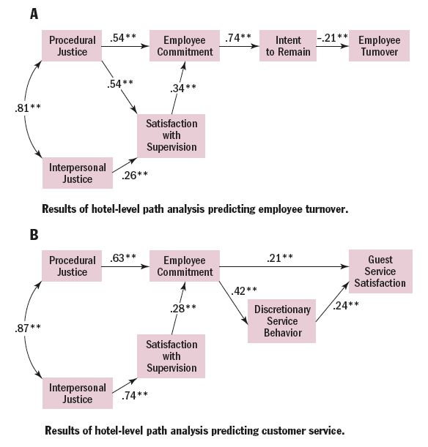
Employee Morale and Behavior Improves When Justice Prevails
Source: Tony Simons and Quinetta Roberson, " Why Managers Should Care about Fairness. The Effects of Aggregate Justice Perceptions on Organizational outcomes,” Journal of Applied Psychology 88, no. 3 (2003), p. 432.

