Slide 1
Management, Organizational Policies & Practices
Lecture 22
Dr. Amna Yousaf
PhD (HRM)
University of Twente, the Netherlands

Slide 2
Recap Lecture 21
What is leadership
Trait Theories of Leadership
  Big five personality model
  Limitations
Behavioral Approaches to leadership
  Ohio State Studies/U. of Michigan
  University of Michigan Studies
Contingency Theories of Leadership
  Fiedler’s Contingency Model
  Cognitive Resource Theory
  Hersey and Blanchard’s Situational Leadership Model
  Path Goal Theory

Slide 3
Recap Lecture 21
Inspirational Approaches to Leadership
  Transformational Leaders
  Transactional Leaders
  Laissez-Faire Leadership
  Ethical Leadership
  Online Leadership
  Mentoring

Slide 4
Power, Politics, Policies and Organizational Resources
Lecture 22

Slide 5
Lecture Outline
What is Power?
Contrasting leadership and power
Basis of power
Dependency – the key to power
Power Tactics
Factors Influencing the Choice and Effectiveness of Power Tactics
Political Behavior
Determinants of Political Behavior
Influences of Political Behavior
Organizational Policies and Resource Allocations

Slide 6
A Definition of Power
Power
A capacity that A has to influence the behavior of B so that B acts in accordance with A’s wishes.
Dependency
B’s relationship to A when A possesses something that B requires.

Slide 7
Contrasting Leadership and Power
Leadership
  Focuses on goal achievement.
  Requires goal compatibility with followers.
  Focuses influence downward.
Research Focus
  Leadership styles and relationships with followers.
Power
  Used as a means for achieving goals.
  Requires follower dependency.
  Used to gain lateral and upward influence.
Research Focus
  Power tactics for gaining compliance.

Slide 8
Bases of Power: Formal Power
Formal Power
Is established by an individual’s position in an organization; conveys the ability to coerce or reward, from formal authority, or from control of information.
Coercive Power
A power base dependent on fear.
Reward Power
Compliance achieved based on the ability to distribute rewards that others view as valuable.

Slide 9
Bases of Power: Formal Power (cont’d)
Legitimate Power
The power a person receives as a result of his or her position in the formal hierarchy of an organization.

Slide 10

Bases of Power: Personal Power
Expert Power
Influence based on special skills or knowledge.
Referent Power
Influence based on possession by an individual of desirable resources or personal traits.

Slide 11
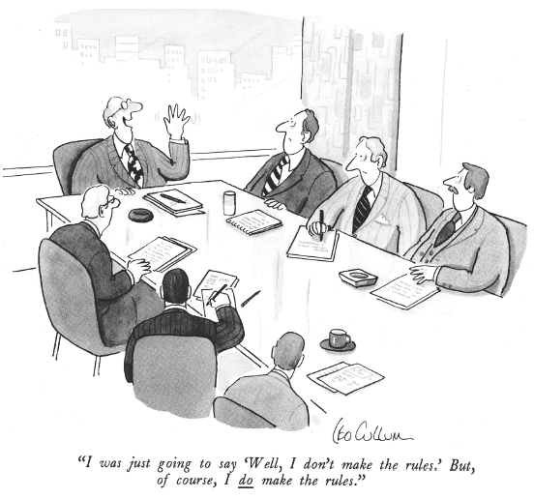
Source: Drawing by Leo Cullum in The New Yorker, copyright ©1986 The New Yorker Magazine. Reprinted by permission.
E X H I B I T 14–1

Slide 12
Dependency: The Key To Power
The General Dependency Postulate
  The greater B’s dependency on A, the greater the power A has over B.
  Possession/control of scarce organizational resources that others need makes a manager powerful.
  Access to optional resources (e.g., multiple suppliers) reduces the resource holder’s power.
What Creates Dependency
  Importance of the resource to the organization
  Scarcity of the resource
  Nonsubstitutability of the resource

Slide 13
Power Tactics
Power Tactics
Ways in which individuals translate power bases into specific actions.
Influence Tactics:
Legitimacy
Rational persuasion
Inspirational appeals
Consultation
Exchange
Personal appeals
Ingratiation
Pressure
Coalitions

Slide 14
Preferred Power Tactics by Influence Direction
Upward Influence Downward Influence Lateral Influence
Rational persuasion Rational persuasion Rational persuasion
Inspirational appeals Consultation
Pressure Ingratiation
Consultation Exchange
Ingratiation Legitimacy
Exchange Personal appeals
Legitimacy Coalitions
E X H I B I T 14–2

Slide 15
Preferred Power Tactics by Influence Direction
Combination of soft and hard tactics
Pressure tactics tend to backfire

Slide 16
Factors Influencing the Choice and Effectiveness of Power Tactics
Sequencing of tactics
  Softer to harder tactics work best.
Skillful use of a tactic
Relative power of the tactic user
  Some tactics work better when applied downward or upward.
The type of request attaching to the tactic
  Is the request legitimate?
How the request is perceived
  Is the request consistent with the target’s values?
The culture of the organization
  Culture affects user’s choice of tactic.
Country-specific cultural factors
  Local values favor certain tactics over others.

Slide 17

Power in Groups: Coalitions
Coalitions
Clusters of individuals who temporarily come together to achieve a specific purpose.
Seek to maximize their size to attain influence.
Seek a broad and diverse constituency for support of their objectives.
Occur more frequently in organizations with high task and resource interdependencies.
Occur more frequently if tasks are standardized and routine.

Slide 18
Politics: Power in Action
Political Behavior
Activities that are not required as part of one’s formal role in the organization, but that influence, or attempt to influence, the distribution of advantages or disadvantages within the organization.
Legitimate Political Behavior
Normal everyday politics. Complaining a supervisor, access to resources, bypassing chain of command, networking
Illegitimate Political Behavior
Extreme political behavior that violates the implied rules of the game. Whistle blowing, illegal strikes, wearing orthodox dress etc

Slide 19
Politics Is in the Eye of the Beholder
“Political” Label “Effective Management” Label
1. Blaming others vs. Fixing responsibility
2. “Kissing up” vs. Developing working relationships
3. Apple polishing vs. Demonstrating loyalty
4. Passing the buck vs. Delegating authority
5. Covering your rear vs. Documenting decisions
6. Creating conflict vs. Encouraging change and innovation
7. Forming coalitions vs. Facilitating teamwork
8. Whistle blowing vs. Improving efficiency
9. Scheming vs. Planning ahead
10. Overachieving vs. Competent and capable
11. Ambitious vs. Career-minded
12. Opportunistic vs. Astute
13. Cunning vs. Practical-minded
14. Arrogant vs. Confident
15. Perfectionist vs. Attentive to detail
Source: Based on T. C. Krell, M. E. Mendenhall, and J. Sendry, “Doing Research in the Conceptual Morass of Organizational Politics,” paper presented at the Western Academy of Management Conference, Hollywood, CA, April 1987.
E X H I B I T 13–3

Slide 20
Factors That Influence Political Behaviors
E X H I B I T 14-4

Slide 21
Employee Responses to Organizational Politics
Moderating role of understanding

Slide 22
Defensive Behaviors
Avoiding Action:
Overconforming
Buck passing
Playing dumb
Stretching
Stalling
Avoiding Blame:
Buffing
Playing safe
Justifying
Scapegoating
Misrepresenting
Avoiding Change:
Prevention
Self-protection
E X H I B I T 14–6

Slide 23
Impression Management (IM)
Impression Management
The process by which individuals attempt to control the impression others form of them.
IM Techniques:
Conformity
Excuses
Apologies
Self-Promotion
Flattery
Favors
Association
Source: Based on B. R. Schlenker, Impression Management (Monterey, CA: Brooks/Cole, 1980); W. L. Gardner and M. J. Martinko, “Impression Management in Organizations,” Journal of Management, June 1988, p. 332; and R. B. Cialdini, “Indirect Tactics of Image Management Beyond Basking,” in R. A. Giacalone and P. Rosenfeld (eds.), Impression Management in the Organization (Hillsdale, NJ: Lawrence Erlbaum Associates, 1989), pp. 45–71.
E X H I B I T 14–7

Slide 24
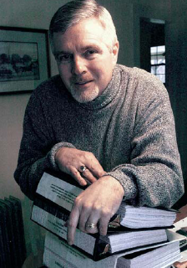
Is A Political Action Ethical?
What is the utility of engaging in the behavior?
Does the utility balance out any harm done by the action?
Does the action conform to standards of equity and justice?
E X H I B I T 14–8

Slide 25
Chapter Check-Up: Power & Politics
Write down two differences between power and leadership. Discuss with a classmate.
Do all leaders have power? Does everyone with power lead others? Discuss.

Slide 26
Chapter Check-Up: Power & Politics
When you go to work, what three things can you do to make people in your organization dependent on you? Write down your answers on a sheet of paper.
Discuss your answers with your neighbor. Do you think it’s bad to plan how you’ll get power over others?

Slide 27
Chapter Check-Up: Power & Politics
What is the difference between a power tactic and an influence tactic? Discuss with a neighbor.

Slide 28
Management Issues
Annual Objectives
Policies
Resources
Management
Issues
Organizational structure
Restructuring
Resistance to Change
Production/operations
Human resources

Slide 29
Annual Objectives
Basis for allocating resources
Evaluation mechanisms
Establish organizational, divisional, and departmental priorities
Horizontal consistency of objectives
Vertical consistency of objectives

Slide 30
Annual Objectives
Objectives should state
  Quantity
  Quality
  Cost
  Time

Slide 31
Policies
Policies set
  Boundaries
  Constraints
  Limits
Policies facilitate solving recurring problems and guide the implementation of strategy
  Policy Manuals

Slide 32
Policies
Example Issues requiring management policy --
  To offer extensive or limited management development workshops and seminars
  To centralize or decentralize employee-training activities
  To recruit through employment agencies, college campuses, and/or newspapers
  To promote from within or hire from the outside
  To promote on basis of seniroty or merit
  To establish a high- or low-safety stock of inventory
  To buy lease, or rent new production equipment

Slide 33
Policies
Variation in posicies such as
  40% companies have no policies on net surfing
  Smoking policy
  Walmart “10 foot rule”

Slide 34
Resource Allocation
Four types of resources
  Financial resources
  Physical resources
  Human resources
  Technological resources

Slide 35
Trade off Decisions in Allocation of Resources
Market development or penetration
Acquire externally and/or build internally
Contractual or permanent employees

Slide 36
        Thank You

