Slide 1
Business Policy and Strategy
Lecture-09

Slide 2
Recap
Importance of External Assessment
  “The idea is to concentrate our strength against our competitor’s relative weakness.”
  Focuses on identifying & evaluating events beyond the immediate control of the firm
How to conduct external audit
  involve managers and employees
  perform an external audit
Key External Factors

Slide 3
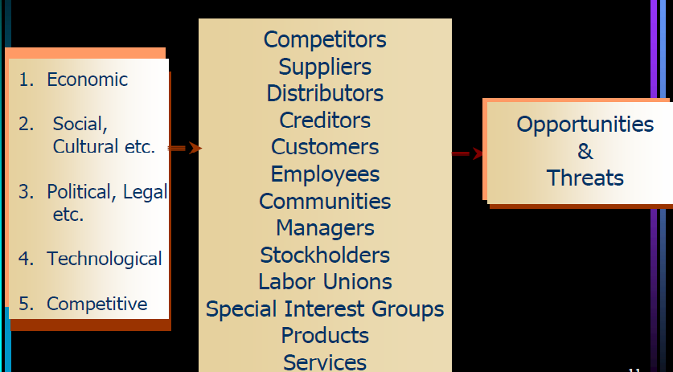
Key External Factors

Slide 4
Today’s Lecture
THE INDUSTRIAL ORGANIZATION (I/O) VIEW
Economic Forces
  Availability of credit
  Interest rates

Slide 5
THE INDUSTRIAL ORGANIZATION (I/O)VIEW
A. External Factors versus Internal Factors
  External factors are more important than internal factors
    External factor helps a firm in achieving competitive advantage
    Organizational performance is primarily determined by industry
  Managing strategically from the I/O perspective entails firms striving
    To compete in attractive industries
    Avoiding weak or faltering industries, and
    Gaining a full understanding of key external factor relationships.

Slide 6
THE INDUSTRIAL ORGANIZATION (I/O)VIEW
Factors Affecting Firm Performance
  Firm performance is primarily based on industry properties:
    Economies of scale
    Barriers to market entry
      Control of resources: If a single firm has control of a resource essential for a certain industry, then other firms are unable to compete in the industry.
      Government regulations
      Research and development
    Product differentiation: Product differentiation is the process of distinguishing a product or service from others, to make it more attractive to a particular target market
    Level of competitiveness

Slide 7
Economic Forces
Monitor Key Economic Variables
  Availability of credit
  Level of disposable income : The amount of money that households have available for spending and saving after income taxes have been accounted for.
  Interest rates: Interest is a fee paid by a borrower of assets to the owner as a form of compensation for the use of the assets.
  Inflation rates: inflation is a rise in the general level of prices of goods and services in an economy over a period of time.
  Federal government budget deficits
    a deficit is an excess of expenditures over revenue in a given time period
    The Federal government budget deficits is the difference between government revenues (e.g., tax) and spending

Slide 8
Monitor Key Economic Variables
  Consumption patterns
  Unemployment trends
  Worker productivity levels: Workforce productivity is the amount of goods and services that a worker produces in a given amount of time. factors affecting labor productivity:
    Individual attitudes
    Motivational and behavioral factors
    Technological factors
  Stock market trends

Slide 9
Monitor Key Economic Variables
  Foreign countries’ economic conditions
  Income differences by region/customer
  Tax rates
  OPEC policies

Slide 10
Summary
  THE INDUSTRIAL ORGANIZATION (I/O)VIEW
  Economic Forces
  Availability of credit
  Level of disposable income
  Interest rates
  Inflation rates
  Federal government budget deficits
  Consumption patterns
  Unemployment trends
  Worker productivity levels
  Stock market trends
  Foreign countries’ economic conditions
  Income differences by region/customer
  Tax rates
  OPEC policies

Slide 11
Next Lecture
Social & Environmental Forces
Political, Govt., & Legal Forces

