Slide 1
Business Strategy and Policy
Lecture 08

Slide 2
Recap
Why Firms do not Plan strategically?
  Poor Reward Structures
  Fire-fighting
  Waste of Time
  Too Expensive
  Laziness
  Content with Success
  Fear of Failure

Slide 3
Recap
  Overconfidence
  Prior Bad Experience
  Self-Interest
  Fear of the Unknown
  Honest Difference of Opinion
  Disbelief
Benefits of planning Strategically
  Financial
  Non-Financial

Slide 4
Today’s Lecture
Importance of External Assessment
How to conduct external audit
Key External Factors

Slide 5
External Assessment
The purpose of an external audit is to develop a finite list of opportunities that could benefit a firm and avoid threats
“The idea is to concentrate our strength against our competitor’s relative weakness.”
Bruce Henderson

Slide 6
External Audit
Industry analysis
  An assessment of the profitability of an industry
  To characterize the driving forces of competition within an industry
  Help management create and maintain a competitive advantage
Environmental scanning
  To indentify the opportunities and threats

Slide 7
External Audit
Focuses on identifying & evaluating events beyond the immediate control of the firm
  Increased foreign competition
  Population shifts
  Demographics (e.g., aging population)
  Information technology

Slide 8
External Audit (Cont.)
External audit reveals
  Key opportunities
  Key threats
  Managers then formulate strategies
  Take advantage of opportunities
  Avoid/reduce impact of threats

Slide 9
Process of External Audit
The process of performing an external audit must involve as many managers and employees as possible
    Lead to understanding &
    Commitment from organizational members
To perform an external audit, a company first must gather competitive intelligence and information about:
    Social
    Cultural
    Demographic
    Environmental
    Economic, political and legal
    governmental, and technological trends

Slide 10
Competitive Intelligence
A broad definition of competitive intelligence is the action of defining, gathering, analyzing, and distributing intelligence about products, customers, competitors and any aspect of the environment needed to support executives and managers in making strategic decisions for an organization.

Slide 11
Process of External Audit
3. Once information is gathered, it should be assimilated, evaluated, and prioritized.
4. Key external factors should be important to achieve:
  long term and annual objectives
  Measurable goals

Slide 12
Facilitating Tools
Monitor sources of information (key magazines, articles, etc.)
Utilization of Internet
Suppliers, distributors, customers as sources of information

Slide 13
Examples of Key External Factors
  Market share
  Breadth of competing products
  World economies
  Price competitiveness
  Technological advancements
  Interest rates

Slide 14
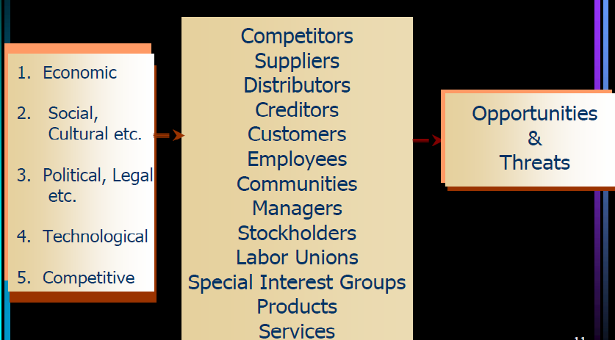
Key External Factors

Slide 15
Summary
Importance of External Assessment
How to conduct external audit
Key External Factors

Slide 16
Next Lecture
THE INDUSTRIAL ORGANIZATION VIEW
Economic Forces
  Availability of credit
  Interest rates
Social, cultural, demographic and environmental forces
  Life expectancy rates
  Per capita income

