Slide 1
Business Policy and Strategy
Lecture 32

Slide 2
Recap
Revision of First 16 lectures

Slide 3
Today's Lecture
Revision of lecture 17-30

Slide 4
Marketing
Marketing Functions
Customer analysis
Selling products/services
Product & service planning
Pricing
Distribution
Marketing research
Opportunity analysis

Slide 5
Marketing Audit Checklist of Questions
Are markets segmented effectively?
Is the organization positioned well among competitors?
Has the firm’s market share been increasing?
Are present channels of distribution reliable and cost-effective?
Does the firm have an effective sales organization?
Does the firm conduct market research?
Are product quality and customer service good?
Are the firm’s products and services priced appropriately?
Does the firm have an effective promotion, advertising, and publicity strategy?
Are marketing planning and budgeting effective?
Do the firm’s marketing managers have adequate experience and training?

Slide 6

Research & Development
Research & Development Functions
Development of new products before competitors
Improving product quality
Improving manufacturing processes to reduce costs

Slide 7
Management Information Systems
Information Systems
Security
User-friendly
E-commerce

Slide 8
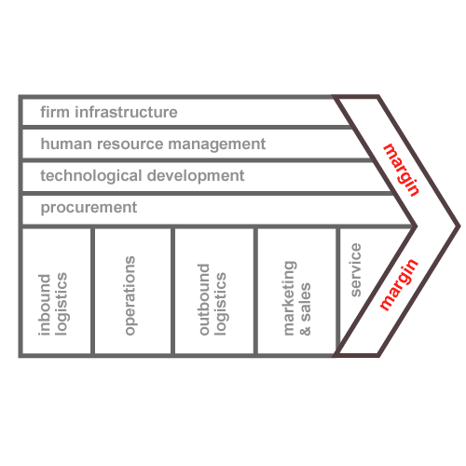
VALUE CHAIN ANALYSIS

Slide 9
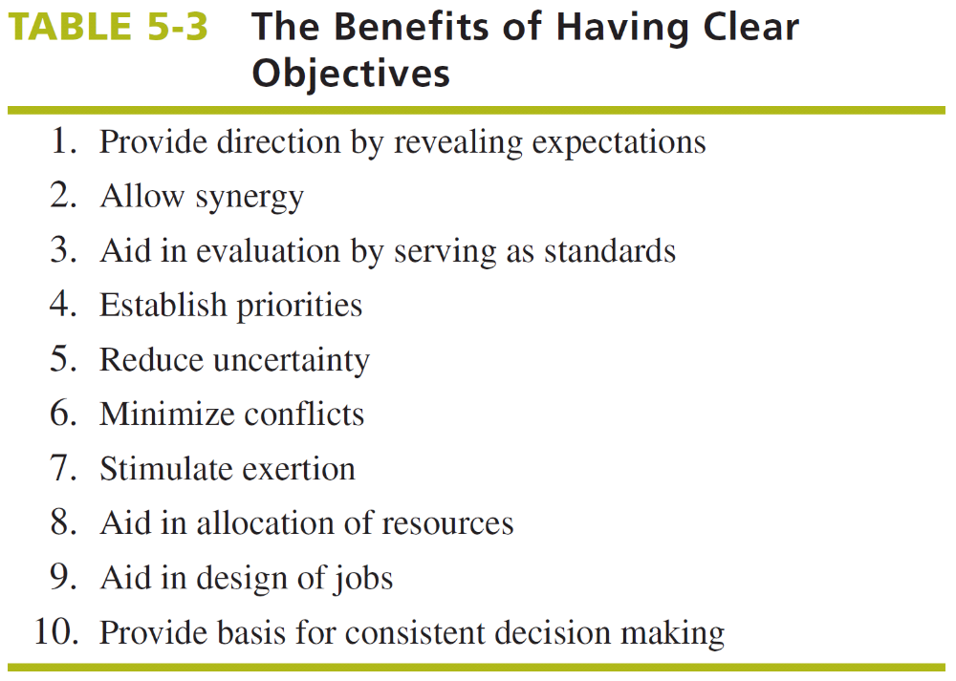

Slide 10
Not Managing by Objectives
Managing by Extrapolation – “If it ain’t broke, don’t fix it”
Managing by Crisis – The true measure of a good strategist is the ability to fix problems
Managing by Subjectives – “Do your own thing, the best way you know how”
Managing by Hope – The future is full of uncertainty and if at first you don’t succeed, then you may on the second or third try

Slide 11
A Simple Organization Chart
(Dominant or Related Product Business)
Corporate
Level
Multibusiness
Corporation
Business
Level
Business 1
(Related)
Business 2
(Related)
Business 3
(Related)
Functional
Level
Research and
Development
Human
Resources
Manufacturing
Marketing
Finance

Slide 12
Strategies
Forward integration involves gaining ownership or increased control over distributors or retailers.
Backward integration is a strategy of seeking ownership or increased control of a firm's suppliers. This strategy can be especially appropriate when a firm's current suppliers are unreliable, too costly, or cannot meet the firm's needs.
Horizontal integration refers to a strategy of seeking ownership of or increased control over a firm's competitors. One of the most significant trends in strategic management today is the increased use of horizontal integration as a growth strateg

Slide 13
Intensive Strategies
Those three strategies are sometimes referred to as intensive strategies because they require intensive efforts if a firm’s competitive position with existing products is to improve.
The aim of intensive strategies is to broaden the market share and to increase the profit by making the existing products more effective and by introducing new and various sets of products in order to increase the market share too.
Market Penetration strategy | Market Development strategy | Product Development strategy

Slide 14
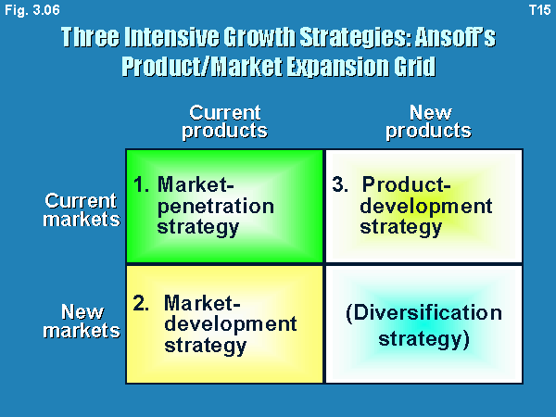

Slide 15
DEFENSIVE STRATEGIES
Retrenchment
Defensive
Strategies
Divestiture
Liquidation

Slide 16
MEANS FOR ACHIEVING STRATEGIES
  Joint Venture
  Mergers and acquisitions
  Leveraged Buyouts (LBOs)
  First Mover Advantages
  Outsourcing

Slide 17
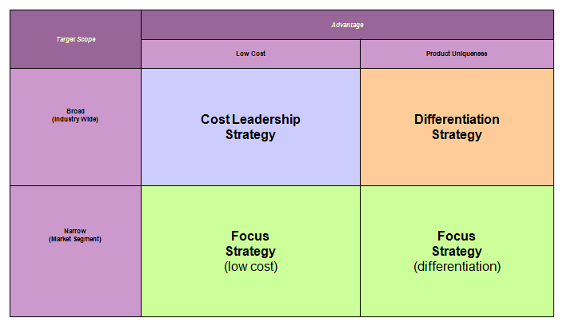
Porter Generic Strategy

Slide 18
Strategy-Formulation Analytical Framework
SWOT Matrix
SPACE Matrix
Stage 2:
The Matching Stage
BCG Matrix
IE Matrix
Grand Strategy Matrix

Slide 19
BCG Matrix - Boston Consulting Group
Relative Market Share Position
High
1.0
Medium
.50
Low
0.0
Industry Sales Growth Rate
Stars
II
Question Marks
I
High
+20
Medium
0
Cash Cows
III
Dogs
IV
Low
-20

Slide 20
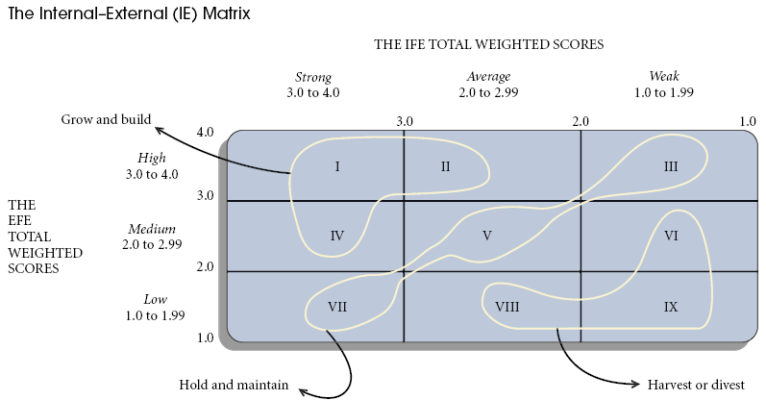

Slide 21
Management Issues (cont’d)
Resistance to Change
Natural Environment
Management
Issues
Supportive Culture
Production/Operations
Human Resources

Slide 22
STRATEGY REVIEW, EVALUATION, AND CONTROL
  The Nature of Strategy Evaluation
  A Strategy-Evaluation Framework
  The Balanced Scorecard
  Published Sources of Strategy-Evaluation Information
  Characteristics of an Effective Evaluation System
  Contingency Planning
  Auditing
  21st Century Challenges in Strategic Management

Slide 23
THANK YOU

