Slide 1
Business Strategy and Policy
Lecture 31

Slide 2
Recap
  The Nature of Strategy Evaluation
  A Strategy-Evaluation Framework
  The Balanced Scorecard
  Published Sources of Strategy-Evaluation Information
  Characteristics of an Effective Evaluation System
  Contingency Planning
  Auditing
  21st Century Challenges in Strategic Management

Slide 3
Today's Lecture
Nature of Business Strategy
Importance of Strategic policy making
  The process of business strategy does not end when the firm decides what strategy or strategies to pursue
  Translation of strategic thought into strategic action
    Management understand the business
    feel a part of the company
    Through involvement in strategy-formulation activities

Slide 4
Nature of business strategy
Even the most technically perfect strategic plan will serve little purpose if it is not implemented.
Change comes through implementation and evaluation, not through the plan.
A technically imperfect plan that is implemented well will achieve more than the perfect plan

Slide 5
Globalization-Benefits
Companies are able to procure input goods and services required at most competitive prices.
Companies get access to much wider markets
It promotes understanding and goodwill among different countries.
Businesses and investors get much wider opportunities for investment.

Slide 6
Vision Statement
  What do we want to become?
    Vision includes the basic concept of what the organization is all about—its purpose for being
  Concentrates on the future
  First step in strategic planning
Our [Amazon's] vision is to be earth's most customer centric company; to build a place where people can come to find and discover anything they might want to buy online." Amazon's

Slide 7
Mission Statement
  A Mission statement talks about HOW you will get to where you want to be.
  Defines the purpose and primary objectives related to your customer needs and team values
  It answers the question, “What do we do? What makes us different”
  A mission statement talks about the present leading to its future.
  “To inspire and empower people affected by cancer”
  Lifestrong

Slide 8
COMPARISION
Mission Statement | Vision Statement
A Mission statement talks about HOW you will get to where you want to be. | A Vision statement outlines WHERE you want to be.
It answers the question, “What do we do? What makes us different” | It answers the question, “Where do we aim to be?”
A mission statement talks about the present leading to its future. | A vision statement talks about your future.
Your mission statement may change, but it should still tie back to your core values, customer needs and vision. | Your vision should remain intact, even if the market changes dramatically, because it speaks to what you represent, not just what you do.
It lists the broad goals for which the organization is formed. | It lists where you see yourself some years from now.

Slide 9
Why Written Mission Statement is important?
Developing a comprehensive mission statement is important because divergent views important among managers can be revealed and resolved through this process.
Considerable disagreement among an organization’s strategists over vision and mission can cause trouble if not resolved.
An organization that fails to develop a vision statement loses the opportunity to present itself favorably to existing potential stakeholders.

Slide 10
Unique Selling Proposition (USP)
USP is the unique thing that you can offer that your competitors can't.
  It's your "Competitive Edge."
  It's the reason that customers buy from you and you alone.
  USPs have helped many companies succeed
  However, USPs are often extremely difficult to find. And as soon as one company establishes a successful USP in a market, competitors rush to copy it

Slide 11
Why Firms do not Plan strategically?
  Poor Reward Structures
  Fire-fighting
  Waste of Time
  Too Expensive
  Laziness
  Content with Success
  Fear of Failure
  Overconfidence
  Prior Bad Experience
  Self-Interest
  Fear of the Unknown
  Honest Difference of Opinion

Slide 12
Benefits of planning Strategically
Financial benefits:
  Improved productivity
  Improved sales
  Improved profitability
Non-Financial benefits:
  Increased employee productivity
  Improved understanding of competitors’ strategies
  Greater awareness of external threats
  Understanding of performance reward relationships
  Better problem-avoidance
  Lesser resistance to change

Slide 13
Process of External Audit
The process of performing an external audit must involve as many managers and employees as possible
    Lead to understanding &
    Commitment from organizational members
To perform an external audit, a company first must gather competitive intelligence and information about:
    Social
    Cultural
    Demographic
    Environmental
    Economic, political and legal
    governmental, and technological trends
3. Once information is gathered, it should be assimilated, evaluated, and prioritized.
Key external factors should be important to achieve:
  long term and annual objectives
  Measurable goals

Slide 14
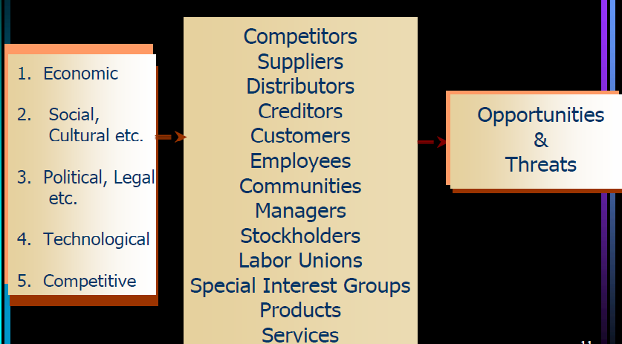
Key External Factors

Slide 15
Key Economic Variables
  Availability of credit
  Level of disposable income : The amount of money that households have available for spending and saving after income taxes have been accounted for.
  Interest rates: Interest is a fee paid by a borrower of assets to the owner as a form of compensation for the use of the assets.
  Inflation rates: inflation is a rise in the general level of prices of goods and services in an economy over a period of time.
  Federal government budget deficits
  Consumption patterns
  Unemployment trends
  Worker productivity levels: Workforce productivity is the amount of goods and services that a worker produces in a given amount of time. factors affecting labor productivity:
    Individual attitudinal
    Motivational and behavioral factors
    Technological factors
  Stock market trends

Slide 16
Key Political, govt., & legal variables
  Government regulation/deregulation
  Tax law changes
  Special tariffs
  Voter participation rates
  Number of patents
  Changes in patent laws
  Environmental protection laws
  Equal employment legislation

Slide 17
Technological Forces
  Revolutionary technological forces
  Internet changes the nature of opportunities and threats
Competitive Forces
  Collection and evaluation of information on competitors

Slide 18
PORTER’S FIVE-FORCES MODEL
The intensity of competition among firms varies widely from industry to industry
Porters model of competitive forces assumes that there are five competitive forces that identifies the competitive power in a business situation. These five competitive forces identified by the Michael Porter are:
  Threat of substitute products
  Threat of new entrants
  Intense rivalry among existing players
  Bargaining power of suppliers
  Bargaining power of Buyers

Slide 19
Forecasting
Business forecasting methods are used to determine the future development or success of a business in regards to its sales, profits, and expenses. In shaky economic times, it is sometimes difficult to create an accurate business forecast for the coming year.
Forecasting is a complex activity due to factors such
  Technological innovation
  Cultural Changes
  New Products
  Improve Services
  Stronger Competitors
  Shift in Govt. priorities
  unstable economic conditions
  unforeseen Events

Slide 20
External Factor Evaluation Matrix
Unilever—Key External Factors
Opportunities
Weight
Rating
Weighted
score
Global markets untapped
.15
1
.15
Increased demand
.05
3
.15
Astronomical Internet growth
.05
1
.05
Leader in discount market
.15
4
.60
More social pressure to quit smoking
.10
3
.30
Threats
Legislation against the tobacco industry
.10
2
.20
Production limits on tobacco
.05
3
.15
Smokeless market
.05
2
.10
Bad media exposure
.10
2
.20
Administration
.20
1
.20
TOTAL
1.00
2.10

Slide 21
Competitive Profile Matrix
Ufone Zong Telenor
Critical Success Factor
Weight
Rating
Score
Rating
Score
Rating
Score
Advertising
0.20
1
0.20
4
0.80
3
0.60
Product Quality
0.10
4
0.40
4
0.40
3
0.30
Price Competition
0.10
3
0.30
3
0.30
4
0.40
Management
0.10
4
0.40
3
0.30
3
0.30
Financial Position
0.15
4
0.60
3
0.45
3
0.45
Customer Loyalty
0.10
4
0.40
4
0.40
2
0.20
Global Expansion
0.20
4
0.80
2
0.40
2
0.40
Market Share
0.05
1
0.05
4
0.20
3
0.15
Total
1.00
3.15
3.25
2.80

Slide 22
Industry Analysis
External Factor Evaluation Matrix
Summarize & evaluate:
Economic
Demographic
Governmental
Social
Environmental
Technological
Cultural
Political
Competitive

Slide 23
Management
Stage When Most Important
Function
Planning
Strategy Formulation
Organizing
Strategy Implementation
Motivating
Strategy Implementation
Staffing
Strategy Implementation
Controlling
Strategy Evaluation

Slide 24
Summary
Revision of First 16 lectures

Slide 25
Next Lecture
Revision of lecture 17-30

