Slide 1
Business Strategy and Policy
Lecture 28

Slide 2
Recap
Nature of Strategy Analysis & Choice
Comprehensive Strategy-Formulation Framework
  SWOT Matrix
  Strategic Position and Action Evaluation (SPACE)

Slide 3
Today’s Lecture
BCG Matrix
The Internal-External Matrix
Quantitative Strategic Planning Matrix

Slide 4
BCG Matrix
Boston Consulting Group Matrix
Graphically portrays differences among divisions
Focuses on market share position and industry growth rate
Manage business portfolio through relative market share position and industry growth rate

Slide 5
BCG Matrix
Relative market share position defined:
Ratio of a division’s own market share in a particular industry to the market share held by the largest rival firm in that industry.

Slide 6
BCG Matrix - Boston Consulting Group
Relative Market Share Position
High
1.0
Medium
.50
Low
0.0
Industry Sales Growth Rate
Stars
II
Question Marks
I
High
+20
Medium
0
Cash Cows
III
Dogs
IV
Low
-20

Slide 7
BCG Matrix
Question Marks
  Low relative market share position yet compete in high-growth industry.
    Cash needs are high
    Cash generation is low
  Decision to strengthen (intensive strategies) or divest

Slide 8
BCG Matrix
Stars
  High relative market share and high industry growth rate.
    Best long-run opportunities for growth and profitability
  Substantial investment to maintain or strengthen dominant position
    Integration strategies, intensive strategies, joint ventures

Slide 9
BCG Matrix
Cash Cows
  High relative market share position, but compete in low-growth industry
    Generate cash in excess of their needs
    Milked for other purposes
  Maintain strong position as long as possible
    Product development, concentric diversification
    If becomes weak—retrenchment or divestiture

Slide 10
BCG Matrix
Dogs
  Low relative market share position and compete in slow or no market growth
    Weak internal and external position
  Decision to liquidate, divest, retrenchment

Slide 11
The Internal-External Matrix
Positions an organization’s various divisions in a nine-cell display.
Similar to BCG Matrix except the IE Matrix:
  Requires more information about the divisions
  Strategic implications of each matrix are different

Slide 12
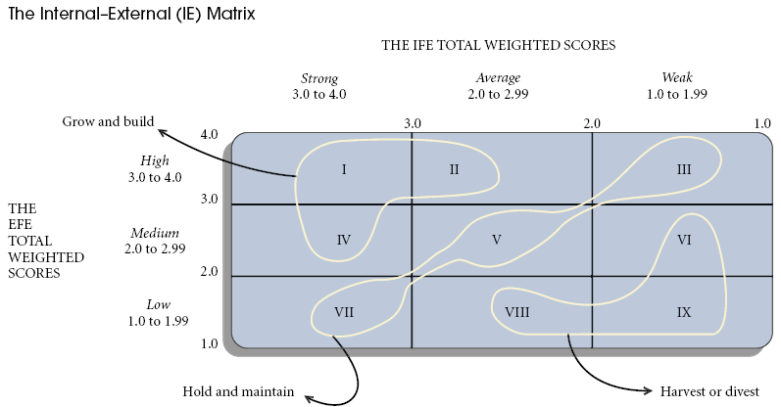

Slide 13
IE Matrix
Based on two key dimensions
  The IFE total weighted scores on the x-axis
  The EFE total weighted scores on the y-axis
Divided into three major regions
  Grow and build – Cells I, II, or IV
  Hold and maintain – Cells III, V, or VII
  Harvest or divest – Cells VI, VIII, or IX

Slide 14
RAPID MARKET GROWTH
Quadrant II
Market development
Market penetration
Product development
Horizontal integration
Divestiture
Liquidation
Quadrant I
Market development
Market penetration
Product development
Forward integration
Backward integration
Horizontal integration
Concentric diversification
WEAK
COMPETITIVE
POSITION
STRONG
COMPETITIVE
POSITION
Quadrant III
Retrenchment
Concentric diversification
Horizontal diversification
Conglomerate diversification
Liquidation
Quadrant IV
Concentric diversification
Horizontal diversification
Conglomerate diversification
Joint ventures
SLOW MARKET GROWTH

Slide 15
Strategy-Formulation Analytical Framework
Stage 3:
The Decision Stage
Quantitative Strategic
Planning Matrix
(QSPM)

Slide 16
QSPM
Quantitative Strategic Planning Matrix
Only technique designed to determine the relative attractiveness of feasible alternative actions
Tool for objective evaluation of alternative strategies
Based on identified external and internal crucial success factors
Requires good intuitive judgment

Slide 17
QSPM
Quantitative Strategic Planning Matrix
List the firm’s key external opportunities & threats; list the firm’s key internal strengths and weaknesses
Assign weights to each external and internal critical success factor
Examine the Stage 2 (matching) matrices and identify alternative strategies that the organization should consider implementing
Determine the Attractiveness Scores (AS)

Slide 18
QSPM
Quantitative Strategic Planning Matrix
Compute the total Attractiveness Scores
Compute the Sum Total Attractiveness Score

Slide 19
QSPM
Key External Factors
Economy
Political/Legal/Governmental
Social/Cultural/Demographic/Environmental
Technological
Competitive
Weight
Strategy 1
Strategy 2
Strategy 3
Key Internal Factors
Management
Marketing
Finance/Accounting
Production/Operations
Research and Development
Computer Information Systems

Slide 20
QSPM
Limitations:
Requires intuitive judgments and educated assumptions
Only as good as the prerequisite inputs
Positives:
Sets of strategies examined simultaneously or sequentially
Requires the integration of pertinent external and internal factors in the decision-making process

Slide 21
Summary
BCG Matrix
IE Martix
QSPM

Slide 22
Next Lecture
IMPLEMENTING STRATEGIES: MANAGEMENT AND OPERATIONS ISSUES
  Management Perspectives
  ANNUAL OBJECTIVES
  POLICIES
  RESOURCE ALLOCATION
  MANAGING CONFLICT
  MATCHING STRATEGY WITH STRUCTURE
  RESTRUCTURING, REENGINEERING, AND E-ENGINEERING
  LINKING PERFORMANCE AND PAY TO STRATEGIES
  MANAGING RESISTANCE TO CHANGE
  MANAGING THE NATURAL ENVIRONMENT
  CREATING A STRATEGY-SUPPORTIVE CULTURE
  PRODUCTION/OPERATIONS CONCERNS
  HUMAN RESOURCE CONCERNS

