Slide 1
Business Strategy and Policy
Lecture 26

Slide 2
Recap
MICHAEL PORTER’S FIVE GENERIC STRATEGIES
  Cost Leadership
  Differentiation
  Focus

Slide 3
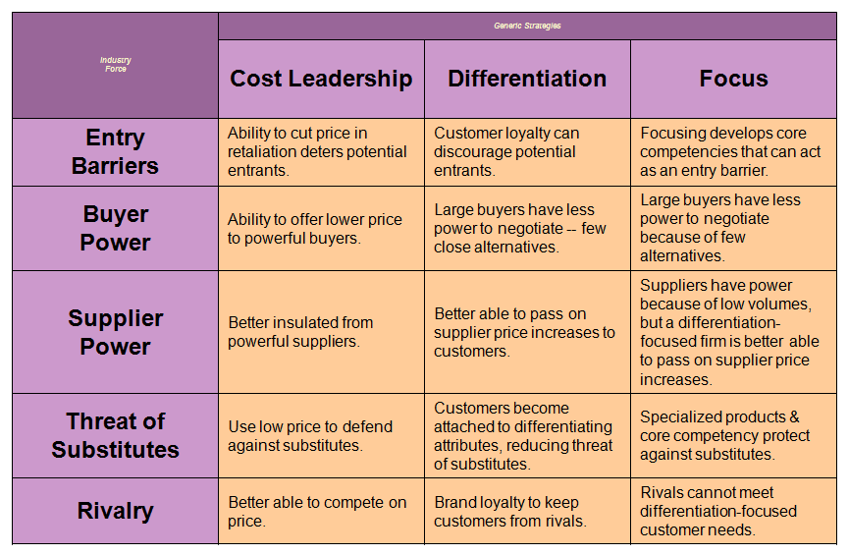
Recap
Generic Strategies/Industry Forces

Slide 4
Today’s Lecture
MEANS FOR ACHIEVING STRATEGIES
  Joint Venture
  Mergers and acquisitions
  Leveraged Buyouts (LBOs)
  First Mover Advantages
  Outsourcing

Slide 5
Joint Venture
Joint venture is a popular strategy that occurs when two or more companies form a temporary partnership or consortium for the purpose of capitalizing on some opportunity.
Other types of cooperative arrangements include
  R&D partnerships
  Cross-distribution agreements
  Cross-licensing agreements
  Cross-manufacturing agreements, and
  Joint- bidding consortia.

Slide 6
Joint Venture
Joint ventures and cooperative arrangements are being used increasingly because they allow companies to improve communications and networking, to globalize operations and minimize risk.
Many, if not most, organizations pursue a combination of two or more strategies simultaneously, but a combination strategy can be exceptionally risky if carried too far.
No organization can afford to pursue all the strategies that might benefit the firm. Difficult decisions must be made. Priorities must be established.
Organizations, like individuals, have limited resources. Both organizations and individuals must choose among alternative strategies and avoid excess indebtedness.

Slide 7
Joint Venture
Joint ventures may fail when:
Managers who must collaborate regularly are not involved in the venture.
b. The venture may benefit partnering companies but not the customers.
c. Both partners may not support the venture equally.
d. The venture competes with one of the partners.

Slide 8
Joint Venture
Joint ventures are especially effective when:
A privately owned organization forms one with a public organization.
b. A domestic organization works with a foreign company.
c. The distinct competencies of the firms complement each other especially well.
d. Some project is potentially profitable but requires much risk.
e. Two or more smaller firms wish to compete against a larger firm.
f. There is a need to introduce a new technology quickly.

Slide 9
Mergers and acquisitions
Mergers and acquisitions are two commonly used ways to pursue strategies.
1. A merger occurs when two organizations of about equal size unite to form one enterprise.
2. An acquisition occurs when a large organization purchases (acquires) a smaller firm or vice versa.

Slide 10
Reasons for Mergers and Acquisitions
To provide improved capacity utilization
To make better use of an existing sales force.
To reduce managerial staff.
To gain economies of scale.
To smooth out seasonal trends in sales.
To gain access to new suppliers, distributors, customers, products, and creditors.
To gain new technology.
To reduce tax obligations

Slide 11
Reasons for Failure of Mergers and Acquisitions
Integration difficulties
Inadequate evaluation of target
Large debt
Inability to achieve synergy
Too much diversification
Managers overly focused on acquisitions
Too large of an acquisition
Difficulty integrating different cultures
Reduced employee morale due to layoffs and relocations

Slide 12
Leveraged Buyouts (LBOs)
The acquisition of another company using a significant amount of borrowed money (bonds or loans) to meet the cost of acquisition.
Besides trying to avoid a hostile takeover, other reasons for the initiation of an LBO by senior management are that particular divisions do not fit into an overall corporate strategy, must be sold to raise cash, or receive an attractive offering price. A LBO takes a corporation private

Slide 13
Leveraged Buyouts (LBOs)
In an LBO, there is usually a ratio of 90% debt to 10% equity. Because of this high debt/equity ratio, the bonds usually are not investment grade and are referred to as junk bonds.
Leveraged buyouts have had a notorious history, especially in the 1980s when several prominent buyouts led to the eventual bankruptcy of the acquired companies.
This was mainly due to the fact that the leverage ratio was nearly 100% and the interest payments were so large that the company's operating cash flows were unable to meet the obligation.

Slide 14
First Mover Advantages
A form of competitive advantage that a company earns by being the first to enter a specific market or industry. Being the first allows a company to acquire superior brand recognition and customer loyalty. The company also has more time to perfect its product or service.
The advantages of being a first mover include securing access to rare resources, gaining new knowledge of key factors and issues, and carving out market share and a position that is easy to defend and costly for rival firms overtake.

Slide 15
First Mover Advantages
eBay was the first company to take the auction process online, kicking off operations in 1995.
Coca-Cola was the first cola producer, and began selling its product to the public in 1886.
First movers are often followed by competitors that try to capitalize on the original company's success. By this time, however, the first mover has usually accumulated enough market share, expertise and customer loyalty to remain on top.

Slide 16
Outsourcing
In business, outsourcing is the contracting out of a business process to a third-party. Outsourcing sometimes involves transferring employees and assets from one firm to another, but not always.
Outsourcing includes both foreign and domestic contracting, and sometimes includes off shoring or relocating a business function to another country. Financial savings from lower international labor rates is a big motivation for outsourcing/offshoring.
Business-Process Outsourcing (BPO): Companies take over functional operations such as human resources, information systems, and marketing for other firms.
Outsourcing can be less expensive, can allow firms to focus on core businesses, and enables firms to provide better services.

Slide 17
Reasons for outsourcing
Lower costs due to economies of scale
Ability to concentrate on core functions
Greater flexibility and ability to define the requisite service more readily
Specific supplier benefits. For example, better security, continuity, etc.
Higher quality service due to focus of the supplier
Improved internal management disciplines resulting from the exercise itself
Less dependency upon internal resources
Control of budget
Faster setup of the function or service

Slide 18
Reasons for outsourcing
Lower ongoing investment required in internal infrastructure
Lack of internal expertise
Increase flexibility to meet changing business conditions
Purchase of industry best practice
Improve risk management
Acquire innovative ideas
Improve credibility and image by associating with superior providers
Generate cash by transferring assets to the provider
Gain market access and business opportunities through the supplier’s network

Slide 19
Summary
MEANS FOR ACHIEVING STRATEGIES
  Joint Venture
  Mergers and acquisitions
  Leveraged Buyouts (LBOs)
  First Mover Advantages
  Outsourcing

Slide 20
Next Lecture
Nature of Strategy Analysis & Choice
Comprehensive Strategy-Formulation Framework
  SWOT Matrix
  Strategic Position and Action Evaluation (SPACE)

