Slide 1
Business Strategy and Policy
Lecture-25

Slide 2
Recap
Retrenchment
DEFENSIVE STRATEGIES
Defensive
Strategies
Divestiture
Liquidation

Slide 3
Today’s Lecture
MICHAEL PORTER’S FIVE GENERIC STRATEGIES
  Cost Leadership
  Differentiation
  Focus

Slide 4
Michael Porter
Michael Porter is a professor in the Harvard Business School and also the president of the Institute for Strategy and Competitiveness. His simple diagram of competitive strategy became very popular in the 1980s, and it is even more popular in today’s competitive world

Slide 5
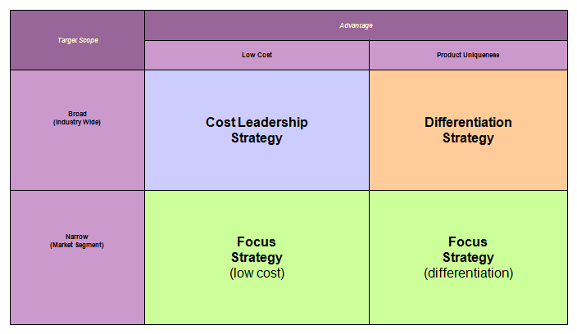
Generic Strategy Picture

Slide 6
Cost Leadership Strategy
Cost leadership emphasizes producing standardized products at a very low per-unit cost for consumers who are price-sensitive
There are two types of cost leadership strategies.
a. A low-cost strategy offers products to a wide range of customers at the lowest price available on the market.
b. A best-value strategy offers products to a wide range of customers at the best price- value available on the market

Slide 7
Cost Leadership Strategy
Striving to be the low-cost producer in an industry can be especially effective when the market is composed of many price-sensitive buyers, when there are few ways to achieve product differentiation, when buyers do not care much about differences from brand to brand, or when there are a large number of buyers with significant bargaining power.

Slide 8
Cost Leadership Strategy
The basic idea behind a cost leadership strategy is to under price competitors or offer a better value and thereby gain market share and sales, driving some competitors out of the market entirely.
To successfully employ a cost leadership strategy, firms must ensure that total costs across the value chain are lower than that of the competition.
This can be accomplished by:
a. performing value chain activities more efficiently than competition, and
b. eliminating some cost-producing activities in the value chain.

Slide 9
Cost Leadership Strategy
Firms that succeed in cost leadership often have the following internal strengths:
  Access to the capital required to make a significant investment in production assets; this investment represents a barrier to entry that many firms may not overcome.
  Skill in designing products for efficient manufacturing, for example, having a small component count to shorten the assembly process.
  High level of expertise in manufacturing process engineering.
  Efficient distribution channels

Slide 10
Cost Leadership Strategy
Risks
  For example, other firms may be able to lower their costs as well.
  As technology improves, the competition may be able to leapfrog the production capabilities, thus eliminating the competitive advantage.
  Additionally, several firms following a focus strategy and targeting various narrow markets may be able to achieve an even lower cost within their segments and as a group gain significant market share.

Slide 11
Example: Cost Leadership Strategy
McDonald’s and Wal-Mart use the same strategy which is the Cost Leadership in the Porter’s Generic Strategies Diagram. They are the lowest cost suppliers of a certain product in the market that they are competing in. Because they use strategy, they are the market leaders and they are very profitable

Slide 12
Differentiation Strategy
Differentiation is aimed at producing products that are considered unique. This strategy is most powerful with the source of differentiation is especially relevant to the target market.
A successful differentiation strategy allows a firm to charge higher prices for its products to gain customer loyalty because consumers may become strongly attached to the differentiation features.

Slide 13
Differentiation Strategy
A risk of pursuing a differentiation strategy is that the unique product may not be valued highly enough by customers to justify the higher price.
Common organizational requirements for a successful differentiation strategy include strong coordination among the R&D and marketing functions and substantial facilities to attract scientists and creative people.

Slide 14
Differentiation Strategy
Firms that succeed in a differentiation strategy often have the following internal strengths:
  Access to leading scientific research.
  Highly skilled and creative product development team.
  Strong sales team with the ability to successfully communicate the perceived strengths of the product.
  Corporate reputation for quality and innovation.

Slide 15
Differentiation Strategy
  Include replication by competitors and changes in customer tastes. Additionally, various firms pursuing focus strategies may be able to achieve even greater differentiation in their market segments.

Slide 16
Differentiation Strategy
Nike / Coca Cola products does not have a lower cost compared to other companies, they use another strategy called Differentiation. Branding is what makes people to recognize the products of these companies. The hand writing of Coca Cola and the swoosh of Nike are two of the brilliantly chosen logos

Slide 17
Focus Strategy
Focus means producing products and services that fulfill the needs of small groups of consumers.
There are two types of focus strategies.
A. A low-cost focus strategy offers products or services to a small range (niche) of customers at the lowest price available on the market.
B. A best-value focus strategy offers products to a small range of customers at the best price-value available on the market. This is sometimes called focused differentiation.

Slide 18
Focus strategies are most effective when the niche is profitable and growing, when industry leaders are uninterested in the niche, when industry leaders feel pursuing the niche is too costly or difficult, when the industry offers several niches, and when there is little competition in the niche segment.

Slide 19
Focus Strategy
Concentrates on a narrow segment and within that segment attempts to achieve either a cost advantage or differentiation.
  The premise is that the needs of the group can be better serviced by focusing entirely on it.
  A firm using a focus strategy often enjoys a high degree of customer loyalty, and this entrenched loyalty discourages other firms from competing directly.

Slide 20
Risks
Include reproduction and changes in the target segments. Furthermore, it may be fairly easy for a broad-market cost leader to adapt its product in order to compete directly. Finally, other focusers may be able to carve out sub-segments that they can serve even better.

Slide 21
Focus Strategy
Ferrari / Rolls-Royce use the Differentiation Focus strategy. They offer quality products for premium cost, but they have a narrower target of customers compared to other car firms.
Ikea uses the Cost Focus strategy. They combine good quality and good function with low prices.

Slide 22
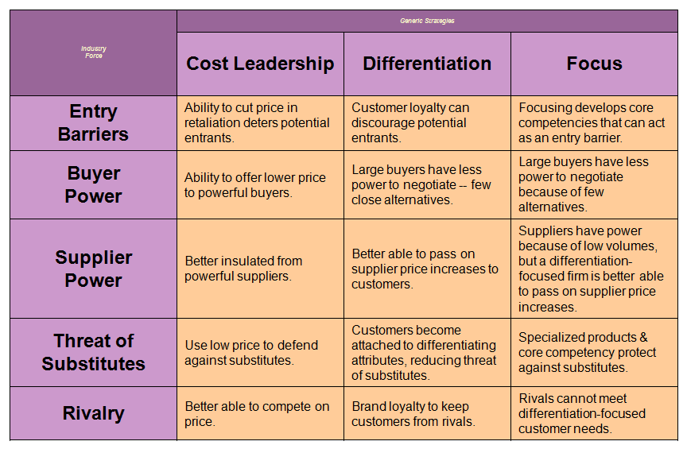
Generic Strategies/Industry Forces

Slide 23
Summary
MICHAEL PORTER’S FIVE GENERIC STRATEGIES
  Cost Leadership
  Differentiation
  Focus

Slide 24
Next Lecture
MEANS FOR ACHIEVING STRATEGIES
  Joint Venture
  Mergers and acquisitions
  Leveraged Buyouts (LBOs)
  First Mover Advantages
  Outsourcing

